Slide 1
Legal Disclaimer
SCE is providing this training as a courtesy for the benefit of our vendors and other interested stakeholders. SCE assumes no liability for any errors or for any conflict between the information presented here and the CPUC’s processes or rules. The CPUC’s rules and policies are subject to change at any time, and the CPUC’s rules and policies, and interpretation thereof, will govern any submittals.

Slide 2
Cost Effectiveness Overview and Calculator
Eric Lee
Economic Analysis and Reporting
December 2017

Slide 3
What is Cost Effectiveness (C/E)?
Commission relies on the Total Resource Cost (TRC) Test as the primary indicator of energy efficiency program cost effectiveness.
Other calculations for cost effectiveness (PAC, RRIMM) exist, however we are generally talking about TRC when cost effectiveness is mentioned
TRC is a ratio of benefits / costs
A ratio of 1.0 means that for every dollar spent, an equal amount of benefit will be captured
Latest guidance from Energy Division is TRC ≥ 1.25 at a portfolio level
May change pending further discussions

Slide 4
Why Does C/E Matter?
SCE’s Energy Efficiency funding comes directly from SCE’s ratepayers.
A cost effective portfolio is required in regulatory statute to ensure SCE Energy Efficiency programs are spending ratepayer dollars efficiently and effectively.
Cost effectiveness is performed on both a prospective and retrospective basis.
TRC calculations used as an assessment of both budgets and actual expenditures.

Slide 5
TRC Benefits and Costs
TRC Benefits = Avoided Costs
Avoided costs of generation, transmission and distribution, energy, ancillary services, renewable portfolio standard (RPS), greenhouse gas (GHG)
All benefit values are calculated in CET based on electric end use shape, climate zone, and amount of energy savings
TRC Costs
Program Costs (admin, marketing, direct implementation, and incentives)
Measure Costs (what the customer paid)

Slide 6
Cost Effectiveness Calculator
Cost Effectiveness Tool (CET) is the California Public Utilities Commission (CPUC) approved calculator for cost effectiveness.
This replaces the “E3 Calculator” used in previous program cycles.
Download from: http://cet.cpuc.ca.gov/
Latest version is 18.1

Slide 7
Cost Effectiveness Calculator Cont’d
In the past, the approved C/E calculator was the E3 Excel Model. The E3 can no longer be used in 2018 as it does not contain the updated avoided costs.
PROS:
No longer limited to 1000 rows per E3 calculator
Processes faster than an Excel spreadsheet
Less time consuming consolidations of entire portfolios leading to more frequent TRC calculations and updates
All data now placed on input sheets rather than in the calculator, speeding up response time in Excel
No calculations or formulas on the input sheet, leading to faster opening of files
CONS:
Does not run in real-time, changes need be processed by CET and correlated with Output sheet
Error logs are a work in progress, not intuitive when errors occur
Check for TRUE/FALSE for electric target sector, end use shape, and climate zone requires the input sheet to be run in the CET
Check for incentives greater than gross measure cost no longer easily identified

Slide 8
Using the CET
CET Icon will be created on your desktop and in your Start Menu.
Excel and Access input templates will be created in your documents folder: Documents\CET\Input Template
Excel is the preferred medium due to the limited number of rows necessary.
2 tabs to be filled: InputProgram and InputMeasure
Excel input sheet template is color coordinated:
Blue = Must be included to run C/E calculation
Green = For reference
SCE requests that you include as much information as possible because ultimate submittals to CPUC require most of the fields to be filled

Slide 9
CET Input Template
There are 3 tabs within the Input template:
Input Program
Contains the program costs that are non-incentive (ie admin, marketing, and non-incentive direct implementation)
Input Measure
Contains the individual measures and associated costing and savings values
Data Dictionary
Translation from E3 to CET based on the columns in the E3 calculator
The input program and input measure tabs need to be filled in to run cost effectiveness.
Leaving numbers in their simplest form on Excel is the safest bet to prevent errors (i.e. 20124.41 instead of $20,124.41)
Do not add any additional columns or the CET will not run.
If needed, SCE may ask for additional details for any of the values provided on these tabs.

Slide 10
CET Input Template (Input Program)
PA = SCE
PrgID = Anything you want, as the actual program ID will be assigned at a later time. Must match exactly to whatever is on the InputMeasure tab.
Program Name = Anything you want, as the actual program ID will be assigned at a later time. Must match exactly to whatever is on the InputMeasure tab.
ClaimYearQuarter = 2018Q4
AdminCostsOverheadandGA and AdminCostsOther = any budget, both labor or non-labor, not associated with the direct implementation or marketing of the program (i.e. Managers/Reporting/Compliance).
MarketingOutreach = any budget associated with marketing for the program or the labor of the staff needed to perform the marketing.
DI Activity = all direct implementation activity except for rebate processing and inspection. Contains labor and non-labor budget associated with running the program. This would include any milestone payments, program managers, or additional pay for performance incentives.
DI Installation, DI HardwareAndMaterials, UserInputIncentive = currently not used by SCE and can be left blank.
DI RebateAndInspection = Contains any budget required for processing of rebates or performing inspections.
EM&V = Please leave blank. This value is currently set at 4% of the total portfolio budget and will be calculated by SCE at a portfolio level.
CostsRecoveredFromOtherSources and OnBillFinancing = Please leave blank. These fields used are by SCE to indicate Pensions & Benefits, Statewide ME&O Budget, ESPI Earnings, and Financing Loan pool amounts.

Slide 11
CET Input Template (Input Measure)
Due to the number of fields on the InputMeasure tab, please refer to the excel below for more detailed notes.
Some additional hints and checks for entering the data:
A glossary of terms can be found in the EE Policy Manual (link found on the Internet Resources slide)
Realization rate for custom measures is defaulted to 0.9 and can only be changed with Energy Division approval
For Custom measures, the standard practice is to set UESkWh to 1 and quantity to whatever the total kWh savings are. UESkW = kW / quantity
Gross measure cost (column AF) should be greater than or equal to incentive (sum of column AH to AK)
RUL should only be populated for RET measures, for ROB, NEW, and REA measures, only the EUL column should have a value

Slide 12
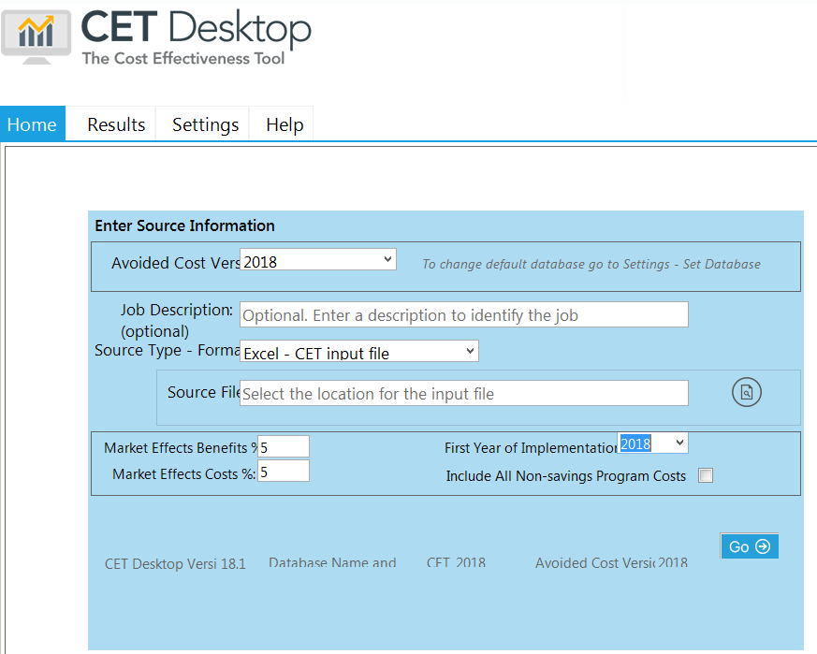

Slide 13
CET Results
Once the calculations are complete, the “Results” tab will show the calculations by job/portfolio, program, and measure.
Any errors will be on the validation section.
To create an export of the data, go the “Save Results” and hit “Save Results to Excel with CET inputs”
Please use this output, which includes the inputs, for all submittals.

Slide 14
CET Results Continued
JobResults, ProgramResults, and MeasureResults will have calculations done for entire input sheet, each program, and each measure, respectively. Actual columns will slightly differ depending on the output tab being used.
For 1st Year Net Savings, use First Year Net kWh and First Year Net kW.
Net kWh and kW columns should not be used because they are based on weighted averages rather than 1st year savings.
TRC ratio will be provided at the job, program, and measure level. If only running a single program, the job and program results will match exactly.
There is currently an error in the CET that will create a false positive for “No Match with Electric Avoided Cost table”
If there are TRC Electric Benefits for measures with electric savings and TRC Gas Benefits for measures with therm savings, the calculator is working correctly

Slide 15
CET Errors
The CET will be unable to process if:
there were additional columns added to the input sheet.
the name of the file is too long.
data is entered into rows without Program IDs.
Errors within the data:
CET Output contains a Validation Summary tab that contains the number of errors and the severity of the error.
The specific row and error can be found on the Validation Messages tab.
The Validation Dictionary tab provides the explanation of the error.

Slide 16
Additional Resources / Information

Slide 17
Internet Resources
Energy Efficiency Policy Manual: Overview of EE policy requirements and term definitions
http://www.cpuc.ca.gov/uploadedFiles/CPUC_Public_Website/Content/Utilities_and_Industries/Energy_-_Electricity_and_Natural_Gas/EEPolicyManualV5forPDF.pdf
Energy Efficiency Standard Practice Manual: Overview of Cost Effectiveness Calculations
http://www.cpuc.ca.gov/uploadedFiles/CPUC_Public_Website/Content/Utilities_and_Industries/Energy_-_Electricity_and_Natural_Gas/CPUC_STANDARD_PRACTICE_MANUAL.pdf
CPUC Energy Efficiency Website: CPUC resources for Energy Efficiency
http://www.cpuc.ca.gov/egyefficiency/
Cost Effectiveness Tool (CET): download C/E calculator
http://cet.cpuc.ca.gov/

Slide 18
Avoided Cost (TRC Benefit) Definitions
Capacity: residual capacity value x loss of load expectation for each hour
Energy: hourly energy prices, based on historical data and forecast prices
Transmission and Distribution: IOU-specific costs x hourly allocators based on historical weather data and differs for each climate zone
Ancillary Services: percentage of Energy
GHG: GHG price + adder
RPS: difference between average cost of a natural gas turbine and the cost of a particular group of RPS projects

Slide 19
Legal Disclaimer
SCE is providing this training as a courtesy for the benefit of our vendors and other interested stakeholders. SCE assumes no liability for any errors or for any conflict between the information presented here and the CPUC’s processes or rules. The CPUC’s rules and policies are subject to change at any time, and the CPUC’s rules and policies, and interpretation thereof, will govern any submittals.

