Slide 1
Statewide Downstream Pilots Follow-up Discussion
October 14, 2016

Slide 2
Agenda
Introductions – Facilitator (5 min)
Agricultural Strategic Energy Management Program – SoCalGas (5 min)
Indoor Agriculture Program - PG&E (5 min)
Water/Wastewater Pumping Program (Nonresidential Sector(s)/Public Sector) – SCE (5 min)
WE&T Career and Workforce Readiness Program – SDG&E (5 min)
Industrial Strategic Energy Management Program – SoCalGas (5 min)
Program Elements – MCE (10 min)
Q&A – All (20 min)

Slide 3
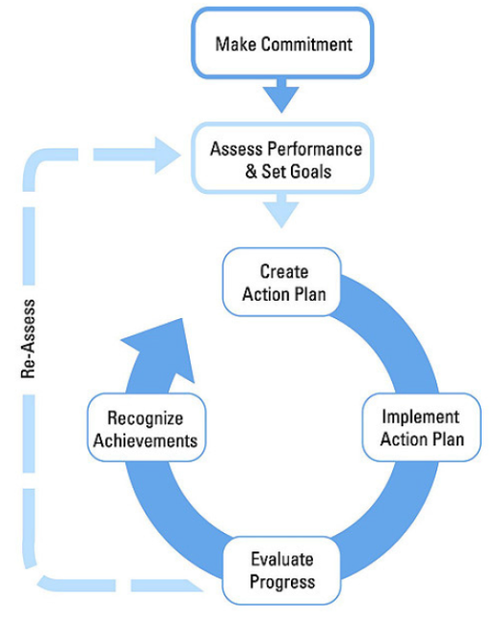
Statewide Downstream Pilot Proposal: Agricultural Strategic Energy Management (SEM)Program
SEM represents a comprehensive, holistic approach to proactively and continuously improve energy performance in the agricultural sector
Key Program Features
Establishes documentation process, data tracking, measurement, and evaluation feedback loop to continuously optimize energy performance
Spurs cultural change to engage all stakeholders (farm owners & labor)
Leverages continuous improvement methodologies modeled after “Total Quality Management “ concepts
Addresses technical, behavioral and organizational aspects of energy use
Benefits
Improves productivity, operations, maintenance, and energy utilization
Increases awareness of energy management across the operation
Enhances team collaboration and cooperation to reduce energy use and
attain shared goals
Creates long-range planning, self-perpetuating, and measureable change
Notes:
These proactive approaches cost less than emergency repairs in the long run by avoiding equipment failure and resulting down time. Well maintained equipment lasts longer and uses less energy, resulting in fewer repairs, fewer replacements and lowered replacement cost.

Slide 4
Statewide Downstream Pilot Proposal: Indoor Agriculture Program
Program Description
Custom Program targeting prospective cannabis producers and trade professionals servicing the medical marijuana industry
Measure design will focus on process lighting and HVAC
Opportunities
Building Types:
Fully enclosed warehouse type growers (existing)
Greenhouses with supplemental lighting (potential)
Field scale outdoor production (potential, not available in other states due to climate)
Technology Types: Energy costs account for 20-50% of total operating costs for growers
Process lighting: 38% of energy consumption, predominate application type in other states
Venting and Dehumidifying: 30% of energy consumption
Air Conditioning: 21% of energy consumption,
Nominal energy usage: Heating (5%), Water (3%), CO2 Injection (2%), Drying (1%)
Data from SDG&E Cannabis Agriculture Energy Demand Study, July, 2016
Current Status
Medical: Mature and expanding market with broad legislative acceptance
Expected to increase if recreational ballot measure fails
Recreational: Anticipated growth pending Prop. 64 approval in November
Influx of venture capital investments due to expected approval
Qualifications for process lighting (grow lights) can be applied to other crops grown indoors
Statewide Potential:
In CA, 9% of household electricity usage is from indoor production
Colorado has observed 0.5-1% total load growth since 2013
0.5-6 MWs of usage per facility in states which have legalized recreational use
6-12 month lag time observed between legalization and direct energy impacts

Slide 5
Statewide Downstream Pilot Proposal: Water/Wastewater Pumping Program
Name: Water Infrastructure and System Efficiency Program (WISE)
Focuses on generating water and energy savings for water-focused entities
2014 IDEEA365 offering transitioning in 2017 to a SCE program
WISEup add-on sub-program also launching for SCE in 2017
Market Segment
Water and wastewater agencies (newly formed Public Sector), plus water distribution and pumping sources
Activity Focus
Pump measures (efficiency and repair), benchmarking, audits
Past Performance
Through July 2016
1.5 million gross kWh savings
152 gross kW reduction
1.88 TRC
Multi-year pipeline developed
16.5 million gross kWh savings
2,000 gross kW reduction
Statewide Potential
Single vendor today for SCE, SDGE, PGE
Proposed budget of $1.1 million for 2017

Slide 6
Statewide Downstream Pilot Proposal: Career & Workforce Readiness Program
Career & Workforce Readiness Program
The PAs recognized that a system already exists to address career readiness in disadvantaged communities.
Influence existing workforce development agencies and organizations through an infusion of EE into existing efforts.
Please see CAEEECC website for full concept proposal.
Market Segment
Disadvantaged workers/communities that are not prepared to enter a traditional energy higher education or job/career path as defined per WE&T Advice Letter A 3567-G/4592-E.
Activity Focus
Support California’s energy efficiency and green energy goals by training the energy workforce (SB 350).
Provide career preparation and readiness for disadvantaged/communities to enter core education or job/career pathway.
Funded orgs should provide soft skills, job development, workforce training and potentially job placement offerings that fall outside the scope of EE funding and training.
Other Considerations
Non-resource program
Open to one or multiple vendors/ Budget TBD
Feedback received from Rising Sun & Blue Green Alliance

Slide 7
Statewide Downstream Pilot Proposal: Industrial Strategic Energy Management (SEM)Program
SEM represents a comprehensive, holistic approach to proactively and continuously improve energy performance
Key Program Features
Establishes documentation process, production data tracking, measurement, and evaluation feedback loop to continuously optimize energy performance
Spurs cultural change within the organization by engaging all stakeholders (leadership through operations)
Leverages continuous improvement methodologies modeled after “Total Quality Management “ concepts
Addresses technical, behavioral and organizational aspects of energy use
Benefits
Improves productivity, operations, maintenance, and energy utilization
Increases awareness of energy management across whole organizations
Enhances team collaboration and cooperation to reduce energy use and
attain shared goals
Creates long-range planning, self-perpetuating, and measureable change
Notes:
These proactive approaches cost less than emergency repairs in the long run by avoiding equipment failure and resulting down time. Well maintained equipment lasts longer and uses less energy, resulting in fewer repairs, fewer replacements and lowered replacement cost.

Slide 8
Statewide Downstream Pilot Proposal: Four Elements
Difference from Other Proposals:
Elements of programs, not full programs
Can improve many more than four programs
Preserves locally tailored customer interface
Benefits:
Saving ratepayer funds through eliminating duplicative administration
Providing consistency among service areas when appropriate
Fostering a positive and valuable experience for the customer, contractor, and installer
Avoids Siloed Program Delivery
Recommended Elements:
Methodology for Normalized Metered Energy Consumption
Development of Workpapers
Development of Deemed Values
Statewide Data Support
Supported by Decision:
It is appropriate to pilot the use of a statewide approach on some downstream programs to test the use of common elements even with regional or local variations.
(D.16-08-019 Conclusion of Law 52)

Slide 9
Statewide Downstream Pilot Proposal: Four Elements
While it is true that many downstream programs must vary due to the diversity of customers and end uses, it is not clear that that necessarily means that all program designs and approaches downstream must be different. For example, even in the industrial sector, where custom projects vary perhaps the most among any sector because of the diversity of processes involved, it could still be desirable to have a consistent set of program rules, documentation requirements, savings measurement requirements, etc. regardless of the area of the state in which the program is operating.
(D.16-08-019 Page 59)

Slide 10
Questions?

