Slide 1
DOE Residential Furnace Standard Development
LCC and Impact Analysis
Yanda Zhang
March 7 2015

Slide 2
Products – Tech Level
Trial Standard Levels (TSL) based on efficiency levels in the table
Non-Weatherized Gas Furnaces
(NWGF)
Mobile Home Gas Furnaces
(MHGF)
Efficiency Level | AFUE % | Technology |  | Efficiency Level | AFUE % | Technology
0-Baseline | 80 | - |  | 0-Baseline | 80 | -
1 | 90 | Baseline + condensing secondary heat exchanger
2 | 92 | Level 1 + Increased secondary heat exchanger area |  | 1 | 92 | Baseline + condensing secondary heat exchanger
3 | 95 | Level 2 + Increased secondary heat exchanger area |  | 2 | 95 | Level 1 + Increased secondary heat exchanger area
4 Max_tech | 98 | Level 3 + Increased secondary heat exchanger area + Step- modulating combustion + Constant-airflow brushless permanent magnet (BPM) blower motor |  | 3 Max_tech | 98 | Level 2 + Increased secondary heat exchanger area

Slide 3
Market
CA: 10.52% of national Gas Furnace Shipments
New Owner: product switch/addition, similar to new construction installation
 | NWGF | MHGF
Residential | 97% | 100%
Commercial | 3% | 0%
New Construction | 25% | 50%
Replacement & New Owner | 75% | 50%
Replacement | 67.5% | 50%
New Owner | 7.5% | 0%

Slide 4
Monte Carlo Method
Reflect Variability & Uncertainty of furnace usage in buildings
Traditional approach: prototype buildings with fixture energy use and cost information representing typical/average market conditions
→ Results reflect typical/average outcome
Monte Carlo: random selected buildings and inputs
→ probability distributions of LCC and PBP
→ show the fraction of market with LCC > 0
  Perform 10,000 calculations
  Each calculation is independent
Analysis Tool: Excel spreadsheets combined with Crystal Ball

Slide 5
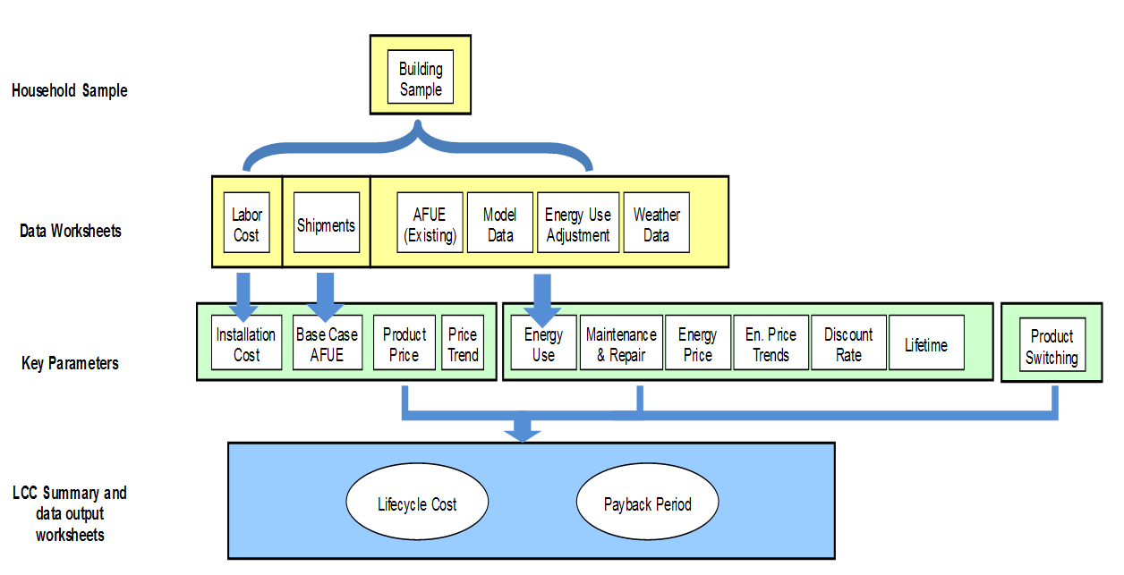
Residential Furnace LCC Spreadsheet Flow Chart

Slide 6
Building Sample
RECS 2009: 12,083 homes /1606 in CA
CBECS 2003: 5,215 buildings
Furnace population weights in 2021
  How representative a particular household is of other households in the distribution—either regionally or nation
  The selection of a household was based on its sample weight
Building heating load (BHL):
  RECS and CBEC reported annual heating fuel consumption and AFUE
  Building shell efficiency index adjustment (0.73 ~ 0.97)
  → better building envelope in 2021
  Historic heating degree days adjustment (0.94 – 1.05)
  → better reflect historic average climate
  Adjustment factors depend on building type, new construction vs replacement
Furnace location

Slide 7
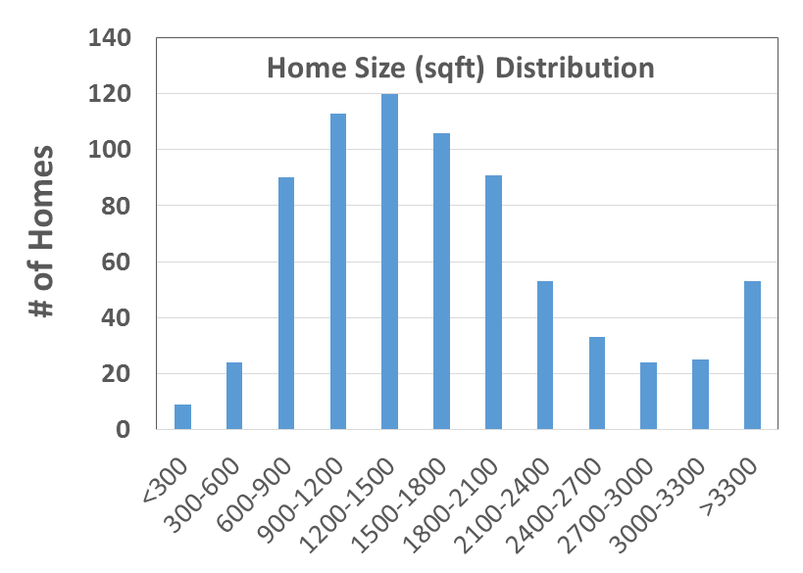
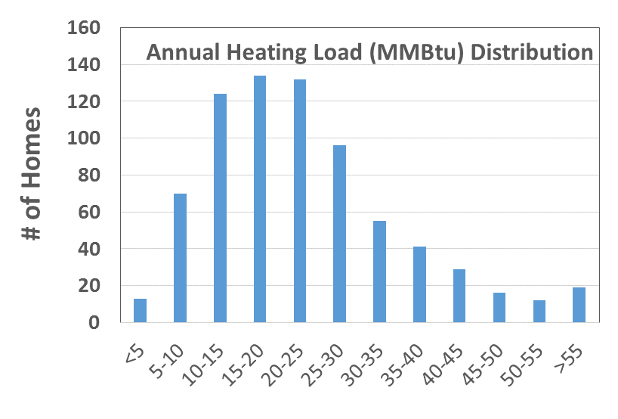
CA Building Sample
Part of South region
  DIVISION 10: Pacific Census Division (AK, CA, HI, OR, WA)
  REPORTABLE_DOMAIN: #26
  Weather station ID available for further location identity
Total 1606 samples: 741 (46%) with natural gas for space heating

Slide 8
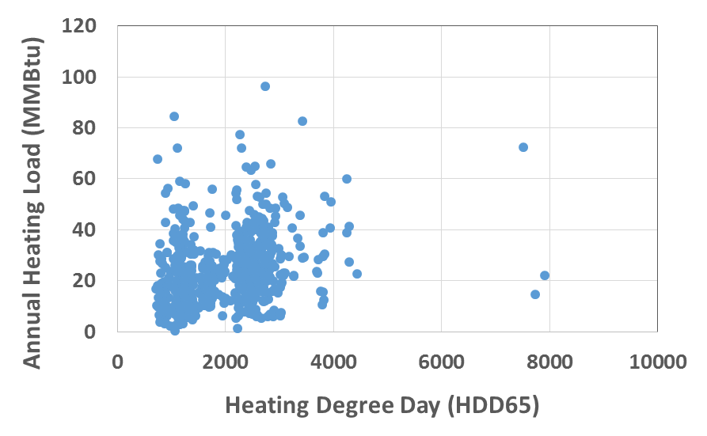
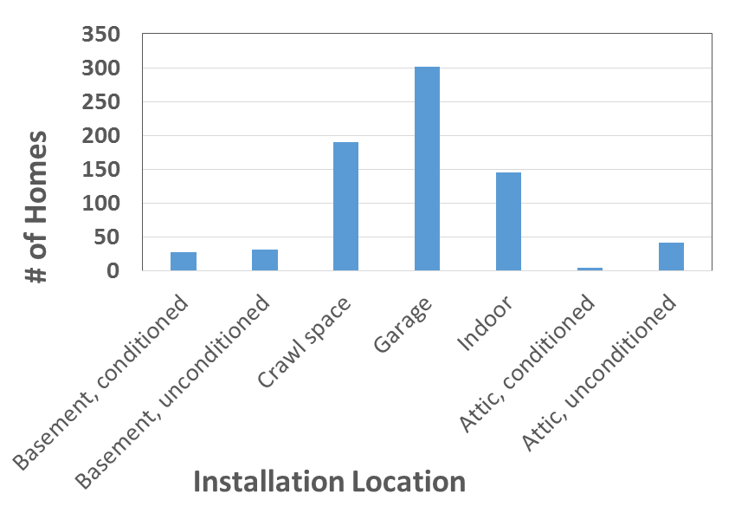
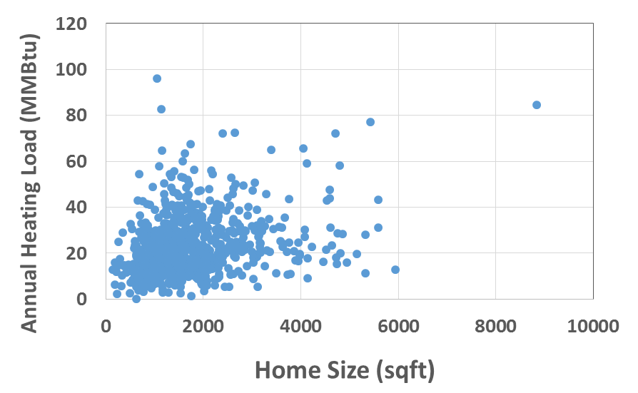
CA Building Sample

Slide 9
Two Major Components of LCC Calculation
Operating Costs
Installed Costs

Slide 10
Two Major Components of LCC Calculation
Installed Costs

Slide 11
Installed Cost – First Cost

Slide 12
Installed Cost – Components
Total Consumer Price
  Product Prices
  Shipping Cost
  Markup
  Future Product Prices (learning curve)
Installation Cost

Slide 13
Total Consumer Price – Product Prices
Variations: manufactured cost adders for different furnace input capacities and design options, including motor type, staging controls (single-stage, two-stage, or modulating), and the use of a low NOx burner.

Slide 14
Total Consumer Price – Shipping Cost
Depends mainly on shipping volume, which was calculated for each product class at each efficiency level.
Variations: Depends on product selected

Slide 15
Total Consumer Price – Markups
Overall markup: manufacturer selling cost (MSP) → consumer price
  Baseline markup: applied to the baseline product MSP
  Incremental markup: applied to incremental increase in MSP of higher efficiency equipment
Different for new construction and replacement applications

Slide 16
Total Consumer Price – Shipping Cost
The cost of transporting a furnace unit to the local distribution point depends mainly on its volume, which was calculated for each product class at each efficiency level.
No variations

Slide 17
Total Consumer Price – Future Product Cost
“learning” or “experience” curve phenomenon
  Real product costs trend downward over time
For furnace: b = 0.937

Slide 18
Total Consumer Price – Average Prices

Slide 19
Installed Cost – Installation Cost
RS Means 2013 Residential Cost Data, manufacturer literature, and information from expert consultants
Accounted for regional differences in labor costs
Basic installation costs – apply to all furnaces (new & replacement)
  Include putting in place and setting up the furnace, gas piping, ductwork, electrical hookup for the thermostat, permit, removal or disposal fees, and, when applicable, additional labor hours for an attic installation.
NWGF replacement installations - adders for a fraction of the sample households
  non-condensing furnaces, these additional costs included updating flue vent connectors, vent resizing, and chimney relining. For condensing furnaces, these additional costs included adding a new flue vent (PVC), combustion air vent for direct vent installations (PVC), concealing vent pipes for indoor installations, addressing an orphaned water heater (by updating flue vent connectors, vent resizing, or chimney relining), and condensate removal. Freeze protection (heat tape) is accounted for in the cost of condensate removal for a fraction of NWGFs installed in attics.
Different condensing furnaces installation cost for replacements, new owners, and new constructions

Slide 20
Installation Cost - NWGF Replacement
Adders for a fraction of the sample households
  non-condensing furnaces, these additional costs included updating flue vent connectors, vent resizing, and chimney relining. For condensing furnaces, these additional costs included adding a new flue vent (PVC), combustion air vent for direct vent installations (PVC), concealing vent pipes for indoor installations, addressing an orphaned water heater (by updating flue vent connectors, vent resizing, or chimney relining), and condensate removal. Freeze protection (heat tape) is accounted for in the cost of condensate removal for a fraction of NWGFs installed in attics.

Slide 21
Installation Cost - NWGF New Owner and NC
Non-condensing furnaces: a new flue vent (metal) is the only adder
Condensing gas furnaces:
  the adders include new flue vent (PVC), combustion air vent for direct vent installations (PVC), accounting for a commonly vented water heater, and condensate removal.

Slide 22
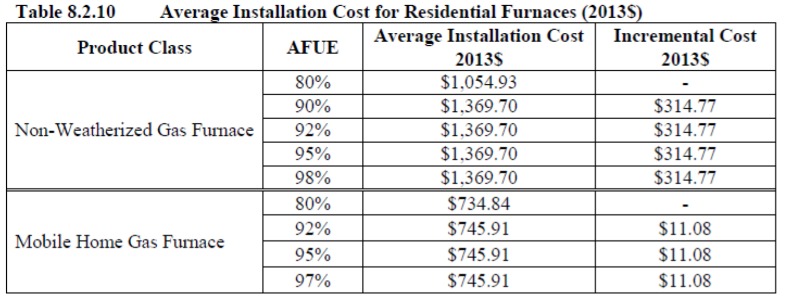
Installation Cost – Average Values

Slide 23
Installed Cost – Average Values

Slide 24
Two Major Components of LCC Calculation
Operating Costs

Slide 25
Operating Costs – Components
Annual Energy Use Savings
Energy Prices
Repair Cost
Maintenance Cost
Lifetime
Discount Rates

Slide 26
Operating Costs (1)
Building Heating Load

Slide 27
Operating Costs (2)

Slide 28
Operating Costs – Annual Energy Use Savings
The base case efficiency is for 2021 and reflects the expected distribution of efficiency levels by product class – NOT 80% AFUE
Direct Rebound Effects: some consumers may use a higher-efficiency furnace more than a baseline one, thereby negating some or all of the energy savings.
  Zero economic impact: Monetary value due to increased comfort is similar to that of the foregone energy savings.

Slide 29
Operating Costs – Energy Prices
Average Annual Energy Prices: EIA Data
Monthly Energy Prices = Average annual prices*Average Monthly Energy Factors
Res Customer: seasonal marginal price factors applied to monthly energy prices
Geographical Price Variations: adjustment factor based on the reported average energy price in RECS 2009 and CBECS 2003
Future Prices: annual energy price factors derived from the forecasts of annual average price changes in EIA’s AEO 2014.

Slide 30
Operating Costs – Repair Cost

Slide 31
Operating Costs – Maintenance Cost
Labor hours and costs: RS Means data.
Frequency of maintenance:
  RECS 2009 data
  A consumer survey on the frequency with which owners of different types of furnaces perform maintenance

Slide 32
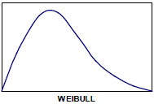
Operating Costs – Lifetime
Weibull distribution
Same across the different product classes and efficiency levels.

Slide 33
Operating Costs – Discount Rates
Estimate a consumer’s opportunity cost of funds related to appliance energy cost savings and maintenance costs
  Federal Reserve Board’s Survey of Consumer Finances (SCF)
Separate discount rate distributions for six income groups
  Shares of Debt and Asset Classes, rates for types of debt & assets

Slide 34
Residential Furnace LCC Spreadsheet Flow Chart

Slide 35
Product Switching
Customer response to potential amended furnace standards
  the furnace that meets a particular standard level
  a heat pump, or
  an electric furnace.
Allow for the possibility of electric water heater installation to avoid expensive re-sizing of the vent system

Slide 36
LCC Results - Average

Slide 37
LCC Results - Distribution

Slide 38
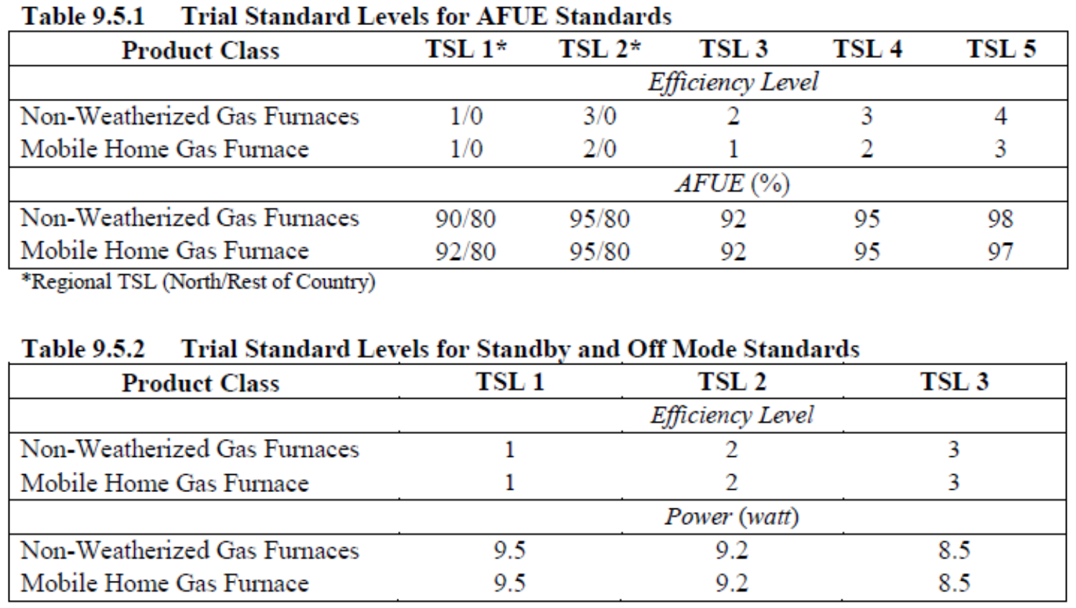
Impact Analysis – Trial Standard Levels (TSLs)

Slide 39
Impact Analysis
Projected Efficiency Trends -“roll-up” scenario
  Products not meeting the standard: meet the new standard level
  Products meeting the standard: not be affected
National Energy Savings
  Average annual energy consumption per unit (UEC)
  Shipments
  Product stock (STOCKV)
  Annual energy consumption for the Nation (AEC)
  Power plant primary energy use factor (src_conv)
UEC based on Monte Carlo analysis results – weight average
Baseline for CA is different

Slide 40
Impact Analysis
Rebound effect of 15%
  15% of the estimated savings not materialized
  because of increased use of the product
Site energy to primary (source) energy
Full-Fuel-Cycle energy factors
  includes point-of-use (site) energy, the energy losses associated with generation, transmission, and distribution of electricity, and
  Upstream activities: the energy consumed in extracting, processing, and transporting or distributing primary fuels

Slide 41
Impact Analysis – Results
CA Annual Natural Gas Savings (MMT) in 2021
  10.5% of national savings
  Need further refinement based on CA baseline efficiency
TSL | 1 | 2 | 3 | 4 | 5
NWGF | 0.95 | 2.28 | 1.16 | 2.57 | 3.60
MHGF | 0.13 | 0.14 | 0.24 | 0.26 | 0.28
Total | 1.07 | 2.42 | 1.40 | 2.83 | 3.87

Slide 42
Next Step
CA specific sensitivity runs
CA specific input
  Natural gas cost – TDV values
Refinement of CA impact analysis

Slide 43
Yanda Zhang
ydzhang@trcsolutions.com

