Slide 1
92% AFUE Furnace Installation Cost Distribution
Yanda Zhang

Slide 2
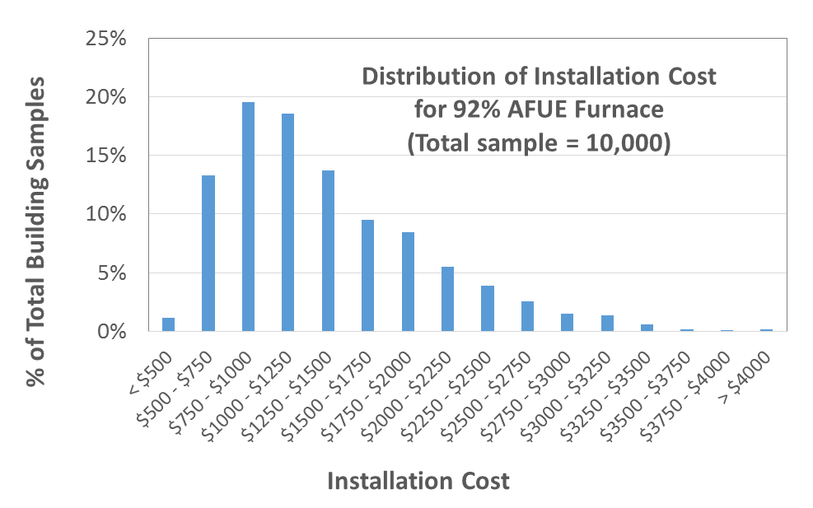

Slide 3
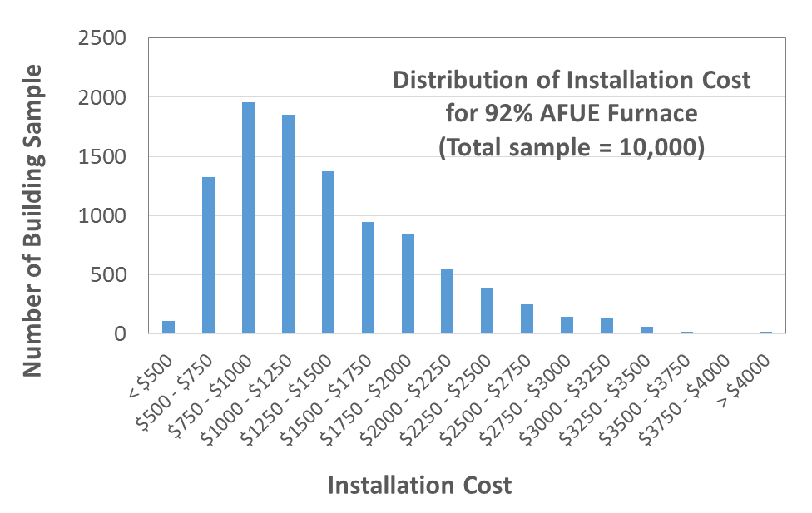

Slide 4
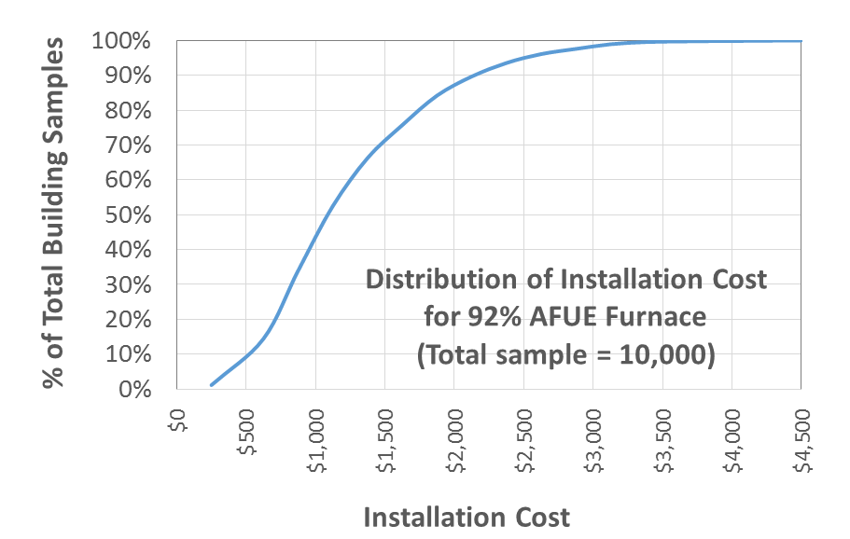

Slide 5
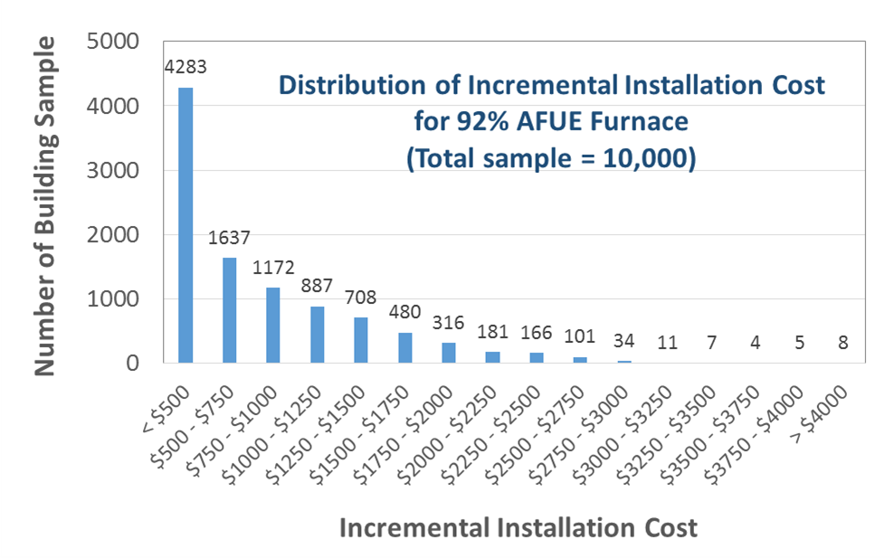

Slide 6
