Slide 1
Furnace LCC Considerations
Marshall Hunt, PE
Pacific Gas & Electric Company
San Francisco, CA
mbh9@pge.com

Slide 2
LCC Analysis is Detailed
http://www.regulations.gov/#!documentDetail;D=EERE-2014-BT-STD-0031-0016

Slide 3
National and Regional Impacts Are Analyzed

Slide 4
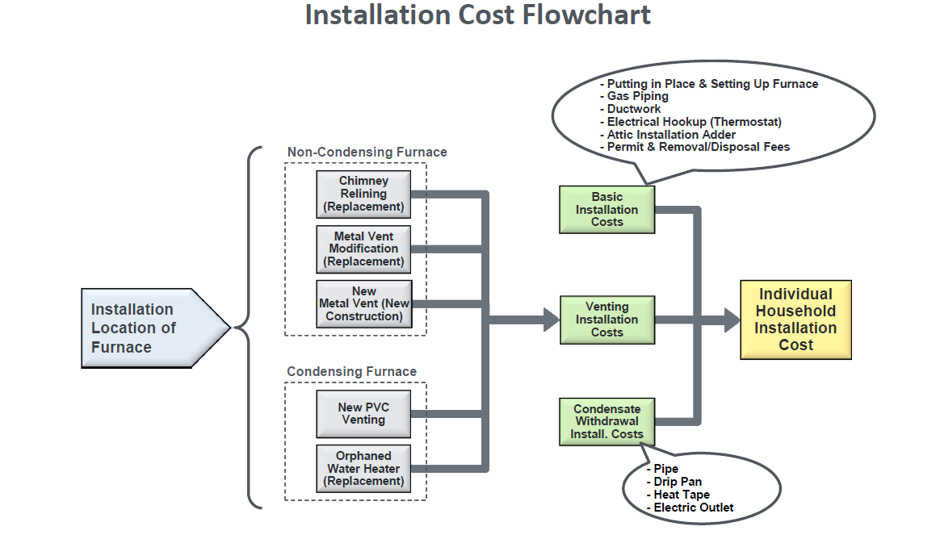
Details of Installation Cost Analysis

Slide 5
Decision Tree for Monte Carlo Analysis

Slide 6
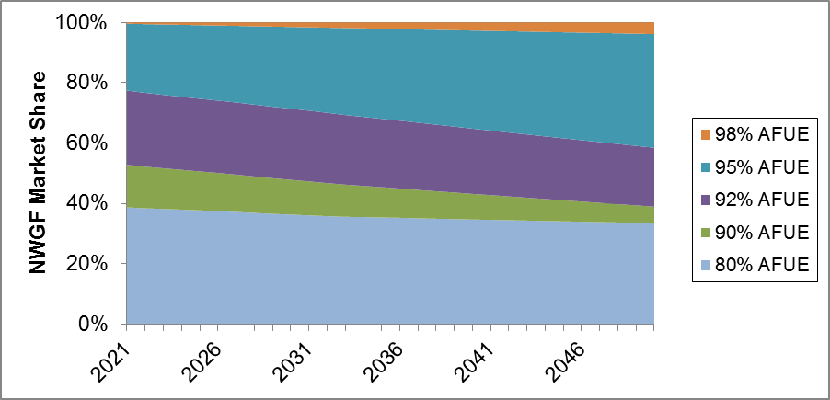
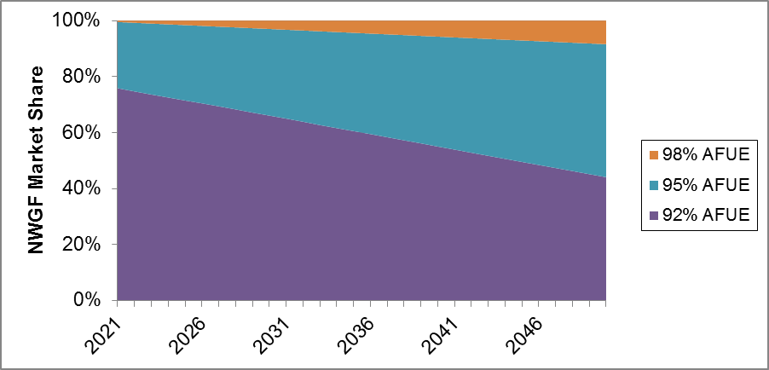
Without TSL 3 Californians Get No Benefit
TSL 1 – A No Standard/ Standard without benefit to California consumers who are 10.5 % of the national market
TSL 3 – Benefits for California consumers who are 10.5 % of the national market, supports carbon reduction State Policy, will drive costs down and innovation up

Slide 7
Addressing Split Incentives
New single family home construction dominated by merchant builders who do not pay for heating
Approximately 40% of dwelling built in CA are apartments
Builders have market purchasing power that will drive down the cost of furnaces and the cost of installation
30 to 40% of single family homes are rented in CA and landlords have no incentive to install high efficiency furnaces
Lowering heating costs is a Consumer Protection issue
Sealed combustion, condensing furnaces do not take combustion air from the dwelling providing a increased level of safety

