Slide 1
DOE Residential Furnace Standard Development
LCC for California
California Building Samples
Farhad Farahmand & Yanda Zhang
June 2 2015

Slide 2
CA Building Sample
Part of South region
DIVISION 10: Pacific Census Division (AK, CA, HI, OR, WA)
REPORTABLE_DOMAIN: #26
Weather station ID available for further location identity
Total 1606 samples: 741 (46%) with natural gas for space heating
406 Homes < 900 ft²
99% of these are single family homes

Slide 3
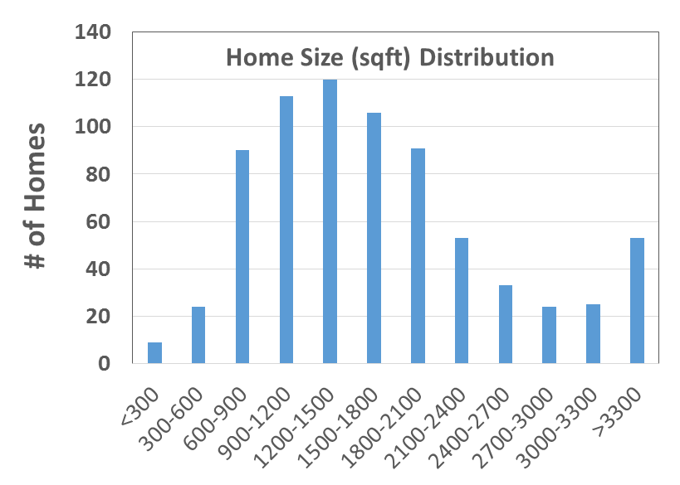
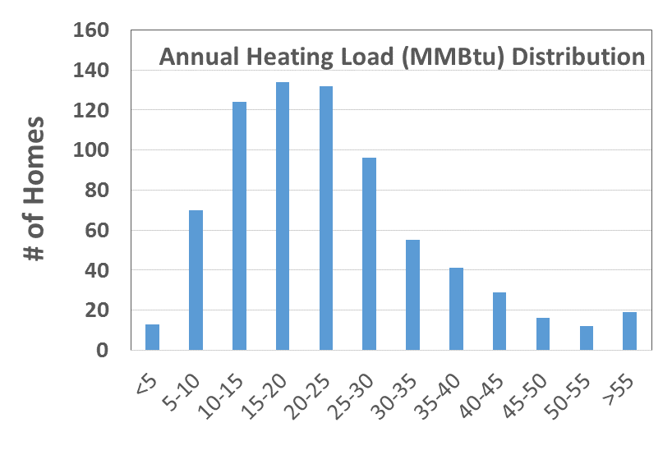
Home Size
Part of South region
DIVISION 10: Pacific Census Division (AK, CA, HI, OR, WA)
REPORTABLE_DOMAIN: #26
Weather station ID available for further location identity
Total 1606 samples: 741 (46%) with natural gas for space heating

Slide 4
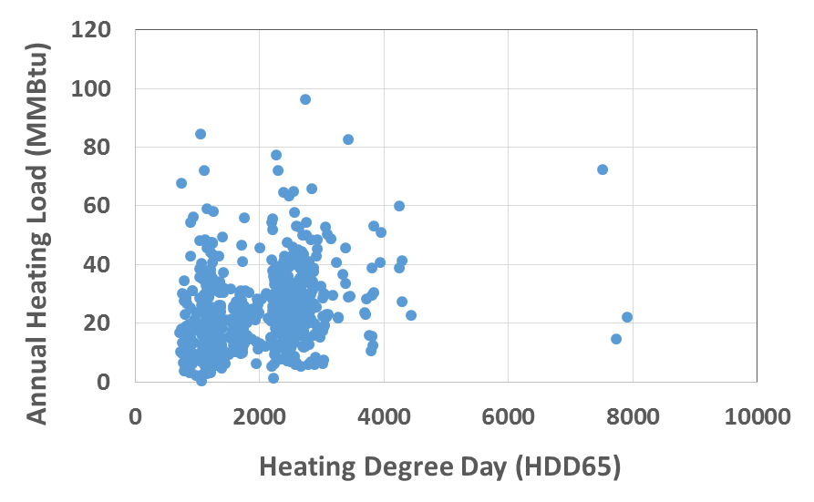
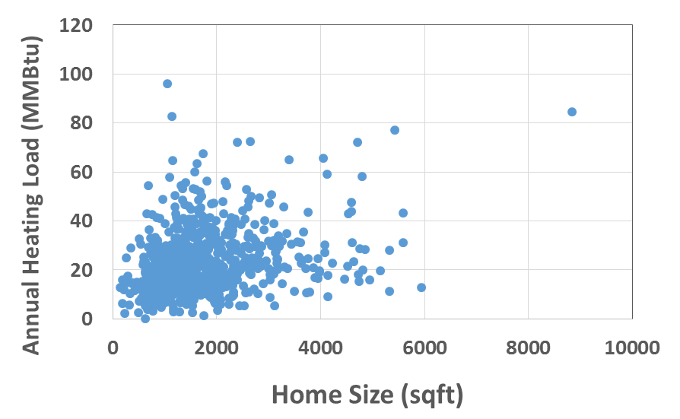
CA Building Sample

Slide 5
DOE Weighing Factor
Distinguishes between weatherized and non-weatherized gas furnaces
Accounts for buildings with multiple furnaces
Matches historical and projected furnace shipments by region (CA is alone)

Slide 6
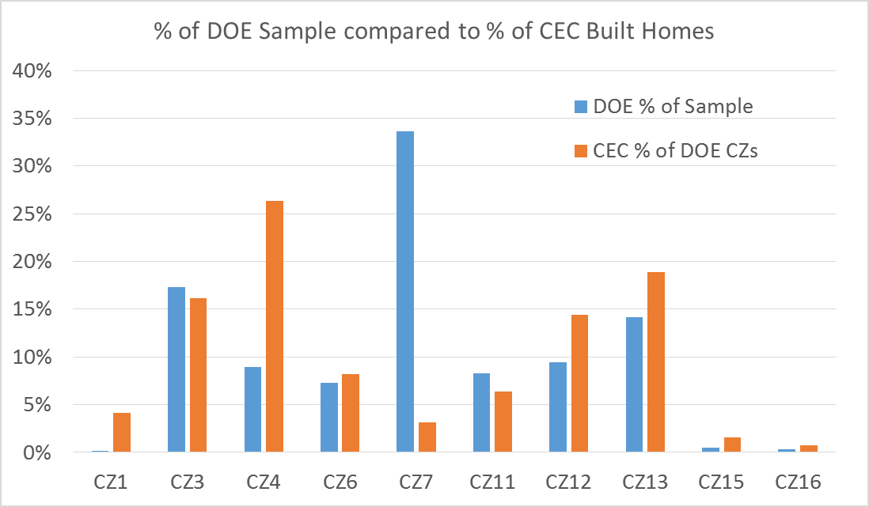
Sample Weighs Too Heavily on South CA
CZs 1 and 4 are underrepresented
CZ7 is overrepresented
Please add a bar to show weighted sample distribution
Add another bar to show existing CA home distribution

Slide 7
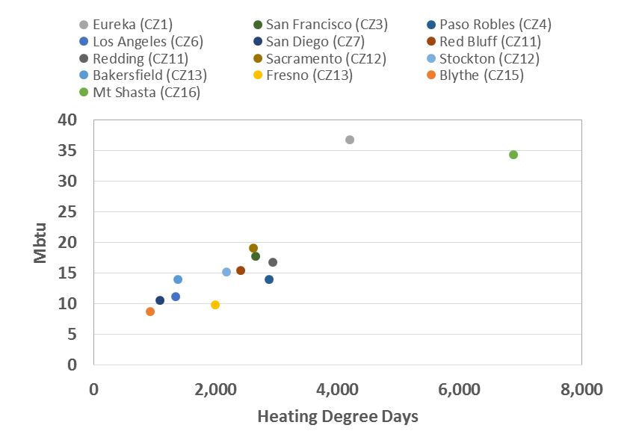
CA Shows Comparatively Mild Heating Climate
Larger Southern CA sample
1036 points from SoCal
570 from NorCal
Weighted Average HDD65
Southern US = 2408 HDD
CA = 1855 HDD
HDD65 aligns with
heating demand

Slide 8
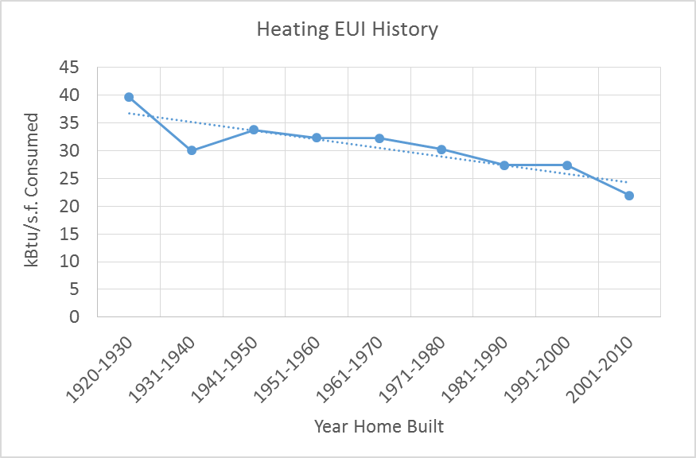
Increasing Energy Efficiency

Slide 9
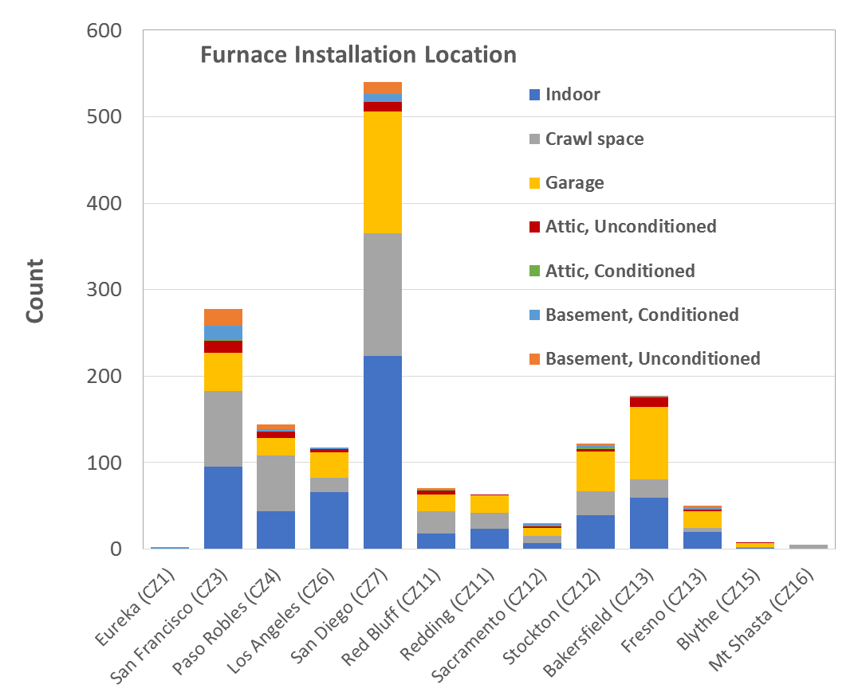
Furnace Installation Location
Explain how location distribution was developed (quote source reference)
Most installation locations indoors, crawl space, or garage
No correlation to climate zone

Slide 10
Yanda Zhang
ydzhang@trcsolutions.com

