Slide 1
Energy Efficiency Market Transformation
Market Transformation Working Meeting
Christie Torok, August 11, 2020

Slide 2
MTA Solicitation Schedule
December 5, 2019: Commission Decision on Market Transformation and RENs
August 4, 2020: Notice inviting stakeholders to submit applications/proposals to participate in solicitation scoring committee and RFP development process.
August 18, 2020: Applications to participate in solicitation MTA Scoring Committee due to CPUC
August 25, 2020: MTA Scoring Committee membership finalized
September 2, 2020: MTA Scoring Committee Kickoff Meeting
September 25, 2020: RFP and scoring rubric finalized
September 29, 2020 PG&E PRG: Present RFP and scoring rubric to PG&E’s PRG
October 6, 2020 Written comments on RFP and scoring rubric due from PRG
October 20, 2020: PG&E releases MTA RFP
October 29, 2020: Bidders Conference

Slide 3
MTA Solicitation Schedule (Continued)
November 9, 2020: Bidders submit questions to PG&E
November 16, 2020: Responses to bidder questions due to PG&E
November 17, 2020: Answers to questions posted on RFP website
November 23, 2020: Bidders submit a statement of Intent to Bid
November 24, 2020: Bidders submit second round of questions to PG&E
December 1, 2020: Responses to bidder questions due to PG&E
December 2, 2020: Answers to second round of questions posted on RFP website
December 3, 2020: Interview guide and scoring rubric compiled by Commission staff distributed to MTA Scoring Committee for review
December 8, 2020: MTA Scoring Committee meeting to discuss interview guide and scoring rubric. Written feedback due from MTA Scoring Committee.

Slide 4
MTA Solicitation Schedule (Continued)
December 17, 2020: Final interview guide and scoring rubric distributed to MTA Scoring Committee
December 21, 2020: RFP responses due to PG&E
January 22, 2020: Scores due to CPUC from MTA Scoring Committee (one set from each group)
January 29, 2020 Bidders moving to interview stage announced
Weeks of February 1 and 8: Interviews with selected bidders
February 9, 2021: Interview scores due from MTA Scoring Committee
February 24, 2021: Proposed Decision regarding contract mailed for 30-day comment
March/April, 2021: Vote at Commission meeting

Slide 5
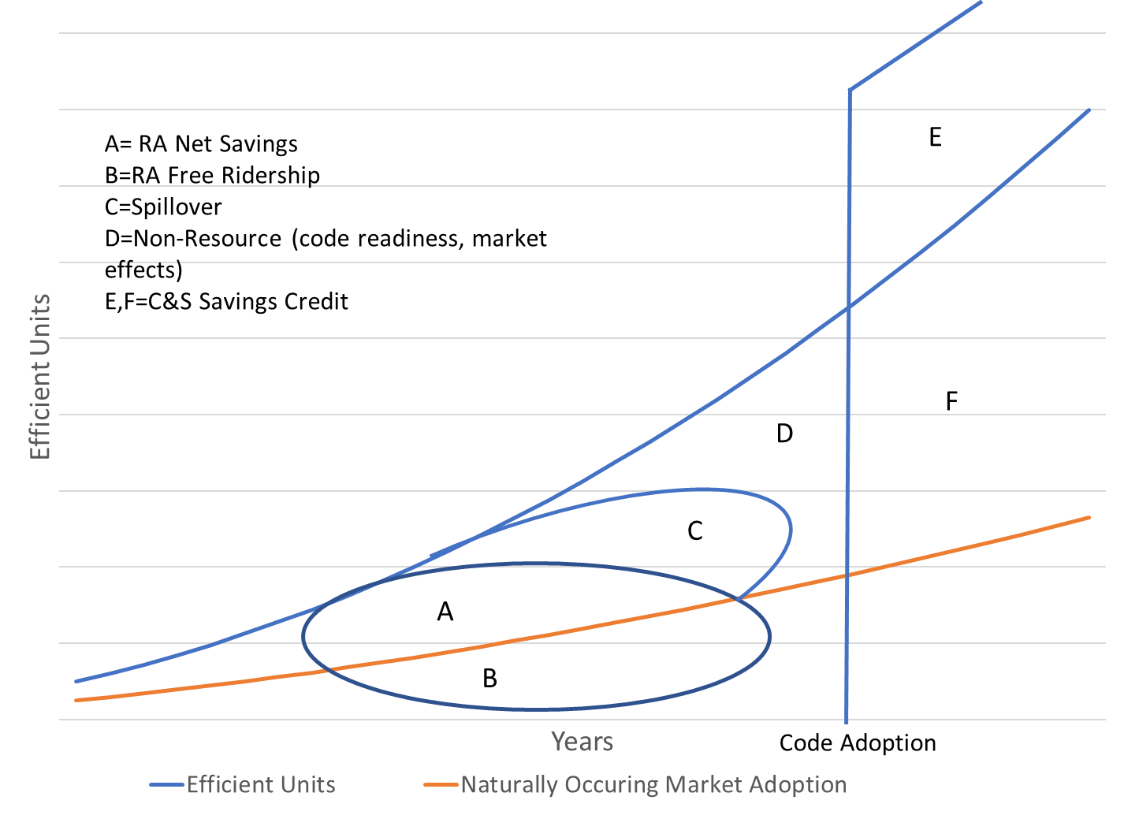
Current Goal-Setting and Attribution

