Slide 1
UWG Meeting on SMB Analysis
December 17,, 2020

Slide 2
Data Overview
SMB Data Set
American Community Survey (ACS)
Sites
CEDAR
Data Request
SITEID
ZIP
County Business Patterns (CBP)
Claims

Slide 3
CEDARS Data Analysis

Slide 4
CEDARS: Claims Overview
Claim relates to a measure/project and has its associated:
Program
Site info
Costs
Savings
Incentives
Cost-effectiveness
Other categorical data

Slide 5
CEDARS: Public Data
Due to privacy concerns, public CEDARS claims are scrubbed from what was is filed by program administrators (PAs)
Primary difference is that public data set does NOT include site-specific details, such as:
City
Zip-code
North American Industry Classification System Code (NAICS Code)
Other data is either renamed or summarized/classified slightly differently (i.e. downstream flag in private,
Makes it nearly impossible to compare data with anything other than State- or PA-level alternate data sources

Slide 6
CEDARS: Data Used in SMB Analysis
Data request for small and medium business data to CPUC
Obtained un-scrubbed claims data for the following PAs:
Pacific Gas and Electric (PGE)
Southern California Edison (SCE)
Southern California Gas (SCG)
San Diego Gas and Electric (SDGE)
Allows Zip-code level analysis
Unclear on exactly how the sub-set of data was selected to be ‘SMB’

Slide 7
SMB Claims Data Cleanup
Upstream Data removed
365,218 claims remaining
Removed claims with no SiteID
358,160 claims remaining
Removed claims with Residential_Flag_y
343,220 claims remaining
Initial Claims Data combined with Site Data
Claims from data request
Data from 2017 to 2019
505,500 unique claims

Slide 8
SMB Claims Data Summary
 | Gross Measure Cost | Gross Incentive | 1st Yr Energy (Elec + Gas, kWh) | Lifecycle Energy (Elec + Gas, kWh)
sum | $ 786,808,600 | $ 280,144,500 | 2,245,672,000 | 22,435,550,000
mean | $ 2,292 | $ 816 | 6,543 | 65,368
std | $ 45,438 | $ 7,213 | 128,084 | 1,598,279
min | $ (2,586) | $ (32,676) | (137,387) | (686,934)
25% | $ 25 | $ 50 | 4 | 10
50% | $ 151 | $ 139 | 288 | 1,262
75% | $ 800 | $ 591 | 1,523 | 10,736
max | $ 18,583,750 | $ 1,654,976 | 39,930,930 | 559,033,000
89,945 unique sites
98% of data has some sort of NAICS code
1,429 of 2,586 zip codes in CA represented (56%)

Slide 9
SMB vs. Public Claims Data
Years 2017-2019 Public claims: 3,495,364
Downstream classification issue
SMB data has “UpstreamFlag”
Public data has three flags (Downstream Flag, Midstream Flag, Upstream Flag)
Not mutually exclusive (393k claims with all three as True)
Incentive issue
TotalGrossIncentive not in Public data
Proxy using Gross Customer Cost – Net Customer Cost?
Comparison to SMB claims by filtering public data in the following ways:
Only claims for PAs in SMB Data Set: 3,475,662
Primary Sector NOT “Residential”: 637,993 claims

Slide 10
SMB vs Public Non-res Claims: Totals
Measure | Public Non-res | SMB | % of Public
Claims | 637,993 | 343,220 | 54%
TotalGrossIncentive (Gross Cust Cost – Net Cust Cost) | $ 4,394,339,000 | $ 280,144,500 | 6%
TotalGrossMeasureCost (Gross Customer Cost) | $ 7,589,578,000 | $ 786,808,600 | 10%
First Year Gross kWh | 7,303,062,000 | 1,050,008,000 | 14%
First Year Gross Therm | 197,878,600 | 40,807,650 | 21%
Lifecycle Gross kWh | 90,481,160,000 | 9,597,375,000 | 11%
Lifecycle Gross Therm | 2,584,501,000 | 438,162,800 | 17%
First Year Gross Energy (kWh) | 13,100,904,980 | 2,245,672,145 | 17%
Lifecycle Gross Energy (kWh) | 166,207,039,300 | 22,435,545,040 | 13%

Slide 11
SMB: Small Business Classification
Two fields: RateScheduleElec, RateScheduleGas
Not validated, but based on submitter discretion
Possible Values
Residential
Small Commercial
Commercial
Large Commercial
Small Industrial (ELEC ONLY)
Agricultural (ELEC ONLY)
Small Business Classification Used
Small Commercial
for
Elec OR Gas

Slide 12
SMB Claims: Small Business Overview
 | Gross Measure Cost | Gross Incentive | 1st Yr Energy (Elec + Gas, kWh) | Lifecycle Energy (Elec + Gas, kWh)
sum | $ 259,469,800 | $ 83,037,940 | 826,937,800 | 8,286,665,000
mean | $ 2,397 | $ 767 | 7,640 | 76,556
std | $ 26,730 | $ 7,464 | 184,413 | 2,324,790
min | $ - | $ - | (60,490) | (604,903)
25% | $ - | $ 50 | - | -
50% | $ 12 | $ 140 | 83 | 305
75% | $ 405 | $ 338 | 1,632 | 12,303
max | $ 3,846,403 | $ 1,491,942 | 39,930,930 | 559,033,000
29.6% of Gross Incentives
33.0% of Gross Measure Costs
33.0% of Gross Energy Savings
108,243 Claims or 31.5% of all claims
27.9% of unique sites

Slide 13
Claims Data Variables – Participation
Participation Counts
Unique SiteIDs by ZipCode
Total Unique Sites
Small Business Unique Sites
Small Business Penetration = Small Business Unique Sites / Total Unique Sites
Unique Sites:
25,124 Small Business of 89,945 Total
Small Business in 713 of 1,429 zips

Slide 14
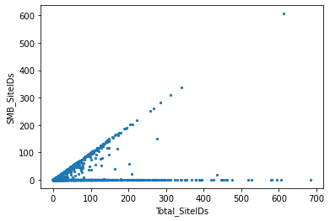
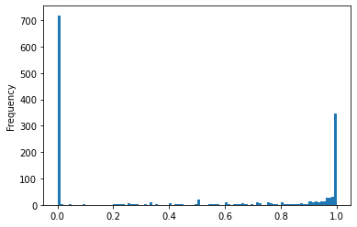
Bifurcation of Zips within SMB Participation
Scatter of Small Biz Counts vs Total Counts by Zip
Histogram Count of Zip-Codes
Clear bifurcation in zip codes between ”small commercial” customers and others
50% of zips had no Small Business sites
70% of zips with any Small Business sites have at least 90% Small Biz Penetration
Small Business SiteIDs
49% of zips with any Small Busines sites have at least 99% Small Biz Penetration
Unique participants that are “SMB” as a percent
of all Participants
Total SiteIDs

Slide 15
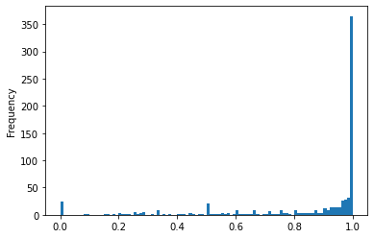
Bifurcation traced to PGE
Histogram Count of Zip-Codes – PGE Only
PGE only PA to use ”Small Commercial” designation
Most of PGE activity for ”Small Commercial”
- 25,125 of 28,018 sites (90%)
Unique participants that are “SMB” as a percent
of all Participants

Slide 16
Claims Data Variables – Investment Flow
Gross Incentive amounts
Gross Measure Costs
Percent of Cost Covered = Gross Incentive / Gross Measure Cost

Slide 17
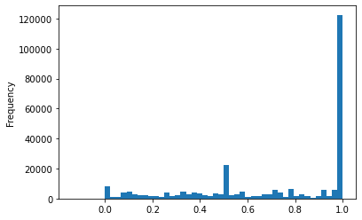
Percent of Cost Covered – All SMB Data
Large barrier for participation within SMB is up-front cost.
The higher the incentive incentive as a percent of costs the better
All SMB Claims
Majority (56%) of claims have 99%+ incentive as percent of cost, probably direct install programs
Wide range of incentive levels otherwise
*Ignores values above 100%
% of Cost Covered by Incentive*

Slide 18
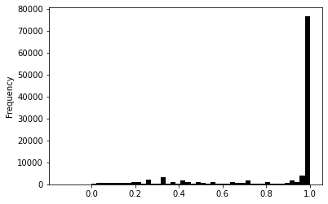
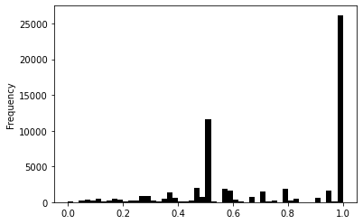
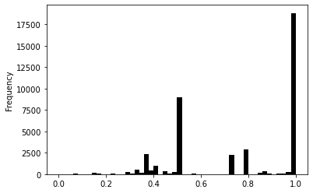
Most PAs have similar Incentive Approaches
SCE
SDGE
% of Cost Covered by Incentive*
% of Cost Covered by Incentive*
SCG
SCE does mostly 100%
SDGE and SCG also have a grouping of incentives around 50%
*Ignores values above 100%
% of Cost Covered by Incentive*

Slide 19
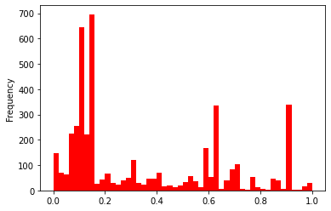
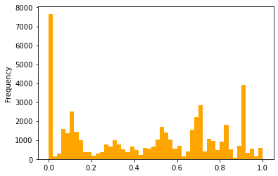
Percent of Cost Covered - PGE
PGE not doing direct install? Maybe related to data provided
Non-”Small Commercial”
”Small Commercial”
% of Cost Covered by Incentive*
% of Cost Covered by Incentive*
*Ignores values above 100%
Small Business customers seem to be missing higher incentive levels
Instead, have 15% of claims without any incentive.

Slide 20
Claims Data Variable - Savings
Accounting for gas and electric savings
Converted gas savings to kWh (29.3 kWh/therm)
Combines electric and gas for a more holistic analysis
Accounts for fuel switching projects
Not yet examined in depth

Slide 21
Bringing in ACS/CBP Data

Slide 22
Initial Data Included - CBP
County Business Patterns (CBP) 2018 Data
Number of establishments Total
Penetration of SiteIDs = SiteIDs / Number of Establishments (MAIN VARIABLE)
A few zips with more Site IDs than establishments in Zip (used 100% for this instance)

Slide 23
Initial Data Included – ACS
American Community Survey (ACS) – 2018 Data
Percent of people living below the poverty line
Measures of ethnic composition
% African American
% Hispanic
% American Indian & Alaska Native (Native American)
Population over 65
Average Household Size
% of total households with Income and benefit that fall within a range:
$50k - $75k

Slide 24
Regressions Run
Dependent Variable: % Penetration of SiteIDs
Independent Variables: CBP and ACS variables

Slide 25
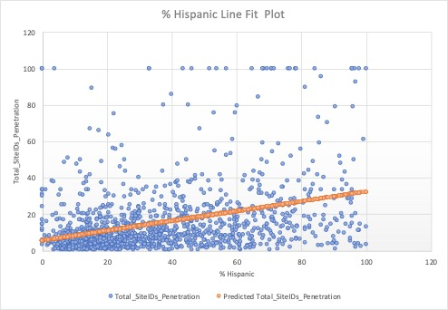
% Hispanic
Most explanatory power
Statistically Significant at 99.9% CI
Higher % Hispanic correlates with
higher penetration

Slide 26
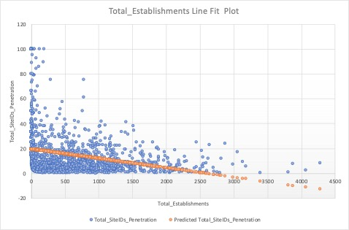
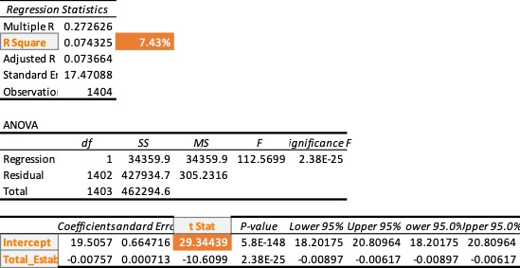
Total Establishments
Statistically Significant at 99.9% CI
Higher number of establishments correlate with
lower penetration

Slide 27
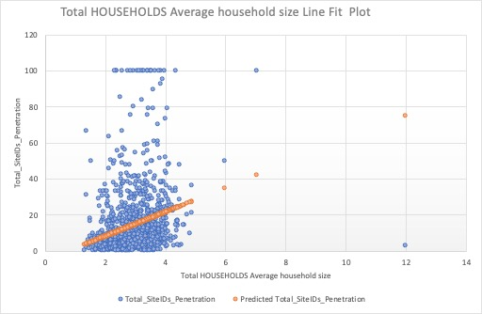
Household Avg Size
Statistically Significant at 99.9% CI
Higher household averages correlate with
higher penetration

Slide 28
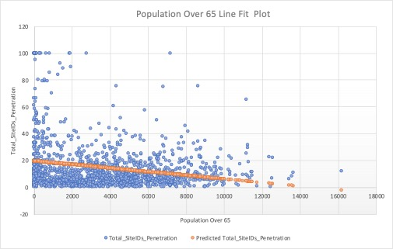
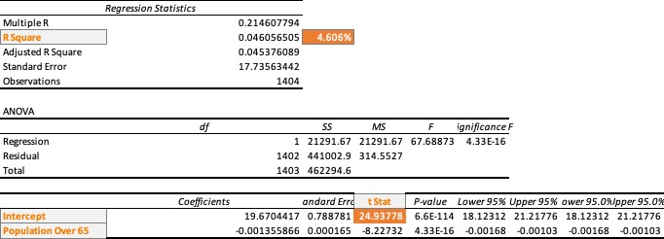
Population Over 65
Statistically Significant at 99.9% CI
Higher population over 65 correlates with
lower penetration

Slide 29
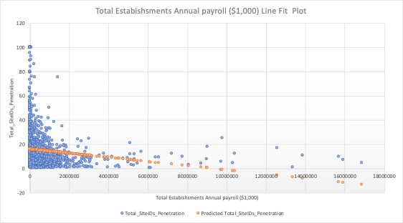
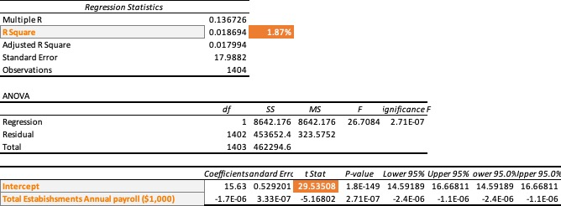
Total Payroll
Statistically Significant at 99.9% CI
Higher total payroll correlates with
lower penetration

Slide 30
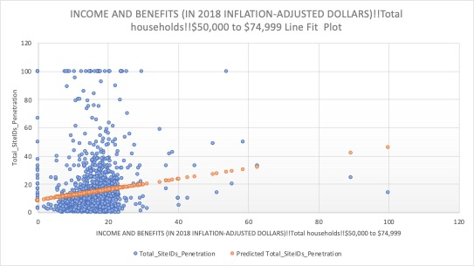
Income $50—$75k
Statistically Significant at 99.9% CI
Higher counts of households correlates with
higher penetration

Slide 31
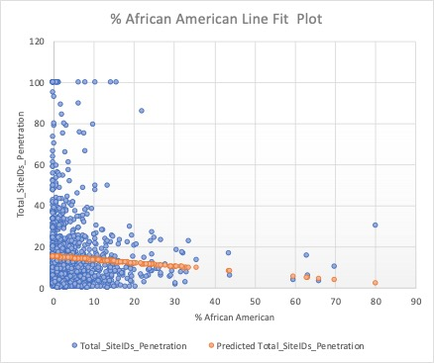
% African American
Statistically Significant at 95% CI
Higher % African American correlates with
Iower penetration

Slide 32
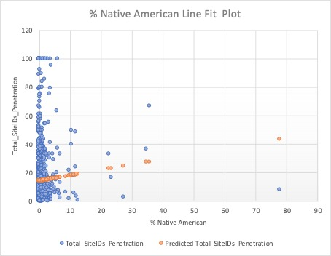
% Native American
Statistically Significant at 95% CI
Higher % Native American correlates with
higher penetration

Slide 33
Future Variable Exploration

Slide 34
County Business Patterns (CBP)
Number of establishments by employee range
<5
5-9
10-19
20-49
50-99
100-249
250+
Small
Medium
Large

Slide 35
American Community Survey (ACS)
Other income ranges
Other ethnic groups
Immigrant status

Slide 36
Claims
Examine other variables such as
Rebate amount
% of cost covered by rebate
Savings amount

Slide 37
Summary and Next Steps

Slide 38
Progress To Date
Much better understanding of data available
Data formatted in way that can be used for in-depth statistical analysis
Initial pass at statistical analysis started with promising results

Slide 39
Next Steps
Review correlations additional between ACS/CBP data and Claims Data
Perform multivariate regression analysis on data
Provide summary presentation of results

Slide 40
Overview of Data Challenges
Claims Data
Public Data does not include site information to compare to other data sources
Public data does not have clear documentation of how fields are derived from submission files
Upstream issue
Incentive issue
Sectors and rate classes
Getting raw submitted data was difficult, and selection criteria unclear
Submitted data does not provide consistent mapping for rate classes or sectors
ACS/CBP
Requires zip-code level values
Not all data is available for all zips

Slide 41
Schedule Proposal
Complete first full statistical analysis - 1/15
Results in presentation form
Feedback from group on most valuable way to present findings.

