Slide 1
Composition, Diversity, Equity & Inclusion Working Group
“Not everything that is faced can be changed, but nothing can be changed until it is faced”
-James Baldwin
WG Hosted by California Energy Efficiency Coordinating Committee (CAEECC)
1st WG Meeting
January 13, 2022 9am-12pm

Slide 2
Agenda
Time | Session | Session & Objectives | Presenter
9:00 | Introductions | Working Group Member & Facilitation Team Introductions Non-CAEECC WG members Disclosures | All Facilitator
9:15 | Session 1: Working Group Charge & Process | Review WG Charge, Scope, Approach, Timeline, Key Questions, Deliverable, Groundrules & Norms | Facilitator
9:30 | Session 2: Background, Context & Best Practices in Other Jurisdictions | Overview of relevant DEI terms CPUC DEI Efforts and Environmental & Social Justice Action Plan 2.0 Initial presentation on best practices, challenges, and successes in other jurisdictions and similar organizations (regarding Composition and DEI) | Facilitator Nicole Cropper, CPUC Facilitator
10:00 | Break
10:15 | Session 3: Diversity, Equity & Inclusion (DEI) | Discuss what we mean by diversity Discuss the types of diversity, equity, and inclusion efforts this WG would like to recommend to the CAEECC* Discuss any missing voices from this WG Review & revise proposed roadmap for developing DEI recommendations | All All All All
11:05 | Session 4: CAEECC Membership Composition Assessment | Discuss and agree on the vision/goal of evaluating CAEECC membership * Discuss how to assess/evaluate composition Review & revise proposed roadmap for developing membership composition recommendations | All All All
11:45 | Wrap-Up and Next Steps | Debrief where ended up and how meeting went Identify clear next steps including homework assignment Discuss sub-WGs, if appropriate | All Facilitator All
12:00 | Adjourn
*Asterisk represents topics for which we plan to seek verbal public comment. The Public will be able to share comments and ask questions at any point in the meeting via the chat.

Slide 3
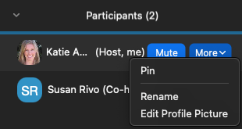
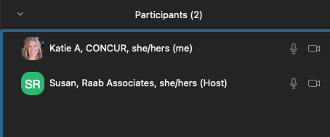
Zoom etiquette
Virtual Etiquette
Log on a few minutes early, if possible, to ensure your technical connection is working.
Share your video if possible – this fosters engagement and helps mimic an in-person meeting setting.
Raise your hand to enter the queue to speak—then wait for the Facilitator to call on you.
Mute yourself when you’re not speaking.
Note that the Public will be muted except during Public Comment
Tip: you can “rename” yourself to include your organization & pronouns

Slide 4
INTRODUCTIONS
Working Group Member & Facilitation Team Introductions
Non-CAEECC WG members Disclosures

Slide 5
CAEECC working group: Facilitation & Leadership Team
Katie Abrams, SESC: Facilitator
Lara Ettenson, NRDC: CAEECC Co-Chair
Susan Rivo, Raab Associates: Operations Wizard
Jonathan Raab, Raab Associates, Senior Advisor

Slide 6
facilitator Commitments & goal
My commitments
Listen with open ears & heart
Lean into discomfort
My goal
We build a “brave space” that fosters trust & inclusion – where you can be your whole self – where you feel empowered to make bold recommendations

Slide 7
CDEI Working group Members
 | # | Company | Lead | Alternate
CAEECC MEMBERS | 1 | CEE | Bernie Kotlier
 | 2 | CSE | Fabi Lao* | Stephen Gunther
 | 3 | SCE | Patty Neri | Chris Malotte
 | 4 | NRDC | Lara Ettenson*
 | 5 | 3C-REN | Alejandra Tellez*
 | 6 | SoCalREN | Fernanda Craig
 | 7 | The Energy Coalition | Melanie Peck*
 | 8 | SJVCEO | Kelsey Jones
NON-CAEECC MEMBERS | 9 | La Cooperativa Campesina de California | Robert Castaneda
 | 10 | ICF | Dany Kahumoku
 | 11 | SEI (Strategic Energy Innovations) | Jake Pollack | Stephanie Doi
 | 12 | Viridis Consulting, LLC | Mabell Garcia Paine
 | 13 | Greenbank Associates | Alice Sung
 | 14 | Energy Efficiency Council | Allan Rago | Ron Garcia
 | 15 | Future Energy Enterprises, LLC | Annette Beitel
 | 16 | Don Arambula Consulting | Don Arambula | Elizabeth Lowe
 | 17 | Silent Running LLC | James Dodenhoff
EX-OFFICIO | 18 | CPUC | Alison LaBonte* | Nils Strindberg*, Nicole Cropper, Yeshi Lemma, and Peter Franzese
* Represents Task Force Members who volunteered to help launch this Working Group

Slide 8
Disclosures (for non-CAEECC members)
Per disclosure Groundrule, Non-CAEECC Member organizations participating in a Working Group are required to disclose to the Working Group and the Facilitation Team the entities with whom they are doing energy-related business with or for, both currently and within the past year. If new contractual relationships develop during the course of the Working Group, they will update their disclosure.
Organization | Disclosures
La Cooperativa Campesina de California | CSD's LIWP, ESA, LIOB, SoCal Gas, SCE
ICF | SoCal Gas, SoCal REN, SCE, SMUD, PG&E
SEI (Strategic Energy Innovations) | PG&E, SCE, MCE, SDG&E, SoCal Gas, ForeFront Power
Viridis Consulting, LLC | SoCal Gas, Qmerit, Ramboll, Franklin Energy, Willdan, Gridpoint, SkyCentrics, Sonoma Clean Power
Greenbank Associates | n/a
Energy Efficiency Council | ASSERT, Community Action Partnerships of Orange County and of Riverside County, Maroma Energy Services, Nexant, Pacific Asian Consortium in Employment, PG&E, Richard Heath & Associates, SDG&E, SoCal Gas, Southwest Gas
Future Energy Enterprises, LLC | PG&E, SCE, SDG&E, SCG, SMUD, LADWP
Don Arambula Consulting | PG&E, SCE, SDG&E, SCG
Silent Running LLC | Venice Family Clinic, Full Turn Direct, Gerson Lehrman, Coleman Research, Orange County Sanitation District, Climate Action Santa Monica, Joel Burbach, Aug-wind, Orange County Water District
Note: Organizations must represent their own respective organization in this WG, and not other organizations with whom they are conducting energy-related business

Slide 9
Meeting Norms
Make space, take space (share the mic).
Stories shared here stay here; what is learned here leaves here.
Share your unique perspective: share your unpopular opinion
Generative thinking: "yes, and" instead of "yes, but".
Listen from the "We", speak from the "I".
Offer what you can; ask for what you need.
Be inquisitive.
Assume best intent.
Be empowered to share impact.
Notes:
Pilot for rest of mtg and WG

Slide 10
How are you feeling in this moment?
Use Zoom’s Annotate button to circle how you’re feeling (anonymous)
Source: Pinterest

Slide 11
WORKING GROUP CHARGE & PROCESS
Review WG Charge, Scope, Approach, Timeline, Key Questions, Deliverable
Groundrules & Meeting Norms

Slide 12
Composition, Diversity, Equity, and Inclusion Working Group (CDEI WG) Overview
Charge: review CAEECC membership and recommend additional ways to create a more diverse, equitable, inclusive, and accessible CAEECC collaborative
4 virtual meetings (plus optional onboarding mtg): January 2022-March 2022
Recommendations delivered to full CAEECC for review, refinement (if needed), final approval, and submitted to CPUC April 2022
Application process for interested non-CAEECC stakeholders closed 12/15/2021
Prospectus available at https://www.caeecc.org/cdei-working-group

Slide 13
Working Group Charge
Review CAEECC membership including composition of the organizations on CAEECC, as well as diversity of Member representatives. Identify next steps to address any composition and diversity issues, including overcoming any identified barriers to participation.
Recommend additional ways to create a more diverse, equitable, inclusive and accessible CAEECC collaborative to (a) allow for easier participation from a wider array of stakeholders and (b) to create a space to ensure that CAEECC’s recommendations on policies and programs are grounded based on input from by a more inclusive and diverse group.

Slide 14
Approach to consensus-building
Process involves dialogue, creativity, and negotiation
Consensus is defined by CAEECC as unanimity
For recommendations without consensus, CAEECC provides two or more options and lists the WG Members that support each option
Example:
Dessert Option | First Choice Option | Acceptable Option
Option 1: Chocolate cake (3 first choice, 5 acceptable of 5 voting members) | Org 3, Org 4, Org 5 | Org 1, Org 2, Org 3, Org 4, Org 5
Option 2: Vanilla cake (2 first choice, 4 acceptable of 5 voting members) | Organization (“Org”) 1, Org 2 | Org 1, Org 2, Org 3, Org 4
Notes:
Process: defining options, eliciting constructive feedback, clarifying and narrowing points of divergence, seeking consensus where feasible, and documenting points of convergence and any remaining divergence.
During the substantive discussions, if a Member cannot agree to support a substantive option under consideration, that member should explain why and propose a specific alternative that they can support.

Slide 15
DEI Questions for WG
How can we diversify the￼lead and/or alternate representatives from CAEECC Member organizations on CAEECC?
What forms of diversity does CAEECC want to foster (e.g. race as well as gender, gender identity or expression, sexual orientation, national origin, citizenship, age, ability, veteran, religion, income?
What additional facilitation practices can we employ to foster more inclusive meetings?
What Member recruitment and retention strategies would advance our DEI commitment (e.g., possible compensation, geographic inclusivity in the context of future in-person meetings)?
What organizational and educational development practices should the CAEECC consider (e.g., building DEI competencies or DEI training for Members and the Facilitation team; creating EE policy basics trainings; updating the CAEECC website and/or Charter)?
Other topics/solution ideas as appropriate
Notes:
Pause here for questions

Slide 16
Membership Composition assessment Questions for WG
What is the vision/goal of evaluating CAEECC membership?
What types of organizations are under-represented or missing altogether as CAEECC Members?
What are the barriers/potential reasons for those gaps (e.g., recruitment, capacity, familiarity with EE policy AND PROGRAM requirements, scope of CAEECC)?
What types of organizations, if any, might be over-represented on CAEECC?
Would funding or other resources facilitate under-resourced organizations’ participation as CAEECC Members and/or in CAEECC Working Groups? (Note: consider coordinating with CPUC on possible pilot opportunities)
Other topics/solution ideas as appropriate

Slide 17
CDEI WG: Meeting Dates & Tasks
Meeting # | Date | Tasks/Objectives
Facilitation Team/CAEECC Leadership Prework | Dec 2021- January 2022 | Outline lessons learned from other jurisdictions to inform the January meeting
Optional CAEECC Onboarding | January 11, 2022 | Introduction to CAEECC (e.g., purpose, structure, history, charter, and approach to seeking consensus)
1st meeting | January 13, 2022 | Review Prospectus—including scope, approach, and timeline Educational sharing (e.g., brief overview of CAEECC historical practices; existing DEI terms, including those in the ESJ Action Plan 2.0; what other jurisdictions are doing; organizational best practices) Identify common vision/shared goal Outline further details of what will be covered in this group
2nd meeting | February 3, 2022 | Discuss key participation and access barriers and issues Outline ways to enhance CAEECC’s ability to center equity and develop energy efficiency policy and program recommendations through a DEI lens Brainstorm possible solutions/recommendations
3rd meeting | February 23, 2022 | Develop draft recommendations
4th meeting | March 5, 2022 | Finalize recommendations
Optional additional meeting(s) –only if needed | Spring/ Summer 2022 | Potentially assist with implementing recommendations (only if needed)
Notes:
Note that mtgs will be virtual, and 9-approx. 1pm

Slide 18
Deliverable & Recommendations Timeline
Deliverable: A report delineating recommendations for the full CAEECC’s consideration and approval.
Recommendations Timeline:
The full WG recommendations will be presented for approval at the April 12, 2022 full CAEECC meeting.
All recommendations will be implemented no later than August 2022.

Slide 19
groundrules
Attend all four meetings (or send designated alternate)
Do your homework (complete pre-and post-meeting work to ensure productive meetings and that a complete deliverable is finalized)
Materials are posted 5 days before the meeting
Propose alternatives if you can’t agree with recommendations – proponents draft the description and rationale for alternative options/ recommendations
See the Prospectus (Appendix A) for the full list of Groundrules: https://www.caeecc.org/cdei-working-group

Slide 20
BACKGROUND, CONTEXT & BEST PRACTICES IN OTHER JURISDICTIONS
Overview of relevant DEI terms
CPUC DEI Efforts, and Environmental & Social Justice Action Plan 2.0
Initial presentation on best practices, challenges, and successes in other jurisdictions and similar organizations (regarding Composition and DEI)

Slide 21
What does diversity, equity & inclusion mean to you?
Word Cloud Exercise:
https://www.menti.com/86qfdz7p64
Enter up to three phrases (spaces are ok)

Slide 22
A few Relevant DEI Terms….
Able-ism
BIPOC
Cis-Gender
Diversity
Equity
Gender Identity
Implicit Bias
Inclusion
LGBTQIA
Microaggression
Racial Equity
Racial Justice
Tokenism
White Fragility

Slide 23
Environmental & Social Justice Action Plan & Diversity, Equity, and Inclusion at the CPUC
Nicole Cropper, Office of the Commission

Slide 24
Environmental Justice
Environmental justice is the fair treatment and meaningful involvement of all people regardless of race, color, national origin, or income, with respect to the development, implementation, and enforcement of environmental laws, regulations, and policies. This goal will be achieved when everyone enjoys:
the same degree of protection from environmental and health hazards, and;
equal access to the decision-making process to have a healthy environment in which to live, learn, and work.
Notes:
Photo - https://www.wilmingtonwire.com/wp-content/uploads/2014/02/unnamed-2-668x437.jpg
Citation - https://www.epa.gov/environmentaljustice

Slide 25
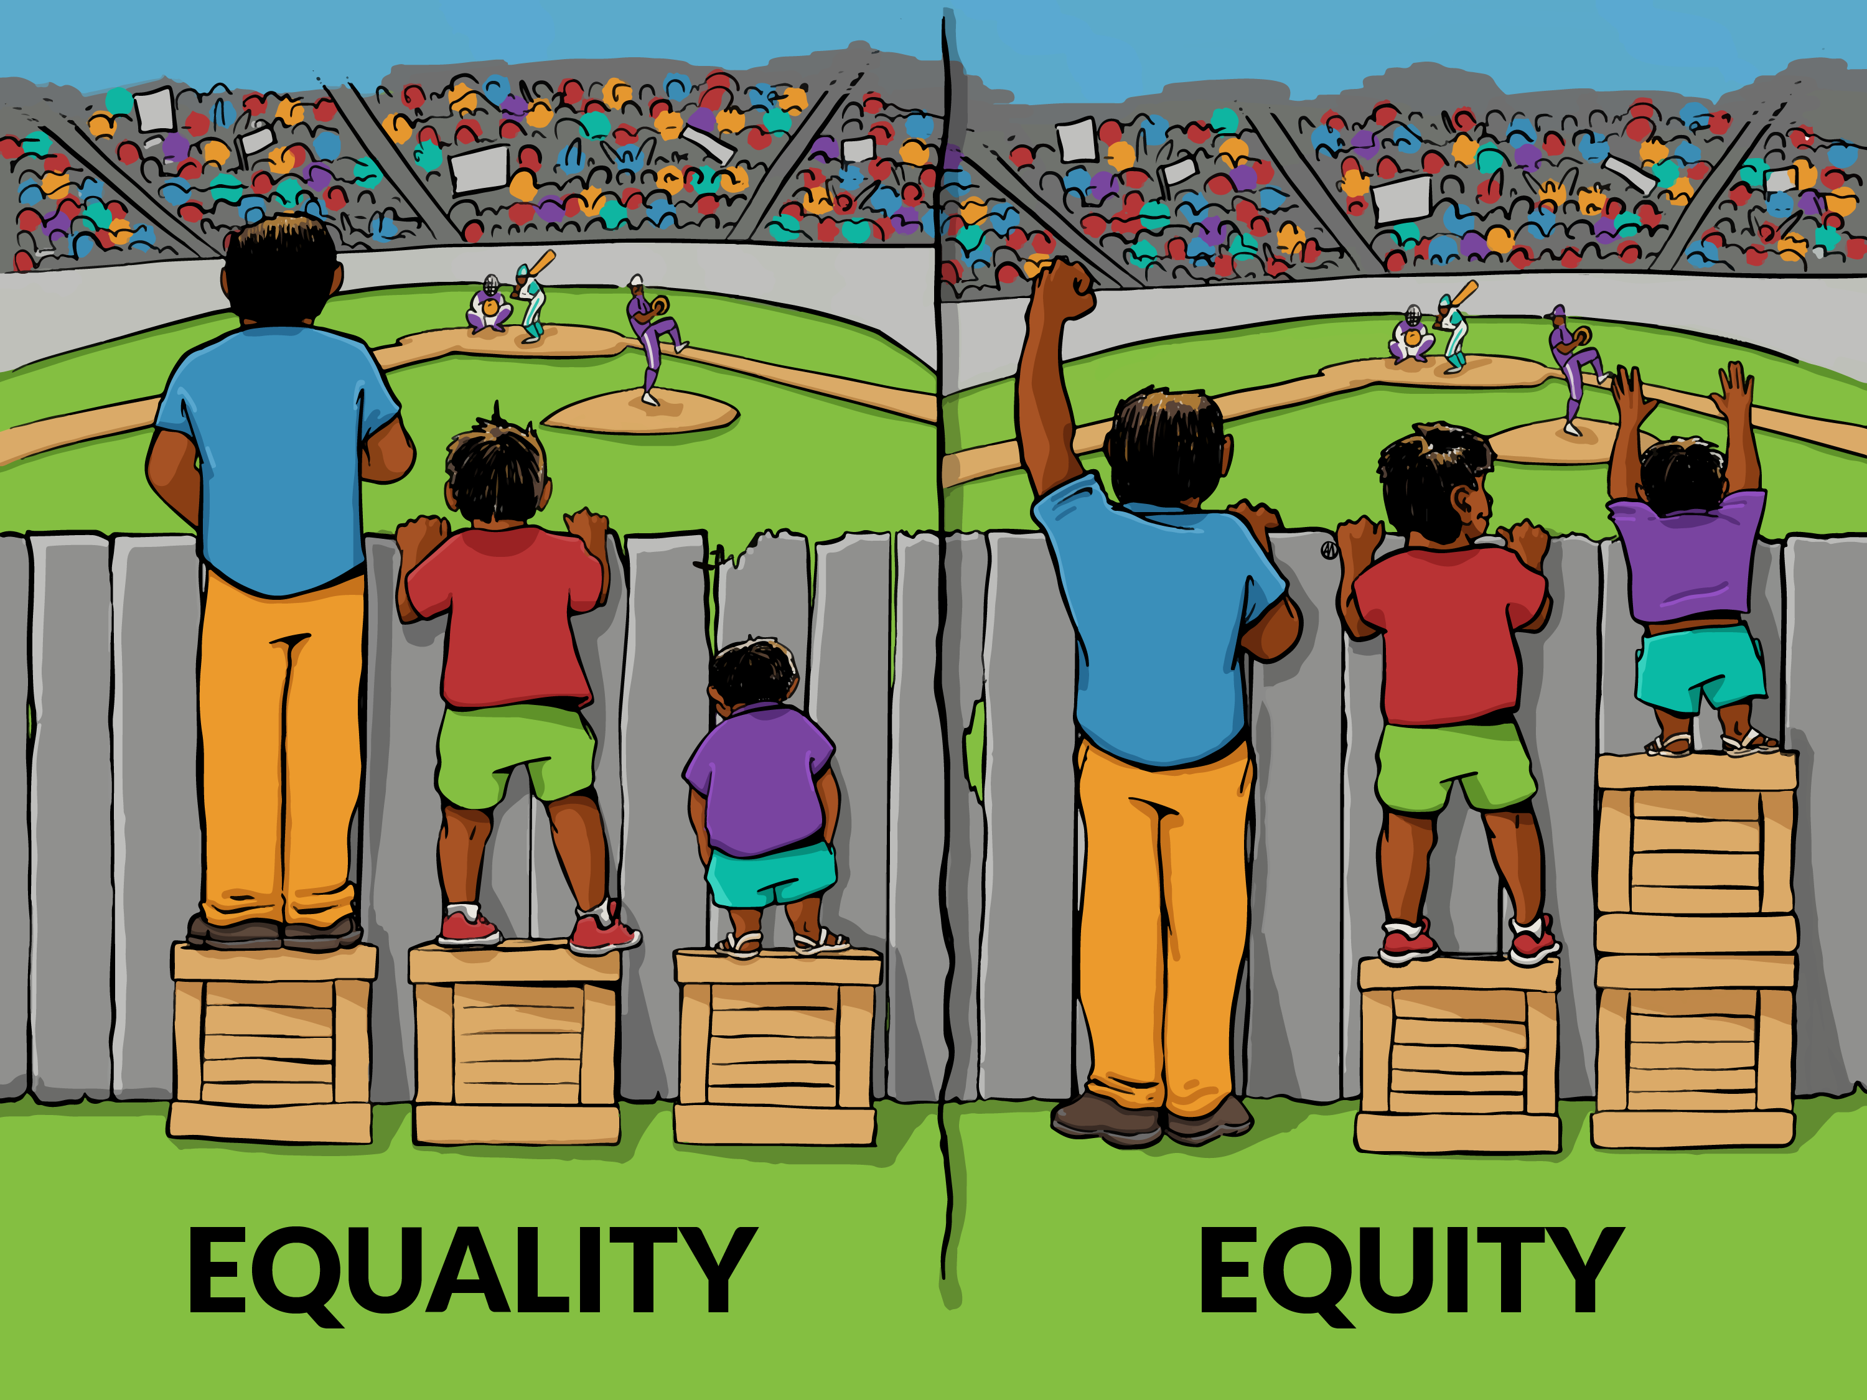
Why this Matters: Equality vs. Equity
Notes:
https://interactioninstitute.org/wp-content/uploads/2016/01/IISC_EqualityEquity.png

Slide 26
About the ESJ Action Plan A comprehensive mission and actionable objectives, for the purpose of considering ESJ
Goals
Consistently integrate equity and access considerations throughout CPUC proceedings and other efforts.
Increase investment in clean energy resources to benefit ESJ communities, especially to improve local air quality and public health.
Strive to improve access to high-quality water, communications, and transportation services for ESJ communities.
Increase climate resiliency in ESJ communities.
Enhance outreach and public participation opportunities for ESJ communities to meaningfully participate in the CPUC's decision-making process and benefit from CPUC programs.
Enhance enforcement to ensure safety and consumer protection for ESJ communities.
Promote economic and workforce development opportunities in ESJ communities.
Improve training and staff development related to ESJ issues within the CPUC's jurisdiction.
Monitor the CPUC's ESJ efforts to evaluate how they are achieving their objectives.

Slide 27
About the DEI Working Group
Foundational Principles
Diversity: Ensure the presence of differences in the workplace.
Including but not limited to race, gender, religion, sexual orientation, ethnicity, nationality, socioeconomic status, language, (dis)ability, age, religious commitment, or political perspective)
Equity: Ensure that access, resources, and opportunities are provided to all, especially for those who are underrepresented and have been historically disadvantaged.
Inclusion: Create a workplace culture that welcomes, values, and respects all people and is an environment where all have the same opportunities to reach their full potential
Structure
16 members
4 Subcommittees
Governance
Recruitment
Workplace Culture
Retention, Promotion and Hiring
Definitions adopted from: University of Washington Diversity, Equity, and Inclusion Definitions - UW Research (washington.edu)

Slide 28
Furthering environmental and social justice, relies on embracing and institutionalizing DEI principles… specifically ensuring equitable access.
Notes:
ESJ Action Plan (2019)
ESJ Action Plan Status Report (2020)
ESJ Workshop Materials & Recordings (2021)

Slide 29
Cultivating Diversity
Structure adopting a structure that supports learning from one another
Climate cultivating a climate that facilitates learning from one another
Navigating Complexity developing a capacity to address complex DEI topics
Social Learning approaching learning as a social, mostly informal process
How can we distribute power differently in the organization so that it is shared more diffusely across the organization?
How can we be open to learning on the job, making mistakes, and trying new things?
How can we have a climate or culture that makes it easy for people to learn and change?
How can we make sure we value and understand the importance of the informal interactions and conversations that are part of our organization?
How can we help ourselves learn to talk about very complex issues, especially where we have very little shared experience?
How can we make visible and value different forms of knowledge within our organization?
How can we make time to reflect on our ways of doing and thinking?

Slide 30
Additional Considerations
Avoid the ‘minority tax’
When developing and implementing DEI policies and practices, be mindful that efforts to ensure representation and inclusion do not lead to the unintended consequence of disproportionately adding to the workload of underrepresented employees.
Empathize
Keep in mind that individuals in underrepresented groups may be disenfranchised and may not eagerly participate in DEI or ESJ efforts due to their past experiences.

Slide 31
Thank You!!!
Nicole.cropper@cpuc.ca.gov
To Learn More https://www.cpuc.ca.gov/ESJActionPlan
Notes:
ESJ Action Plan (2019)
ESJ Action Plan Status Report (2020)
ESJ Workshop Materials & Recordings (2021)

Slide 32
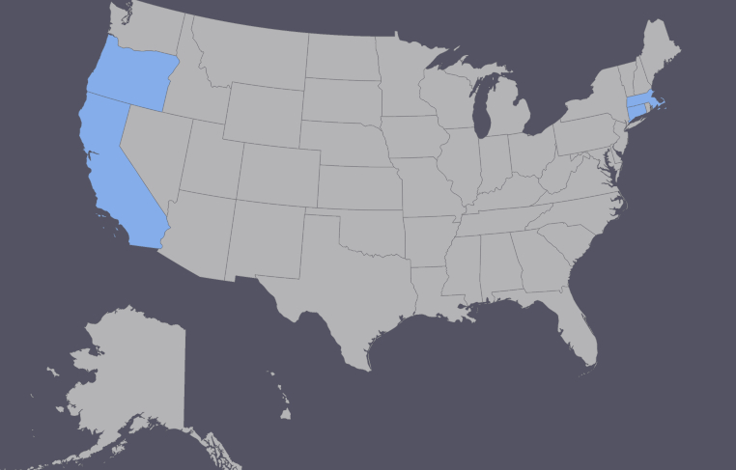
Initial Research on Best Practices: Organizations Researched/Interviewed
Connecticut Energy Efficiency Board
Disadvantaged Communities Advisory Council (CPUC)
Environmental Justice Advisory Council (CARB)
Energy Trust of Oregon’s Diversity Advisory Council
Massachusetts Energy Efficiency Advisory Council
Partners Advancing Climate Equity
Strategic Growth Council

Slide 33
Interview highlights: Diversity, equity & Inclusion
Successes
Application: process for eliminating subconscious bias and “minority tax”
Facilitation: equal space for lived experience and technical expertise; rotating guest speakers; listening sessions
Public engagement: call-in option for people without access to a laptop
Charter: broad definition of equity priorities; specific action plans
Policy recommendation: Program Administrators hire DEI consultants for program design
Challenges
Assigned & elected seats (representatives may not speak for their constituents)
Dominant voices
Clarity on charge
Burnout
Capacity
Maintaining a productive environment

Slide 34
Interview highlights: membership composition
Successes
Composition: Use market characterization & participation studies to inform gaps & design composition of seats
Composition: Dedicated seats for sectors such as income-eligible programs, environmental justice, and municipal
Recruitment: Leverage Working Groups, stakeholder groups, and/or RFPs to conduct outreach
Retention: Provide stipends and/or grant funding to capacity constrained organizations
Challenges
Reaching and retaining hard-to-reach sectors (e.g., Community Based Organizations)
Term limits – too short or too long

Slide 35
Break

Slide 36
Discuss what we mean by diversity
Discuss the types of equity and inclusion efforts this WG would like to recommend to the CAEECC*
Discuss any missing voices from this WG
Review & revise proposed roadmap for developing DEI recommendations
DIVERSITY, EQUITY & INCLUSION

Slide 37
WHAT DO WE MEAN BY DIVERSITY?
Any objections to the proposal put forth in the Prospectus?
Race as well as gender, gender identity or expression, sexual orientation, national origin, citizenship, age, ability, veteran, religion, income
This will inform the strategies this WG recommends and the ultimately guide CAEECC’s commitment
We can specify that it is a “living definition” subject to revision

Slide 38
What types of Diversity, equity, & inclusion efforts would this WG like to recommend to the CAEECC?*
Member organization recruitment & retention
Diversity of types of organizations
Diversity of individual leads and alternates
DEI related education development
Public engagement
Facilitation practices
Other categories?

Slide 39
Public Comment
Breakout group discussion to follow

Slide 40
DEI Breakout groups
Discussion topics
What types of DEI efforts would this WG like to recommend to the CAEECC?
What voices are missing from this Working Group (who we’d like to capture in public comment, panel sessions, etc.)?
[Plus get to know your fellow WG Members!]
Breakout logistics
Assigned one of 7 breakout rooms
20 minutes for discussion
Suggest final 5 mins to review group summary
Facilitation team will use summary to offer prioritization ideas
Public will be muted but can use the chat to provide comments

Slide 41
Review & revise proposed roadmap for developing dei recommendations
Any suggested changes to the approach laid out in the Prospectus (see table below)?
Any objections to mini-homework assignment before 2nd WG mtg (e.g., poll requesting preliminary recommendations (in the categories we just brainstormed))?
Meeting # | Date | Tasks/Objectives
1st meeting | January 13, 2022 | Review Prospectus—including scope, approach, and timeline Educational sharing (e.g., brief overview of CAEECC historical practices; existing DEI terms, including those in the ESJ Action Plan 2.0; what other jurisdictions are doing; organizational best practices) Identify common vision/shared goal Outline further details of what will be covered in this group Sketch out strategy to collect data on current composition
2nd meeting | February 3, 2022 | Discuss key participation and access barriers and issues Outline ways to enhance CAEECC’s ability to center equity and develop energy efficiency policy and program recommendations through a DEI lens Brainstorm possible solutions/recommendations
3rd meeting | February 23, 2022 | Develop draft recommendations
4th meeting | March 5, 2022 | Finalize recommendations

Slide 42
CAEECC MEMBERSHIP COMPOSITION ASSESSMENT
Discuss and agree on the vision/goal of evaluating CAEECC membership *
Discuss how to assess/evaluate composition
Review & revise proposed roadmap for developing membership composition recommendations

Slide 43
DISCUSS AND AGREE ON THE VISION/GOAL OF EVALUATING CAEECC MEMBERSHIP*
Proposed focus is on how to operationalize DEI recommendations
Any objections and/or suggested additions?
This will guide the WG’s focus going forward

Slide 44
Public Comment
Breakout group discussion to follow

Slide 45
Structure & Composition
Facilitation Team: Raab Associates
Co-Chairs: 1 Program Administrator (BayREN) & 1 Non-Program Administrator (NRDC)
Advocates (6)
Implementers (5)
Program Administrators (10)
Government (4)
California Public Advocates
Small Business Utility Advocates
Natural Resources Defense Council
Labor Management Cooperation Committee
California Advanced Lighting Controls Training Program
Sheet Metal Workers Local 104
California Energy Efficiency + Demand Council
Center for Sustainable Energy
CodeCycle
San Joaquin Valley Clean Energy Organization
The Energy Coalition
Investor-owned Utilities (4): PG&E, SCE, SDG&E, and SoCalGas
Regional Energy Networks (4): 3C-REN, BayREN, I-REN, and SoCalREN
Community Choice Aggregators (2):
MCE and RCEA
San Francisco Environment
Local Government Sustainable Energy Coalition
California Public Utilities Commission (ex officio)
California Energy Commission (ex officio)
List of Members: https://www.caeecc.org/members

Slide 46
DISCUSS HOW TO ASSESS/EVALUATE COMPOSITION
Prospectus calls for a two-part focus:
CAEECC Membership at the organizational level (e.g., NRDC, PG&E, The Energy Coalition)
Individual level (the people who represent each Member organization)
CAEECC Charter calls for periodic assessment of underrepresented, missing, and/or over-represented organizations CAEECC membership
Brainstorm how to approach assessment

Slide 47
Membership Composition Breakout groups
Discussion questions
How would you recommend assessing the CAEECC composition at the organizational level (structural composition)
How would you recommend assessing the CAEECC composition at the individual level (diversity representation)
[Plus get to know your fellow WG Members!]
Breakout logistics
Assigned one of 7 breakout rooms (different from 1st breakout)
20 minutes for discussion
Suggest final 5 mins to review group summary
Facilitation team will use summary to prep for 2nd meeting
Public will be muted but can use the chat to provide comments
Notes:
Example strategies: Organizational level: Evaluation of underrepresented, missing, and/or over-represented organizations CAEECC membership
Individual level: Develop strategy to collect data on diversity of individual representatives

Slide 48
Review & revise proposed roadmap for developing MEMBERSHIP COMPOSITION recommendations
Any suggested changes to the approach laid out in the Prospectus (see table below)?
Meeting # | Date | Tasks/Objectives
1st meeting | January 13, 2022 | Review Prospectus—including scope, approach, and timeline Educational sharing (e.g., brief overview of CAEECC historical practices; existing DEI terms, including those in the ESJ Action Plan 2.0; what other jurisdictions are doing; organizational best practices) Identify common vision/shared goal Outline further details of what will be covered in this group Sketch out strategy to collect data on current composition
2nd meeting | February 3, 2022 | Discuss key participation and access barriers and issues Outline ways to enhance CAEECC’s ability to center equity and develop energy efficiency policy and program recommendations through a DEI lens Brainstorm possible solutions/recommendations
3rd meeting | February 23, 2022 | Develop draft recommendations
4th meeting | March 5, 2022 | Finalize recommendations

Slide 49
WRAP UP &
NEXT STEPS
Debrief where ended up and how meeting went
Identify clear next steps including homework assignment
Discuss sub-WGs, if appropriate

Slide 50
How are you feeling in this moment?
Use Zoom’s Annotate button to circle how you’re feeling (anonymous)
Source: Pinterest

Slide 51
Meeting debrief
Quick feedback using zoom annotation:
Was it easy to access the meeting documents?
Not at all easy ………… Somewhat easy …........... Easy to access
Do you feel this was an inclusive and trusting environment?
Not at all safe……........ Somewhat safe ………….. Very safe
Do you feel the meeting was effective?
Not at all effective…… Somewhat effective ……. Very effective
Verbal feedback:
What worked well?
How can we improve?

Slide 52
Next steps
Homework?
Goals for next meeting (2/3/2022) – per Prospectus
Discuss key participation and access barriers and issues
Outline ways to enhance CAEECC’s ability to center equity and develop energy efficiency policy and program recommendations through a DEI lens
Brainstorm possible solutions/recommendations
Others?

Slide 53
CDEI WG: Meeting Dates & Tasks
Meeting # | Date | Tasks/Objectives
Facilitation Team/CAEECC Leadership Prework | Dec 2021- January 2022 | Outline lessons learned from other jurisdictions to inform the January meeting
Optional CAEECC Onboarding | January 11, 2022 | Introduction to CAEECC (e.g., purpose, structure, history, charter, and approach to seeking consensus)
1st meeting | January 13, 2022 | Review Prospectus—including scope, approach, and timeline Educational sharing (e.g., brief overview of CAEECC historical practices; existing DEI terms, including those in the ESJ Action Plan 2.0; what other jurisdictions are doing; organizational best practices) Identify common vision/shared goal Outline further details of what will be covered in this group
2nd meeting | February 3, 2022 | Discuss key participation and access barriers and issues Outline ways to enhance CAEECC’s ability to center equity and develop energy efficiency policy and program recommendations through a DEI lens Brainstorm possible solutions/recommendations
3rd meeting | February 23, 2022 | Develop draft recommendations
4th meeting | March 5, 2022 | Finalize recommendations
Optional additional meeting(s) –only if needed | Spring/ Summer 2022 | Potentially assist with implementing recommendations (only if needed)
Notes:
Note that mtgs will be virtual, and 9-approx. 1pm

Slide 54
APPENDIX SLIDES

Slide 55
Other relevant caeecc working groups
Underserved Working Group (2020-2021)
“Determine who is not benefiting from Energy Efficiency and propose solutions address this issue, including potentially a definition for ‘underserved,’ reframing the current definition of HTR to include others that are underserved, or other means.”
3 sub-Working Groups: Residential, Small-Medium Businesses, and Public sector
Final Summary Memo and reports for each of the three sectors available at: https://www.caeecc.org/underserved-working-group-2020
Equity Metrics Working Group (summer 2021)
“The charge of the Working Group is to identify and define the most important Objectives for the Equity segment, and then to define the associated key Metric(s) under each Objective. The Objectives and associated key Metric(s) for each objective would be used to support and provide rationale for portfolio segmentation and program design, as well as used for program benefit/value forecasting, tracking, and evaluation. Although the WG will not be tasked with setting the specific numeric Targets for the Metric(s) used in each PA’s filing, the WG will discuss the basis (i.e., principles and guidelines) PAs should use in setting such targets in their filings.” (Prospectus)
Final Report & other materials available at: https://www.caeecc.org/equity-metrics-working-group-meeting

Slide 56
Market rate vs energy savings assistance programs
Market Rate serves all customers except those who qualify for the Energy Savings Assistance Program (ESAP)
The following are the income limits effective June 1, 2021 to May 31, 2022 (Posted to CPUC website: https://www.cpuc.ca.gov/consumer-support/financial-assistance-savings-and-discounts/energy-savings-assistance)
Household Size | Income Eligibility Upper Limit
1-2 | $34,840
3 | $43,920
4 | $53,000
5 | $62,080
6 | $71,160
7 | $80,240
8 | $89,320
Each Additional Person | $9,080

