Slide 1
Simplified Savings Program Closure
September 02, 2026
10:00 am – 11:00 am

Slide 2
Webinar Agenda
Safety Moment
Antitrust Statement
Program Description
Program Timeline - Execution to Termination
Schedule of Milestones
Questions, Answers and Resources

Slide 3
Safety Moment

Slide 4
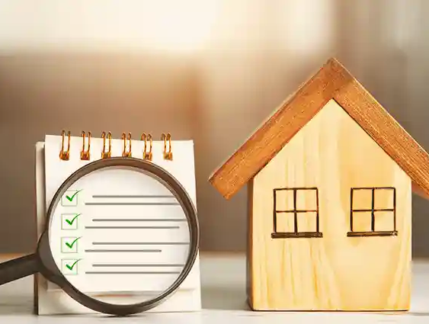
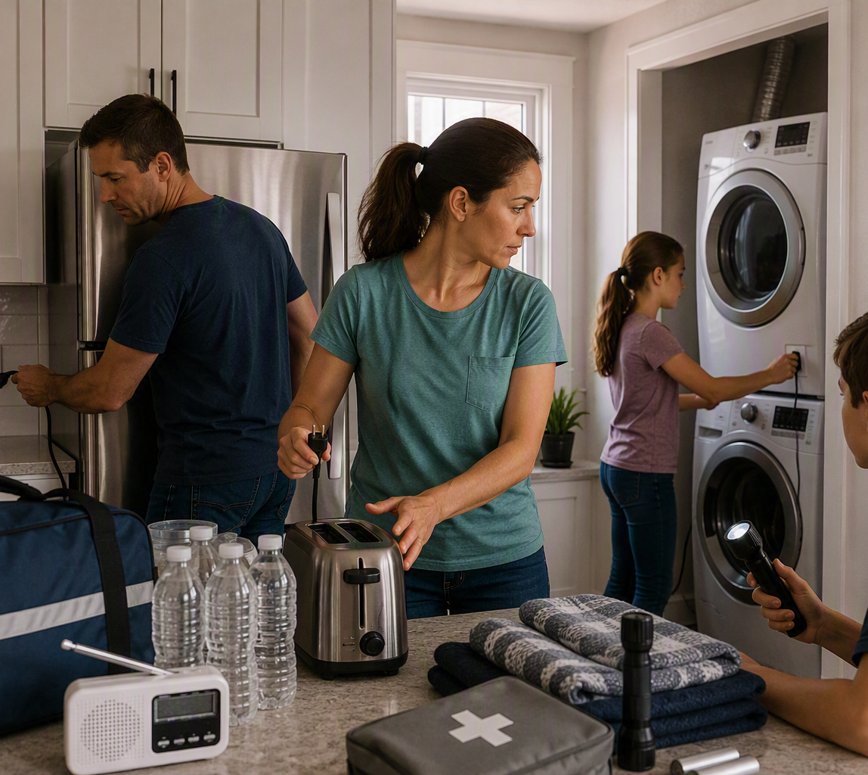
Safety Moment
SAFETY MOMENT
Home Appliance Safety
in an Emergency
Prevent hazards before they escalate. If conditions are unsafe, leave first and call 911.
1
Before: Reduce fire risk
Plug major appliances directly into wall outlets.
Do not overload outlets or power strips.
Replace damaged, cracked or loose cords.
2
During: Act only if safe
Turn off burners and heat-producing appliances.
Unplug small appliances after use or during outages.
Evacuate for smoke, sparks, burning odor or fire.
Quick check before every emergency type:
3
After: Inspect before reuse
Can I shut it off?
Can I unplug it safely?
Is my emergency kit accessible?
Keep appliances away from water and damaged cords.
Do not use water-exposed appliances until inspected.
Restock flashlight, batteries and first aid kit.
Home appliance safety | Emergency preparedness
Takeaway: Know what to use, what to shut off, and when to get out.
Notes:
Presenter Script (about 60 seconds):
"Before we get started, let's take a moment for safety. Today's topic is home appliance safety in an emergency.
Before an emergency, reduce fire risk: plug major appliances directly into wall outlets, don't overload outlets or power strips, and replace any cord that's cracked, damaged or loose.
During an emergency, act only if it's safe: turn off burners and heat-producing appliances, and unplug small appliances after use or during an outage. If you see smoke or sparks, or smell something burning, don't troubleshoot it - leave first and call 911.
After the event, inspect before reuse: keep appliances away from water, don't use anything water-exposed until it's been inspected, and restock your flashlight, batteries and first aid kit.
The quick check is three questions: Can I shut it off? Can I unplug it safely? Is my emergency kit accessible?
The takeaway - know what to use, what to shut off, and when to get out. Thanks, everyone. Let's move on."
Safety Moment Speaker Notes:
- Emphasize that the goal is to prevent small hazards from becoming fire, electrical or evacuation risks.
- Reinforce the three simple decisions: use appliances safely before an event, act only when it is safe during an event, and inspect before reuse after an event.
- If there is smoke, fire, sparking, burning odor or immediate danger, leave first and call 911.
[Sources]
- U.S. Fire Administration, "Appliance and Electrical Fire Safety," used for appliance/electrical safety messages including plugging major appliances directly into wall outlets, avoiding overloaded outlets/power strips, unplugging small appliances when not in use, and replacing damaged cords. Reference: turn1search1.
- Ready.gov, "Home Safety," used for home preparedness, first aid kit, and emergency readiness framing. Reference: turn1search22.
- Internal SCE result "Emergency Preparedness & Safety Moments" used for the safety moment format and emergency preparedness framing. Reference: turn1search38.
- Visuals on this slide were generated with Microsoft Copilot.

Slide 5
Antitrust Statement
Pursuant to the California Public Utilities Commission (CPUC) Decisions D.16-08-019 and D.18-05-041, SCE is hosting a meeting for the purpose of complying with the Energy Division’s process checklist for closing a program in compliance with D.21-05-031 and is intended to take place in full compliance with all applicable provisions of the CPUC orders, rules and regulations and all applicable provisions of state and federal antitrust laws. These discussions will be conducted in full conformance with the Antitrust Guidelines. Among other things, the antitrust laws forbid any agreement between or among competitors regarding prices, availability of service, terms of sale, division or markets, allocation of customers or any other activity that unreasonably restrains competition, including components of pricing such as vendor or contractor costs. It is the responsibility of every participant at this meeting to carry out this commitment.

Slide 6
Program Description: SCE_SMB_Equity_001 Simplified Savings

Slide 7
Program Description
The Simplified Savings Program was developed to address participation gaps among small and medium business (SMB) customers located in Disadvantaged (DACs) and Underserved Communities, including Hard-to-Reach (HTR) markets.
Traditional energy efficiency programs had been challenging for equity customers to access due to lack of awareness, limited eligibility requirements, language barriers, and program offerings that did not align with the operational realities of smaller businesses.
Simplified Savings was a local downstream EE equity program focused on delivering bill savings to SCE’s small and medium business customers, including commercial, industrial, agricultural, and public sector customers.
Program was delivered through a network of trade allies, community-based organizations, and local market partners that help identify and engage eligible customers. Participating customers receive support that includes awareness, bill analysis, facility energy assessments, and no-cost direct installation of eligible energy efficiency measures.

Slide 8
Program Timeline - Execution to Termination: Simplified Savings

Slide 9
Program Timeline - Execution to Termination
Key Milestones and Events | Activity Dates / Periods
Program Agreement Executed | March 2023
Initial Delivery Period Delayed – Project Pipeline and Measure Mix Challenges | 2023 – 2024
Amendment #1 Executed – Expected and Initial Delivery Dates Revised | August 2024
SCE and Resource Innovations Mutually Agree to Terminate Agreement, due to, among other things, measure mix challenges. | June 2026

Slide 10
Schedule of Milestones:
Simplified Savings

Slide 11
Schedule of Milestones
Milestones | Milestone Dates
Communicate with Program Implementer | June 14, 2026
Execute Termination Agreement(s) | July 26, 2026
Notify Service List and Stakeholders | August 07, 2026
Host Program Closure Webinar | September 02, 2026 (Today)
File Advice Letter for Program Closure | September 22, 2026
Receive CPUC Approval for Program Closure | Targeting for November 2026
Update Program Status for “SCE_SMB_Equity_001” to “Closed” on CEDARS website | December 2026
13

Slide 12
Questions, Answers, and Resources

Slide 13
Questions
QUESTIONS ABOUT THE WEBINAR OR PRESENTATION
Service List Participants
Call Toll-Free: 1-800-600-4723
Program Manager: Jared Rivas
Email: jared.rivas@sce.com
Monday-Friday, 8am-5pm PT
(11am to 8pm ET)
IMPORTANT RESOURCES - WEBINAR LINKS
SCE Related Websites
SCE's Energy Efficiency Home Page:
https://www.sce.com/about-us/environment/energy-conservation
SCE Advice Letters:
https://www.sce.com/regulatory/advice-letters
EE Solicitations Home Page:
https://www.sce.com/partners/Energy-Efficiency-Solicitations

