Slide 1
2019 ABAL Overview
3C-REN
Tri-County Regional Energy Network (3C-REN)
Counties of Ventura, Santa Barbara, and San Luis Obispo

Slide 2
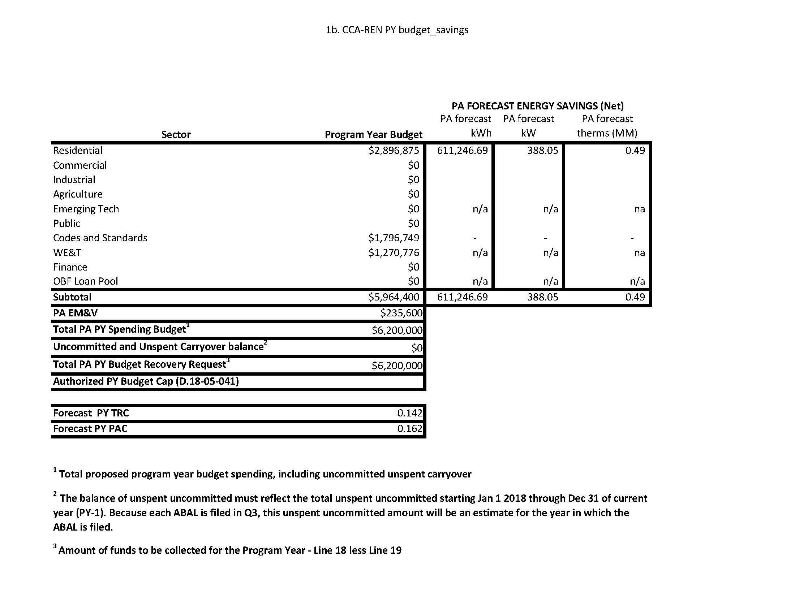
2019 Budget
3C-REN

Slide 3
Cost-Effectiveness Forecast
3C-REN
Forecast Portfolio PY TRC | 0.142
Forecast Portfolio PY PAC | 0.162

Slide 4
Proposed Portfolio
3C-REN
Workforce, Education, & Training (WE&T)
  The 3C-REN proposes a cross-cutting WE&T program designed to fill gaps in current investor-owned utilities (IOU) offerings for the 3C-REN territory, as the region is far removed from IOU training & resource hubs
  Target local building professionals and hard-to-reach (HTR) workers and those in identified disadvantaged communities (DACs)
  Offer career pathways and enrichment, and in-depth technical code compliance, home performance, overall training access and mentorship

Slide 5
Proposed Portfolio
3C-REN
Codes & Standards (C&S)
  Target all construction design-side stakeholders and local building professionals
  Offer local, person-to-person training and mentorship, in-person counter and on-call expert assistance for plan review and field compliance
  3C-REN will leverage existing IOU curriculum and training and will have regular coordination meetings with IOU partners

Slide 6
Proposed Portfolio
3C-REN
Residential Direct Install (R-DI)
  Target residential customers in the HTR and DACs in the Tri-Counties Region and meet needs not currently be served by ESA, LIHEAP, or MIDI in the Tri-County Region
  3C-REN Region is served by three different IOUs – PG&E to the north, SCE to south, SCG in all three counties – with overlapping electrical services in Santa Barbara and Ventura
  Offer behavior change education, installation of simple energy saving measures, deliver pathway to deeper savings through co-pay options for more substantial upgrades

Slide 7
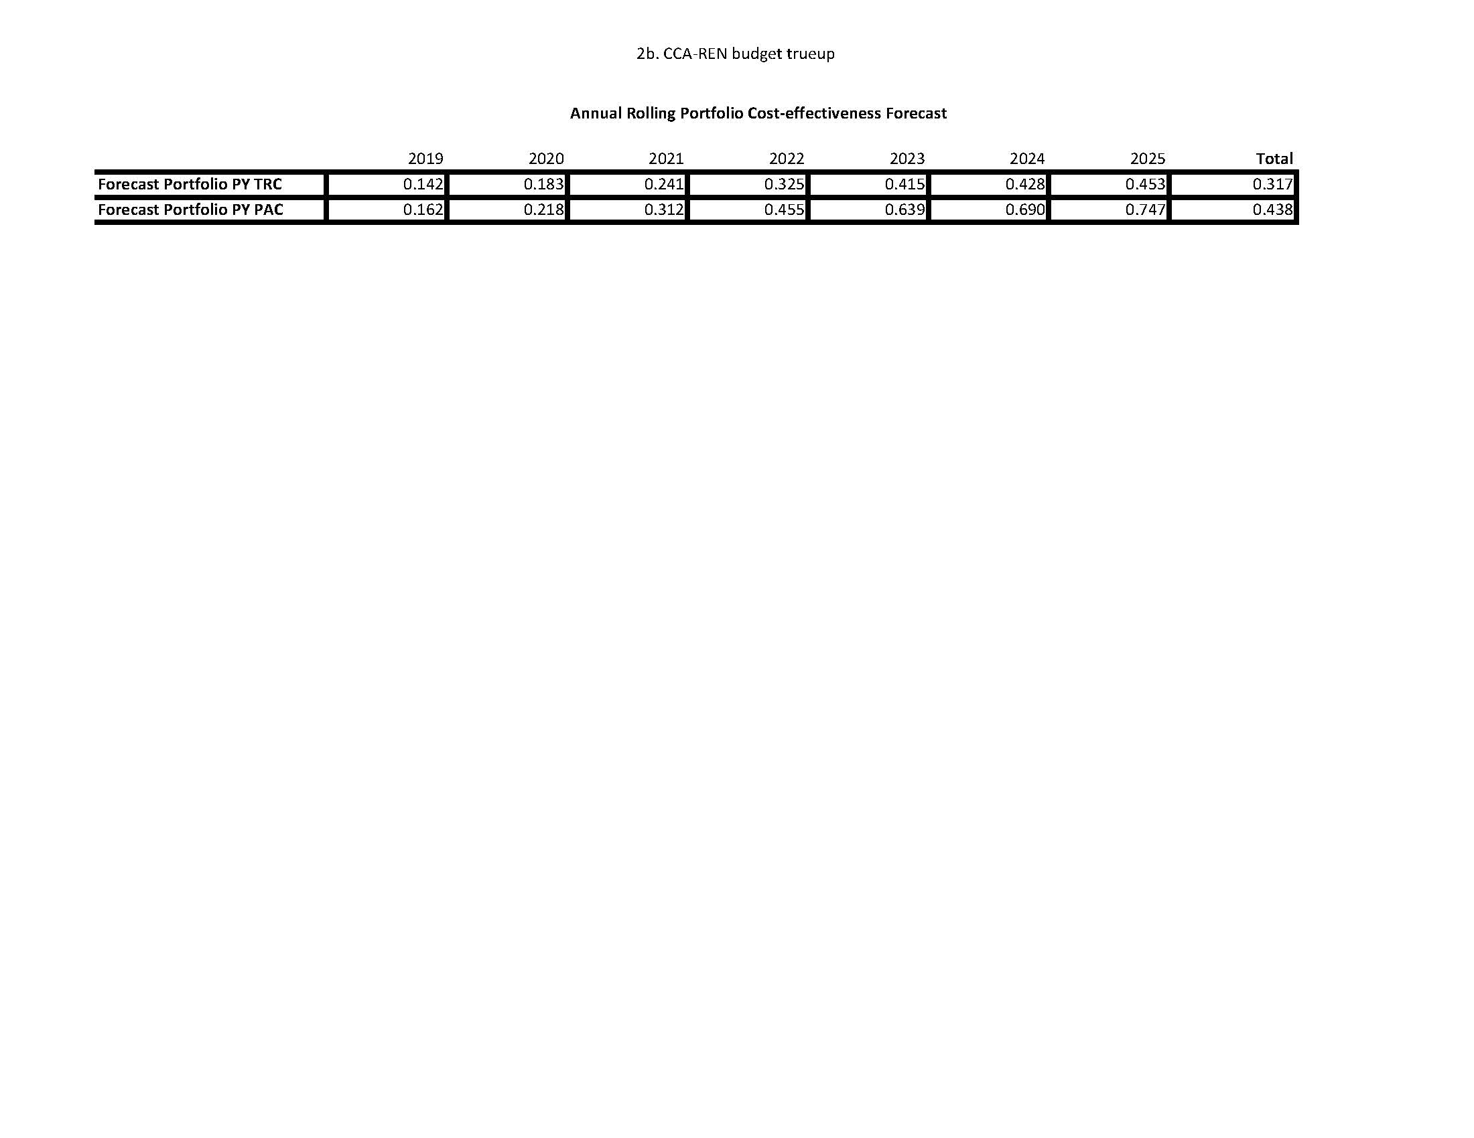
Proposed Next Steps to Address Cost-effectiveness Challenges
3C-REN
The TRC forecast is < 1.25, and the challenges with the portfolio forecast relates to the allowed REN scope which targets hard-to-reach customers and has a limited portfolio.
TRC forecast shows that the REN will increase cost-effectiveness over time.

