Slide 1


2020 Annual Budget Advice Letter
San Diego Gas & Electric Company (SDG&E)
© 2019 San Diego Gas & Electric Company. All copyright and trademark rights reserved.

Slide 2

2020 Budget & Cost-Effectiveness
SDG&E Forecast Net Energy Savings

Slide 3
2020 Cost-Effectiveness
SDG&E Portfolio Overview
Cost-Effectiveness Calculation | TRC | PAC
Without C&S | 1.26 | 1.54
With C&S | 1.29 | 2.86
Does not include market effects
Uses the proposed 2020 avoided costs and the updated CET
Uses workpapers that are approved by staff as of July 12, 2019, or workpapers that Staff has indicated will be approved by September 1, 2019
For third-party program forecasts pending from solicitations, SDG&E used the same forecasting methods used for custom projects in terms of measures and measure mix being “unknown” prior to a program year

Slide 4
Portfolio & Programs
SDG&E Proposed Changes
The updated 2020 and Beyond Goals and Potential Study provided relief through the reduction of the 2020 EE goals
SDG&E reduced its budget from $106 million in 2019 to approximately $88.4 million for 2020 to correspond with the reduction in its goals
SDG&E’s proposed portfolio responds to the significant reductions in savings while meeting the target TRC greater than 1.25 by reducing or eliminating many non-cost-effective measures – for example, SDG&E’s portfolio is less reliant on lighting savings consistent with the draft Potential & Goals Study that lighting is no longer a major source of cost effective savings.
SDG&E will eliminate several non-cost effective programs or programs that have not had significant program participation – for example, SDG&E has eliminated its current HVAC programs with the anticipation that new third party programs will offer more cost-effective programs

Slide 5
Third-Party Solicitations
SDG&E 2020 Transition Plan
SDG&E expects that the following sectors will have third party program implementers in 2020
  Small Commercial Sector
  Large Commercial Sector
  Multi-Family Sector
Contract execution expected in Q1 2020 with Advice Letter approval anticipated in 60-90 days
Development and filing of program Implementation Plans within 60-90 days of Advice Letter approval
SDG&E will ramp down its corresponding programs as third party programs begin ramp up and implementation

Slide 6
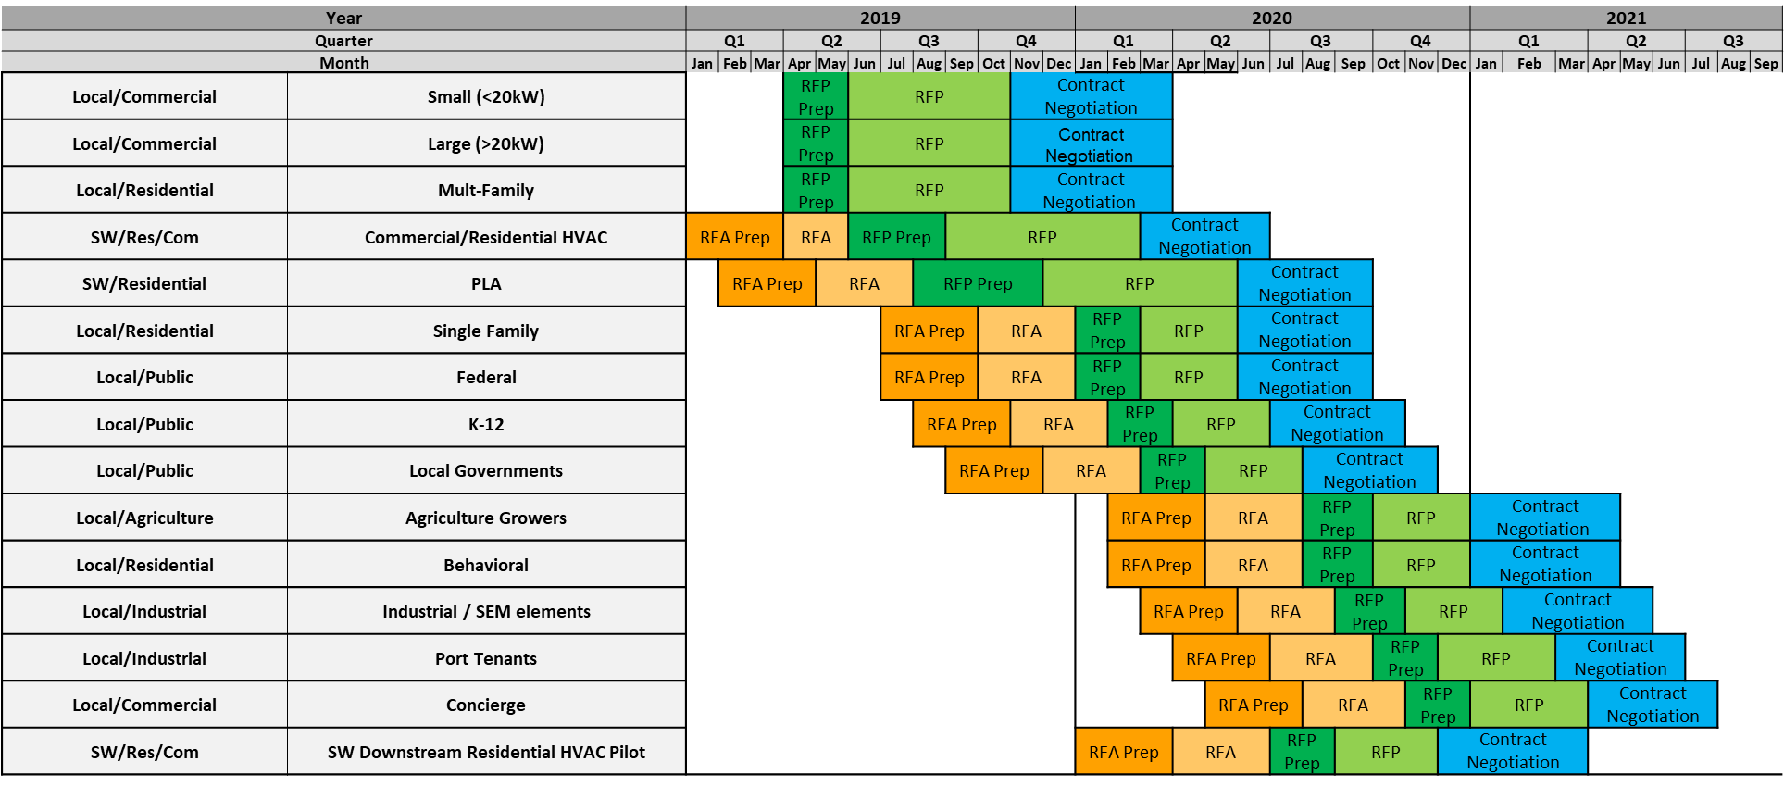
Third-Party Solicitations
SDG&E Schedule
60% of energy efficiency programs must be
third-party by 2022

Slide 7
Statewide Programs—SDG&E-Led Programs
Proposed Funding and Budgets
Actual Launch date assumes a 60 - 90 day approval for the Advice Letter and another 60 days to develop and upload the Implementation Plan with an additional 30 days of Program Ramp Up
Program spending does not begin until AL is approved

Slide 8
Questions?
Thank you for your time.

