Slide 1
Energy Division Staff Updates
CAEECC Q3 Meeting, 9/23/26
Pamela Rittelmeyer and Amy Reardon

Slide 2
Energy Division Energy Efficiency Activity
Proceeding Activity
  SDG&E withdrawal from EE Proposed Decision released 9/2
    Earliest date for voting on a decision is 10/8
  Q1/Q2 EE claims submitted on 9/15
Other EE/ DER work
Avoided Cost Calculator Decision approved 9/3. Draft Resolution might be voted on as early as 10/8.
  CET Updates expected within 60 days of Decision approval
Upcoming
  Database for Energy-Efficient Resources (DEER) Resolution
  ETA CCA budget ruling and staff proposal received comments. Proposed decision in the future.

Slide 3
Business Plan Application Updates
Supplemental Testimony – All Due September 30, 2026
CEDARS Forecast Corrections
BP Application Corrections
Question about future potential CARB rules in BP Application
Question for IOUs about their Third-Party solicitation schedules
Opening Testimony – Due Oct 30, 2026
PAs and Parties respond to Applications and Ruling Questions
Rebuttal Testimony – Due December 3, 2026
Proposed Decision – Anticipated Q2 2027

Slide 4
Evaluation, Measurement, & Verification Response-to-Recommendations (RTRs)
Studies with all or most RTRs on CPUC Public Document Area (PDA):
  Emerging Technology Programs (ETP) Pulse Check
  Code Compliance Improvement
  2024 Custom, Industrial, Agricultural, & Commercial
  Site-level NMEC PY2024
  Non-Residential Population-level NMEC PY2022-2024
Studies that will have RTRs on PDA late Sept - early Oct:
  Strategic Energy Management (SEM) Evaluation PY2023-2024

Slide 5
CEDARS updates: Participants and Bill Impacts;
Metrics & Indicators
Participant Counts (Participant_Type)
  Historically, number of participants was not identified;
  Simple count of claims is not an adequate proxy;
  Evaluators use various methods.
  Needed to calculate Metrics and Indicators, as well as important policy requests, often seek information at a participant level.
  The Claims Specification includes NEW TABLE called Participant_Type* to identify how many actual participants are associated with a Claim.
Data outputs will show counts by participant type at the program level. Example on next slide.
EE Billing Impacts
EE can cause reductions for participants' gas and electric bills, while fuel substitution may cause increases in participants' electric bills.
The CET calculates these reductions based on average rates for each IOU territory (updated biennially, during ACC update years.)
We disaggregate to show increases and reductions by fuel type as well as the total net impact.

Slide 6
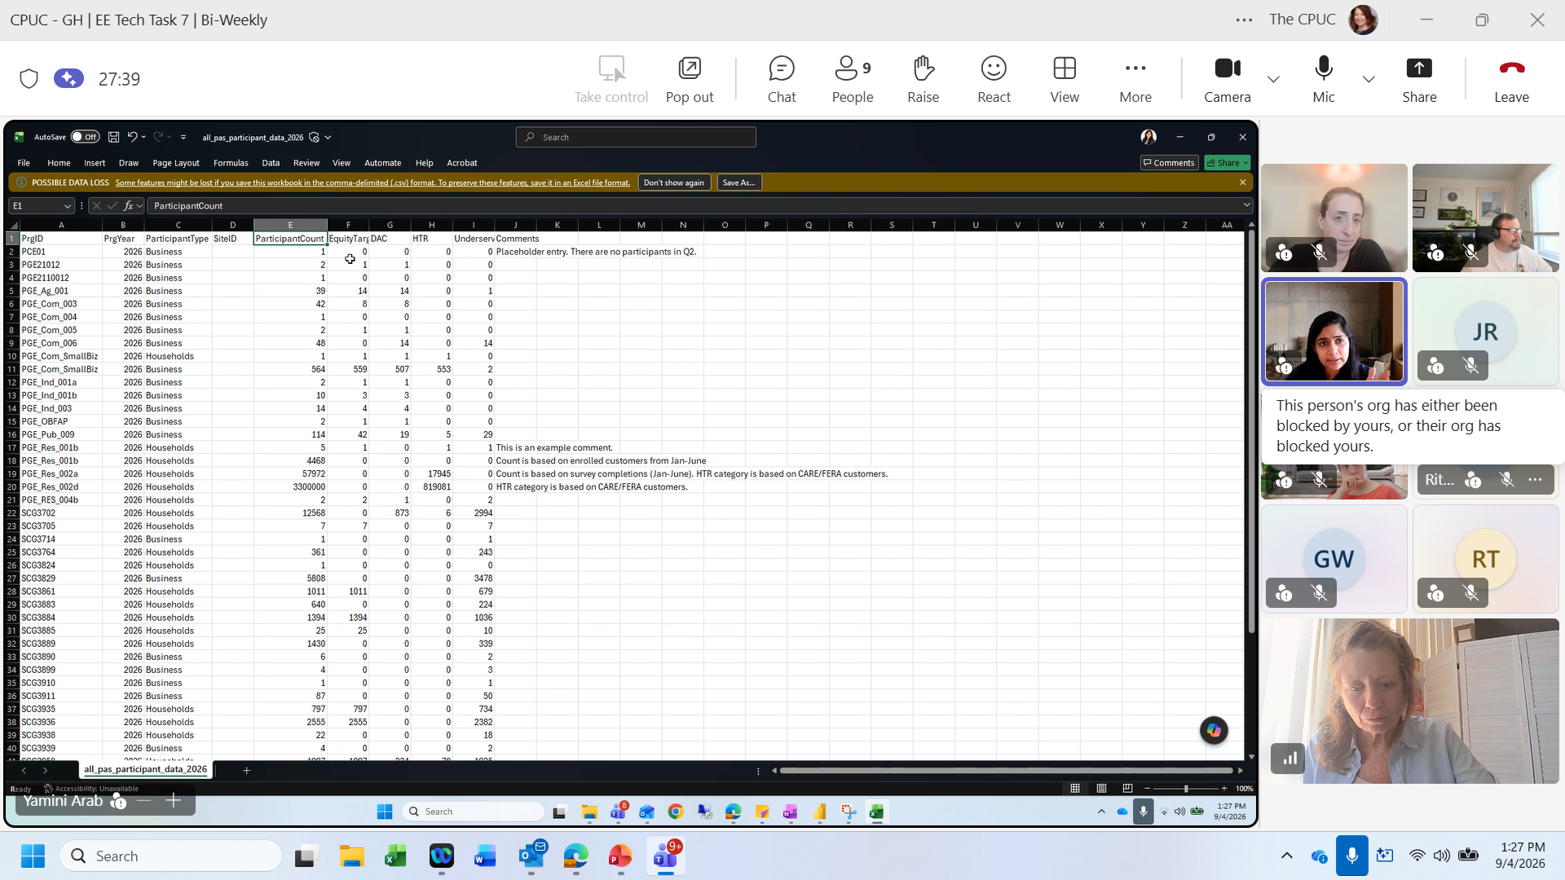
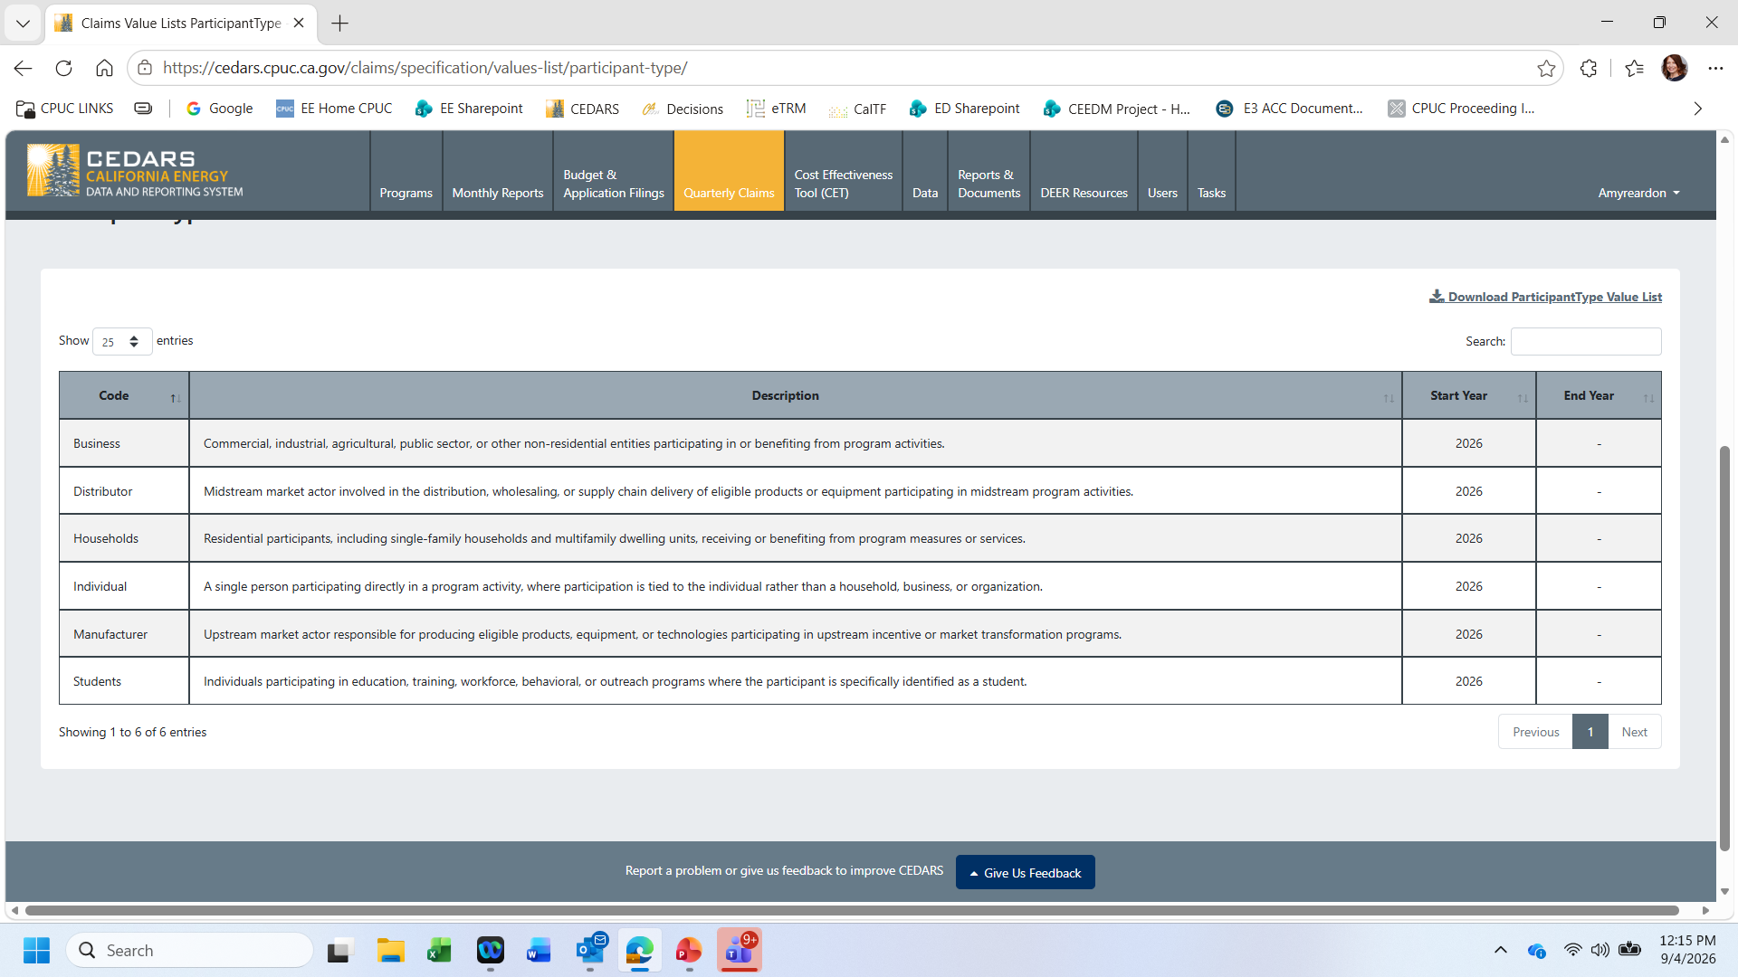
Process for adding new Participant Types:
Submit Featurebase ticket via CEDARS “Give Us Feedback” tab, bottom of each webpage.
Proposal will be discussed by PCG members, developers, and ED staff at subsequent Dev Demo meeting.
Update Program Definition Table, programs.

Slide 7
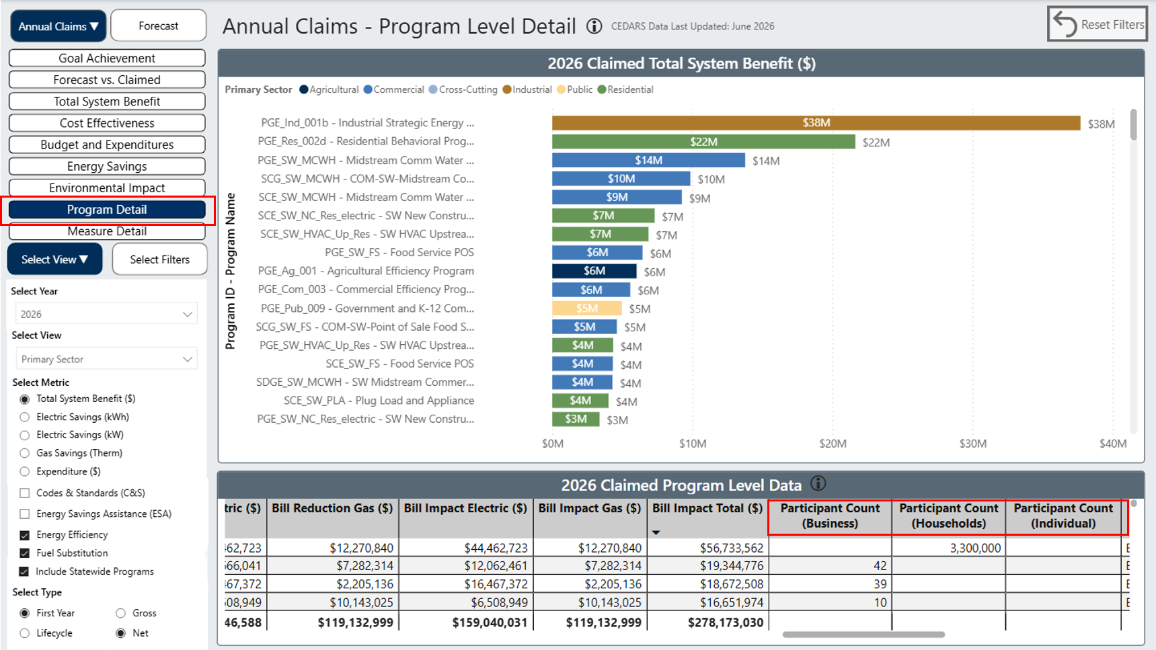
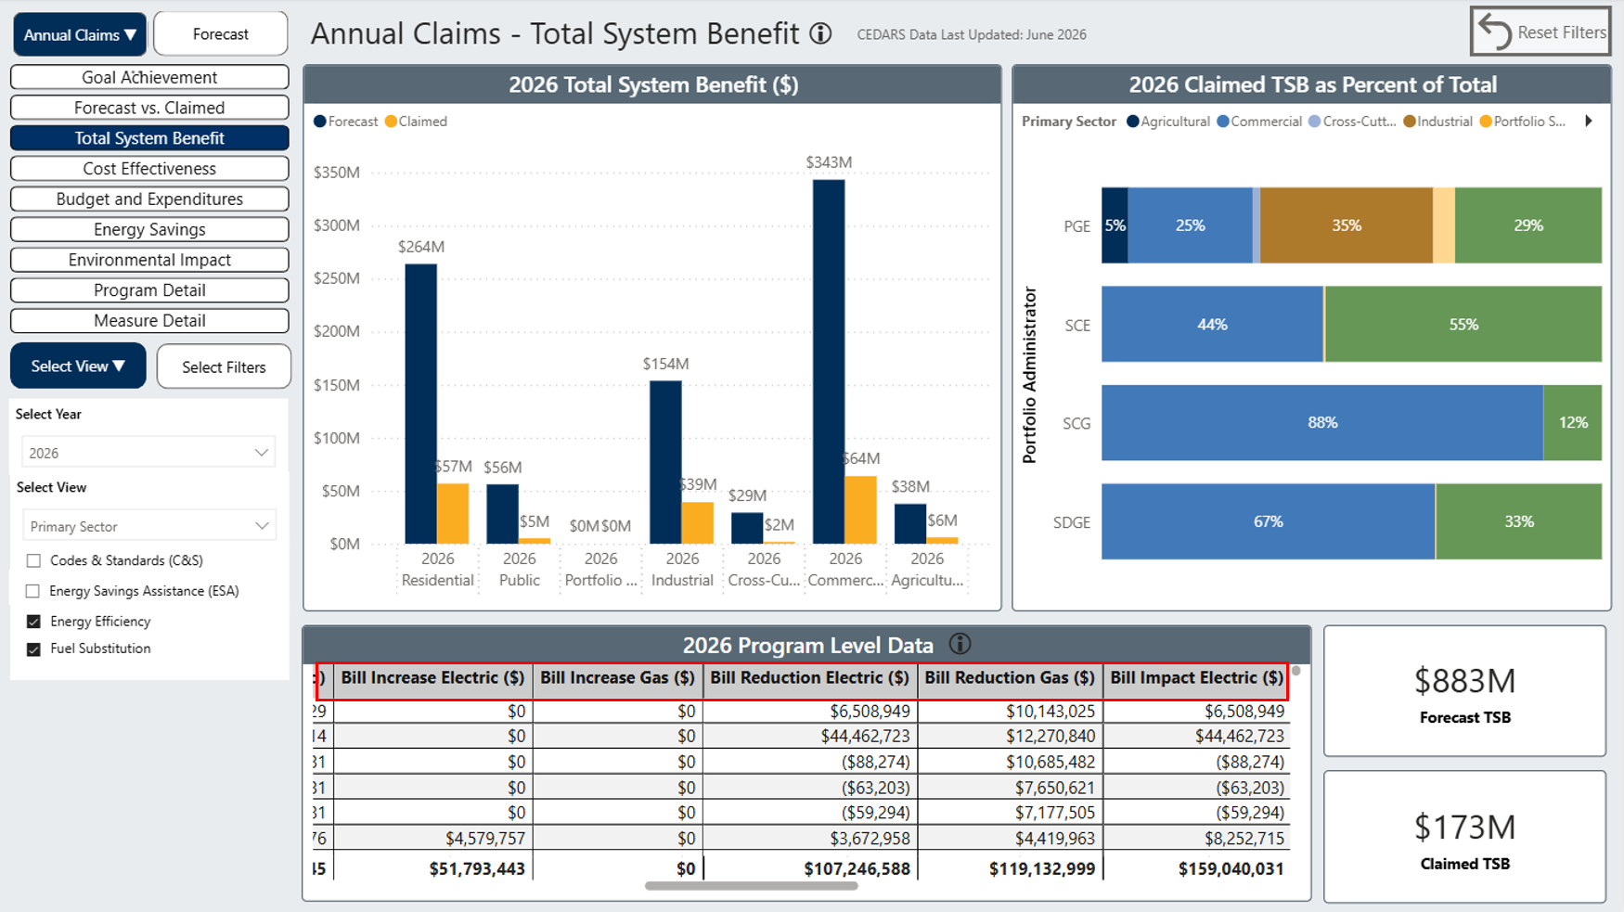
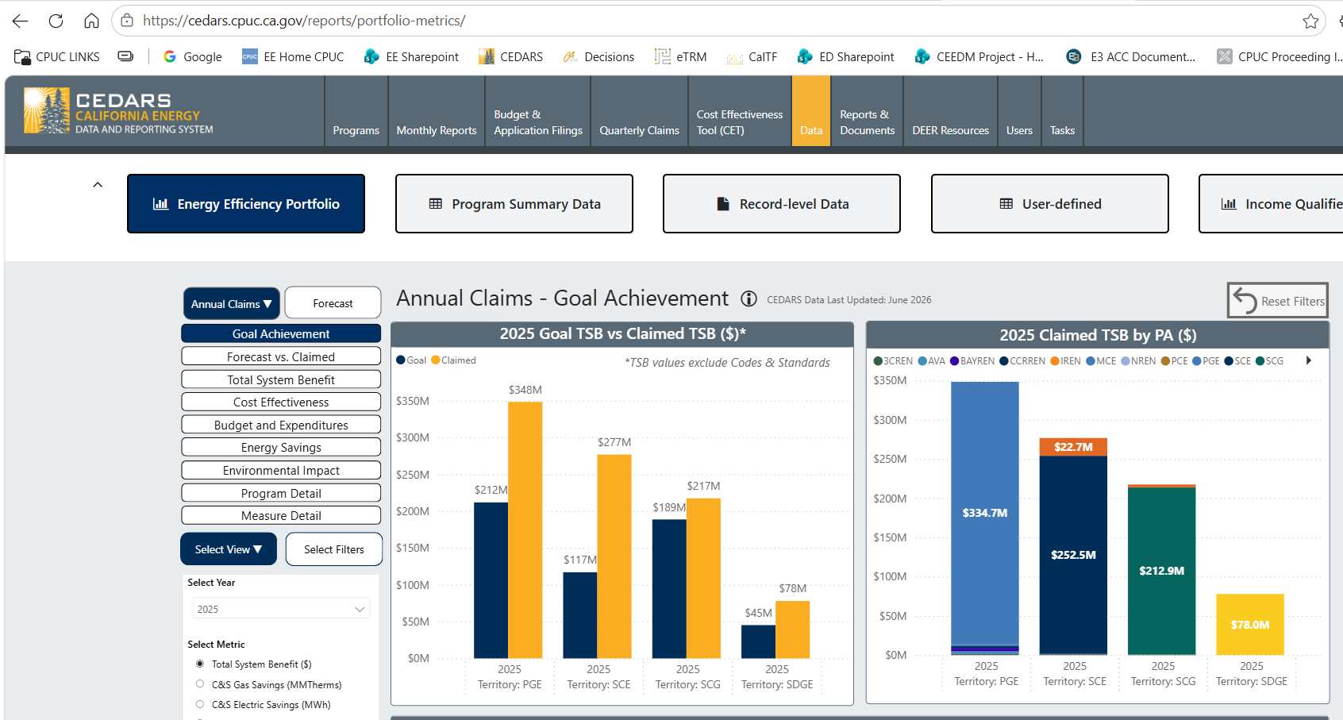



Use the “Data” tab on CEDARS to find Bill Impact and Participant data https://cedars.cpuc.ca.gov/reports/portfolio-metrics

Slide 8
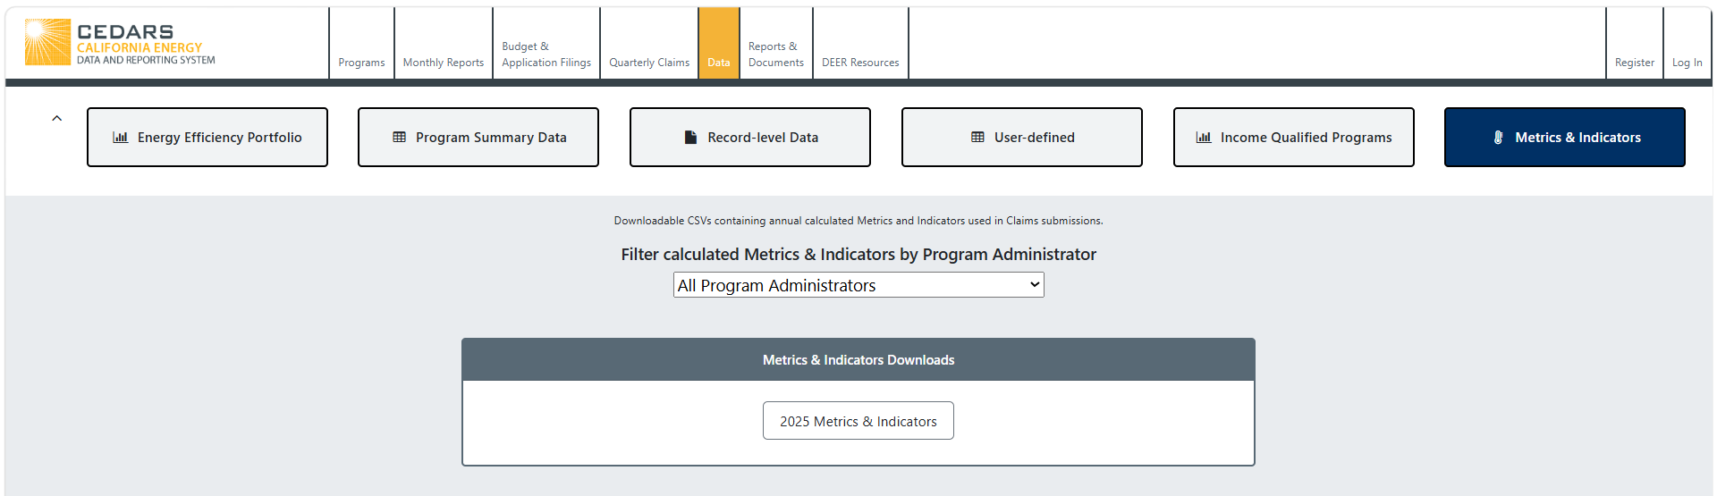

Metrics and Indicators
Still in draft form (as of 9/15/26) but finalizing soon

Slide 9

Questions?

