Slide 1
Building Capacity in the EE Industry
SoCalREN Workforce and Education Training Program
CAEECC Coordinating Committee Meeting #25
May 14, 2020

Slide 2

SoCalREN is focused on identifying gaps in the market by utilizing a regional approach and delivery
of valuable services throughout
the entire SoCalREN territory
Notes:
SoCalREN is ensuring regional reach and delivery of valuable services throughout the entire SoCalREN territory
Focusing on DACs and HTR communities, we’ve started implementing specific strategies to reach all the communities throughout our territory, including the 700+ public agencies we serve
And we can use our Public Agency Programs as a funnel to promote our other SoCalREN programs, since public agencies are in a unique position to communicate to their constituents about the various opportunities and resources available

Slide 3
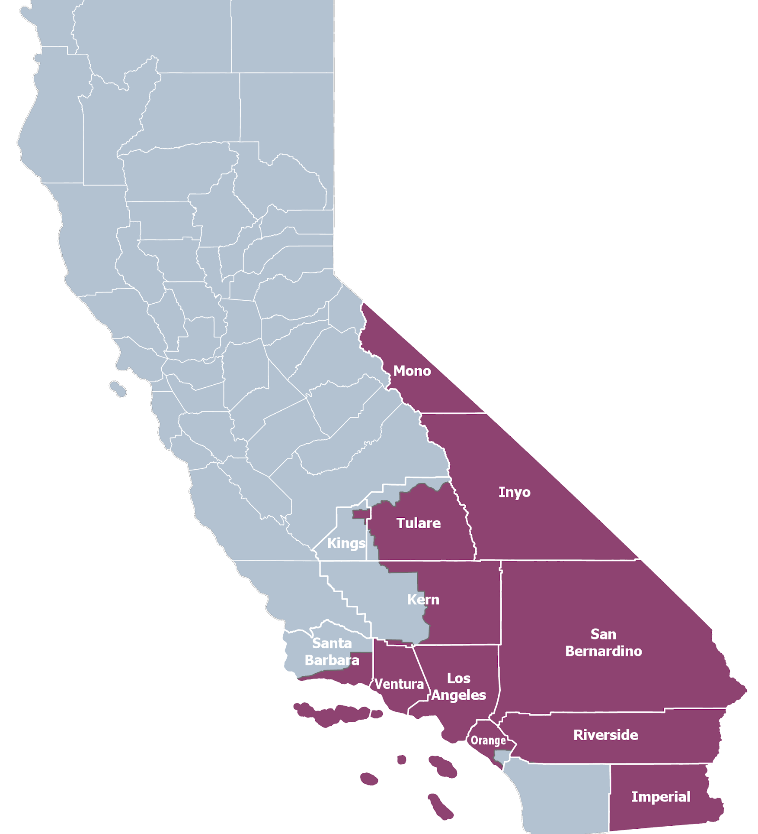





Who’s in the Network?
SoCalREN Service Territory
20 million people
12 counties
Over 50,000 sq mi
Over 700 public agencies
=
93 Cities
19 School Districts
144
Agency Enrollments
5 Counties
22 Water Agencies
5 Special Districts

Slide 4
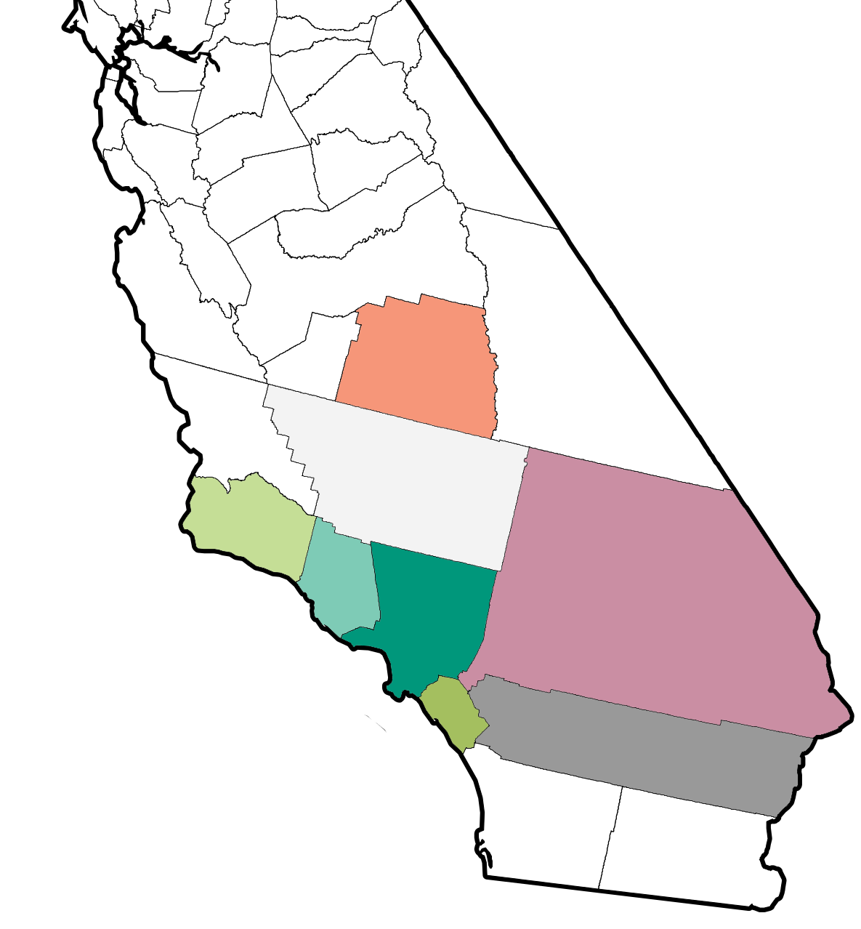
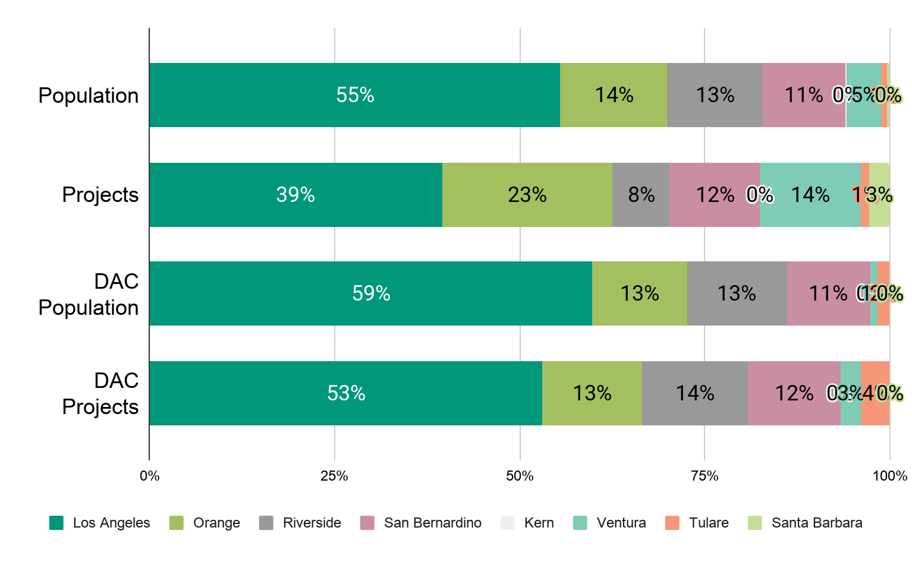
Regional Public Sector Impacts
500+ completed projects
Mono
<1% population
0% projects
Tulare
1% population
1% projects
Inyo
<1% population
0% projects
Santa Barbara
<1% population
2% projects
Kern
<1% population
0% projects
Ventura
5% population
14% projects
San Bernardino
11% population
12% projects
Los Angeles
55% population
39% projects
Orange
14% population
23% projects
Riverside
13% population
8% projects
Imperial
<1% population
0% projects
Notes:
As you can see here, our distribution of public sector energy efficiency retrofit projects has been mostly proportional to population size
We strive to distribute services to the regions that need it most and look to continue to emphasize underserved and disadvantaged communities
To identify regional needs we started working with additional trusted voices within communities to customize services and support filling of additional gaps

Slide 5



In 2019, a gap presented itself within the SoCalREN Region
Starting in 2019, many LGPs were diminished and thus SoCalREN began its regional partnership strategy (many “LGP Implementers”)
The Goal of Regional Partners
To increase impacts through enrollments, enhanced engagement, and ultimately increase energy projects and their associated savings.
Enrollments | Engagement | Energy Savings!
Through Peer to Peer sharing comes innovation and new ideas.
Notes:
SoCalREN working with regional groups (many “LGP Implementers”) to support increased enrollment, peer-to-peer sharing and regional tailoring to maximize projects and energy savings
Value of Regional Partners
Local & regional knowledge
Existing relationships with agencies
Access to key decision makers

Slide 6

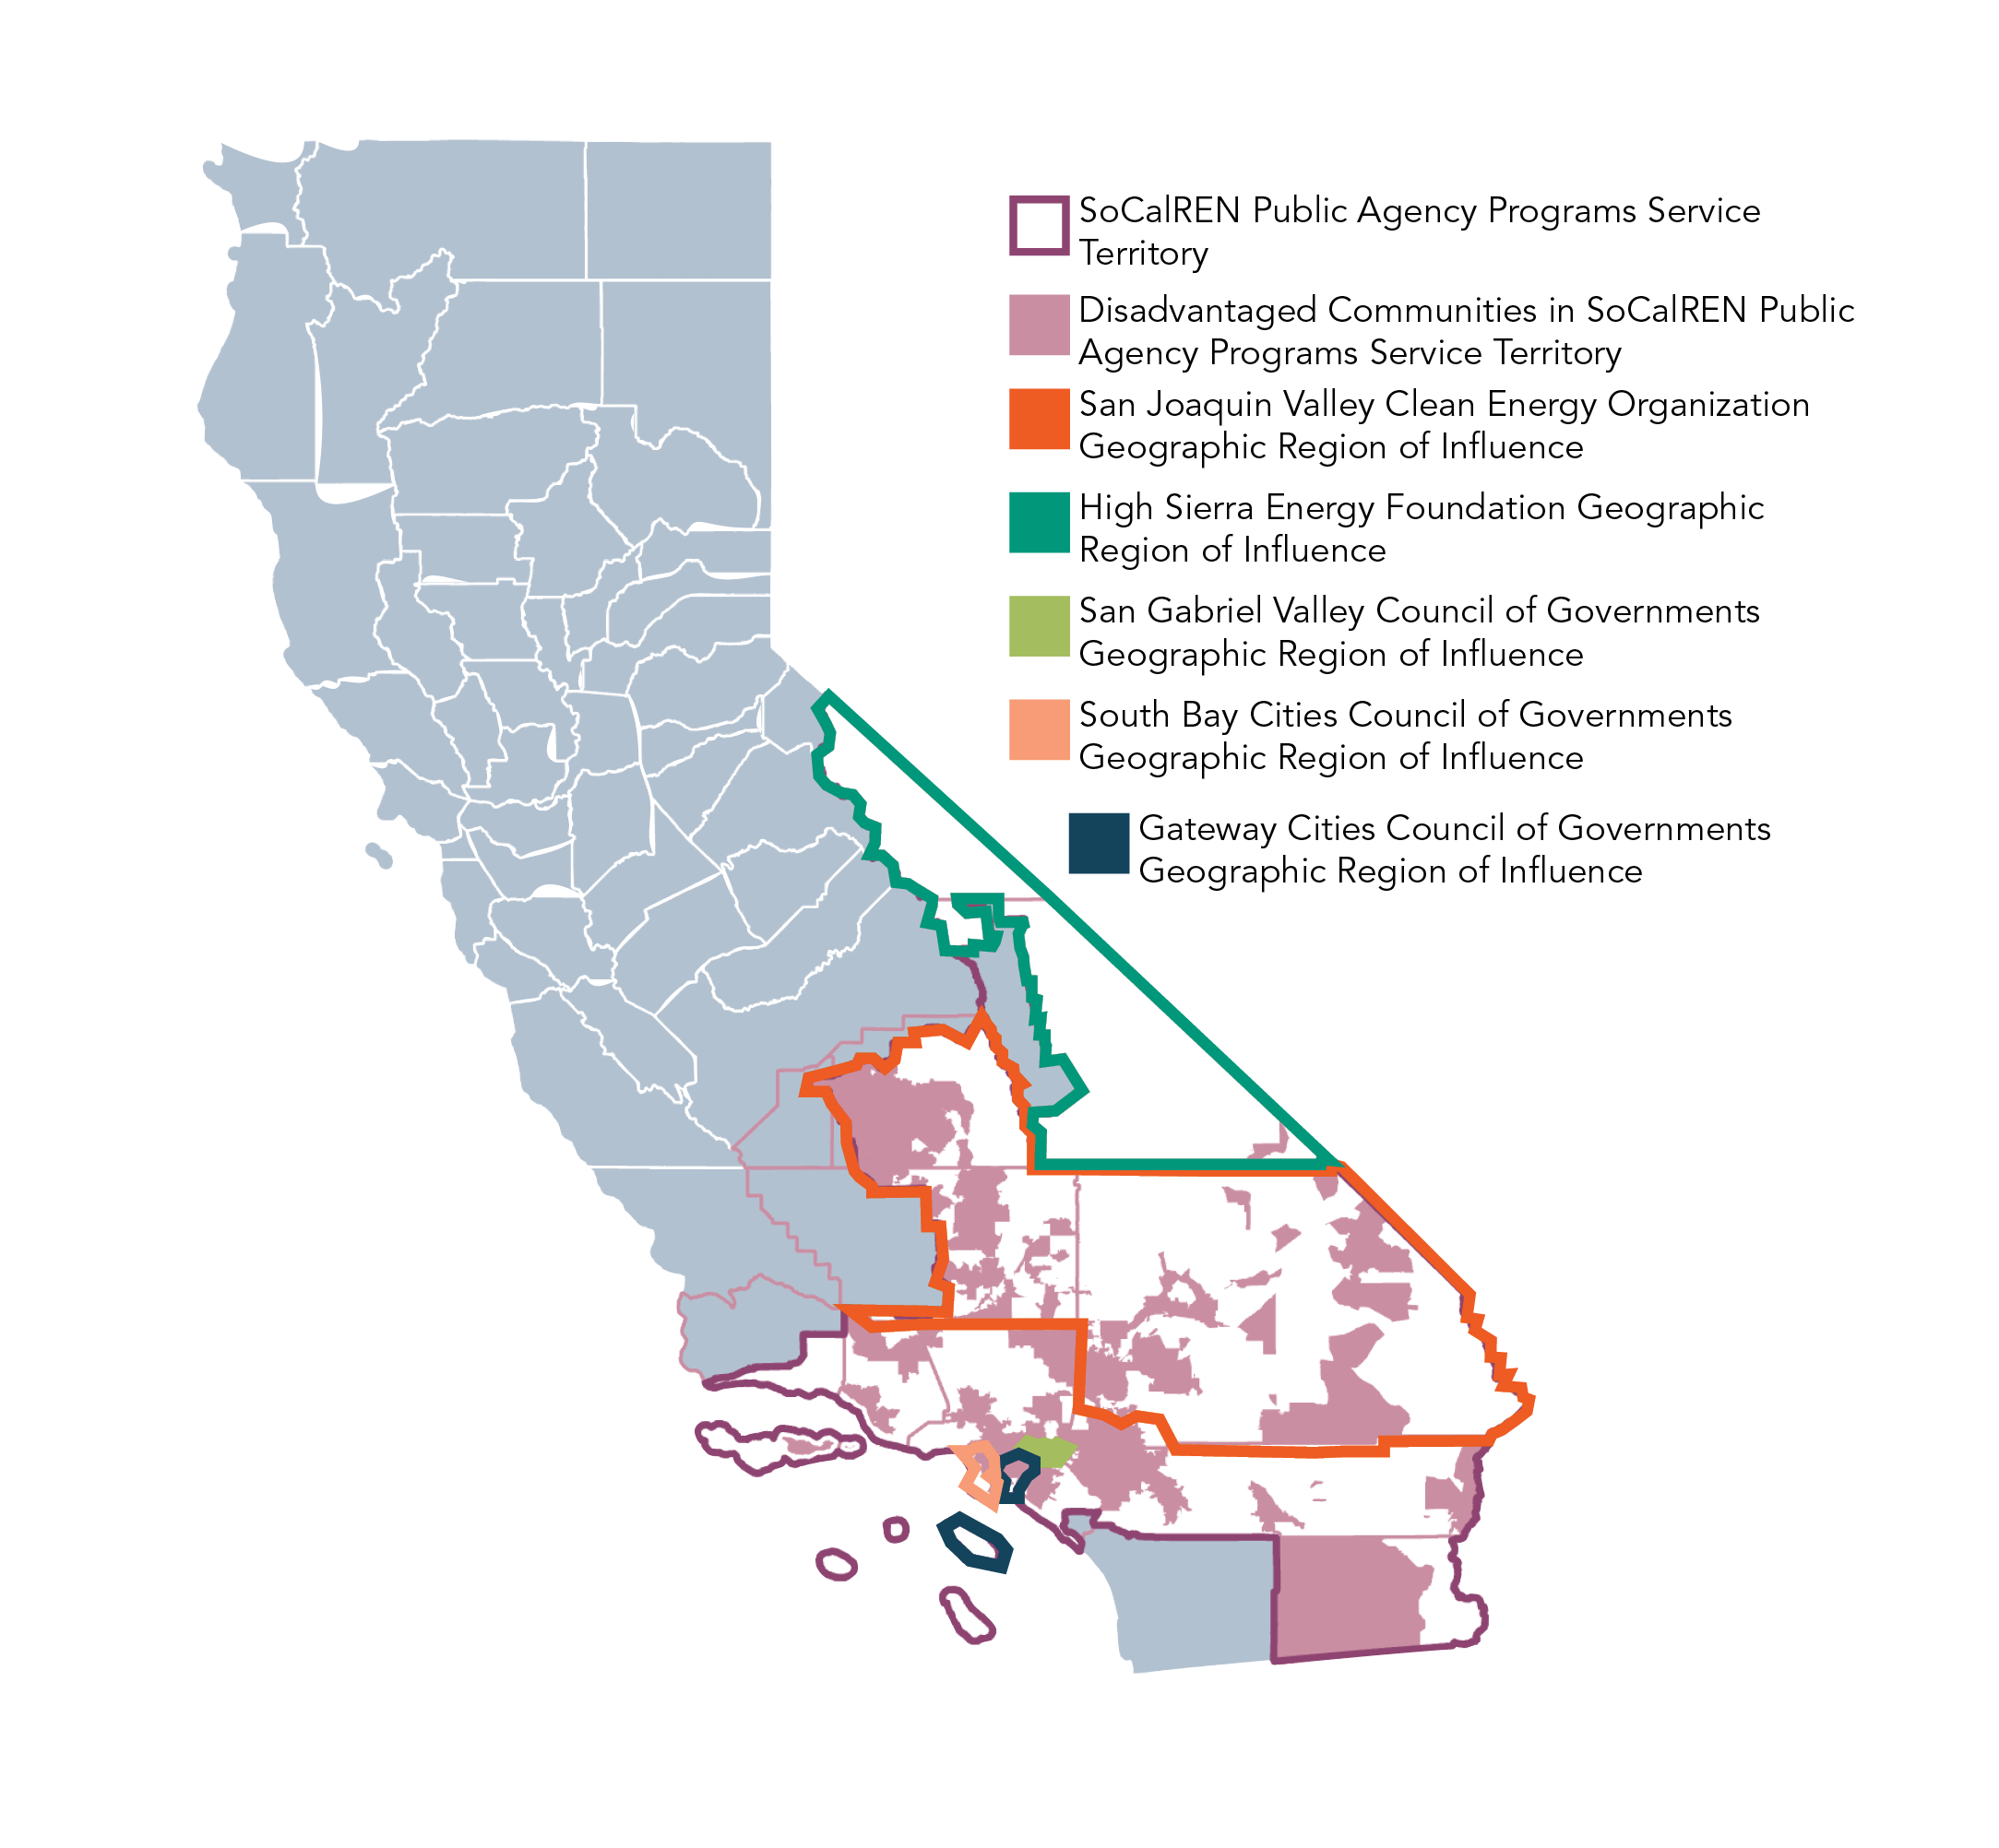




2020 Regional Partners
Notes:
Local Strategies: Work with Regional Partners to identify local needs and opportunities in 2020 and beyond for potential new SoCalREN programs, or modifications to existing programs.

Slide 7
Green Path Career Sub-Program
Through peer to peer sharing a sub-program to SoCalREN’s WE&T program was developed.

Slide 8
SoCalREN “Green Path Career” Disadvantaged Workforce Program
Objective
  The Green Pathway Career (GPC) program’s overarching objective is to help transition age youth (TAY) ingress emerging, thriving, and rewarding careers of the sustainable economy, by teaching them skills required in the high-growth energy efficiency industry.
  This goal will be achieved through careful advance planning, the involvement of multiple stakeholders, and a process that ensures accountability, so that societal, community, program, practitioners, and organizational influences cannot affect the quality of the program implementation.
Market Segment:
  Classified homeless “at-risk”
  foster youth
  Ages 18-24
"Green jobs present tremendous opportunities for people who have the core skills and competencies needed in such well-paying and rapidly growing industries as energy efficiency (...)"
- Hilda Solis

Slide 9
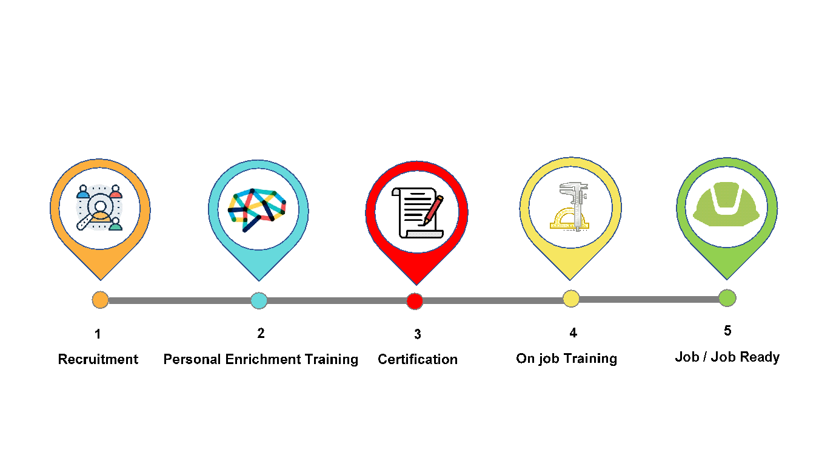
SoCalREN “Green Path Career” Program Model

Slide 10





SoCalREN “Green Path Career” Program Model
Recruitment:
Recruitment of Transition Age Youth (TAY) in Homelessness or at risk of homelessness would be lead by Regional Workforce Development Community Service organizations, with the support of SoCalREN’s Regional partner SGVCOG, and its partner Hathaway Sycamore (TAY organization).
Personal Enrichment Training:
Personal enrichment training would be offered in preparation of the participant transitioning into the workforce, this will include financial literacy, work ethics, life skills, career exploration and goal setting.
Certification:
Two pathways of training would be offered to participants: 1) Initial BPI Building Analyst Certifications Training, where participants would be prepared to perform residential energy audits on single family units; and 2) MF Energy Audit Training, where participants would receive an industry-recognized credential to work on multifamily units. Providing an industry-recognized certification and credential will help TAY progress into successful careers in the EE workforce
On Job Training:
The program would establish an employee referral program to help GPC participants obtain work experience. GPC participants would be connected to EE contractors participating in SoCalREN’s EE programs. To incentivize EE contractors to hire GPC participants, the first 120 hours of employment would be funded through WDACs.
    Job/ Job Ready:
Participants would be offered support to enter the workforce (hand-holding), including: career coaching and planning, individualized career plan, labor market information, resume/cover letter and interview training etc.

Slide 11
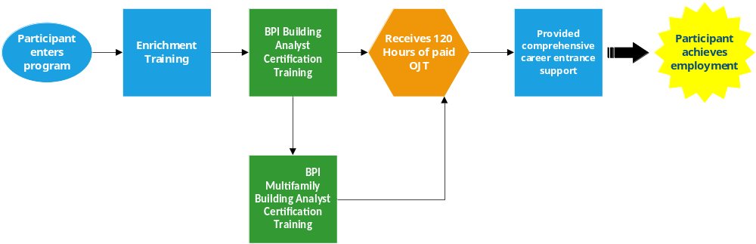
SoCalREN “Green Path Career” Pathways
Phase 1
  BPI Building Analyst Certification Training
    Includes Building Science Principles Certificate
Phase 2
  BPI Multifamily Building Analyst Certification Training

Slide 12
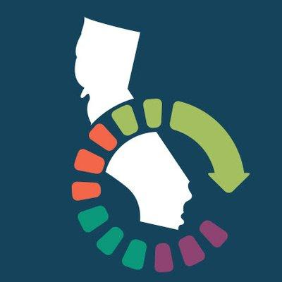


SoCalREN “Green Path Career” Program Partners
SoCalREN
The County of Los Angeles administers the Southern California Regional Energy Network (SoCalREN) to bring together a wide variety of services with the common goal of achieving unprecedented levels of energy savings throughout Southern California. The SoCalREN Workforce Development Program provides training, tools, and opportunities for minority participants in disadvantaged communities, to pursue careers in energy efficiency.
The SoCalREN would provide administrative, marketing, education and outreach (ME&O) resources, in addition to inspection training for those individuals hired to work on the Multifamily Residential Program projects.
SGVCOG
The SGVCOG represents 30 cities, 3 Los Angeles County Supervisorial Districts, and the 3 municipal water districts located in the San Gabriel Valley. It leads numerous initiatives to combat homelessness within the San Gabriel Valley region. Funding has been earmarked for programs combating homelessness, which would be allocated to fund part of the GPC program, focusing on providing training and certification.
WDACS
The Workforce Development, Aging and Community Services (WDACS) programs, offered by the Los Angeles County, connects individuals to careers, and employers to a skilled workforce, and improve human relations in our diverse County.
WDACS would lead the recruitment, and personal enrichment training efforts of the proposed program; furthermore, it would provide funding for the first 120 hours of employment for those who attain certification, as an incentive for contractors to hire the program participants.

Slide 13
Budget
As a NON-IOU PA, SoCalREN’s unique value is its ability to leverage external funds in the implementation of EE Programs
 | 2020 | 2021 | 2022 | Funding Source
Admin | 15,652 | 42,845 | 54,890 | SoCalREN
ME&O | 13,636 | 54,545 | 81,818 | SoCalREN
Direct Implementation | 86,909 | 150,000 | 150,000 | SoCalREN
Training Costs | 27,980 | 111,920 | 167,880 | WDACS/LG Homeless Earmarked Funds
OJT Costs | 18,000 | 72,000 | 108,000 | WDACS
Total Program Costs | $162,177 | $431,310 | $562,588
% of Budget Non-CPUC Funded | 28% | 43% | 49%

Slide 14
SoCalREN “Green Path Career” Program Timeline and Goals
Estimated Number of Participants
2020-2022 Goals* | 2020 | 2021 | 2022 | Total
Number of Trainees/Graduates | 10 | 40 | 60 | 110
*Goals are contingent to funding availability of additional funding could result in much higher estimates. Numbers display minimum ideal outcomes.
GPC program is scheduled to launch mid year (July 2020)

Slide 15
Questions?
Lujuana Medina
SoCalREN
Environmental Initiatives Manager
County of Los Angeles
213.864.5896
Lmedina@isd.lacounty.gov

