Slide 1
Add CP Cover Slide
MCE 2021 ABAL Overview
August 5, 2020
Please review the following tips!

Slide 2
2021 Budget & Cost-Effectiveness

Slide 3
Cost-Effectiveness Challenges
Shrinking pool of cost-effective savings.
Forecasting savings during COVID-19.
Difficult to track upcoming workpaper updates and impact on programs.
Year-to-year uncertainty in avoided cost impacts.
Transitioning portfolio from non-CE to CE.
TRC test related challenges:
Does not adequately capture all benefits of energy efficiency. For example, it doesn’t fully support or accurately evaluate fuel substitution measures.
Short-cost-effectiveness time frame.
Inequitable distribution of services and funding.

Slide 4
Cost-Effectiveness Challenges
Year-to-year changes to Avoided Cost updates. Illustrative example below shows MCE 2021 portfolio with avoided costs from 2018 – 2021 (no other changes).
The 2021 ACC was approved on June 25.

Slide 5
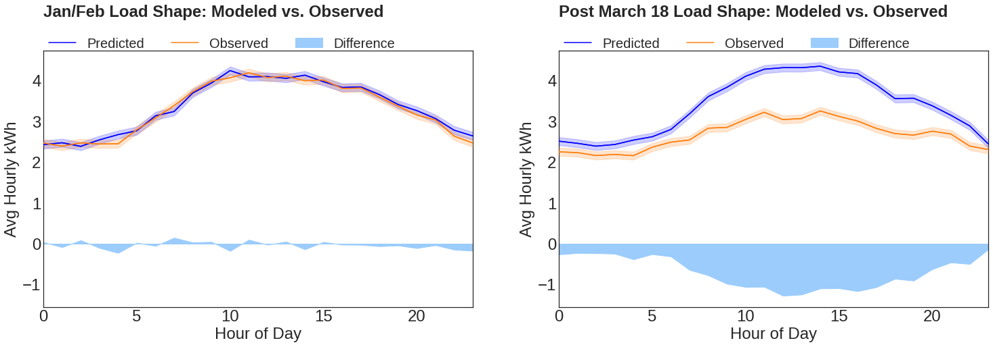
COVID-19 Impacts
Commercial sector energy usage is down. However, impacts vary to a great degree between business types.
Notes:
CalTRACK predicted (blue) and observed (orange) average daily load shapes for a sample of 28,519 commercial meters in MCE’s service territory. Left: January and February. Right: March 19 - May 8. The difference is shown as the solid curve.

Slide 6
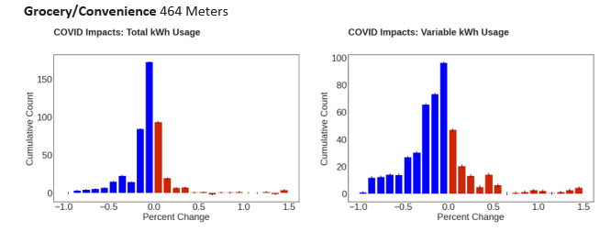
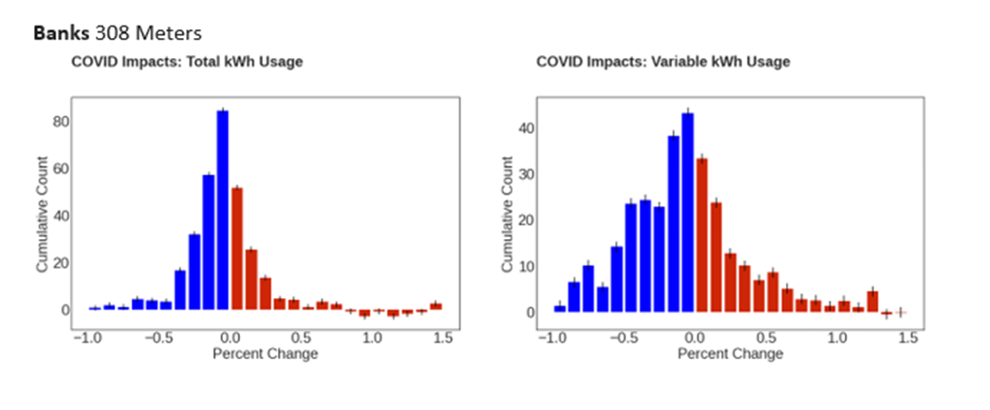
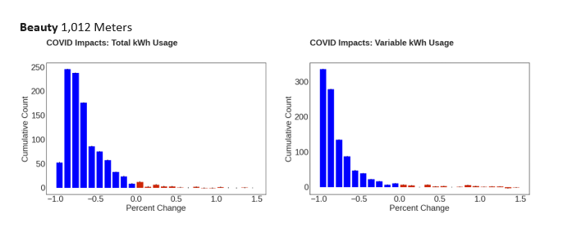
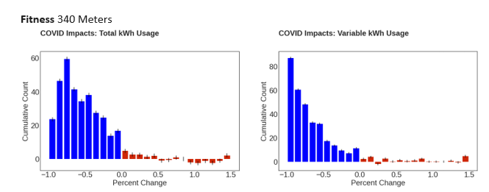
COVID-19 Impacts
Decreased usage is shown in blue with increased usage in red.

Slide 7
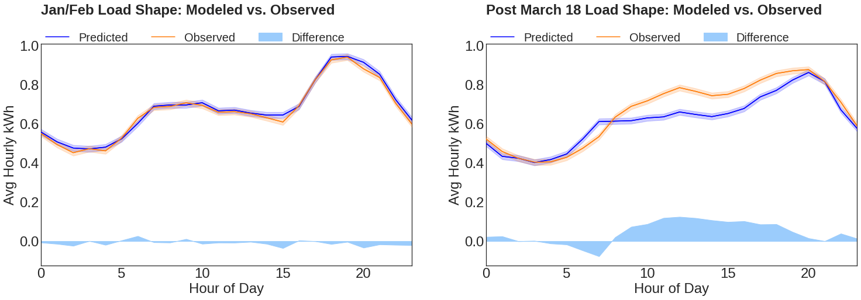
COVID-19 Impacts
Residential sector usage has increased.
Notes:
CalTRACK predicted (blue) and observed (orange) average daily load shapes for 37,762 Residential MCE customers. Left: January and February. Right: March 19 - May 8. The difference is shown as the solid curve. Plots begin at midnight on Sunday.

Slide 8
Strategies for Addressing Cost-Effectiveness Challenges
Improved program coordination and referral systems with other partner programs to improve CE without limiting opportunities for our customers.
MCE has launched 5 programs since Business Plan approval and expect cost-effective savings in 2020 and 2021.
Deployed measure cost savings strategies such as Strategic Energy Management (SEM) and Behavioral, Retrocomissioning, and Operational (BROs) in programs.
Launched programs with NMEC and performance-based payment structures.
Use of AMI Analytics platform to track COVID-19 impacts on demand, by sector, income group, and other categorical factors.

Slide 9
Proposed Portfolio/Program Changes
No new programs.
Expansion of the Commercial program to include a new program strategy using population-level NMEC savings.
Expansion of SF Comprehensive Program to include behavioral messaging to additional 100K customers.
New Residential Direct Install measures.
New fuel substitution measures.
Discontinued MF Direct Install Program.

Slide 10
Questions/Discussion

Slide 11
Alice Havenar-Daughton
Director of Customer Programs
Ahavenar-daughton@mcecleanenergy.org

