Slide 1





&
Residential Energy Advisor Program
Workshop
July 24, 2023

Slide 2
Kick-off Meeting Agenda
Safety & introductions of implementation team
Program overview
  Program implementation team
  Program design
  Program goals
  Launch timeline and key milestones
Program delivery strategy
  Marketing and outreach
  Measures and energy savings
  Safety and quality assurance
Discussion / Q&A

Slide 3
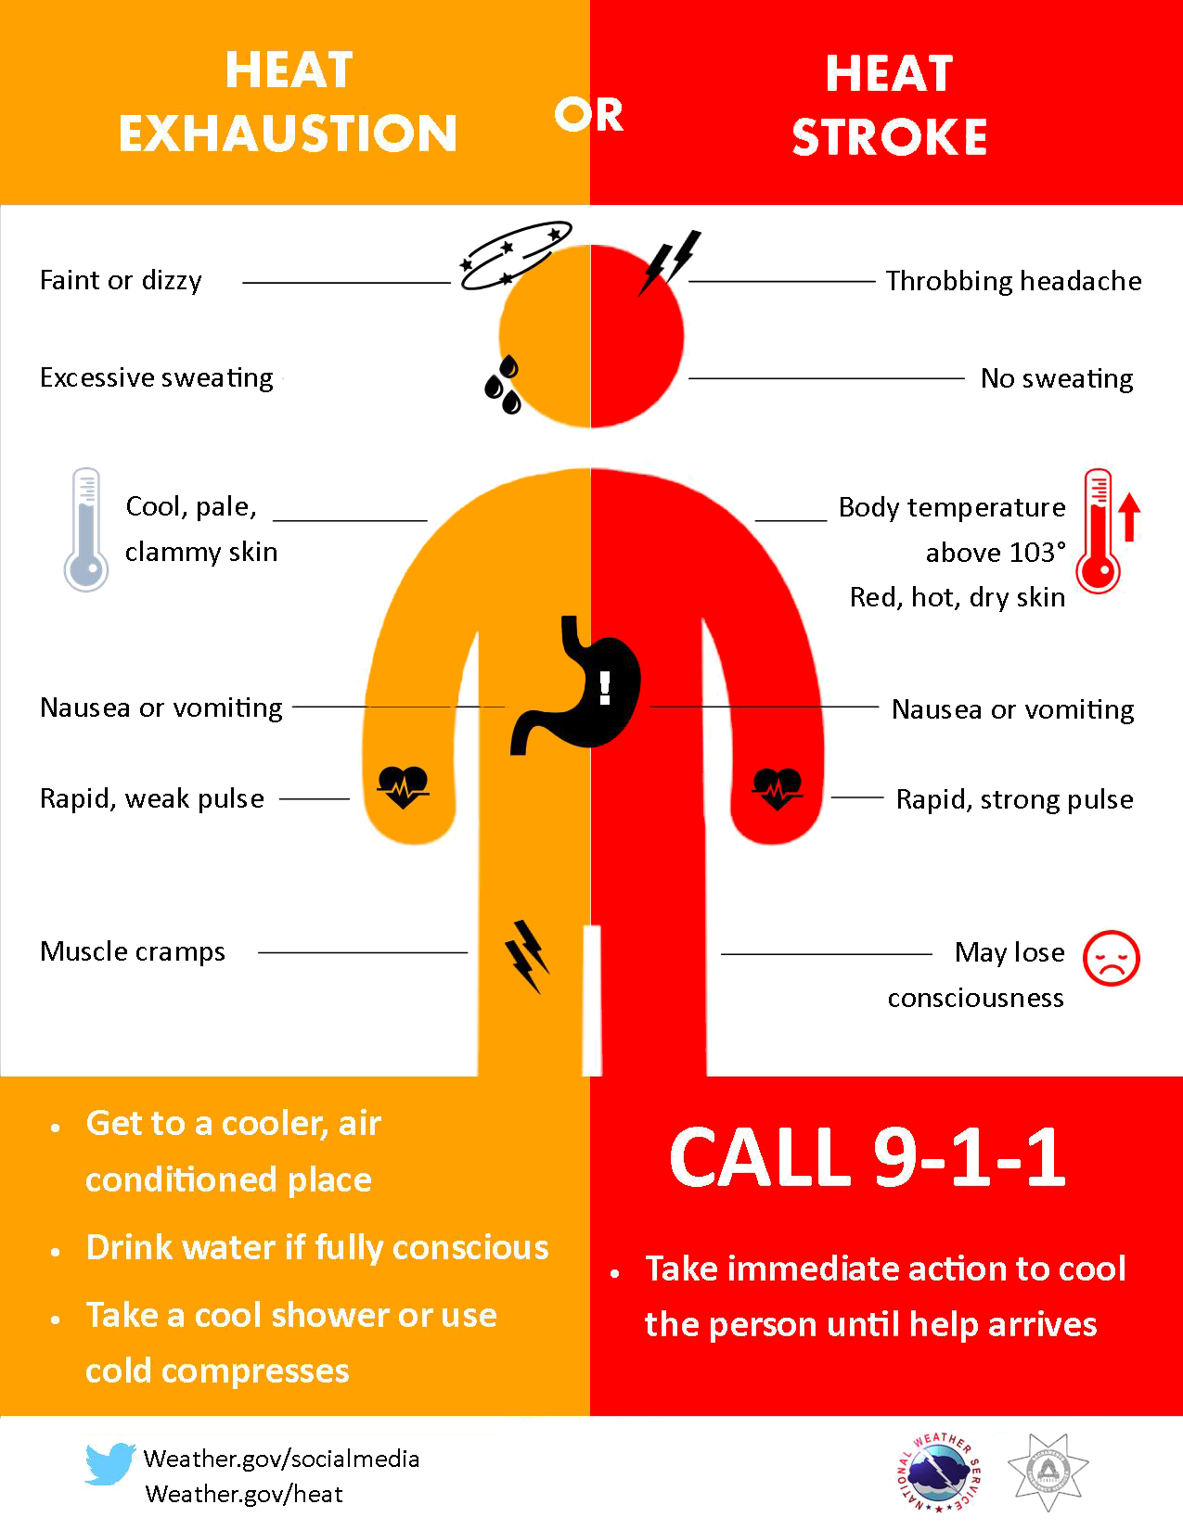

Safety Moment: Heat Illness
The more you know…
Heat Rash
Prickly Heat rash occurs in hot and humid environments Rest in cool place and allow skin to dry
#1 It is easier to talk cool than to stay cool some summer days, but overheating can make you sick, put you in the hospital, even kill you. Do not try to tough it out.
#2 Watch for warning signs and symptoms of others and yourself.
#3 So BE COOL! When the temperature rises, drink a lot of water, sports drinks, or juices. Wear light-colored loose clothes, take breaks to avoid overexerting yourself and beat the heat!
Heat Cramps
Painful muscle spasms Rest in cool place and drink 6oz water every 15 minutes
Heat Exhaustion
Due to loss of fluids through sweating Cool down in cooler location. Use fans, ac, mist, or cool wet cloth Drink small amount of water every 15 minutes
HEAT STROKE
Sweating stops, skin is dry and hot Call 911

Slide 4

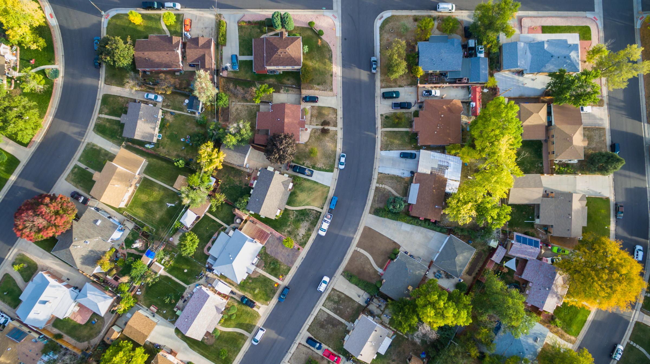
Program Overview
Residential Energy Advisor Program

Slide 5
Implementation Team
  CLEAResult
Program management
Targeting, marketing and outreach
Energy Advisor
Trade Ally Recruitment, Onboarding, and Training
Rebate Processing
  FCI Management
  Subcontractor Partner
  In-Home Assessments and Direct installs
  Post installation Quality Assurance/Quality Control

Slide 6


DO NOT DELETE
IMPORTANT FOR TRANSITIONS
ABOUT US
Our people power our success.
2,400+
Employees
200+
Technology Experts
100+
Marketing Experts
200+
Program Managers
2,400 strong with experts in all aspects of the customer journey
400+
Energy Advisors
& Technicians
750+
Local Field Members
170+
Engineers
250+
Integrated Customer Service Experts
Low Income Experience
(30+ current offerings)
Tennessee Valley Authority
Tucson Electric Power
Consumers Energy
National Grid
BayREN (Moderate Income)
CLEAResult client information on this page is confidential and not to be shared or duplicated.

Slide 7
FCI Management (Subcontractor)
Relevant Experience
A contractor for the Energy Savings Assistance Program (ESAP) for Southern California Edison and SoCal Gas.
An authority on energy, assessments, audits, and comprehensive engineering audits-ASHRAE Level I & II for commercial, residential, industrial, and governmental customers.
A C-10 licensed electrical contractor by the California State License Board. This authorizes FCI to perform as an electrical contractor for construction at both residential and commercial facilities.
Extensive experience in utility program design and implementation for multi- and single-family space and water heating, and electrification.
Woman/minority-owned company established in 1998 to focus on marketing innovative technologies and energy efficiency strategies that lower energy costs for consumers, heighten the security of energy and water supply and improve the quality of the environment by reducing the carbon footprint.
Qualifications:
  Active C-10, CALCTP Acceptance Test certified
  ASHRAE Level I & II, ESAP (SCE & SoCal Gas), LEED
  NMSDC Member, EDWOSB certified, SBA WOSB certified, MBE certified, DBE certified, WBENC certified, WMBE certified business

Slide 8
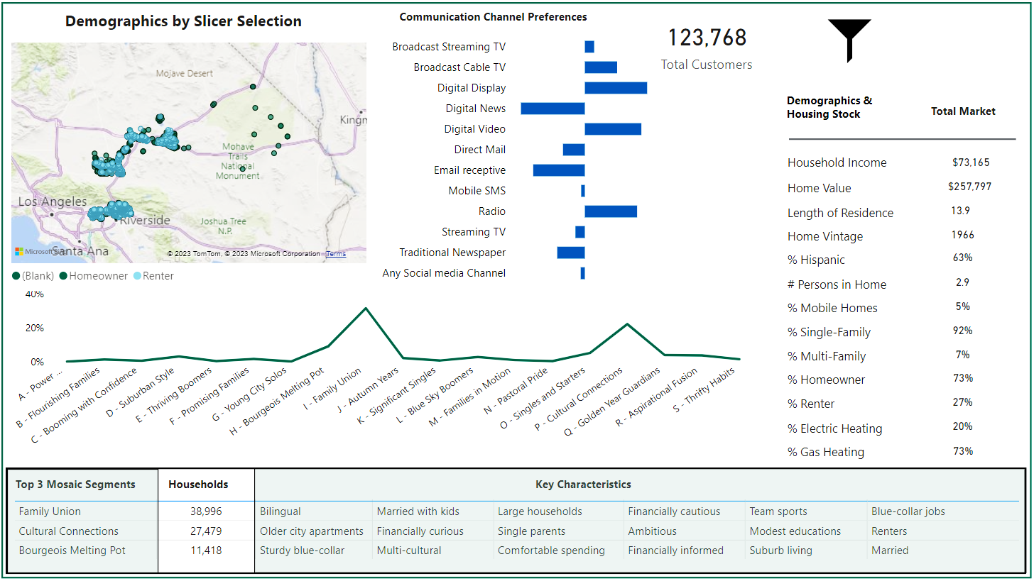
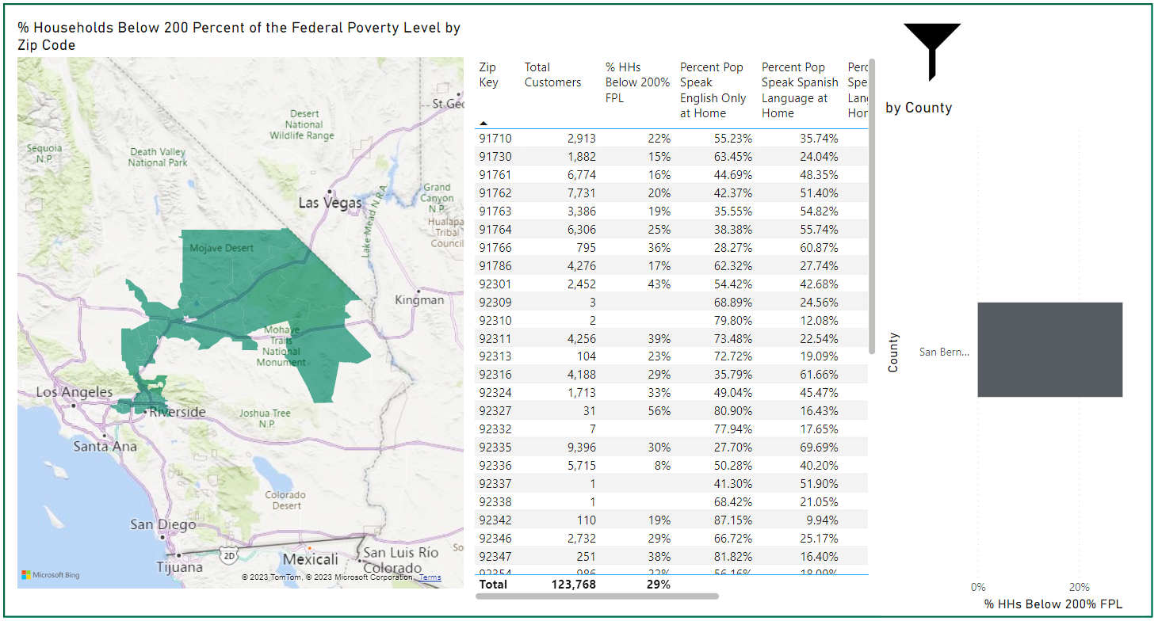
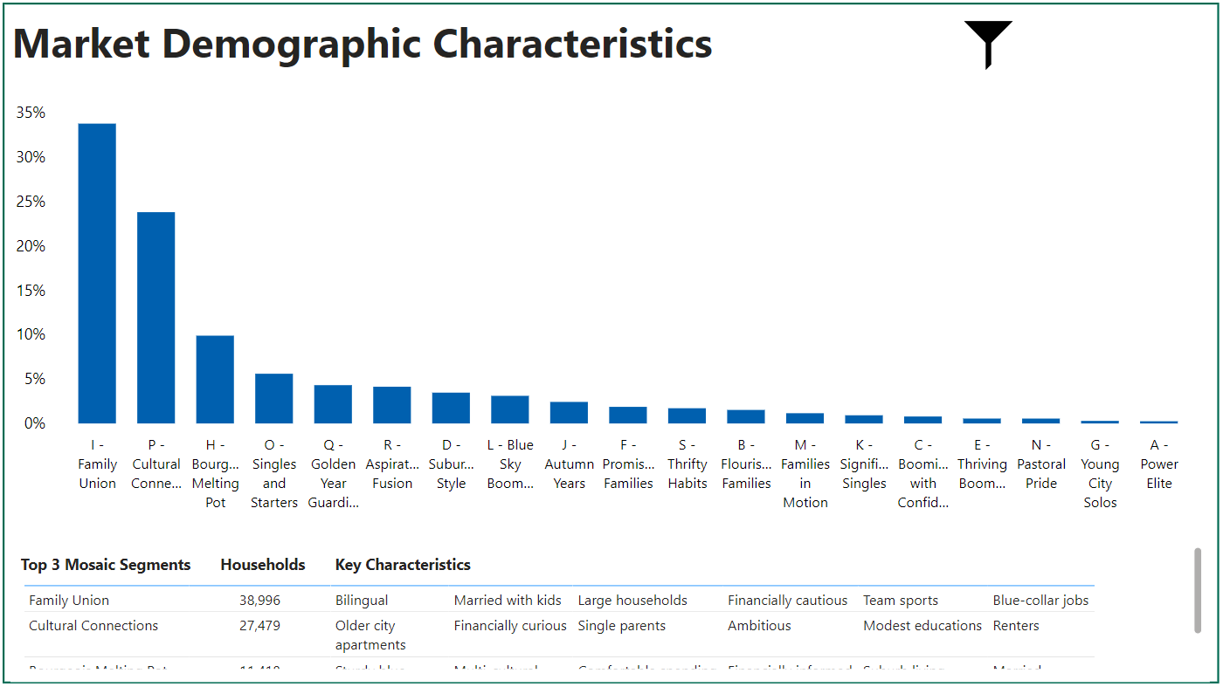
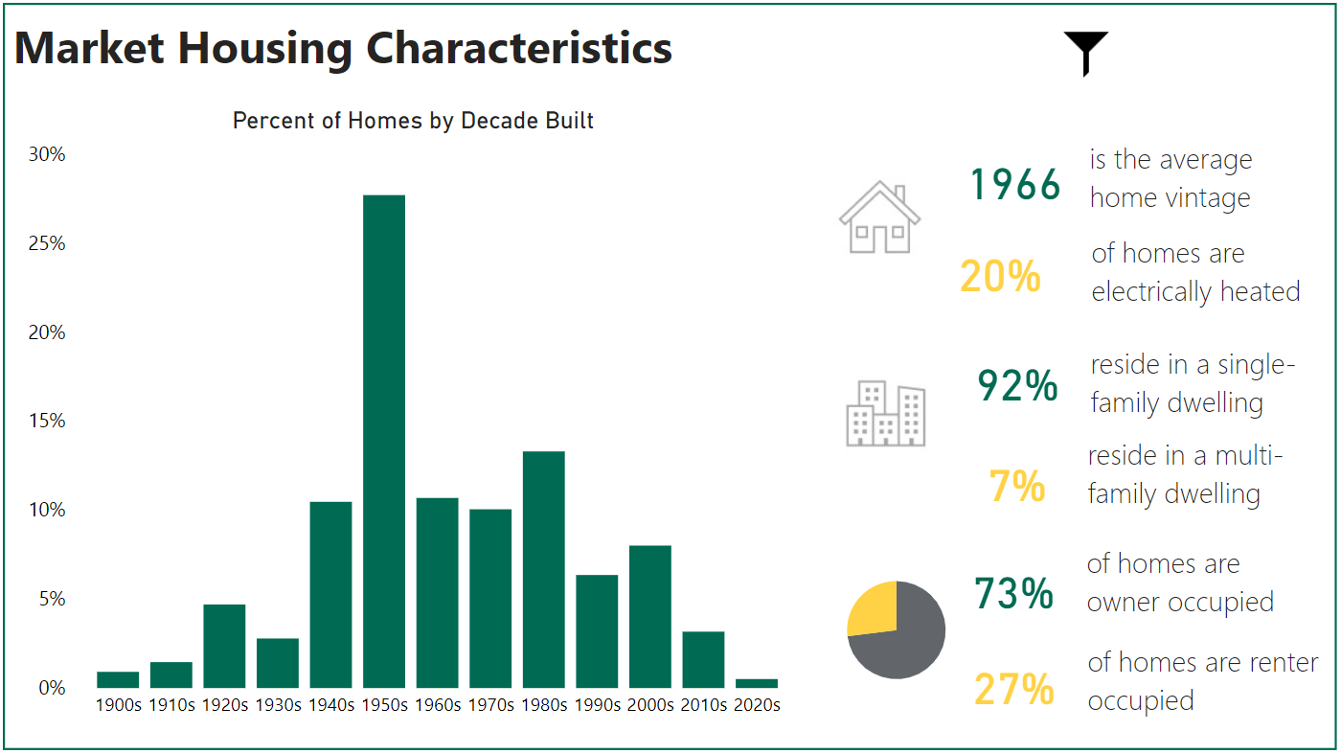
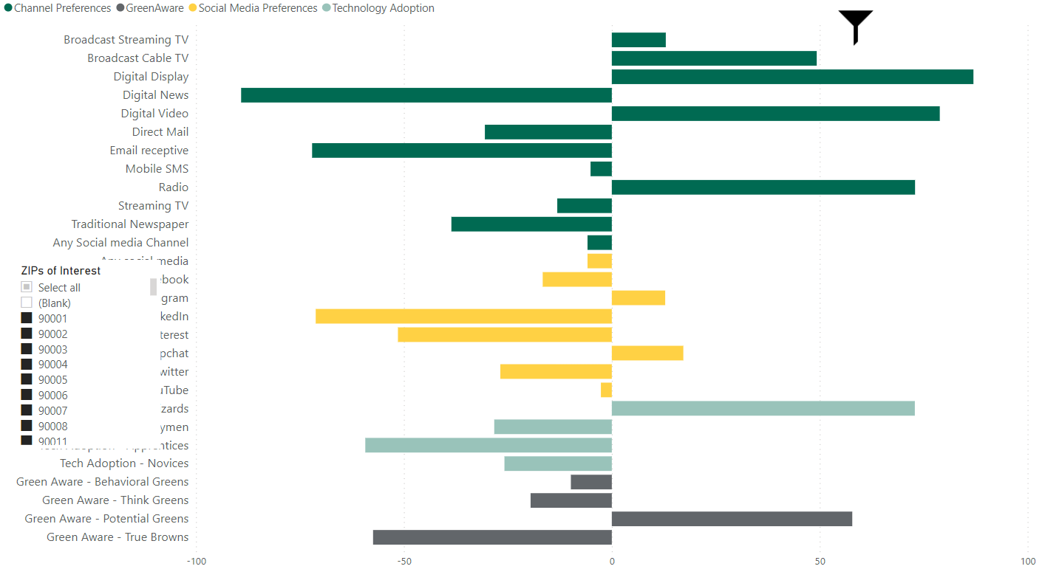
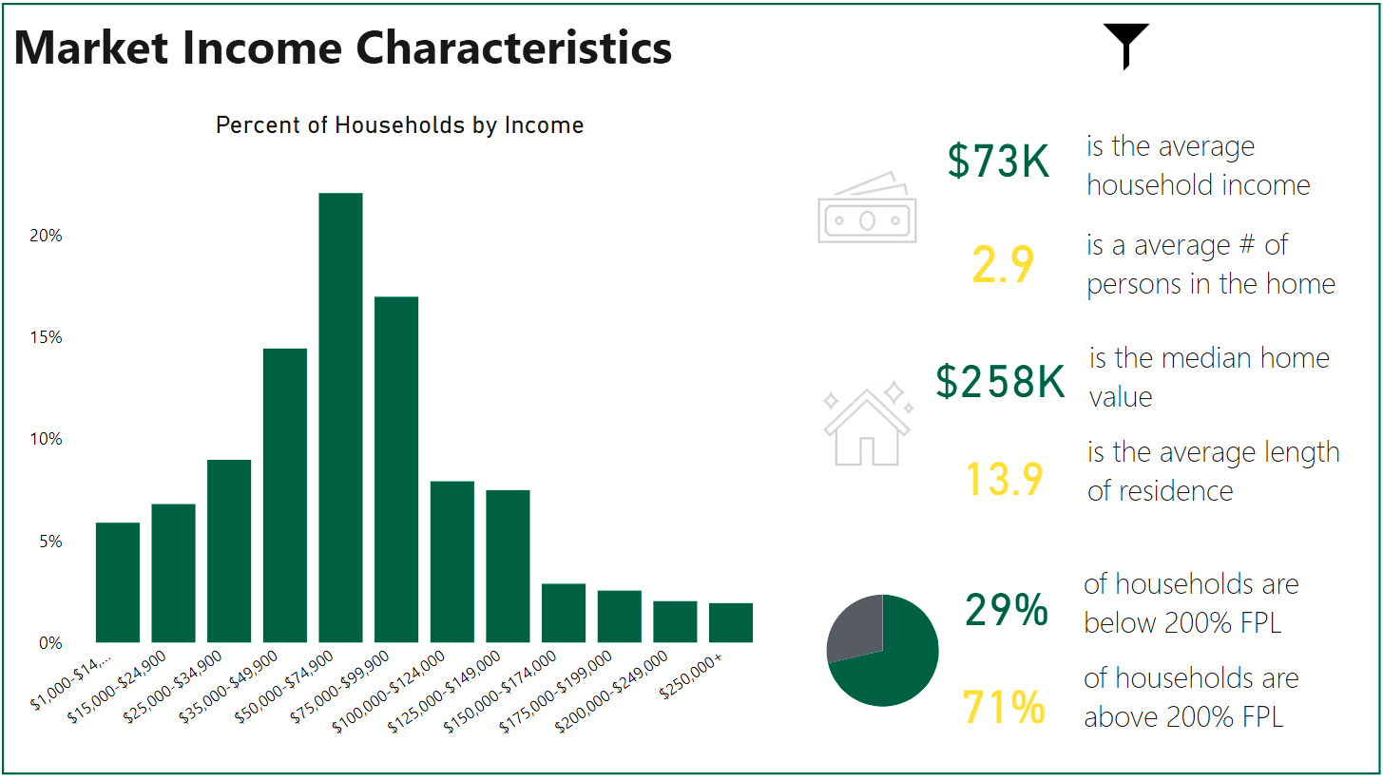
CLEAResult Analytics
Power BI Analytics Platform

Slide 9
Program design

Slide 10
ESJ Action Plan and Program Objectives
ESJ Communities are Defined as:
“predominantly communities of color or low-income communities that are underrepresented in the policy setting or decision-making process, subject to a disproportionate impact from one or more environmental hazards, and are likely to experience disparate implementation of environmental regulations and socioeconomic investments in their communities.” p. 2 of the ESJ Action Plan. Under this definition the CPUC aimed to target the following communities:
• Disadvantaged Communities, defined as census tracts that score in the top 25% of CalEnviroScreen 3.0, along with those that score within the highest 5% of CalEnviroScreen 3.0's Pollution Burden but do not receive an overall CalEnviroScreen score
• All Tribal lands
• Low-income households (Household incomes below 80 percent of the area median income)
• Low-income census tracts (Census tracts where aggregated household incomes are less than 80 percent of area or state median income)
The Residential Energy Advisor program is a new, innovative Equity Program that offers energy efficiency rebates and services targeted specifically to Hard-to-Reach (HTR) residential customers, including moderate income households, renters, and those residing within disadvantaged and underserved communities (DAC) in support of CPUC ESJ Action Plan 2.0 goals.
The Program specifically supports the following goals under the ESJ Action Plan:
  Increased investment in clean energy resources to benefit ESJ communities, especially to improve local air quality and public health: This is achieved through offering electrification incentives and access to Energy Advisors for assistance in making improvements to the indoor space.
  Increased climate resiliency in ESJ communities: This is achieved through offering energy efficiency incentives and assessments, coupled with the Energy Advisor service, to better educate customers in selecting products that can adapt to load capacity conditions in the market.
  Promoting high road career paths and economic opportunity for residents of ESJ communities: This will be achieved through engagement with local contractors in the DACs. Helping these contractors grow their business will open more careers in the community.

Slide 11
Program Objectives
Objectives​ | Opportunities​
Energy Efficiency Improvements Help disadvantaged and hard-to-reach homeowners and renters reduce their energy use, while improving market awareness of health, safety, indoor air quality, and other non-energy benefits Positive bill impacts through increased incentives for select measures, layering of incentives from complimentary programs and customer education | New measures​ Electrification​ Whole home performance Affordability/positive bill impact​ Customer satisfaction​ Customer energy education​ Persistent savings​
Quality: Focus on delivering persistent utility cost savings, comfort and health benefits for Hard-to-Reach customers and disadvantaged and underserved communities
Equity: Leverage data analytics to identify, target, and reach customers in hard-to-reach, disadvantaged and underserved communities identified as the top 25% scoring census tracts according to CalEnviroscreen as well as census tracts with a high density of residents who speak a language other than English or rent their homes Coordinate with Community Based Organizations (CBOs) to better access target communities Recruit, onboard, and train Trade Allies in target communities to provide increased access to careers in the community | Newly defined eligibility criteria​ Improved targeting, messaging and engagement​

Slide 12
Program Objectives
Objectives​ | Opportunities​
Customer-centric: A seamless program delivery with focus to improve Program participation within targeted communities One-on-one, on-going energy advisement leading to high customer satisfaction | Innovative program design​ Intentional project scheduling​ Improved customer communications​
Optimization: Data driven analytics for targeted customer marketing, utilization of established Trade Ally network and Community Based Organizations (CBOs) with partnered coordination Trade Ally-driven outreach and project attainment Integrated Demand Side Management (IDSM) technical assistance through Energy Advisor Leverage Assessment and Energy Advisor pathways to drive participation and referrals to other Programs where appropriate | Marketing and outreach tailored to Customers Resource and non-resource pathways provide complementary services Building trust through CBOs familiar to targeted Customers
Workforce development: Recruitment, training, retention, development, and support, including leveraging Workforce, Education and Training (“WE&T”) resources, other training resources Worker development including career-ladder job progression Engagement with local programs serving disadvantaged workers Equitable hiring of workers from local, tribal, or Disadvantaged Communities (“DACs”) | No-cost Atlas Academy online on-demand training Drive local and equitable hiring Monitor and increase participation from disadvantaged workers

Slide 13
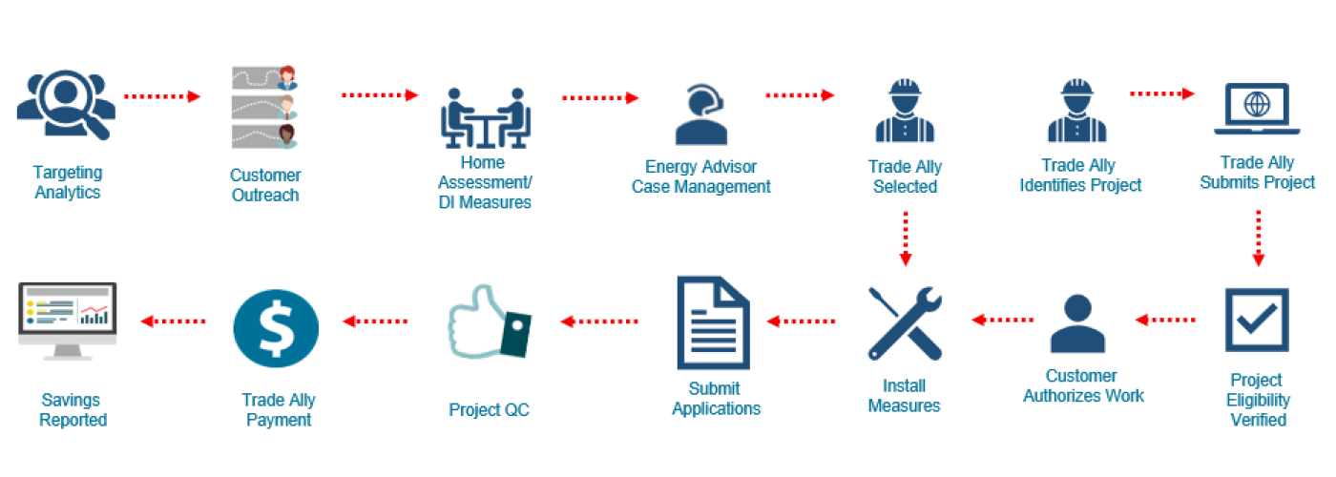
Program Design Summary

Slide 14
Electrification
Objective: Increase access to beneficial electrification opportunities, increasing indoor air quality and improving safety
Home Assessment/ DI Measures
Trade Ally Selected
Measure installation
On-going energy advising and customer feedback
Energy Advisor Case Management

Slide 15
PROGRAM GOALS

Slide 16
Non-Resource Program Goals
Program Cost Effectiveness (TRC)*
Program Budget
 | 2023 | 2024 | 2025
TRC | 0.17 | 0.21 | 0.23
Non-Resource
Program Budget Cost | 2023 | 2024 | 2025 | Total
Administration Costs | $ 37,998 | $ 148,589 | $ 127,559 | $ 314,146
Marketing/Outreach | $ 42,220 | $ 66,039 | $ 54,685 | $ 162,944
Incentive/Rebate | $ - | $ - | $ - | $ -
Direct Implementation | $ 341,984 | $ 1,436,358 | $ 1,640,556 | $ 3,418,898
Total | $ 422,202 | $ 1,650,986 | $ 1,822,800 | $ 3,895,988
*Program and/or Sub-Program Cost Effectiveness (TRC)
Program Cost Effectiveness (PAC)*
Program Gross Impacts
 | 2023 | 2024 | 2025
PAC | 0.17 | 0.23 | 0.24
Non-Resource
Delivery Period Year | Targeted Customer Marketing and Community Engagement Projects | Customer Energy Advisements | Customer Energy Case Management
2023 | 4 | 913 | 91
2024 | 4 | 3654 | 457
2025 | 3 | 3655 | 579
Total | 11 | 8222 | 1127
*Program and/or Sub-Program Cost Effectiveness (PAC)

Slide 17
Resource Program Goals
Program Cost Effectiveness (TRC)*
Program Budget
 | 2023 | 2024 | 2025
TRC | 0.17 | 0.21 | 0.23
Resource
Program Budget Cost | 2023 | 2024 | 2025 | Total
Administration Costs | $ 11,345 | $ 113,448 | $ 113,472 | $ 238,265
Marketing/Outreach | $ 19,204 | $ 61,069 | $ 64,734 | $ 145,007
Incentive/Rebate | $ 415,521 | $ 2,202,037 | $ 2,964,129 | $ 5,581,687
Direct Implementation | $ 196,346 | $ 959,959 | $ 1,260,292 | $ 2,416,597
Total | $ 642,416 | $ 3,336,513 | $ 4,402,627 | $ 8,381,556
*Program and/or Sub-Program Cost Effectiveness (TRC)
Program Cost Effectiveness (PAC)*
Program Gross Impacts
 | 2023 | 2024 | 2025
PAC | 0.17 | 0.23 | 0.24
Resource
Energy Savings | 2023 | 2024 | 2025 | Total
Gross Demand Reduction (kW) | 45 | 152 | 190 | 387
Net Demand Reduction (kW) | 18 | 51 | 64 | 133
Gross Energy Savings (kWh) | 181,886 | 953,692 | 1,196,386 | 2,331,964
Net Energy Savings (kWh) | 160,857 | 776,912 | 974,526 | 1,912,295
*Program and/or Sub-Program Cost Effectiveness (PAC)

Slide 18
Program Goals
Invest in clean energy resources to benefit ESJ communities
Increase climate resiliency and improve air quality and public health in these communities
Increase access to energy efficiency through a skilled energy efficiency workforce for SCE customers in service territories meeting CPUC definitions of HTR and DAC
Engage with local contractors, helping these contractors grow their business and open more careers in the community
Capture measurable predetermined energy savings in DAC, HTR, and underserved communities through education, assessment, DI, and installed measures
Drive higher participation rates through community outreach, direct marketing, no-cost home energy assessments and direct install packages
Achieve and maintain high customer satisfaction rating within target communities
Build sustained relationships with local Trade Allies and CBOs for long term program effectiveness and community development

Slide 19
PROGRAM timelines and milestones

Slide 20
Program Timeline
Program start-up
Launch and outreach, Trade Ally enrollment
Ramp-up
Steady state and continuous improvement
Program end, begin closeout reporting
June-Aug
2023
Sept
2023
Oct ‘23– Mar ‘24
March ‘24 – Sept ‘25
Dec. 2025

Slide 21
Residential Energy Advisor Near-Term Milestones
July
August
September
  Approval and finalization of marketing collateral
  Continue development of Trade Ally portal, marketing site, and sub-contractor field tool
  Analytics/reporting dashboards development
  Subcontractor agreement executed
  SCE Workshop
  Finalization of Program Manual and Implementation Plan
  Marketing collateral complete
  Customer targeting analytics complete
  Contractor engagement
  Development of Trade Ally portal, marketing site, and field tool complete
  Website and marketing launch
  Trade Ally and training portal available
  Customer enrollment begins
  Database & Learning Management System (LMS)
  Ongoing contractor engagement

Slide 22
Residential Energy Advisor Mid-Term Milestones
November
December
October
Continue Trade Ally recruitment & onboarding
Continue Trade Ally recruitment & onboarding
In-home assessments & DI
Trade Ally sales and measure installation
Reporting dashboards
Program stabilization phase begins
Hold community engagement events
Hold community engagement events
In-home assessments & DI
In-home assessments & DI

Slide 23
Residential Energy Advisor Long-Term Milestones
2024
2025
2023
Net energy savings of 776,912 kWh
Net energy savings of 776,912 kWh
Net energy savings of 160,857 kWh
4 targeted customer marketing and community engagement projects
913 energy advisements
91 customer energy management cases
4 targeted customer marketing and community engagement projects
3654 energy advisements
457 customer energy management cases
3 targeted customer marketing and community engagement projects
3655 energy advisements
579 customer energy management cases

Slide 24

Program Delivery
Residential Energy Advisor

Slide 25
Marketing and outreach

Slide 26


Marketing Approach
Reaching Diverse Audiences
Objectives: Drive targeted customer group to SCE Home Performance Plus marketing site
Key message: Request an Assessment, Speak to an Energy Advisor
Secondary message: Confirm eligibility, find a participating contractor, and next steps
Tactics: Direct messaging through digital, print, and other methods
Trade Ally representation
Multi-lingual customer experience
CBO engagement and support
Customer targeting based on DAC, HTR, and underserved communities
Digital marketing
Build relationship with participants and refer to complementary programs
Direct-to-customer marketing

Slide 27
Measures and Energy savings

Slide 28
Measures and Incentives
Measure |  | Incentive Level
Operations and Maintenance Measures |  | 2023 Incentive | 2023 Incentive | 2023 Incentive | Unit Per Measure | URL
Induction Cooktop | Induction cooktop (must replace gas cooktop or gas range) | $400.00 | $424.00 | $449.44 | Each | https://www.caetrm.com/measure/SWAP013/02/
Heat Pump Dryer | Standard size heat pump clothes dryer, any volt, vented or ventless (must replace gas dryer) | $400.00 | $424.00 | $449.44 | Each | https://www.caetrm.com/measure/SWAP014/02/
Faucet Aerator | Faucet, kitchen or lavatory aerator, 1.0 to 1.5 gpm, gas or electric, AOE | $6.50 | $6.89 | $7.30 | Each | https://www.caetrm.com/me asure/SWWH001/03/
Low-Flow Showerheads | Efficient showerhead, gas or electric, 1.5 gpm | $7.00 | $7.42 | $7.87 | Each | https://www.caetrm.com/me asure/SWWH002/03/
Duct Sealing | Duct seal and test, residential, medium to low (24% to 12%) for SFm/MFm < 2006 | $270.00 | $286.20 | $303.37 | Cap-Tons | https://www.caetrm.com/me asure/SWSV001/04/ https://www.caetrm.com/me asure/SWSV001/05/
Duct Replacement | Crossover duct replacement (total leakage reduction 35% to 15%), Return duct retrofit (total leakage reduction 50% to 15%) | $1,080.00 | $1,144.80 | $1,213.49 | Cap-Tons | https://www.caetrm.com/measure/SWSV013/02/ https://www.caetrm.com/measure/SWSV013/03/
Building Shell Measures
Attic Insulation | Ceiling - add R-19 batts on top of vintage-specific existing insulation | $1.01 | $1.07 | $1.14 | Area-ft2 | https://www.caetrm.com/measure/SWBE006/01/ https://www.caetrm.com/measure/SWBE006/02/
Wall Insulation | Residential wall blow-in R-0 to R-13 insulation | $1.00 | $1.06 | $1.12 | Area-ft2 | https://www.caetrm.com/measure/SWBE007/01/ https://www.caetrm.com/measure/SWBE007/02/

Slide 29
Measures and Incentives
Water Heating Measures
Heat Pump Water Heater | HP water heater: 45 to 55 gal (UEF = 3.30) replacing electric storage water heater: 40 gal (UEF = 0.92) | $1,161.00 | $1,230.66 | $1,161.00 | Each | https://www.caetrm.com/measure/SWWH014/04/
Heat Pump Water Heater - Fuel Sub | Heat pump water heater, > 75 gal, UEF = 3.30 replacing storage natural gas water heater, 50 gal, UEF = 0.63, 60 gal, UEF = 0.61, or 75 gal, UEF = 0.59 Heat pump water heater, > 55 to <= 75 gal, UEF = 3.30 replacing storage natural gas water heater, 40 gal, UEF = 0.64, UEF = 0.63, or 60 gal, UEF = 0.61 | $1,350.00 | $1,350.00 | $1,350.00 | Each | https://www.caetrm.com/measure/SWWH025/06/
Heating and Cooling Measures
Split Air Conditioners | Residential SEER2-rated split/pkg AC, 18 - 45 kBtu/hr, SEER2 >= 16.0 (EER2 >= 12.6), NR | $750.00 | $795.00 | $842.70 | Cap-Tons | https://www.caetrm.com/measure/SWHC049/03/
Split Heat Pumps | Residential SEER2-rated split/pkg HP, SEER2 >= 16.0 (EER2 >= 12.6), HSPF2 >= 8.0, NR Residential legacy-rated split/pkg HP, SEER >= 17 (EER >= 13.3), HSPF >= 9.4, NR | $850.00 | $901.00 | $955.06 | Cap-Tons | https://www.caetrm.com/measure/SWHC049/03/
Heat Pump - Fuel Sub | Res DXHP SEER >= 17 and HSPF >= 9.4 | $1,350.00 | $1,431.00 | $1,516.86 | Each | https://www.caetrm.com/measure/SWHC045/01/
Ductless Minisplit Heat Pump - Fuel Sub | Ductless mini-split heat pump (SEER 17, HSPF 9.4) replacing window AC and wall furnace, NR | $1,032.00 | $1,093.92 | $1,159.56 | Cap-Tons | https://www.caetrm.com/measure/SWHC044/02/

Slide 30
Targets and Measures
Expanded measure list
Increased focus on water heating systems and HVAC with shell measures
Comprehensive electrification and fuel substitution
Deemed Energy Savings per CA eTRM approved workpapers
Net energy savings:
1,912,295 kwh
26,711 therms

Slide 31
Safety and quality assurance

Slide 32



Post Installation - Quality Control (QC)
100% documentation desk QC on all projects
Ride-alongs and field QC, feedback loop for any needed ongoing Trade Ally training and coaching
Energy Advisors will provide follow up to participants to evaluate satisfaction with work and opportunities for next steps

Slide 33
Residential Energy Advisor
Q & A

Slide 34
Dustin R. Diamond, Program Manager
Dustin.Diamond@CLEAResult.com

Slide 35
Organizational Chart
Kim Dicello
Program Director, West
IT
Raul Grinberg
Marc Bigby
Program Portfolio Manager
Raven San Andres
Program Coordinator
Dustin Diamond
Program Manager
Eric Syren
Field Manager
FCI Management
TBH
Field Specialist
Katrina Inouye
Field Manager
TBH
Energy Advisor
TBH
Energy Advisor
Jeri Gee
Manager of Marketing Acct. Management
Mark Jerome/ Brady Patrias Engineering
Matt Braman Business Intelligence Director
Erin Martinez
Health & Safety

