Slide 1
Identifying underserved public sector customers within energy efficiency programs
UCSB Team

Slide 2
UCSB team members
PI: Ranjit Deshmukh
Researchers:
Audrey Meiman
Matt Lai
Michelle Le
Measrainsey Meng
Nathaniel Villa
Shirly Xue
Sydney Litvin

Slide 3
Research questions
Research Question | Indicator | Measurement | Data Sources
Are there gaps in program participation by geographic areas? | Participation | Number of public agencies participating by neighborhood | CEDARS, Census Tract
 | Investment | Dollars (incentives) | CEDARS
 | Energy Savings | kWh or therms saved per public agency | CEDARS
Are there gaps in program participation by public agency criteria? | Participation | Number of public agencies participating by size, type of public agency, annual budget, etc | CEDARS
 | Investment | Dollars (incentives) | CEDARS
 | Energy Savings | kWh or therms saved per public agency | CEDARS
Are there gaps in program participation by socio-demographic indicators? | Participation | Number of public agencies by income level, ethnicity, primary language spoken of population served | CEDARS, Census Tract, CalEnviroScreen
 | Investment | Dollars (incentives) | CEDARS
 | Energy Savings | kWh or therms saved per public agency | CEDARS

Slide 4
Research questions
Research Question | Indicator | Measurement | Data Sources
Are there gaps in program participation by geographic areas? | Participation | Number of public agencies participating by neighborhood | CEDARS, Census Tract
 | Investment | Dollars (incentives) | CEDARS
 | Energy Savings | kWh or therms saved per public agency | CEDARS
Are there gaps in program participation by public agency criteria? | Participation | Number of public agencies participating by size, type of public agency, annual budget, etc | CEDARS
 | Investment | Dollars (incentives) | CEDARS
 | Energy Savings | kWh or therms saved per public agency | CEDARS
Are there gaps in program participation by socio-demographic indicators? | Participation | Number of public agencies by income level, ethnicity, primary language spoken of population served | CEDARS, Census Tract, CalEnviroScreen
 | Investment | Dollars (incentives) | CEDARS
 | Energy Savings | kWh or therms saved per public agency | CEDARS

Slide 5
Research questions
Research Question | Indicator | Measurement | Data Sources
Are there gaps in program participation by geographic areas? | Participation | Number of public agencies participating by neighborhood | CEDARS, Census Tract
 | Investment | Dollars (incentives) | CEDARS
 | Energy Savings | kWh or therms saved per public agency | CEDARS
Are there gaps in program participation by public agency criteria? | Participation | Number of public agencies participating by size, type of public agency, annual budget, etc | CEDARS
 | Investment | Dollars (incentives) | CEDARS
 | Energy Savings | kWh or therms saved per public agency | CEDARS
Are there gaps in program participation by socio-demographic indicators? | Participation | Number of public agencies by income level, ethnicity, primary language spoken of population served | CEDARS, Census Tract, CalEnviroScreen
 | Investment | Dollars (incentives) | CEDARS
 | Energy Savings | kWh or therms saved per public agency | CEDARS
Notes:
Analysis by Public Agency ENTITY (category)

Slide 6
Research questions
Research Question | Indicator | Measurement | Data Sources
Are there gaps in program participation by geographic areas? | Participation | Number of public agencies participating by neighborhood | CEDARS, Census Tract
 | Investment | Dollars (incentives) | CEDARS
 | Energy Savings | kWh or therms saved per public agency | CEDARS
Are there gaps in program participation by public agency criteria? | Participation | Number of public agencies participating by size, type of public agency, annual budget, etc | CEDARS
 | Investment | Dollars (incentives) | CEDARS
 | Energy Savings | kWh or therms saved per public agency | CEDARS
Are there gaps in program participation by socio-demographic indicators? | Participation | Number of public agencies by income level, ethnicity, primary language spoken of population served | CEDARS, Census Tract, CalEnviroScreen
 | Investment | Dollars (incentives) | CEDARS
 | Energy Savings | kWh or therms saved per public agency | CEDARS
Notes:
Change to indicators

Slide 7
Data sources

Slide 8
CEDARS
The primary data source we will use is the CEDARS database. The following information/variables are of interest for our analysis:
Site information: Site ID, NAICS Code, Site Zip Code, Site City, Site State
Incentives: Total Gross Incentive
Costs: Total Gross Measure Cost
Savings: Total Lifecycle Gross kWh, Total Lifecycle Gross Therm

Slide 9
Types of Programs
By Chris Malotte’s recommendations, we are looking at 330 unique programs
167 programs will be our main focus
Programs fall under these categories
Local Government Partnership
Energy Leader Partnership Program (SCE)
Government Partnership Programs (PGE)
Master Government Partnership (PGE)
Public LGP Third Party Programs (PGE)
Local Partnerships
Local Programs (SCG)
State Institutional Partnership
Institutional and Government Core Energy Efficiency Partnership (SCE)
Institutional Partnerships (PGE, SCE)
Local Partnerships
IOU Core/Statewide (only to SCG/SDGE)
Third/Local Party (SCG, PGE, SCE)
REN/CCA (only to SCR)

Slide 10
Synthetic variables
Percentage of cost covered = incentive amount / measure cost
Percentage savings or depth of savings = savings / usage
Incentive per kWh
Incentive per therm
Measure cost per kWh
Measure cost per therm

Slide 11
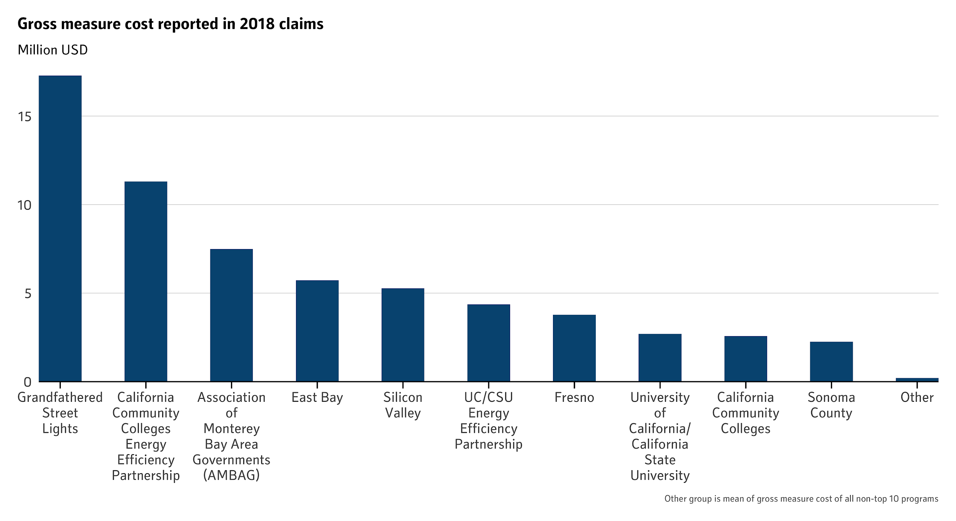
Top 10 gross measure costs filed in 2018

Slide 12
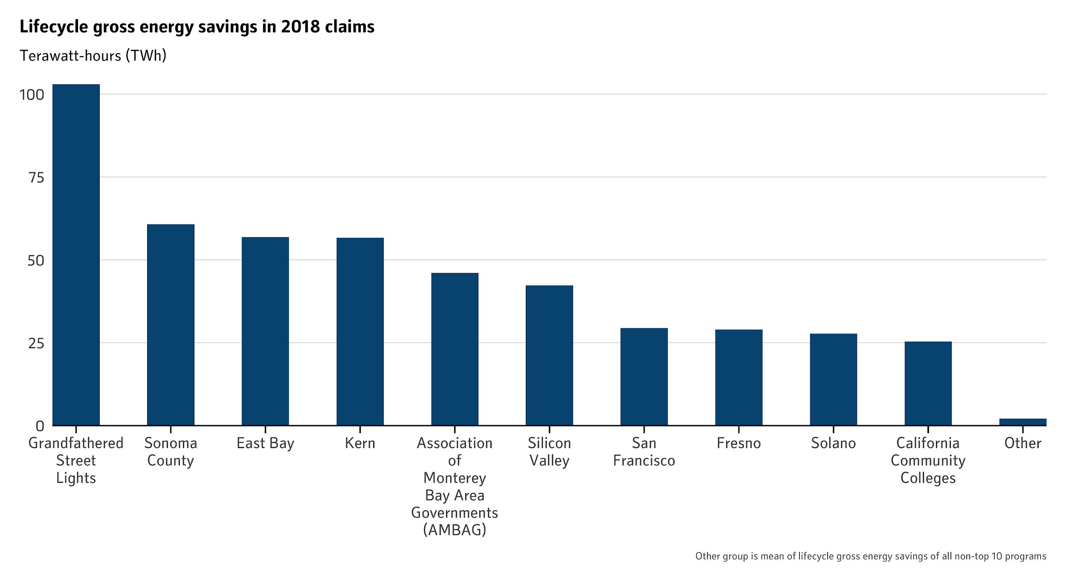
Top 10 lifecycle gross energy savings filed in 2018

Slide 13
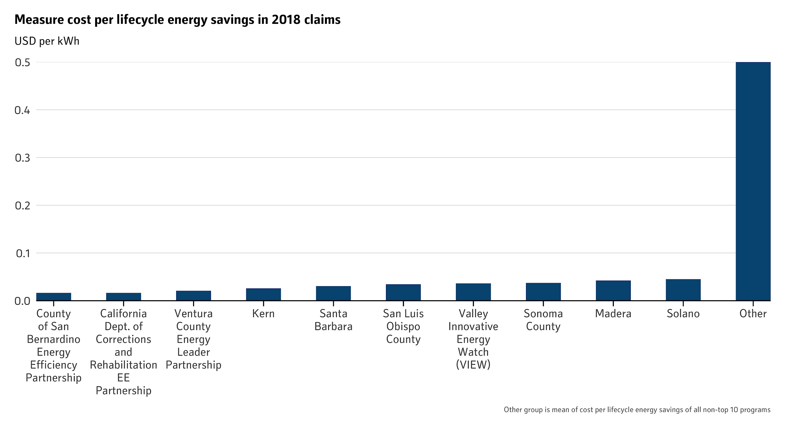
Top 10 measure cost per kWh saved in 2018

Slide 14
Questions on CEDARS data
What is the difference between filings and claims?
Which is reported in the zip code level data?
How do we classify and understand what some of the programs are? (e.g., the various PUB-[location] Partnerships)
Should we look for keywords? Do we treat them as separate programs or a single program?
Do any of these programs correspond to CEC programs?

Slide 15
CalEnviroScreen
Identifies California communities that are most affected by pollution and that are often especially vulnerable to pollution’s effects
Includes 20 indicators that can be grouped into four categories: exposures, environmental effects, sensitive populations, and socioeconomic factors
Indicators provided at the census tract level
We are interested in using the following socioeconomic indicators in the CalEnviroScreen dataset to analyze gaps in program participation:
Linguistic Isolation
Poverty
Unemployment
Notes:
Percentiles might not be the best for regression analysis

Slide 16
Census Bureau
The U.S. Census Bureau provides data at varying spatial resolutions on population, demographics, etc. We will use census-tract level income data from the Census Bureau to analyze gaps in program participation.

Slide 17
Preliminary ideas for methodology

Slide 18
Analyzing gaps by geographic area
Number of public agencies participating by neighborhood
Overlay spatially-specified CEDARS data onto census tracts, climate zones, etc
Questions about geographic area analysis:
Do we separate spatial analyses by participant groups (zip code for municipalities versus county for Department of Corrections, for example)?

Slide 19
Analyzing gaps by public agency criteria
Number of public agencies participating by size, type of public agency, annual budget, etc.
Use CEDARS data to analyze budget, costs, and savings across different agency types, sizes, etc.
Questions about public agency criteria analysis:
How is the “size” of an agency defined? (number of people served?)
Is there data available on how budgets are allocated?
Should there be any aggregation of types of public agencies (for example, do we group municipalities together?)

Slide 20
Analyzing gaps by socio-demographic indicators
For municipalities, we can overlay zip code level data onto Census Bureau income data, CalEnviroScreen indicators, etc.
For other types of programs, it is still unclear how to analyze socioeconomic variables, depending on the populations CAEECC think are best appropriate to look into
Questions about socio-demographic analysis:
For programs such as higher education, Department of Corrections, state governments, how do we assess the demographics? (Another way of thinking about this, how do we assess which customers are “underserved” or “hard-to-reach”?
Will there be spatially resolved data for these larger programs?

Slide 21
Thank you!

