Slide 1
Equity Metrics WG Fourth & Final Mtg
September 29, 2021
California Energy Efficiency Coordinating Committee

Slide 2
Agenda – see detailed version posted to meeting page for details: https://www.caeecc.org/equity-metrics-working-group-meeting
Time | Topic
9:00 | Agenda/Goals for Today’s Meeting/WG Close Out Process
9:10 | Report Section 3: Objective
9:25 | Report Section 2: Principles
10:20 | Break
10:30 | Report Section 2: Metrics and Indicators
12:30 | Remainder of the Report
12:45 | Wrap-Up and Next Steps
1:00 | Adjourn

Slide 3
Primary Meeting Goals
Refine, seek consensus, and finalize Objective, Metrics, & Principles
Review the other sections of the draft report
Discuss steps to close-out the EMWG

Slide 4
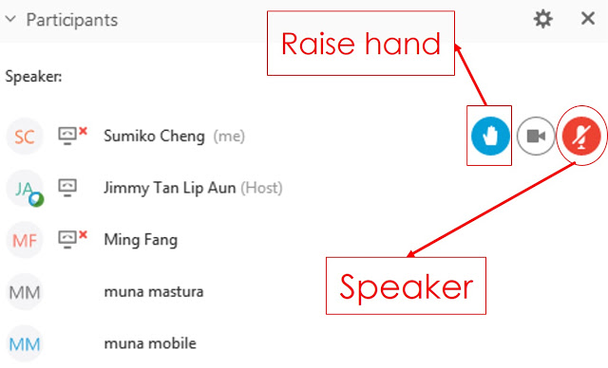
WebEx Technical Reminders
Raise hand to enter queue – then unmute when called upon
Mute when not speaking
Zoom in & out of documents
Members of the Public can provide feedback when invited via Q&A; they will be muted
Image courtesy: Blended Learning

Slide 5
Groundrule Reminders
Attendance
Silence = implied consent
Today is the final opportunity to for propose alternative options

Slide 6
Approach/Process to Finalizing Report & Recommendations
Today
Discussion
Test for agreement
If your organization cannot support text, propose a specific alternative
We will strive to bridge any non-consensus options
We strive to finalize text and proceed with deliberations
After the meeting
WG Members will have a few days to submit alternative supporting text for any new non-Consensus items (10/5)
Facilitation Team will post an updated report with final text
WG Members will have a few days to review the final report and fill out a poll indicating their preferences on non-consensus options
Final report will be submitted 3rd week in October

Slide 7
Sign up process for non-consensus items
Which is your organizations 1st choice? (Select 1)
Option A; or
Option B
Regardless of your 1st choice, please indicates specifically whether both options are acceptable to your organization? (Select 1)
Yes, both options are acceptable to my organization
No, only my 1st choice is acceptable to my organization

Slide 8
Report out on Non-Consensus Issues
Target-Setting Option | First Choice Option | Acceptable Option
Option 1 | Members A, B, and C | Members A,B,C, and E
Option 2 | Members D, E, and F | Members D,E,F, and B

Slide 9
PRINCIPLES
The WG’s recommendations for how to operationalize the Objectives & Metrics, and best practices for program development
PRIMARY OBJECTIVE
The primary purpose of the Equity segment portfolio of programs.
INDICATORS
Important measures of progress that are tracked, measured, and reported – but do NOT have associated Targets.
METRICS
The most important yardsticks by which progress in the Equity segment is tracked, measured, and reported.
TARGETS
Quantitative and/or qualitative goal for each Metric

Slide 10
Next Steps
Facilitation team to post redline document to be generated based on today’s meeting (9/30)
WG Members to submit alternative supporting text for any new non-Consensus items (10/5)
Facilitation Team to circulate Final Draft Report and sign-up process poll (10/7)
Due date for sign up process for non-consensus items, if any (10/12)
Final Report produced, posted, and noticed (10/15)
NRDC to submit motion to CPUC with EMWG report, 3rd week in October

