Slide 1






Northwest Perspectives on Market Transformation: Additional Thoughts
Presentation to the CPUC Market Transformation Workshop 9-25-2018
Jeff Harris
Northwest Energy Efficiency Alliance
©2018 Copyright NEEA

Slide 2
Today’s Talk
MT as a Paradigm for EE
Managing MT throughout EE life-cycle: DHPs
Integrating existing EE programs into MT
Evaluation and Market Research
Notes:
The main purpose of this presentation will be to present some practical examples of Market Transformation and how the NEEA ILC plays out over time.

Slide 3

NEEA is
AN ALLIANCE of 140+ utilities and energy efficiency organizations across four states
Notes:
First, a word about the Northwest Energy Efficiency Alliance…

Slide 4
Definition:
MARKET TRANSFORMATION
The strategic process of intervening in the market to create lasting change
in market behavior by removing identified barriers and/or exploiting opportunities to accelerate the adoption of all cost-effective energy efficiency as a matter of standard practice.
Notes:
First coined in a paper presented at the ACEEE Summer Study in 1992,^{[5]} the term "market transformation" is underpinned by the classic microeconomic model of markets, which describes a downward-sloping demand curve and an upward-sloping, presumably short-run supply curve.^{[6]} In the energy efficiency market, however, standard price and quantity equilibria are often rendered inefficient because of structural market barriers like split incentives, asymmetric information, distorted market power, and hassle costs. ^{[5][6]} Market transformation targets these barriers to optimal efficiency with strategies to shift entire market sectors into a more efficient product mix.
While it recognizes and harnesses the power of market forces and players, market transformation has also been conceptualized as a holistic, market-based marketing strategy, building on the diffusion of innovations theory through a strategic framework for justifying market intervention.^{[1]}
NEEA’s definition states the objective: create lasting change in market behavior to accelerate market adoption of all cost-effective energy efficiency as a matter of standard practice
The what: a strategic process of intervention
“How” is summarized as well: “by removing identified barriers and/or exploiting opportunities”
There’s a lot in here. Let’s start with the process.

Slide 5
Market Transformation as a Paradigm:
Key Characteristics:
Whole market perspective – aligned with resource planning
Focus on long-term outcomes
Design grounded in barriers and opportunities
Sustained market change –
Leverage points and natural market forces
Measured by market progress
Adaptively managed as markets change

Slide 6
Market Transformation: Accelerating Market Adoption
Dollars Invested
Codes & Standards
New Market Baseline
Natural Baseline
Market
Market Share
Transformation
Early Adopters
Early Majority
Late Majority
Laggards
Time
Notes:
This graph shows the impact of market transformation over time on market share.
As you can see from the graph, as market share increases NEEA’s investment decreases.
In fact, the majority of savings from NEEA market transformation program come years after we’ve stopped paying for it.
The investments we make today deliver savings far into the future. As a result, our programs are extremely cost-effective.

Slide 7

NEEA’s Stage-Gate Process for MT
Notes:
NEEA has a robust stage-gate process for managing its programs called the ‘initiative lifecycle’ (ILC)
The ILC provides a set of core business processes & tools that ensure standardized management of investment, risk and best practices.
Initiatives move through this graphic (from left to right) as we learn more about their promise and potential for the region, the barriers preventing that promise from being achieved, and ways to leverage the power of the region to remove those barriers.
The end of each ILC Phase is marked by a formal management review called a milestone.
NEEA formally solicits approval from the Regional Portfolio Advisory Committee at key program milestones

Slide 8
NEEA’s Initiative Lifecycle

Slide 9
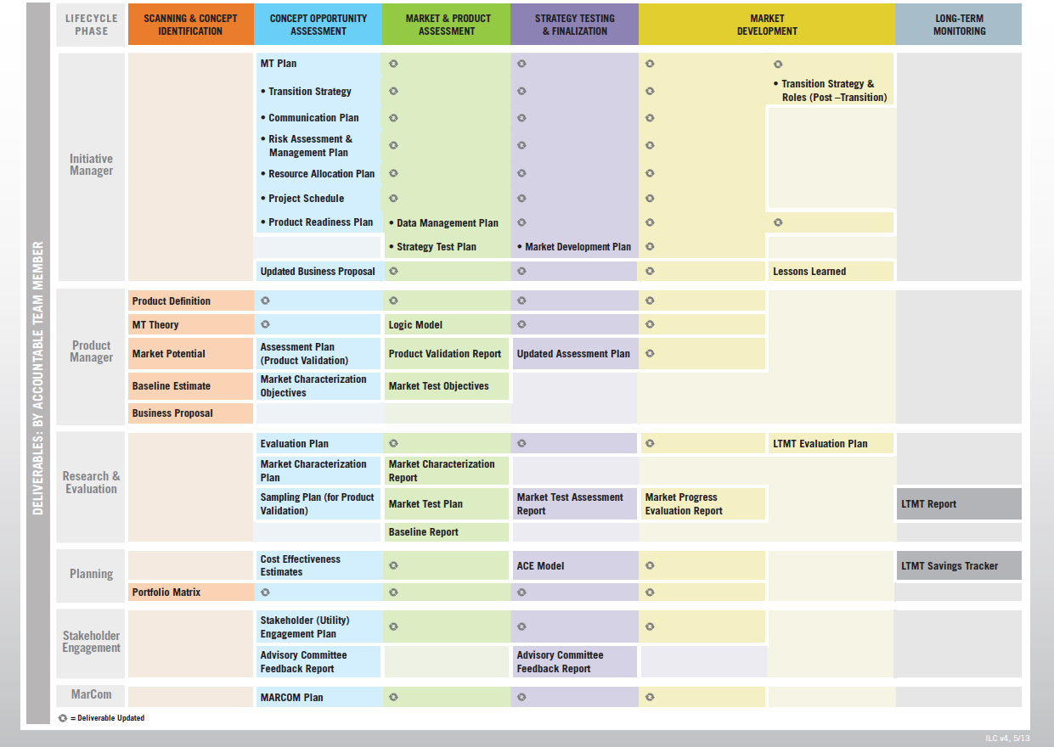
Functional Deliverables by Phase

Slide 10
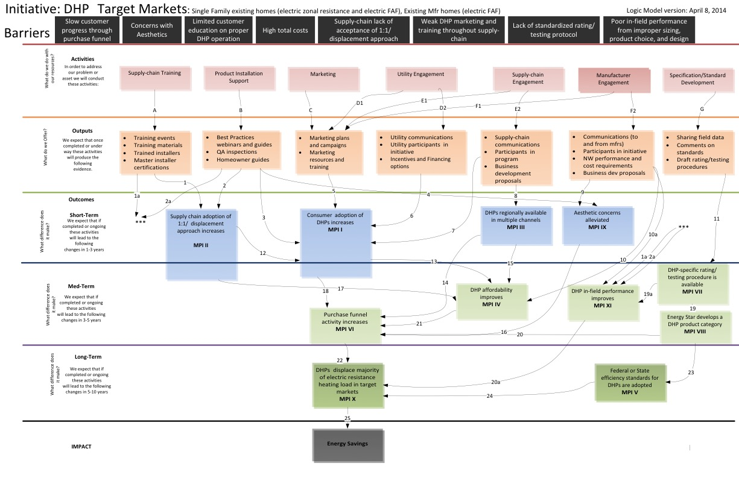
NEEA Logic Model – Ductless Heat Pumps

Slide 11
Key Role of Market Research & Evaluation
Product Testing | Confirm performance and customer acceptance
Baseline | Forecast the expected counterfactual adoption
Market Characterization | Confirm/refine understanding of market structure, barriers, opportunities, and key leverage points Identify competing products or solutions Estimate market size and confirm energy savings potential
Develop MPIs | Refine expected market progress indicators and how to measure them
Measure progress | Repeat assessments of progress on MPIs, market development, and programmatic adaptation
Build and disseminate market intelligence | Integrate other market data into evaluation findings; socialize insights and support market partners (including supply chain, utility programs, national organizations)
Document progress | Ensure progress through short- and mid-term outcomes is documented and vetted; monitor for signs of market stabilization

Slide 12

Real world MT Examples: Ductless Heat Pumps

Slide 13

Ductless Heat Pumps
MT in Action
Full-Scale Market Transformation Program
Implementation
“Master Installer”
Training and Recruiting
Pilot Program Utility Incentives and Contractor Marketing Tools
Retail partnership launch
Demonstration
projects
Field testing and regional technical trainings
  2006-2007
  2008
  2009
  2011
  2012
  2013-2018
Notes:
Change to click appear

Slide 14
Ductless Heat Pumps
Utility programs and incentives
Mature intervention
Demonstration
projects
Master Installer
Program
Retail partnership launch
Field testing and regional technical trainings
  2006-2007
  2008
  2009
  2011
  2012
  2013-2018
Product testing
Counterfactual baseline
Market characterization
Refine MPIs
Measure progress
Build market intelligence
Disseminate findings
Refine market assumptions
Document progress
Market Research & Evaluation
Notes:
Change to click appear

Slide 15
DHP Logic Model: Ready to Transition….

Slide 16
DHP Market Transformation and Local Programs
Source: NEEA DHP Market Progress Evaluation Report #7, September 2018

Slide 17
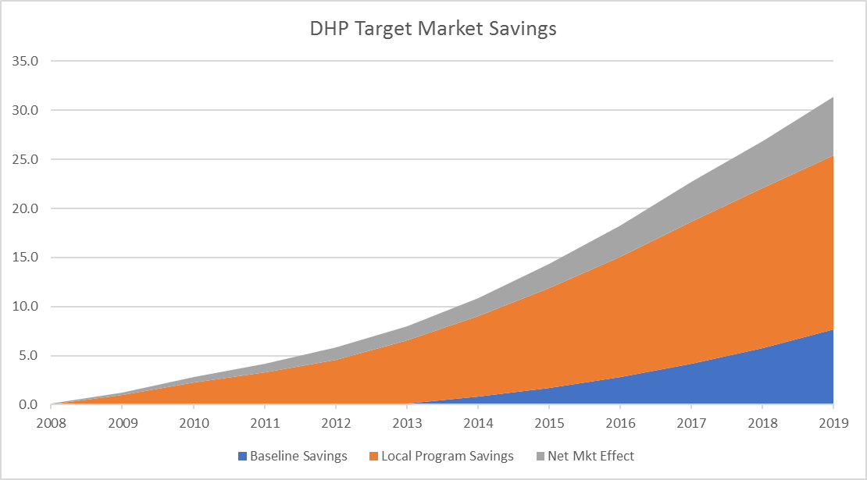
DHP Savings: Local Programs View

Slide 18
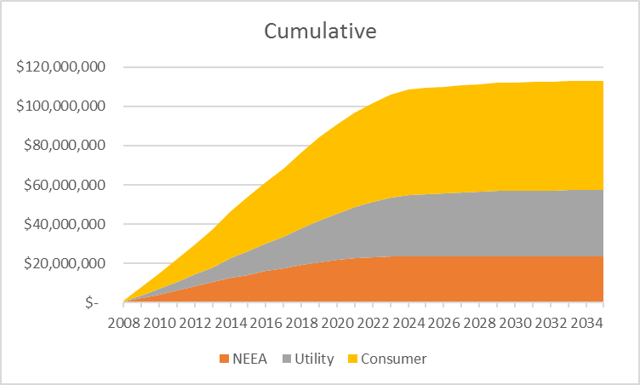
DHP Example: Costs

Slide 19
Ductless Heat Pumps
Market Transformation in Action
We are here
80%
Market
Transformation
17%
Baseline Market Share
Total Market Share
Notes:
Make this scale long and huge

Slide 20

Questions?

Slide 21

LET’S TALK ABOUT MARKETS
Buyers, Sellers Supply and Demand
Supplier
Consumer
Manufacturer
Distributor
Retailer
Notes:
In mainstream economics, the concept of a market is any structure that allows buyers and sellers to exchange any type of goods, services and information. [Wikipedia]

Slide 22
Knowing Your Market:
Market Baseline and Market Characterization
Suppliers:
Who has the influence?
Manufacturers:
Who makes it?
Distributors:
How does it get here?
Retailers:
Who sells it?
Customers:
Who buys it?

Slide 23





Step One (Part 1):
Identify Barriers and Opportunities
Lack of Awareness/ Information
Lack of Knowledge/ Capability
High First Cost
Product Quality
Lack of Availability
Notes:
Availability has a lot packed into it:
Could mean there are issues with the manufacturer getting channel access
Could mean only available in limited channels
Could mean that product has low shelf/floor space because of lack of demand
Could mean that there isn’t enough competition—too few offering a product
I don’t have a slide specifically on points of leverage/opportunities. But some examples:
self-referencing groups (industrial);
Professional/industry association (BOMA, NWFPA, SHAs, builder associations)
Other strategic partners;
Manufacturers;
Retailers;
us—our alliance/ability to coordinate with utility incentive programs;
National Orgs
CEE;
EPA & DOE;
Opportunities
codes;
upcoming federal standards revisions

Slide 24







Step One (Part 2):
Identify Opportunities
Professional & Industry Associations
Technology Changes
State and Federal
Legislation
Codes & Standards Spec Revisions
National
Organizations
Regional/National
Supply-Side Market Actors
Economic Changes
Notes:
Professional/industry orgs—demand side: BOMA, NWFPA, SHA’s
Regional/National market actors—supply side (manufacturers, distributors, retailers, designers, builders, service providers
National Orgs—could include standards-setting organizations: e.g. DOE, ASHRAE, ISO
Prominent orgs with “green efforts”: USGBC, AIA, BOMA
also CEE,
those who influence building energy codes
ce building energy codes

Slide 25





Step Two:
Develop Strategies for Intervention
Provide credible information
Build market capability,
knowledge and experience
Redefine the value proposition
Align EE product
with consumer needs
Influence energy codes
and standards
Notes:
Build knowledge—there’s a lot in here. It can be training. And it can be knowledge of how to get to increased energy efficiency/best practices (e.g., CEI)
One obvious one not on here is partnering with utilities—coordinated strategy.
So we looked at the S-curve—focused on market adoption—the long-term objective.
And we looked at some common market barriers & opportunities, and some MT strategies for addressing them.
The second part of this agenda is going to dig deeper into MT theory and strategy development.
Now I want to take a few minutes and look at the language that goes along with each of these.
Develop & Implement Strategic Market Interventions
Develop market intelligence
Build & leverage relationships
Develop strategic partnerships
Deliver education & training
Align messaging with
end-user needs
Provide credible information
Identify the barriers,
Intervention indicators,
Develop & Implement Strategic Market Interventions,
3rd party evaluation
Professional/industry orgs—demand side: BOMA, NWFPA, SHA’s
Regional/National market actors—supply side (manufacturers, distributors, retailers, designers, builders, service providers
National Orgs—could include standards-setting organizations: e.g. DOE, ASHRAE, ISO
Prominent orgs with “green efforts”: USGBC, AIA, BOMA
also CEE,
those who influence building energy codes

Slide 26












Step Three:
Define Key Metrics & Progress Indicators
$
%
aMW
#
aMW
%
$
Notes:
About Data….
Before we talk about actual markets, I’d like to make one stop to talk about DATA.
If your brain represents the theory of your MT initiative and your hands represent your implementation – Data is really the life blood of your project. With out it the project will certainly die.
Since these projects are almost always long in nature and based on theory and assumption you MUST have a method to assess your progress.
The data to validate your theory or progress needs to be designed in up front, along with answers on exactly how and who is going to capture it. It is critical to assure the continuous flow.
Finally your analysis of the information can help you adapt the project design to better pursue your objective.

Slide 27





MT Logic: The Core of the MT Program
BARRIERS & OPPORTUNITIES
INTERVENTION STRATEGIES
OUTPUTS
OUTCOMES
IMPACT
Your Planned Work
Your Intended Results
Notes:
Source: Stephen Doyle, "If A, Then B Poster," AIGA Los Angeles, 1995
The logic is in the linkages…. Not the boxes.

Slide 28








Objective
MT IMPLEMENTATION
An Adaptive Process
Market
Assessment
MT Theory
& Strategy
Implementation
Plan
Implement
Evaluate
Are we there yet?
Notes:
--------------
We said it was a “strategic process”. Here’s that process: it’s a continuous cycle with entry and exit points.
Start with an objective in mind. Generally, it’s to increase energy efficiency in a targeted market. Can be focused on a product, a business practice, or a combination of things.
Before doing anything, we assess the market. Before we can develop a theory of change or strategy, need to understand what is keeping the market from naturally becoming more energy efficient. We also need to understand potential points of leverage (since we can’t change things one building or person at a time), and any other potential opportunities. We’ll talk more about this later
Once we know the objective and know our market, we need to develop a theory of change and a strategy. Which market barriers will be go after? What points of leverage and opportunities will we use? How will we tackle those barriers & oppts? What do we expect to see happen that will tell us whether our strategy is working or needs adjustment?
Once we have our strategy, need to develop an implementation plan (operational) with specific tactics, resources, etc.
Implement
Evaluate (based on MT theory and logic model)
Adjust as needed
First, let’s talk about the long-term objective.
Strategic—the strategy development occurs here, and it is an area where NEEA has been an innovator.

Slide 29





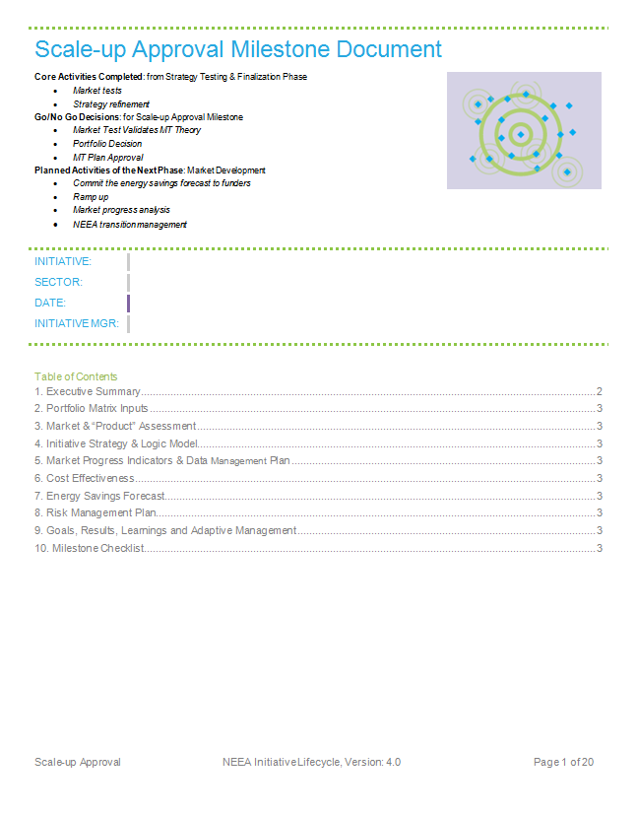




MT Initiative Life Cycle Documentation
Wraps a business plan around the MT Logic Model
  Market
  Progress
  Goals
  Risks
  Strategies for
  Regional Equity,
  NEEA Transition,
  Regional
  Coordination
  Energy
  Savings
  Data
  Management
  Plan
  Budget
  Cost-
  Effectiveness
  Cross-Functional
  Integration
  Plans
Notes:
Milestone Documents are prepared to summarize the initiative progress to date, vet the go/no-go decisions through formal engagement with NEEA’s management, and seek approval to begin the core phase activities of the next phase

