Slide 1

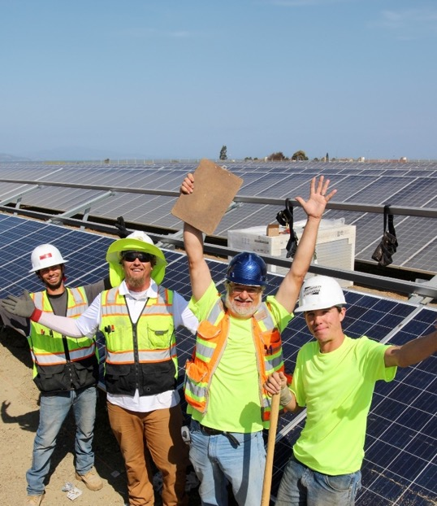


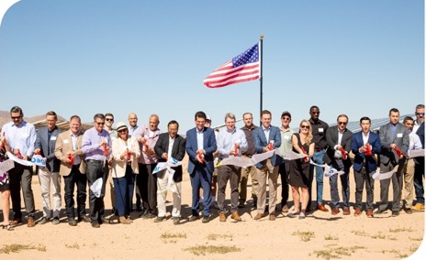

November 6, 2025
MCE
CAEECC Semi-Annual Energy Efficiency Report Out
Q1-Q2, 2025
Notes:
This is a a sample cover slide.

Slide 2
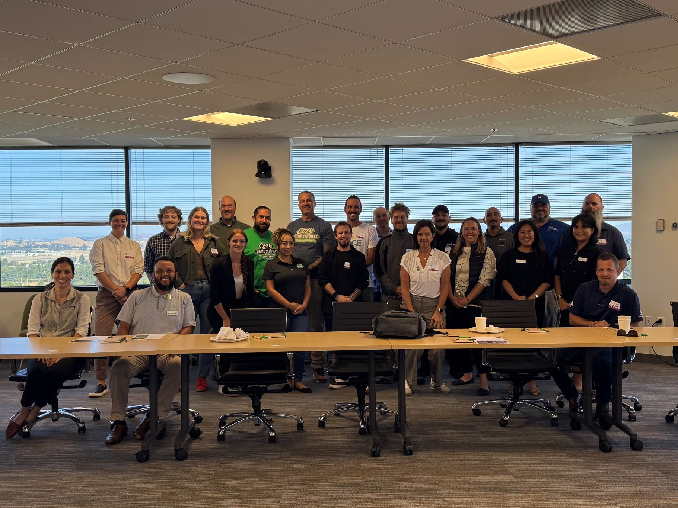
Home Energy Savings (HES): Upgraded 52% of forecasted homes in Q1–Q2
Green Workforce Pathways:
  Contractor Event in August
  Launched Contractor Finder Tool
Residential Flex Market:
  Relaunched mid-2025 with strong participation
  Project volume driven by MCE’s kicker incentive layered on EE funds
Non-Residential Flex Market:
  Ongoing challenge meeting cost-effectiveness thresholds
  MAP Program rule changes impacting project pipeline
  Forecasts to be revised downward in next application
Strategic Energy Management (SEM):
  New sales team launched in 2025
  Successful large-customer enrollments
  Anticipated TSB increase in 2026
MCE Q1-Q2 2025 Recent Developments/Key Highlights/Challenges

Slide 3
MCE Summary of TSB and Expenditures for Q1 and Q2 2025
​ | Q1 2025​ |  | Q2 2025​ |  | Q1 + Q2 2025​​
 | Total System Benefit ($)​ | Total Expenditure ($)​ | Total System Benefit ($)​ | Total Expenditure ($)​ | Total System Benefit ($)​ | Total Expenditure ($)​
Resource Acquisition​ | (17,023)​ | ​$463,925 | ​$276,251 | $928,305 | ​$259,228 | $1,392,230
Market Support​ | ​$0 | ​$163,783 | $0 | ​$351,046 | ​$0 | ​$514,828
Equity​ | ​$271,050 | ​$1,066,620 | ​$269,381 | ​$1,583,309 | ​$540,431 | ​$2,649,928
EM&V​ | ​$0 | ​$45,101 | ​$0 | ​$56,277 | $0​ | ​$101,378
Codes & Standards​ | ​N/A | ​N/A | ​N/A | ​N/A | ​N/A | ​N/A
TOTAL Portfolio​ | ​$254,027 | ​$1,739,429 | $545,632 | ​$2,918,937 | ​$799,659 | ​$4,658,366

Slide 4
MCE 2025 Full Year TSB and Expenditures Estimate and 4-Year Budget Standing
2025 TSB Full Year Estimate​ and 4-Year Progress |  |  | 2025 Full Year Expenditure Estimate and 4-Year Progress
Q1 and Q2 ​TSB Claimed​ | $545,632 |  | Q1 and Q2 ​Expenditure | $4,658,366
Q3 and Q4 ​TSB Forecast | $3,000,000 |  | Q3 and Q4 ​Expenditure Forecast | $6,000,000
Total TSB Forecast ​Attainment​ | $3,545,632 |  | Total 2025 Forecast Expenditure | $10,658,366
2024 + 2025 TSB Forecast | $6,827,869 |  | 2024 + 2025 Total Expenditures | $21,429,989
Approved 4-year TSB goal | % of TSB (‘24+’25)​ to 4-yr goal | $92,772,618 | 7% | Approved 4-year budget amount | % of budget spent | $78,217,316 | 27%

Slide 5
MCE 2025 Q1 and Q2 Claims by Sector & Prevalent Measures
​ |  | Ag. | Commercial | Cross-Cutting​ | Industrial​ | Public​ | Residential​ | Total
TSB​ |  | $0 | $259,228 | $0 | $0 | N/A | $540,431 | 799,659
GHG (w/ C&S)​ |  | 0 | 929 | 0 | 0 | N/A | 2,019 | 2,948
kWh​ | Annual Gross​ | 0 | 529,283 | 0 | 0 | N/A | (86,385) | 442,898
 | Annual Net​ | 0 | 541,871 | 0 | 0 | N/A | (101,749) | 440,122
 | Lifecycle Net​ | 0 | 2,947,290 | 0 | 0 | N/A | (1,111,160) | 1,836,130
Therms | Annual Gross​ | 0 | 4,182 | 0 | 0 | N/A | 26,066 | 30,248
 | Annual Net​ | 0 | 2,718 | 0 | 0 | N/A | 24,616 | 27,334
 | Lifecycle Net​ | 0 | 13,592 | 0 | 0 | N/A | 444,405 | 457,997
kW​ | Annual Gross​ | 0 | 63 | 0 | 0 | N/A | 54 | 117
 | Annual Net​ | 0 | 64 | 0 | 0 | N/A | 40 | 104
Top Measures by TSB by Sector
 | Agricultural​ | Commercial​ | Cross-Cutting​ | Industrial​ | Public​ | Residential​
Measure Name | No Ag. Measures Installed as of Q2 | Pop-NMEC | Non-resource program | No Ind. Measures Installed as of Q2 | N/A | Duct Sealing
Average Measure Cost / Deemed Value | $0 | $35,263 | $0 | $0 | N/A | $3,755

Slide 6
Thank you!

