Slide 1
CAEECC Quarterly Meeting
Full CAEECC Meeting #31
Facilitation Team: Dr. Jonathan Raab and Katie Abrams
December 2, 2021

Slide 2
Agenda
Time | Session | Objectives | Document | Presenter
9:00 | Introductions | Introductions, review of agenda and meeting objectives | Agenda | Facilitator
9:10 | Session 1: Important Updates | 3rd Party Solicitation Update Market Support and Equity Metrics WG Debrief I-REN Update | Slides 7-11 Slides 12-21 Slides 22-26 | Vanessa Mapula Garcia (SDG&E) Facilitators Nils Strindberg (CPUC)
9:30 | Session 2: CAEECC Composition, Diversity, Equity, and Inclusion Working Group (CDEI WG) | Discuss Prospectus Discuss recruitment strategy and timeline Initial CDEI Team Recommendations for CAEECC Provide opportunity for public input Refine & approve Prospectus & recruitment strategy Review & finalize Conflict of Interest Policy update | Prospectus, and slides 29-42 Slides 38-39 Slides 40-41 Slides 29 and 42 Slide 43 Slide 44 | Facilitator Facilitator Facilitator Public Facilitator Facilitator
10:40 | Break
10:50 | Session 3: Strategies for Business Plans/4 year Applications | Discuss PA segmentation strategies for upcoming Business Plans/4 year Applications (reflecting on Metrics WGs recommendations and BBALs) Discuss how PAs will address non-consensus recommendations in MSMWG and EMWG reports Provide opportunity for public input | Compilation of BBAL Segmentations, slides 49-50 WG Reports, slide 51 Slides 48 and 52 | All All Public
11:50 | Session 4: CAEECC 2022 Planning | 2022 Workplan & full Quarterly Meeting Dates Topics for next full CAEECC meetings (early and late March 2022) CAEECC Facilitation Contract Update | Slide 55 Slide 56 Slide 57 | Facilitators Facilitators Co-Chairs and/or PG&E?
12:10 | Wrap-Up/Next Steps | Meeting evaluations Summarize accomplishments for day and delineate next steps | Slides 59-60 | Facilitators
12:15 | Adjourn (please complete meeting evaluation asap)

Slide 3
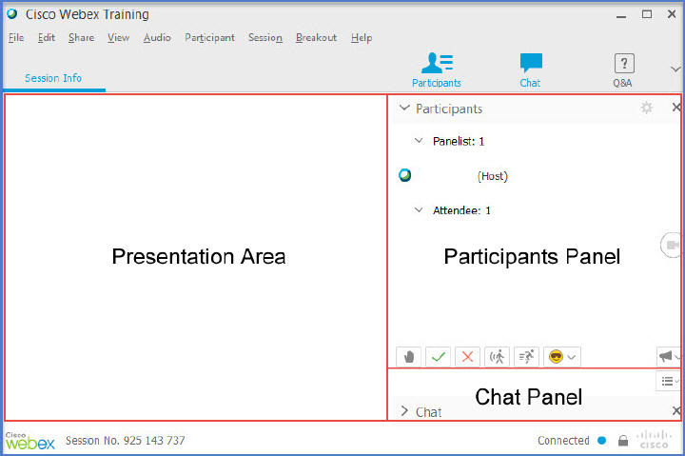
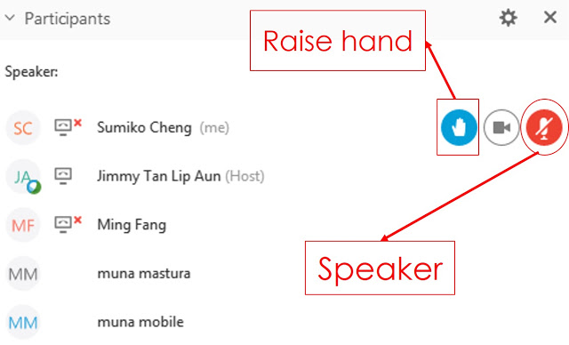
WebEx Technical Reminders
Raise hand to enter queue – then unmute when called upon
Mute when not speaking
Zoom in & out of documents
Chat the Host (Susan Rivo) with technical difficulties
Image courtesy: Blended Learning and FCSO

Slide 4
Piloting Expanded Public Participation
The Public can use the Q&A at any time during the meeting to ask questions or provide feedback. CAEECC Co-Chairs Lara Ettenson (NRDC) and Jenny Berg (BayREN) will respond.
  Use the Chat for technical difficulties (send to the Host, Susan Rivo)
There will be two opportunities for verbal public participation
  Session 2: CAEECC Composition, Diversity, Equity, and Inclusion Working Group (CDEI WG)
  Session 3: Strategies for Business Plans/4 year Applications

Slide 5
Session 1: Important Updates

Slide 6
Topics
3rd Party Solicitation Update
Market Support and Equity Metrics WG Debrief
I-REN Update

Slide 7
third party programs solicitations update
CAEECC Quarterly Meeting
December 2, 2021

Slide 8
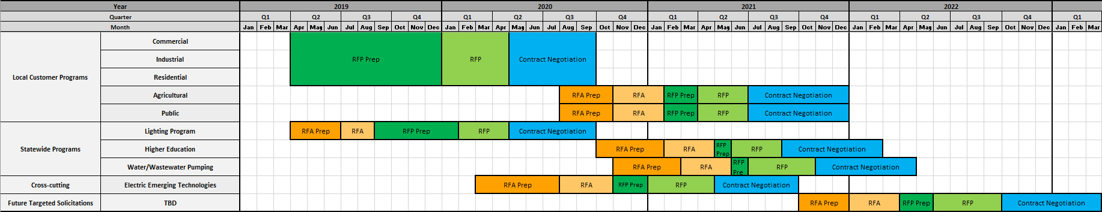
SCE Solicitation Timeline
Today

Slide 9
PG&E Solicitation Timeline
Today

Slide 10
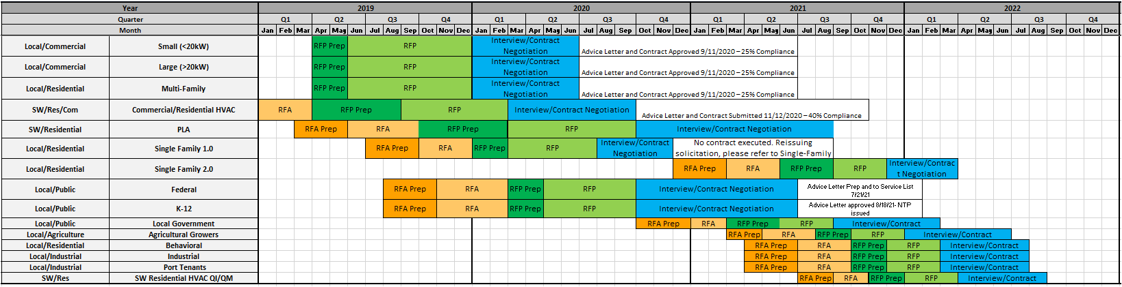
SDG&E Solicitation Timeline
Today

Slide 11
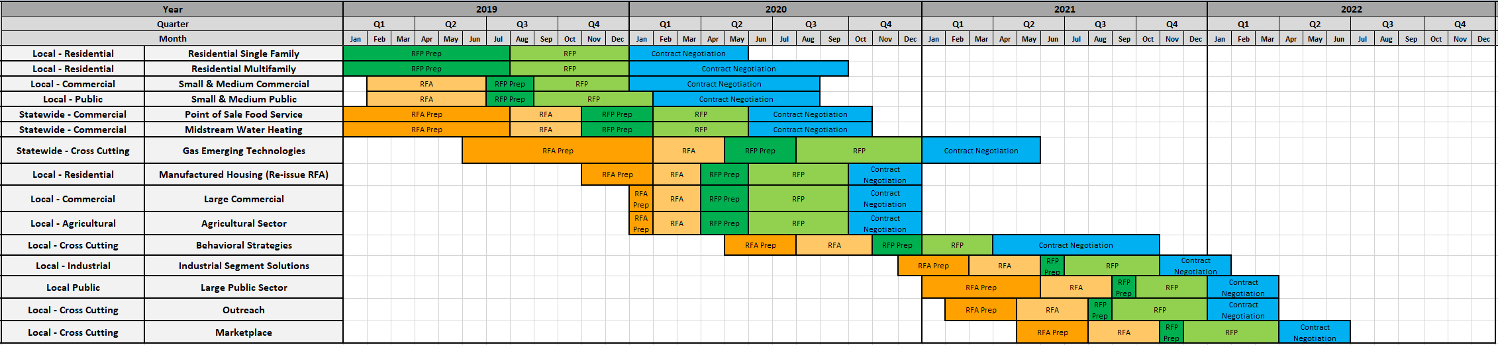
SoCalGas Solicitation Timeline
Today

Slide 12
Market Support and Equity Metrics WG Debrief
Both WGs ran June-October; final reports posted to CAEECC website
Each WG reached consensus on nearly all its recommendations
The CPUC decided that these reports should be filed as part of the Program Administrators’ (PAs) applications due February 15, 2022 (rather than in a stand-alone filing now) – PAs must use the recommendations in developing their energy efficiency portfolio applications and Business Plans.

Slide 13
Market Support Metrics Working Group (MSMWG) Final Report
Principles
  Segment vs program-level
  Guidelines to setting metrics
  Relationship between programs and sub-objectives
  Program portfolios
  Reporting
  Target-setting (non-consensus)
Objectives
  Primary Objective: “Supporting the long-term success of the energy efficiency (EE) market"
  Sub-Objectives and associated key Metrics
    Demand
    Supply
    Partnerships
    Innovation and accessibilities
    Access to capital
Reached consensus on all but one recommendation
Report posted to MSMWG landing page: https://www.caeecc.org/market-support-metrics-wg

Slide 14
MSMWG Target-setting options summary for the 1 non-consensus item
Target-Setting Option | First Choice Option | Acceptable Option
Option 1: Targets will be set by the PAs for MS segment metrics following the collection of the first two program years of data (or a baseline has been set using reasonable proxy data). (15 first choice, 18 acceptable of 19 voting members) | 3C-REN, BayREN, CEDMC, CHEEF, Nexant, PG&E, RCEA, SCE, SCG, SDGE, SJVCEO, SoCalREN, The Energy Coalition, The Mendota Group, Viridis Consulting | 3C-REN, BayREN, CEDMC, CHEEF, CodeCycle, CSE, Nexant, PG&E, RCEA, SBuA, SCE, SCG, SDGE, SJVCEO, SoCalREN, The Energy Coalition, The Mendota Group, Viridis Consulting
Option 2: In their Budget Applications, PAs will propose targets and/or set a date certain by which they will propose targets for all MS segment metrics. (4 first choice, 13 acceptable of 19 voting members) | Cal Advocates, CodeCycle, CSE, SBUA | Cal Advocates, CEDMC, CHEEF, CodeCycle, CSE, Nexant, SBUA, SJVCEO, SoCalREN, The Energy Coalition, The Mendota Group, Viridis Consulting, SBUA

Slide 15
Equity Metrics Working Group (EMWG) Final Report
Principles
  Segment vs program-level
  Guidelines to setting metrics
  *Program portfolios
  *Best practices for program development
  Reporting
  Target-setting (non-consensus)
  *Community engagement (non-consensus)
Primary Objective: “For hard-to-reach, disadvantaged, and/or underserved individuals, households, businesses, and communities: address disparities in access to energy efficiency programs and workforce opportunities*; promote resilience, health, comfort, safety, energy affordability**, and/or energy savings; and reduce energy-related greenhouse gas and criteria pollutant emissions***.”
13 Metrics and Indicators across the following 3 categories
  Measure who and how target populations are “served” (9 consensus recommendations)
  Assess energy and/or cost savings in targeted populations (2 of 3 recommendations were consensus)
  “Holistic” benefits (1 consensus recommendation)
Definition of “Underserved” (non-consensus)
Reached consensus on all but 3 recommendations
Report posted to EMWG landing page: https://www.caeecc.org/equity-metrics-working-group-meeting

Slide 16
EMWG Target-setting options summary for non-consensus item
Target-Setting Option | First Choice Option | Acceptable Option
Option 1: Targets will be set by the PAs for Equity segment metrics following the collection of the first two program years of data (or a baseline has been set using reasonable proxy data). (12 first choice, 21 acceptable of 24 voting members) | 3C-REN, BayREN, CEDMC, MCE, PG&E, RCEA, SCE, SCG, SDGE, Silent Running LLC, SJVCEO, Viridis Consulting | 3C-REN, BayREN, CEDMC, CodeCycle, CSE, High Sierra Energy Foundation, MCE, PG&E, RCEA, Resource Innovations, Rising Sun Center for Opportunity, SBUA, SCE, SCG, SDGE, Silent Running LLC, SJVCEO, SoCalREN, The Energy Coalition, TRC, Viridis Consulting
Option 2: In their Budget Applications, PAs will propose targets and/or set a date certain by which they will propose targets for all Equity segment metrics (12 first choice, 19 acceptable of 24 voting members) | Cal Advocates, CodeCycle, CSE, EEC, High Sierra Energy Foundation, NRDC, Resource Innovations, Rising Sun Center for Opportunity, SBUA, SoCalREN, The Energy Coalition, TRC | 3C-REN, BayREN, Cal Advocates, CEDMC, CodeCycle, CSE, EEC, High Sierra Energy Foundation, MCE, NRDC, Resource Innovations, Rising Sun Center for Opportunity, SBUA, SCG, Silent Running LLC, SoCalREN, The Energy Coalition, TRC, Viridis Consulting

Slide 17
EMWG Community engagement options summary for non-consensus item
Community Engagement Option | First Choice Option | Acceptable Option
Option 1: Community engagement as an Indicator (8 first choice, 17 acceptable of 24 voting members) | CSE, MCE, NRDC, Rising Sun Center for Opportunity, SBUA, Silent Running LLC, SoCalREN, The Energy Coalition* | CEDMC, CodeCycle, CSE, EEC, High Sierra Energy Foundation, MCE, NRDC, Rising Sun Center for Opportunity, RCEA Resource Innovations, SBUA, Silent Running LLC, SJVCEO, SoCalREN, The Energy Coalition, TRC, Viridis Consulting
Option 2: Community engagement as a Principle (16 first choice, 22 acceptable of 24 voting members) | 3C-REN, BayREN, Cal Advocates, CEDMC, CodeCycle, EEC, High Sierra Energy Foundation, PG&E, RCEA, Resource Innovations, SCE, SCG, SDGE, SJVCEO, TRC, Viridis Consulting | 3C-REN, BayREN, Cal Advocates, CEDMC, CodeCycle, EEC, High Sierra Energy Foundation, MCE, NRDC, PG&E, RCEA, Resource Innovations, Rising Sun Center for Opportunity, SBUA, SCE, SCG, SDGE, SJVCEO, SoCalREN, The Energy Coalition, TRC, Viridis Consulting

Slide 18
EMWG “Underserved” definition options summary for non-consensus item
Underserved Definition Option | First Choice Option | Acceptable Option
Option 1: Use ESJ Action Plan Definition (2 first choice, 13 acceptable of 24 voting members) | Cal Advocates, CodeCycle | 3C-REN, BayREN, Cal Advocates, CEDMC, CodeCycle, High Sierra Energy Foundation, Resource Innovations, Rising Sun Center for Opportunity, SBUA, SCE, SCG, SJVCEO, TRC
Option 2: Use ESJ Action Plan Definition + allow an avenue for PAs to propose additional ‘underserved’ with rationale. (19 first choice, 21 acceptable of 24 voting members) | 3C-REN, BayREN, CEDMC, CSE, EEC, NRDC, PG&E, Resource Innovation, Rising Sun Center for Opportunity, SBUA, SCE, SCG, SDGE, Silent Running LLC, SJVCEO, SoCalREN, The Energy Coalition, TRC, Viridis Consulting | 3C-Ren, BayREN, CEDMC, CodeCycle, CSE, EEC, High Sierra Energy Foundation, NRDC, PG&E, Resource Innovations, Rising Sun Center for Opportunity, SBUA, SCE, SCG, SDGE, Silent Running LLC, SJVCEO, SoCalREN, The Energy Coalition, TRC, Viridis Consulting
Option 3: Allow the PAs to determine underserved. (3 first choice, 14 acceptable of 24 voting members) | High Sierra Energy Foundation, MCE, RCEA | 3C-REN, BayREN, CEDMC, CodeCycle, High Sierra Energy Foundation, MCE, RCEA, Resource Innovations, Rising Sun Center for Opportunity, SBUA, SCE, SCG, SJVCEO, TRC
Notes:
Members were asked if “Regardless of your 1st choice, are all three options acceptable to your organization?” – some Members found only two of three options acceptable. See Appendix C for details

Slide 19
Recommended Reporting Templates

Slide 20
Market Support and Equity Metrics WG Evaluation Scores
 | EMWG Averages | MSMWG Averages
Goals Clearly Articulated | 5.0 | 4.9
Goals Accocmplished | 4.5 | 4.6
Effective sub-WG Process | 4.8 | 4.7
Successful Approach to joint text development | 5.0 | 4.7
Documents Clear & Helpful | 4.7 | 5.0
Timeframe appropriate | 15 too short; 7 about right; 0 too long | 9 too short, 9 about right, 1 too long
Members Flexible Seeking Agreements | 4.9 | 4.5
Facilitators Were Effective | 4.5 | 4.9
Research Teams Were Effective | NA | NA
EMWG Process Created More Value Than if at CPUC | 5.0 | 4.8
Overall Process was successful in meeting goals and objectives and yielding productive outcomes. | 4.6 | 4.7
Notes
1) Scores are 1-6 scale, where 1 is "strongly disagree" and 6 is "strongly agree”; and 3.5 is mid-point of 1-6 scale
2) Scores based on responses from 22/24 voting EMWG members and 18/19 voting MSMWG members
3) EMWG and MSMWG Member associated evaluation comments available on the respective landing pages: https://www.caeecc.org/equity-metrics-working-group-meeting and https://www.caeecc.org/market-support-metrics-wg

Slide 21
Past Evaluations: “All Things Considered” Score
Evaluation Question | MTWG Phase I | MTWG Phase II | EMWG | MSMWG | UWG
All Things Considered, WG Was A Successful Process | 5.3 | 4.5 | 4.6 | 4.7 | 4.1

Slide 22
Welcome, Inland Regional Energy Network (I-REN)!
I-REN’s service area includes San Bernardino County, Riverside County, and all of the jurisdictions within the region – representing 52 cities, 78 unincorporated county areas, 17 tribes and 11% of the population of California
Coalition of three councils of government, the Western Riverside Council of Governments (WRCOG), the Coachella Valley Association of Governments (CVAG), and the San Bernardino Council of Governments (SBCOG)
Lead representative: Benjamin Druyon, Program Manager
Alternate: Tyler Masters, Program Manager
There are now 24 CAEECC members!

Slide 23

ENERGY DIVISION PRESENTATION ON DECISION TO APPROVE INLAND REGIONAL ENERGY NETWORK (I-REN)
Nils B. Strindberg
Energy Division
December 2, 2021

Slide 24
Background
February 26, 2021: I-REN filed a motion with business plan for CPUC to consider
  Requested ~$50M for 2021-25 to offer C&S, Public Sector and WE&T to Riverside and San Bernardino Counties
May 2021: CPUC adopted D.21-05-031, which adopts a new filing schedule and processes (among many changes)
July 6, 2021: ruling with questions for parties on the I-REN business plan was mailed
Responses focused on:
  Whether I-REN would have to refile their business plan with the other PAs in February 2022 to align with the schedule;
  The reasonableness of I-REN’s proposed budget;
  If I-REN’s business plan was filling gaps and/or targeting HTR customers.
October 15, 2021: Proposed Decision mailed
November 18, 2021: Proposed Decision adopted

Slide 25
What did the Decision Approve
(Budget and Portfolio)
Approved $65M budget for I-REN and approves their business plan from 2022-27
  I-REN does not have to refile a business plan and application in February 2022
  The decision added extra years because of changes to the filing schedule in D.21-05-031 and to ensure that I-REN will be on the same timeline as other PAs filing their applications in early 2026 for 2028-31 funding cycle
  Did not adopt significantly smaller budgets as proposed by certain parties
Approved I-REN’s portfolio of programs as proposed

Slide 26
What did the Decision Approve
(Filing Requirements)
By no later than July 1, 2022, I-REN must submit a Tier 2 advice letter, detailing its portfolio segmentation strategy and updating its proposed sectoral and program metrics
60 days after the adoption of the decision, I-REN and all overlapping PAs must submit a joint cooperation memo to the CPUC as a Tier 2 advice letter
  In program year 2023 and thereafter I-REN, like all other PAs, will submit the joint cooperation memos in annual reports as directed by D.21-05-041
I-REN will be required to file mid-cycle “true up” advice letter with all other PAs
I-REN will be required to comply with the requirements and schedules of all other energy efficiency PAs

Slide 27
Session 2: CAEECC Composition, Diversity, Equity, and Inclusion Working Group (CDEI WG)

Slide 28
Topics
Discuss Prospectus
Discuss recruitment strategy and timeline
Provide opportunity for public input
Refine & approve Prospectus & recruitment strategy
Review & finalize Conflict of Interest Policy update
Initial CDEI Team Recommendations for CAEECC

Slide 29

Process for Public Participation
The Public can use the Q&A at any time during the meeting to ask questions or provide feedback. CAEECC Co-Chairs Lara Ettenson (NRDC) and Jenny Berg (BayREN) will respond.
  Use the Chat for technical difficulties (send to the Host, Susan Rivo)
To provide verbal feedback:
  Email <Susan@raabassociates.org> before 10:00 to be added to the queue
  Public mics will be open from approximately 10:05-10:15
    CAEECC Members/Speakers will respond to the Public, if applicable and time permitting

Slide 30
Composition, Diversity, Equity, and Inclusion Working Group (CDEI WG) Overview
Charge: review CAEECC membership and recommend additional ways to create a more inclusive and accessible CAEECC collaborative
4 virtual meetings (plus optional onboarding mtg): January 2021-March 2022
Recommendations delivered to full CAEECC for approval March 2022
Application process for interested non-CAEECC stakeholders extended thru 12/15
Prospectus available at https://www.caeecc.org/cdei-working-group

Slide 31
CDEI Design Team
Group of stakeholders who met in early November
Focus was to discuss & refine Prospectus and Recruitment Strategy in preparation for today’s meeting
Recruitment process was open to CAEECC and non-CAEECC Members
Design team members
  Alejandra Tellez, 3C-REN
  Alison LaBonte, CPUC
  Fabi Lao, CSE
  Lara Ettenson, NRDC
  Lujuana Medina, SoCalREN
  Melanie Peck, The Energy Coalition
  Monica Palmeira, CPUC
  Nils Strindberg, CPUC

Slide 32
Background
Membership composition scope stems from CAEECC Groundrule 7: “Periodically (i.e., every other year) the CAEECC should consider whether important broad stakeholder clusters are missing from current CAEECC make-up—e.g., an organization specializing in social justice issues”
Originally, the focus of the WG was going to be on membership composition, but at the request of the California Public Utilities Commission (CPUC), the scope expanded to include charting a course for CAEECC to be a leader in fostering diversity and inclusivity

Slide 33
Working Group Charge
Review CAEECC membership including composition of the organizations on CAEECC, as well as diversity of Member representatives. Identify next steps to address any composition and diversity issues, including overcoming any identified barriers to participation.
Recommend additional ways to create a more inclusive and accessible CAEECC collaborative to (a) allow for easier participation from a wider array of stakeholders and (b) to create a space to ensure that CAEECC’s recommendations on policies and programs are grounded based on input from by a more inclusive and diverse group.

Slide 34
Membership Composition Questions for WG
What is the vision/goal of evaluating CAEECC membership?
What types of organizations are under-represented or missing altogether as CAEECC Members?
What are the barriers/potential reasons for those gaps (e.g., recruitment, capacity, familiarity with EE policy AND PROGRAM requirements, scope of CAEECC)?
What types of organizations, if any, might be over-represented on CAEECC?
Would funding or other resources facilitate under-resourced organizations’ participation as CAEECC Members and/or in CAEECC Working Groups? (Note: consider coordinating with CPUC on possible pilot opportunities)
Other topics/solution ideas as appropriate

Slide 35
DEI Questions for WG
How can we diversify the￼lead representatives from CAEECC Member organizations on CAEECC?
What forms of diversity does CAEECC want to foster (e.g. race as well as gender, gender identity or expression, sexual orientation, national origin, citizenship, age, ability, veteran, religion, income?
What additional facilitation practices can we employ to foster more inclusive meetings?
What Member recruitment and retention strategies would advance our DEI commitment (e.g., possible compensation, geographic inclusivity in the context of future in-person meetings)?
What organizational and educational development practices should the CAEECC consider (e.g., building DEI competencies or DEI training for Members and the Facilitation team; creating EE policy basics trainings; updating the CAEECC website and/or Charter)?
Other topics/solution ideas as appropriate
Notes:
Pause here for questions

Slide 36
CDEI WG: Meeting Dates & Tasks
Meeting # | Approximate Meeting Month | Tasks/Objectives
Facilitation Team/CAEECC Leadership Prework | Dec 2021- January 2022 | Outline lessons learned from other jurisdictions to inform the January meeting
Optional CAEECC Onboarding | January 2022 | Introduction to CAEECC (e.g., purpose, structure, history, charter, and approach to seeking consensus)
1st meeting | January 2022 | Review Prospectus—including scope, approach, and timeline Educational sharing (e.g., brief overview of CAEECC historical practices; existing DEI terms, including those in the ESJ Action Plan 2.0; what other jurisdictions are doing; organizational best practices) Identify common vision/shared goal Outline further details of what will be covered in this group Sketch out strategy to collect data on current composition
2nd meeting | January or February 2022 | Discuss key participation and access barriers and issues Outline ways to enhance CAEECC’s ability to center equity and develop energy efficiency policy and program recommendations through a DEI lens Brainstorm possible solutions/recommendations
3rd meeting | February 2022 | Develop draft recommendations
4th meeting | March 2022 | Finalize recommendations
Optional additional meeting(s) –only if needed | Spring/ Summer 2022 | Potentially assist with implementing recommendations (only if needed)
Notes:
Note that mtgs will be virtual, and 9-approx. 1pm

Slide 37
Deliverable & Recommendations Timeline
Deliverable: A report delineating recommendations for the full CAEECC’s consideration and approval.
Recommendations Timeline:
  The full WG recommendations will be presented for approval at the March 31, 2022 full CAEECC meeting.
  All recommendations will be implemented no later than August 2022.

Slide 38

Member Application Process
CAEECC Member Organizations
Automatically eligible to participate (as long as lead representative or alternate commits to attending all WG meetings, abiding by Groundules, and completing assigned work)
If interested email Susan Rivo by 12/15 to indicate who will be the lead representative (and alternate, if desired) from your organization, and their contact information (email/phone)
Other Interested Stakeholders
Requirements:
Attend all meetings (either lead or designated alternate)
Have experience in DEI and/or energy efficiency
Abide by all Groundrules
Complete assigned work between meetings
Applications:
Applications from qualified people/organizations will be accepted 11/17-12/15
To apply, fill out the Survey Monkey application using link on the CDEI WG landing page
Note: The WG will be open to the public to observe and provide input at designated times
Final determination made 12/17

Slide 39
Outreach
Outreach to Listservs:
  CAEECC listserv
  R.13-11-005
  A.19-11-003 et al.
  ESJ list
  LIOB list
  DAC Advisory Group
  Strategic Growth Council
  CEC list servs: EE, Advanced EE, and Barriers listserv
  Additional organizations may be directly recruited by CAEECC for their expertise and experience in the subject matter of each WG
Targeted Outreach
  Rising Sun, Greenlining, TURN, CalEPA, CARB
Other outreach suggestions or application process improvements?
Notes:
3rd pause for feedback

Slide 40
Recommendations of CDEI Design Team to CAEECC
Completed
  WG Design: Developed draft Prospectus and Recruitment strategy (for CAEECC review and Approval).
  CAEECC Website: Adopt inclusive scheduling protocol (i.e., update the CAEECC calendar to show major religious holidays and continue to schedule around them)
In-progress:
  Diversity of CAEECC Member Representation: Evaluate and consider updating chosen representation on CAEECC to foster greater diversity (request from Commissioner Shiroma/ED)
Piloting at CDEI Working Group Meetings & full CAEECC Meetings
  Facilitation: Pilot public participation process/options (e.g., chat vs verbal participation)
  Facilitation: Include DEI norms in groundrules

Slide 41
Proposed New Meeting Norms
Make space, take space (share the mic).
Stories shared here stay here; what is learned here leaves here.
Share your unique perspective: share your unpopular opinion!
Generative thinking: "yes, and" instead of "yes, but".
Listen from the "We", speak from the "I".
Offer what you can; ask for what you need.
Be inquisitive.
Assume best intent.
Be empowered to share impact.
Notes:
Pilot for rest of mtg and WG

Slide 42
Questions & Input?
Public Participation
Verbal comments from approximately 10:05-10:20 (as mentioned earlier, the Public needed to email Susan by 10:15 to be added to the queue to speak)
The Public can use the Q&A at any time during the meeting to ask questions or provide feedback. CAEECC Co-Chairs Lara Ettenson (NRDC) and Jenny Berg (BayREN) will respond.

Slide 43
Refine & Approve Prospectus & Recruitment Strategy
CAEECC Members
Feedback, Refinement, and Approval

Slide 44
COI/Disclosure Policy Update
Is there approval to add Groundrules that were Piloted for Metrics WGs?
  Non-CAEECC Member organizations participating in a Working Group are required to disclose to the Working Group and the Facilitation Team the entities with whom they are currently doing energy-related business with or for, both currently and within the past year. If new contractual relationships develop during the course of the Working Group, they will update their disclosure.
  Non-CAEECC Working Group members must disclose whether they are proposing to represent their own organization or another, and if the latter to disclose that organization or organizations
Pending CAEECC Member approval, we will ask CDEI WG applicants these questions before they’re formally approved
Notes:
“CAEECC Roles and Responsibilities III.E.ii”

Slide 45

Break

Slide 46
Session 3: Strategies for Business Plans/4 Year Applications

Slide 47
Topics
Discuss PA segmentation strategies for upcoming Business Plans/4 year Applications (reflecting on Metrics WGs recommendations and BBALs)
Discuss how PAs will address non-consensus recommendations in MSMWG and EMWG reports
Provide opportunity for public input

Slide 48
Process for Public Participation
The Public can use the Q&A at any time during the meeting to ask questions or provide feedback. CAEECC Co-Chairs Lara Ettenson (NRDC) and Jenny Berg (BayREN) will respond.
  Use the Chat for technical difficulties (send to the Host, Susan Rivo)
To provide verbal feedback:
  Email <Susan@raabassociates.org> before 11:30 to be added to the queue
  Public mics will be open from approximately 11:35-11:50
    CAEECC Members/Speakers will respond to the Public, if applicable and time permitting

Slide 49
2022/2023 BBAL Segmentation Budgets
For more info, see BBAL Segmentation Compendium (Word doc including table above) posted to 12/2 mtg page: https://www.caeecc.org/12-2-21-full-caeecc-mtg
Note that the % columns refer to the percent within RA, MS, and Equity (not including Codes & Standards or Evaluation, Measurement, & Verification)
 | Resource Acquisition |  | Market Support |  | Equity |  | Total
PA | Budget, $000 | % | Budget, $000 | % | Budget, $000 | % | Budget, $000
BayREN | $ 7,778 | 17% | $ 5,865 | 12% | $ 33,448 | 71% | $ 47,091
3-C REN | $ - | 0% | $ 3,758 | 21% | $ 14,012 | 79% | $ 17,770
MCE | $ 21,965 | 76% | $ 1,378 | 5% | $ 5,521 | 19% | $ 28,864
PG&E | $ 356,521 | 79% | $ 80,656 | 18% | $ 14,511 | 3% | $ 451,688
RCEA | $ 1,210 | 100% | $ - | 0% | $ - | 0% | $ 1,210
SCE | $ 531,278 | 82% | $ 81,318 | 13% | $ 34,255 | 5% | $ 646,851
SDG&E | $ 134,210 | 82% | $ 28,241 | 17% | $ 515 | < 1% | $ 162,966
SoCal Gas | $ 179,097 | 73% | $ 33,429 | 14% | $ 32,000 | 13% | $ 244,526
SoCalREN | $ 22,235 | 46% | $ 15,814 | 33% | $ 10,484 | 22% | $ 48,533
Total Budget/ Avg % | $ 1,246,516 | 78% | $ 244,594 | 15% | $ 111,298 | 7% | $ 1,602,408
Notes:
Public input

Slide 50
BBALs Discussion
Reflecting on PAs’ BBALs Segmentation and the Metrics WGs Recommendations:
Do you have any questions for individual PAs on their BBAL segmentation decisions?
For PA CAEECC Members: Is there anything you’d like feedback regarding segmentation strategies for the upcoming Business Plans/4 year Applications?
For the non-PA CAEECC Members: Do you have any advice for the PAs on their segmentation strategies for the upcoming Business Plans/4 year Applications?
Other questions or feedback?
Notes:
Public input

Slide 51
Addressing Non-Consensus Issues in MSMWG & EMWG Reports in PA 4 Year Application/Business Plan Filings
From MSMWG Final Report: “The PAs will follow any consensus recommendations in developing their Market Support programs, metrics, and targets for their Business Plans/4 Year Applications to be filed in February 2022. The Commission, through the Energy Division, has implied that it is not planning to resolve any non-consensus issues prior to the February 2022 filings. If that is the case, on any non-consensus issues, the PAs will be free to use their best judgement but should either select one or the other option, or both, but should not propose a new and different option.”
From EMWG Final Report: “The PAs will follow any consensus recommendations in developing their Equity programs, metrics, and targets for their Business Plans/4 Year Applications to be filed in February 2022. There is no current plan for the Commission to resolve any non-consensus issues prior to the February 2022 filings. Therefore, for any non-consensus issues, the PAs will be free to use their best judgement but should either select one or the other option, or both, but should not propose a new and different option.”

Slide 52
Questions & Input?
CAEECC Members
Feedback and Questions?
Public Participation
Verbal comments from approximately 11:35-11:50 (as mentioned earlier, the Public needed to email Susan by 11:30 to be added to the queue to speak)
The Public can use the Q&A at any time during the meeting to ask questions or provide feedback. CAEECC Co-Chairs Lara Ettenson (NRDC) and Jenny Berg (BayREN) will respond.

Slide 53
Session 4: CAEECC 2022 Planning

Slide 54
Topics
2022 Workplan & full Quarterly Meeting Dates
Topics for next full CAEECC meetings (early and late March 2022)
CAEECC Facilitation RFP

Slide 55
2022 Workplan & full Quarterly Meeting Dates
2022 Workplan
  Five Full Quarterly CAEECC Meetings
  Four CDEI Working Group Meetings
  Other TBD
Proposed Full CAEECC Meeting Dates
  March 3rd and March 31st
  Thurs June 23
  Thurs Sept 15
  Thurs Dec. 1

Slide 56
Potential Topics for Next CAEECC Meeting Series
March 3rd:
  Overview of PA Applications (including budgets, segmentation, etc.)
  Others?
March 31
  Composition, Diversity, Equity & Inclusion Working Group Recommendations
  Discussion on membership requirement for all recipients of ratepayer funds
  CAEECC Meeting Evaluations
  Others?

Slide 57
CAEECC Facilitation Contract Update
Contract update
  Original 2-year contract will be extended thru June 2022 (4.5 years)
  Contract administrator switching from SCE to PG&E
  Review RFP rebid schedule, length of new contract, and any other new expected requirements/qualifications

Slide 58
Wrap Up & Next Steps

Slide 59
9/2 Full CAEECC Meeting Evaluation Survey Results
Question | Avg. Score
Objectives of the meeting were clearly articulated on the agenda | 5.4
Objectives of the meeting were accomplished | 5.4
Presentations and background documents were clear and helpful | 5.4
Program administrators (PAs) were responsive to stakeholder input, where applicable | 5.3
CAEECC Members (including PAs) were flexible in seeking outcomes that were potentially mutually agreeable, where applicable | 5.2
The facilitators were effective in running the meeting (e.g., fostering a constructive and efficient forum, being impartial, and making sure no one dominated discussions) | 5.4
Overall, the online meeting format (WebEx) was smooth and effective | 5.3
Overall, this Full CAEECC meeting was successful | 5.3
Notes
1) Scores are 1-6 scale, where 1 is "strongly disagree" and 6 is "strongly agree” ; and 3.5 is mid-point of 1-6 scale
2) Scores based on responses from 24 members
3) Facilitation Team and Co-Chairs reviewed and debriefed comments from respondents

Slide 60
12/2 Meeting Evaluation
See email from Susan Rivo
Please complete today! (no later than December 9th in any case)

