Slide 1
CAEECC Quarterly Meeting
Full CAEECC Meeting #29
Facilitation Team: Dr. Jonathan Raab, Dr. Scott McCreary, and Katie Abrams
June 24, 2021

Slide 2
Agenda
Time | Session | Objectives | Presenter
9:00 | Introductions | Introductions, review of agenda and meeting objectives; Welcome New CAEECC Member (Redwood Coast Energy Authority) | Facilitator
9:10 | Session A: Important Updates & CAEECC Discussion | Underserved WG 3rd Party Solicitation Process | Facilitator; PA’s: Brandon Sanders, SCE
9:30 | Session B: EE Filing Processes & Potential & Goals Policies [Note: plus 10-15 minute break] | ED Presentation on Final Decision (25 minutes) ED/PA Presentation & CAEECC Initial Feedback on Filing Outline Template/Guidance (45 minutes) Equity & Market Support Sector Metrics WG(s)/Workshop (60 minutes) Initial discussion of short- and long-term implications for CAEECC of Final Decision (25 minutes) | Nils Strindberg, ED Alison LaBonte, ED/Brandon Sanders, SCE; Facilitator & Co-Chairs; Facilitator & Co-Chairs
12:20 | Session C: CAEECC Planning & Policies | Conflict of Interest Policy (discuss whether still need COI, and if so, how current COI needs updating & by whom) Next CAEECC mtg date & topics Mtg. Evaluation (3/17 and 6/24) | Co-Chairs Facilitator Facilitator
12:50 | Wrap-Up/Next Steps | Summarize accomplishments for day and delineate next steps | Facilitator
1:00 | Adjourn (please complete meeting evaluation asap)

Slide 3
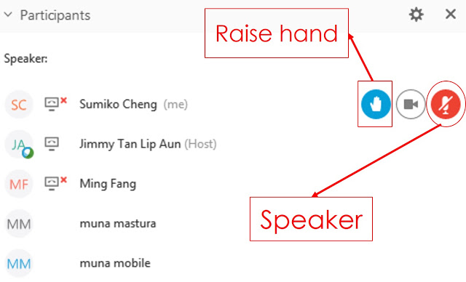
WebEx Technical Reminders
Raise hand to enter queue – then unmute when called upon
Mute when not speaking
Zoom in & out of documents
Image courtesy: Blended Learning

Slide 4

Instructions for Public Participation (participants who are not CAEECC members)
To Ask a Question
  Type your full question in the chat. Send your chat to “all participants”
  Presenters will answer questions in chat where possible; Jenny Berg, CAEECC Co-Chair will be screening questions and may relay certain questions to full CAEECC
To make a comment (only for a few key agenda items identified by Facilitation Team—and time allowing)
  Type “Request to make a verbal comment” in the chat. Send chat to “all participants”
  Susan Rivo will elevate you to “panelist” so you can speak, and she will let the Facilitation Team know. Wait to be called on, then remember to unmute yourself.

Slide 5

Welcome Redwood Coast Energy Authority!
RCEA is a Community Choice Energy provider in Humboldt County
Lead representative: Stephen Kullmann, Director
Alternate: Aisha Cissna, Regulatory and Legislative Policy Manager
Note, there are now 23 CAEECC members!

Slide 6
Session A: Important Updates & CAEECC Discussion

Slide 7
Topics
Underserved WG
3rd Party Solicitation Process

Slide 8
Underserved WG
Next full UWG meeting 7/12/2021
Status of 3 sub-WGs:
  Residential (UC Davis): analysis/report completed Dec 2020
  SMB (UC Irvine and Green Love Economics): analysis in-progress; report summer 2021
  Public sector (UCSB): analysis in-progress; report summer 2021
Preliminary findings on whether and why certain segments might be underserved are emerging, but are not yet sufficiently developed or definitive to form the basis for compelling policy recommendations
Anticipate final analysis completed late summer 2021
WG report to Energy Division upon completion of analyses

Slide 9
third party programs solicitations update
CAEECC Quarterly Meeting
June 24, 2021

Slide 10
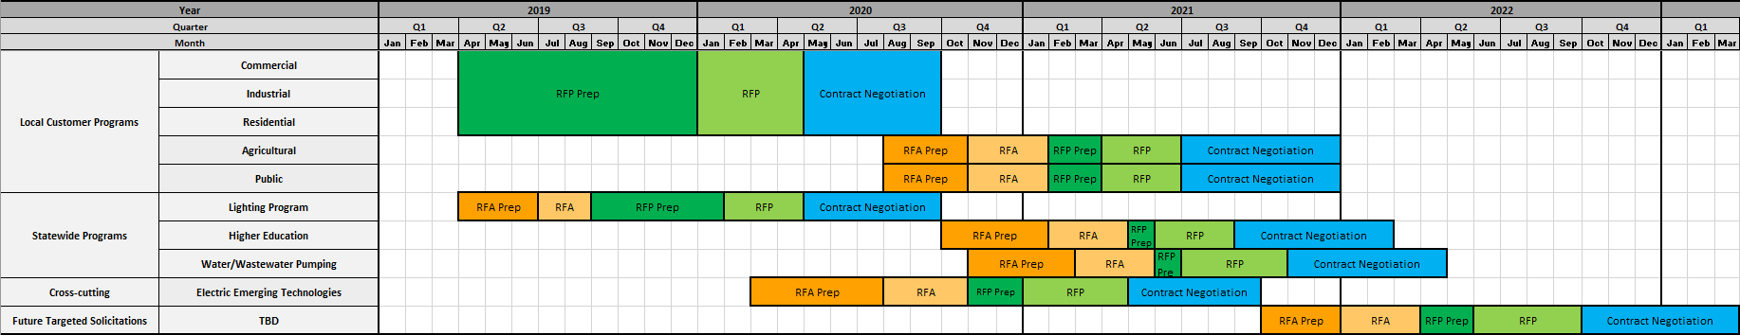
SCE Solicitation Timeline
Today

Slide 11
PG&E Solicitation Timeline
Today

Slide 12
SDG&E Solicitation Timeline
Today

Slide 13
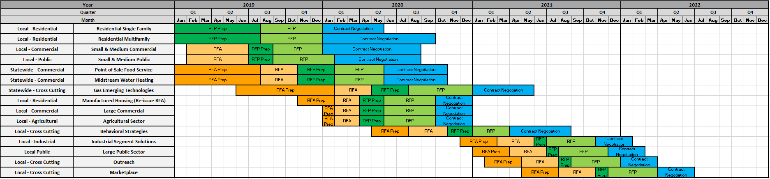
SoCalGas Solicitation Timeline
Today

Slide 14
Session B: EE Filing Processes and Potential & Goals Policies

Slide 15
Topics
ED Presentation on Final Decision (25 minutes)
ED/PA Presentation & CAEECC Initial Feedback on Filing Outline Template/Guidance (45 minutes)
Equity & Market Support Sector Metrics WG(s)/Workshop (60 minutes)
Initial discussion of short- and long-term implications for CAEECC of Final Decision (25 minutes)

Slide 16
Topics
ED Presentation on Final Decision (25 minutes)
ED/PA Presentation & CAEECC Initial Feedback on Filing Outline Template/Guidance (45 minutes)
Equity & Market Support Sector Metrics WG(s)/Workshop (60 minutes)
Initial discussion of short- and long-term implications for CAEECC of Final Decision (25 minutes)

Slide 17
EE Goals Policy Track and Modification of Portfolio Process Decision (D.21-05-031)
Nils B. Strindberg
Procurement and Portfolio Management Section
Energy Efficiency Branch
Energy Division, CPUC

Slide 18
Overview
Key Topics | Decision Changes
Total System Benefit | Changed our current kWh, kW, therms metrics for EE goals and accountability to a new metric: Total System Benefit ($), which would be the avoided cost.
Portfolio Structure and Segmentation | Segment EE portfolios according to three primary objectives. Resource Acquisition Market Support Equity Cost Effectiveness of Portfolio Segments
Portfolio Processes | Adopted modified portfolio processes which included: 4-year Funding Application, with 8-year business plan section Mid-cycle (2-year) budget refresh.

Slide 19
Total System Benefits

Slide 20
Total System Benefit
Total system benefit is an expression, in dollar terms, of the lifecycle energy, capacity, and GHG benefits, expressed on an annual basis.
How it works:
Replace current metrics (GWh, MW, MMTherms) with 1 new metric for EE portfolios: Total System Benefit ($).
Total System Benefit = the $ avoided costs, as calculated by a cost effectiveness calculator used across all of the EE proceeding.

Slide 21
Portfolio Structure and Segmentation

Slide 22
Changes to the Portfolio Structure
Status Quo
All programs assessed collectively at portfolio level.
All program benefits must outweigh all program costs in a ratio of 1.25 by Program Year 2023 (except for RENs).
Adopted Change
Programs segmented based on primary purpose:
    Resource Acquisition
    Market Support
    Equity
  Resource acquisition benefits must have a 1.0 TRC (except for RENs).
  Market support and equity program budgets must not exceed 30% (except for RENs).
  CAEECC working groups will develop quantitative assessment metrics. Process will be discussed at full committee meeting on June 24th. https://www.caeecc.org/6-24-21-full-caeecc-mtg

Slide 23
Segment Definitions
The decision ordered program administrators to segment their portfolios based on the program’s primary purpose:
  Primary Resource Acquisition: Programs with a primary purpose of, and a short-term ability to, deliver cost-effective avoided cost benefits to the electricity and natural gas systems (D.21-05-031, 14).
  Market Support: Programs with a primary objective of supporting the long-term success of the energy efficiency market by educating customers, training contractors, building government partnerships, or moving beneficial technologies towards greater cost effectiveness (D.21-05-031, 14).
  Equity: Programs with a primary purpose of providing energy efficiency to hard-to-reach or underserved customers and disadvantaged communities in advancement of the Commission’s Environmental and Social Justice Action Plan. Improving access to energy efficiency for ESJ communities may provide corollary benefits such as increased comfort and safety, improved indoor air quality, and more affordable utility bills, consistent with Goals 1, 2 and 5 in the ESJ Action Plan (D.21-05-031, 14).

Slide 24
Program Segmentation Timeline
July-September 2021: CAEECC Metrics Working Groups
    CAEECC will form two Working Groups to identify and define metrics for Equity and Market Support Segments of the EE Portfolio.
    Working Groups will recommend metrics that can be used to track progress for the Equity and Market Support Segments of the EE Portfolio.
September 2021: Informational segmentation for 2022 & 2023 ABALS.
    Not a criteria for ABAL approval.
    No assessment of segmentation reasonableness.
February 2022: ​PAs propose segmentation in 2024 Application
    Reasonableness assessed in application process.
    Encouraged to work with CAEECC.
    CPUC decision will approve final segmentation scenarios.

Slide 25
Portfolio Process

Slide 26
Rationale for the Change
The 10-year portfolio cycle did not provide a meaningful opportunity for stakeholder and regulatory review of Energy Efficiency budgets and programs.
The ABALs were intended to be ministerial but became contentious.
Portfolio adjustments based on program cost effectiveness over only an annual horizon may cause unnecessarily adjustments with both external market factors or program fluctuations.
Annual spending applications resulted in de facto annual cycles which created uncertainty for program implementors.

Slide 27
Changes to the Portfolio Process
Topic | Status Quo | Adopted Process
Timeline | 10-year cycles | 4-year cycles
Budget | Set for 10 years w/ Annual Budget Advice Letters | Set for 4 years via application, with 8-year budget cap in business plan section
Cost Effectiveness | Annual | Measured over 4 years
Interim Filings | Annual budget advice letters | Mid-cycle “check in” advice letters
Potential and Goals | Biennial P&G update | Biennial P&G update
Avoided Costs | Yearly updates | Update avoided costs biennially with P&G study
Technical Inputs | Updated annually | Updated biennially

Slide 28
Topics
ED Presentation on Final Decision (25 minutes)
ED/PA Presentation & CAEECC Initial Feedback on Filing Outline Template/Guidance (45 minutes)
Equity & Market Support Sector Metrics WG(s)/Workshop (60 minutes)
Initial discussion of short- and long-term implications for CAEECC of Final Decision (25 minutes)

Slide 29
Guidance and Templates development for EE 2024-2032 applications
Alison LaBonte, Ph. D.
Procurement and Portfolio Management Section Supervisor
Energy Efficiency Branch
Energy Division, CPUC

Slide 30
Work plan
Templates, to adhere to guidance
Guidance (D.21-05-031 Attachment A)
June 24
PA work plan shared w/ CAEECC
Application Prose Outline
Spreadsheets
July 22
PAs submit templates for ED review
Before Sept 30
ED issues templates as final on website
June 24, 2021
ED presents revision at CAEECC
July 22
ED issues final guidance on website
Stakeholders’ final input due to ED
July 6

Slide 31
Attachment A (D. 21-05-031)
Part 1: Strategic Business Plan
Program Administrator (PA) 8 year high level summary and budget
Desired outcomes of portfolio, strategies, and alignment with statute and CPUC mandates
Chapters by Sector and Segment
Coordination across service region (overlapping PA), statewide and local, other ratepayer programs, roles of PA vs. third party implementer
Connect Strategic Plan Outcomes with 4-year application metrics
Part 2: Four-Year Portfolio
Budget distribution and program identification among sectors and segments
Goals, performance metrics, cost-effectiveness, and reasonableness demonstration
Course correction strategy
Solicitation schedule
Coordination and stakeholder input: account for overlaps, customer perspective, environmental and social justice, and stakeholder input on the application

Slide 32
To date- Input received from
IOUs
RENs
CCAs
California Public Advocates Office
California Efficiency-Demand Management Council

Slide 33
Changes to the Guidance
Topic | Revision Location | June 24 Revision
Document Elements | Application Guidance | Removes the word “Template” from heading to describe this document. This is not a template or a specific order to the Business Plan or Application. This document identifies information needed for EE portfolio screening.
Policy Alignment | Application Guidance | Addition of “greenhouse gas reduction” as a policy objective
Unique aspects of PA territories | Strategic Bus. Plan: Portfolio Overview | Addition of description of significate climate, or other characteristics in specific markets that can positively or negatively impact achievement of EE goals.
Innovation | Strategic Bus. Plan: Portfolio Overview | Addition of methods to spur advancement of the EE market through new or enhanced relationships and partnerships, adoption of advanced technologies, and stronger alignment with multiple markets.

Slide 34
Changes to the Guidance
Topic | Revision Location | June 24 Revision
Portfolio Alignment | Strategic Bus. Plan Chapters | Clarification of the need for sector- and segment-specific elements to align with portfolio objectives
Budget distributions over 8 years | Strategic Bus. Plan Chapters | Clarification of the need for sector and segment budgets for the 8 year period, and the rationale for their distribution
PA Coordination in Business Plans | Strategic Bus Plan Chapters: Coordination | Deletion of description of complementary services by PAs with overlapping service territory. Information is also requested in 4-Year Portfolio Application.
Zero-Based Budgeting | 4-Year Port Application: Reasonableness of Budget | Addition of inclusion of quantitative contributions toward portfolio, segment, and sector goals/outcomes
Portfolio Description | 4-Year: Reasonableness of Budget | Addition of program descriptions, their rationale for inclusion, and how they relate to portfolio, sector, and segment goals and budget

Slide 35
Changes to the Guidance
Topic | Revision Location | June 24 Revision
Portfolio Description | 4-Year: Reasonableness of Budget | Addition of a Snapshot of the PA’s current portfolio and descriptions of and rationale for significant changes planned in this application.
Metrics | 4-Year: Reasonableness of Budget | Clarification that PAs are to use the metrics developed by CAEECC Market Support and Equity segment Working Groups.
Portfolio Management | 4-Year: Portfolio Management | Addition of bullets related to: cost recovery, portfolio optimization, risk management, need for flexibility.
Third Party Solicitation | 4-Year: Port. Management - 3rd Party Solicitation | Addition of bullets related to: scope and schedule of solicitations, procurement methods, engagement with a diversity of organizations, risk mitigation and distribution, and stakeholder engagement.
Coordination | 4-Year: Coordination and stakeholder input | Clarifications of necessity to reduce duplication of efforts, align portfolio goals and outcomes with state greenhouse gas reduction goals, and customer data.

Slide 36
Additional input?
Final input due to Energy Division July 6, 2021

Slide 37
EE Application Outline Development (IOU presentation)
June 24, 2021

Slide 38
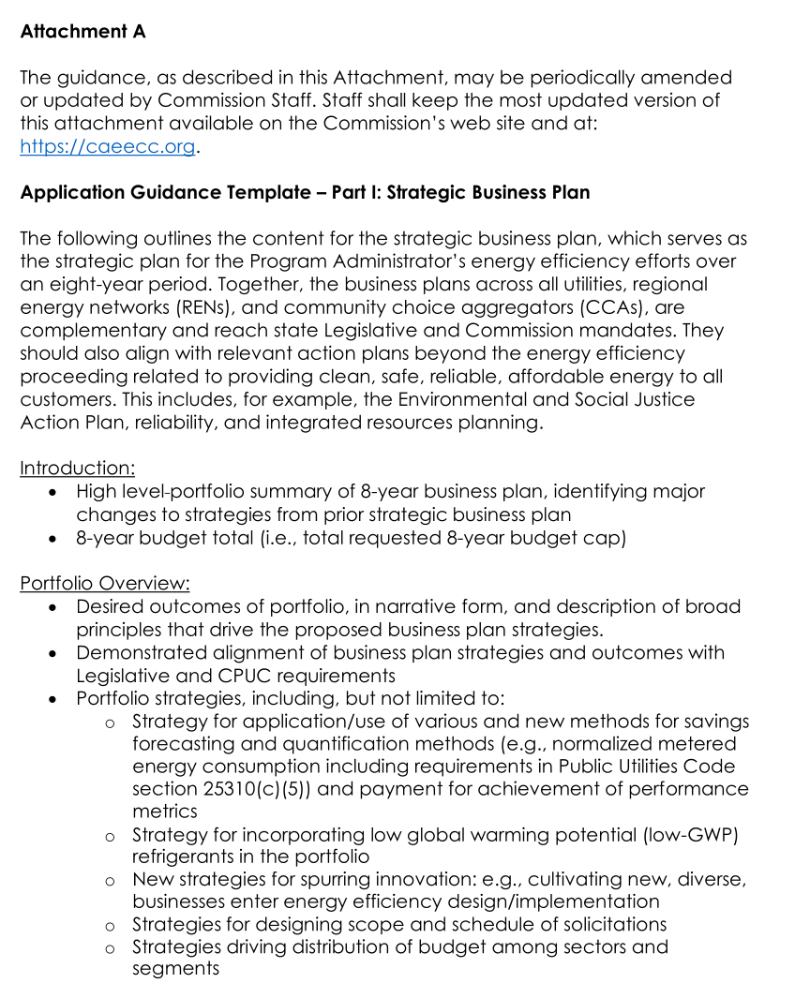
Background
D.21-05-031 OP 6 requires PAs to use a standard template when preparing EE applications.
A draft template was included with the decision.
The final version will be posted no later than September 30.

Slide 39
Outline & Spreadsheets
On May 27th during the reporting PCG ED staff asked PAs to convene and develop a plan to deliver a draft of application spreadsheets and application prose templates by June 24th (today).
By July 22nd PAs will complete templates for review and receive ED & Cal Advocates feedback.
ED Staff has the final word on the outline and spreadsheet templates, and will incorporate into official templates by September 30th
SCE shared the outline documents developed for their own Application with the team as a starting point.

Slide 40
Plan for Outline and Spreadsheet Template Development
By June 18th – PAs provide feedback on Outline and Spreadsheets (based on SCE’s starter materials or new materials)
  Send feedback directly to SCE (Brandon.Sanders@sce.com)
By June 23 SCE to provide Feedback summary including revised outline / spreadsheets to PAs
June 24 – Plan presented at CAEECC
June 25 – PAs meet to discuss outline feedback, document consensus items, determine how to handle outstanding items (large meetings or small item-specific discussions)
By June 30 – Spreadsheet sub-team meets to discuss spreadsheet templates, determine how to handle outstanding items
By July 9 – All PA feedback incorporated into draft outline and spreadsheets which are sent to ED, Cal Advocates, and others for feedback / comment.

Slide 41
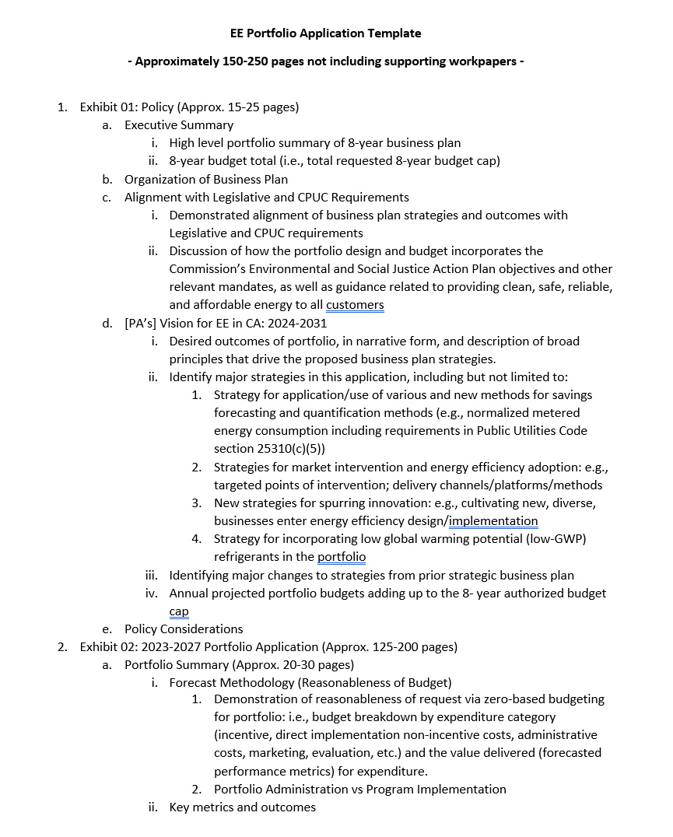
SCE’s Outline & Spreadsheet Starters

Slide 42

Break

Slide 43
Topics
ED Presentation on Final Decision (25 minutes)
ED/PA Presentation & CAEECC Initial Feedback on Filing Outline Template/Guidance (45 minutes)
Equity & Market Support Sector Metrics WG(s)/Workshop (60 minutes)
Initial discussion of short- and long-term implications for CAEECC of Final Decision (25 minutes)

Slide 44
Equity & Market Support Metrics WGs: Overview
Charge: Recommend to ED/Commission and PAs Objectives & Metrics, plus approach for target-setting, for two new portfolio segments: Equity and Market Support
Two separate but parallel Working Groups—one on Equity segment; the other on Market Support segment
4 half-day WG meetings each (plus 1 Equity Workshop): July-September 2021
Report delivered to PAs and CPUC September 2021
Application process for interested non-CAEECC stakeholders 6/26-7/7
Prospectus available at https://www.caeecc.org/6-24-21-full-caeecc-mtg

Slide 45
Background
CPUC 5/20/21 Decision: “Assessment of Energy Efficiency Potential and Goals and Modification of Portfolio Approval and Oversight Process” directs PAs to “further segment their portfolios based on the primary program purpose, into the following three segments”: Resource Acquisition, Market Support, and Equity
The decision directs CAEECC to form a Working Group “to develop and vet new reporting metrics for the market support and equity program categories that will be considered alongside the portfolio filings due from all program administrators in February 2022”

Slide 46
Working Groups Charge
Identify and define the most important Objectives for each portfolio segment (Market Support and Equity), and then to define the associated key Metric(s) under each Objective
Objectives and associated key Metric(s) would be used to support and provide rationale for portfolio segmentation and program design, as well as used for program benefit/value forecasting, tracking, and evaluation.
Also, discuss the basis (i.e., principles and guidelines) PAs should use in setting targets for Metrics in their filings

Slide 47
Nomenclature: Objectives, Metrics & Targets
OBJECTIVE: The primary purpose(s) of a segment (and programs within the segment).
METRIC(S): The most important yardstick(s) by which an Objective can be tracked and measured.
METRIC(S): The most important yardstick(s) by which an Objective can be tracked and measured.
TARGET: A quantitative and/or qualitative goal for each Metric
TARGET: A quantitative and/or qualitative goal for each Metric

Slide 48
Questions for WGs
Objective and Metric(s) - setting questions
  What are the specific Objectives for each segment?
  What are the specific associated key Metric(s) for each Objective?
  For each Objective and key Metric(s) describe whether it will be expressed quantitatively, qualitatively, or a mixture of both—and when each will be established and by whom.
  For each Objective and associated key Metric(s) describe whether its primary application is to justify portfolio segmentation and program design; forecasting of benefits/values from the budgeted program; tracking and evaluation; or some combination?

Slide 49
Questions for WGs (continued)
Objective and Metric(s) - setting questions (cont.)
  Are Objectives and associated key Metrics required at the program level, in addition to the Segment level?
  What must all PAs include in their filings with respect to Objectives, associated key Metrics, and Targets for Metrics, and under what conditions can PAs propose additional Objectives, Metrics, and Targets?
  What should be the basis (i.e., principles and guidance) for the PAs to set their own Targets for associated key Metric(s) in their filing?
Procedural questions:
  How will any non-consensus Objectives and/or associated key Metric(s) be addressed in the PA filings?
Notes:
Pause here for questions

Slide 50
Equity & Market Support Metrics WGs: Meeting Dates & Tasks
Meeting Dates & Tasks
Meeting/ Workshop | Market Support WG | Equity WG | Tasks
First WG Mtg. | 13-Jul | 15-Jul | -Discuss WG final deliverables, and any assumptions to make WG successful -Review pre-existing Objectives and Metric(s) -Identify gaps in Objectives and Metric(s) -Brainstorm alternatives -Discuss initial priorities
Second WG Mtg. | 12-Aug | 18-Aug | -Flesh out Objectives and Metric(s) -Identify options in cases where consensus is not reached
Equity Workshop | NA | 31-Aug | -Get feedback on Objectives & Metric(s) (test for completeness & preferences for options in cases where consensus is not reached) -Consider using polling techniques to reveal and document participant preferences
Third WG Mtg. | 9-Sep | 14-Sep | -Refine Objectives & Metric(s) -Seek consensus on Objectives and Metrics -Discuss the basis PAs should use in setting Targets for Metrics in their filings
Final WG Mtg. | 21-Sep | 29-Sep | -Finalize recommendations document -Strive for consensus & record supporters of options where consensus is not reached
Notes:
Note that mtgs will be virtual, and 9-approx. 1pm

Slide 51

Deliverables
A Report from each Working Group delineating recommendations for Objectives for their respective segment as well as the associated key Metric(s) for each Objective. Each Working Group will also describe the basis (i.e., principles and guidance) for the PAs to use for setting Targets for associated key Metric(s) in their filings. Finally, each Working Group will address the other questions delineated above as well as any other related issues they agree are necessary to resolve
Any recommendations would be made by consensus of the Working Group where possible. Where consensus is not reached, the Report would delineate two or more alternatives including their supporting rationales and list which WG Members support each alternative.
Notes:
2nd Pause for feedback

Slide 52

Member Application Process
CAEECC Member Organizations
Automatically eligible to participate (as long as lead representative or alternate can attend ALL the WG meetings)
If interested email Susan Rivo by 7/5 to indicate who will be the lead representative and alternate from your organization, and their contact information (email/phone)
Other Interested Stakeholders
Requirements:
Attend all meetings (either lead or designated alternate)
Have sufficient substantive knowledge of EE in CA and related Equity/Market Support experience
Abide by all Groundrules
Complete assigned work between meetings
Applications:
Applications from qualified organizations will be accepted 6/28-7/6. Final determination made 7/7
To apply, fill out the appropriate form using link on the 6/24 mtg page (“Equity [or Market Support] Metrics WG Application”)
Note: WGs will be open to the public to observe (and provide limited input, time permitting)

Slide 53
Outreach
Planned outreach:
  CAEECC listserv
  CPUC general energy efficiency service list
  For Equity WG, also CPUC low-income service list, CPUC Low-Income Oversight Board, and the CEC Disadvantaged Community Advisory Board
  Additional organizations may be directly recruited by CAEECC for their expertise and experience in the subject matter of each WG
Other outreach suggestions or application process improvements?
Notes:
3rd pause for feedback

Slide 54
CAEECC Approval & Delegation
Do CAEECC Members support the delineation of the process in the Prospectus (inclusive of any adjustments made in this meeting)?
Do CAEECC Members also agree to delegate recommendation-making to the Working Groups?
  Note, per CAEECC groundrule IV.A.v. (“Substantive & Process Issues”), the full CAEECC can agree to delegate recommendation-making to each Working Group to go directly to the Program Administrators and Energy Division without needing to come back to the Full CAEECC for formal review and approval

Slide 55
Topics
ED Presentation on Final Decision (25 minutes)
ED/PA Presentation & CAEECC Initial Feedback on Filing Outline Template/Guidance (45 minutes)
Equity & Market Support Sector Metrics WG(s)/Workshop (60 minutes)
Initial discussion of short- and long-term implications for CAEECC of Final Decision (25 minutes)

Slide 56
Initial Discussion of Short- and Long-Term Implications for CAEECC of Final Decision
Short-Term Implications (2021)
  Formation of Equity & Market Support Metrics WGs (June-Sept 2021)
  Discuss Biz Plan & 4-yr Portfolio filing template—June and possibly September full CAEECC meetings
  Consultation role for Biz Plans & 4-yr Portfolio filings due Feb 2022 – September meeting
  Brief updates on filed 2-year ABALs (dropped requirement to fully vet thru CAEECC pre-filing) – September full CAEECC meeting
  Review of select issues on Draft Biz Plans & 4-yr Portfolio filings (e.g., metrics)-–November/December full CAEECC meeting
  Other short-term implications?
Long-Term Implications (2022 and beyond)
  Mid-cycle--true-up advice letters and trigger-based filings
  Mid-cycle--potential, goals, engineering, & avoided cost updates?
  Business Plans (every 8 years) & Portfolio Application (every 4 years) filing(s)
  Other long-term implications?
Notes:
Public comment, time permitting

Slide 57
Session C: CAEECC Planning & Policies

Slide 58
CAEECC Conflict of Interest (COI) Policy
Is a COI still needed?
If so, in what ways if any should CAEECC’s existing be updated and by whom?

Slide 59
Next CAEECC Meeting: 9/2/2021
Topics
  Vet the revised Biz Plan/4-year portfolio filing template
  Updates on Working Groups
    UWG final findings & recommendations
    Equity and Market Support Working Groups
  Brief Two-Year ABAL Updates?
  Other topics related to the Biz Plan/4-yr portfolio filings and/or other topics?

Slide 60
3/17 Full CAEECC Meeting Evaluation Survey Results
Question | Avg. Score
Objectives of the meeting were clearly articulated on the agenda | 5.3
Objectives of the meeting were accomplished | 4.8
Presentations and background documents were clear and helpful | 5.0
Program administrators (PAs) were responsive to stakeholder input, where applicable | 5.0
CAEECC Members (including PAs) were flexible in seeking outcomes that were potentially mutually agreeable, where applicable | 4.9
The facilitators were effective in running the meeting (e.g., fostering a constructive and efficient forum, being impartial, and making sure no one dominated discussions) | 5.1
Overall, the online meeting format (WebEx) was smooth and effective | 4.9
Overall, this Full CAEECC meeting was successful | 4.9
Notes
1) Scores are 1-6 scale, where 1 is "strongly disagree" and 6 is "strongly agree” ; and 3.5 is mid-point of 1-6 scale
2) Scores based on responses from 23 members
3) Facilitation Team and Co-Chairs reviewed and debriefed comments from respondents

Slide 61
6/24 Meeting Evaluation
See email from Susan Rivo
Please complete today! (no later than June 30th, 2021)

Slide 62
Wrap Up & Next Steps

