Slide 1
CAEECC MEETING WITH ENERGY DIVISION ON ENERGY EFFICIENCY REFORM PROPOSED DECISION
Facilitation Team: Dr. Jonathan Raab and Katie Abrams
April 29, 2021

Slide 2
Meeting Background and Overview
On April 16th the Commission issued a Proposed Decision: ASSESSMENT OF ENERGY EFFICIENCY POTENTIAL AND GOALS AND MODIFICATION OF PORTFOLIO APPROVAL AND OVERSIGHT PROCESS. This PD addresses, among other things, CAEECC’s recommendations on a new energy efficiency filing process.
The purpose of this meeting is for Energy Division to review the proposed decision with CAEECC (and other interested stakeholders) and respond to questions ahead of the deadline for filing comments (which is May 6th).
See 4/29 meeting page for background documents: https://www.caeecc.org//4-29-21-ee-portfolio-filing-process

Slide 3
Agenda
Time | Topic | Format | Presenter
9:30-9:35 am | Agenda Review & Technical Reminders | Presentation by Facilitator | Jonathan Raab, Facilitator
9:35-10:00 am | -Potential and Goals Metrics (Section 2) | Presentation by Energy Division (ED) followed by questions from CAEECC* | Coby Rudolph, ED
10:00-10:25 am | -Portfolio Segmentation (Section 3) -Cost Effectiveness Requirements and Budget Limitations (Section 4) | Presentation by Energy Division followed by questions from CAEECC | Jessica Allison, ED
10:25-10:55 am | -Portfolio Process (Section 5) -Interim/Transition Process (Section 6) | Presentation by Energy Division followed by questions from CAEECC | Travis Holtby and Nils Strindberg, ED
10:55-11:00 am | Wrap Up & Next Steps |  | Jonathan Raab
*Note: CAEECC and EE Portfolio Filing Working Group members will have an opportunity to ask questions on ED’s presentation. Members of the Public will also be able to ask questions, time-permitting.

Slide 4
WebEx Technical Reminders and Process
CAEECC and EE Portfolio Filing working group members
  You will be “panelists” (able to unmute, show video, and ask questions)
  Raise hand to enter queue – then unmute and state name/organization when called upon
  Remember to mute when not speaking
Public
  You will be “attendees” (muted and no video, but able to see and hear)
  Use Q&A to ask questions
Note:
1) Chat or email Susan Rivo with any technical difficulties: susan@raabassociates.org
2) The meeting will be recorded and available on the CAEECC website (no meeting summary)

Slide 5
Presentation on EE Reform Proposed Decision
Presented by CPUC Energy Efficiency Staff to CAEECC on April 29

Slide 6
Agenda
1) Portfolio Goals metric
2) Portfolio Segmentation & Cost Effectiveness Policy
3) Portfolio Process
4) Transition to New Portfolio Process

Slide 7
Resource Portfolio Goals Metrics

Slide 8
Objectives for Goals Metrics Change
Focus on priority objectives of resource portfolios: Grid value and GHG value from energy and capacity savings.
Value long-duration savings more appropriately
Align goals metrics with cost effectiveness benefits
Simplify metrics, forecasting and portfolio evaluation (including for fuel substitution) by moving to one metric instead of three.

Slide 9
Introduction to Total System Benefit Metric
Total System Benefit (TSB)
Portfolio and Process Reform PD proposes to transition EE goals metrics to Total System Benefit (TSB) instead of the current metrics (1st-yr GWh, GW, MMTherms). TSB proposed definition:
“Total net benefit that a measure provides to the electric and natural gas systems".
TSB Calculation
TSB calculation will use CPUC cost effectiveness policies (& CET tool) and Avoided Cost Calculators (ACC) to calculate the benefits of an energy efficiency measure/program/portfolio according to the hourly values adopted in the ACC.
Hourly values include values for energy and capacity savings, & GHG compliance costs).
TSB = $ (Avoided cost of gas and electric savings) - (increased supply costs, if applicable)
TSB Forecasting / Goalsetting
Goals will be set in dollars.
Potential and Goals Study is metrics-neutral. This year's study produced a TSB output along with fuel-specific outputs – the measure mix is the same either way.
Forecasting results could shift over time – as PAs and implementors could place more emphasis on programs with higher TSB, this would get reflected in future forecasts.

Slide 10
Example: TSB Goals vs Current Goals
Reference Scenario - 2021 DRAFT P&G Study
Year | Total System Benefit | 1st-yr GWh | 1st-yr MW | 1st-yr MMTherms
2022 | $750,250,294 | 836 | 199 | 35
2023 | $828,089,113 | 878 | 205 | 38
2024 | $938,752,870 | 931 | 215 | 42
2025 | $1,045,611,935 | 975 | 221 | 44
2026 | $1,136,720,062 | 1,023 | 229 | 46
2027 | $1,259,699,469 | 1,077 | 239 | 48
2028 | $1,387,294,622 | 1,126 | 248 | 50
2029 | $1,444,733,839 | 1,136 | 249 | 51
2030 | $1,594,811,435 | 1,176 | 257 | 53
2031 | $1,710,705,497 | 1,208 | 262 | 54
2032 | $1,870,340,821 | 1,249 | 270 | 55

Slide 11
Next Steps: Feedback & Implementation
EE Policy and Reform PD proposed to adopt TSB as the goals metric starting in program year 2024, and as an informational metric starting in 2022.
2021 EE Potential and Goals Study included TSB outputs for each scenario.
April 23rd Ruling on Potential and Goals Study asked for feedback on TSB definition and calculation, including for fuel substitution. Comments due May 21st / replies due May 28th.
Additional stakeholder engagement may be conducted in the coming months if further development of TSB metric/calculation is needed.

Slide 12
Questions?

Slide 13
Portfolio Segmentation & Cost Effectiveness Policy
Dividing the portfolio into primary resource, market support, and equity segments

Slide 14
Rationale for Segmentation
Increasing pressure to maintain cost effectiveness while delivering balanced portfolios (p.10).
Parties agree that non-resource programs are important (p.11).
Traditional definition of resource / non-resource program segmentation does not capture a limited number of equity and EE market support that do generate some savings (p.11).

Slide 15
Segment Definitions
Resource Acquisition: Programs with a primary purpose of, and a short-term ability to, deliver cost-effective avoided cost benefits to the energy system.
Market Support: Programs with a primary objective of supporting the long-term success of the energy efficiency market by educating customers, training contractors, building partnerships, or moving beneficial technologies towards greater cost-effectiveness.
Equity: Programs with a primary purpose of serving hard-to-reach or underserved customers and disadvantaged communities in advancement of the Commission's Environmental and Social Justice Action Plan.

Slide 16
Assessment of a Segmented Portfolio
Resource Acquisition
  TRC of 1.0 over the 4-year application cycle.
  Programs have avoided cost benefits.
Market Support & Equity Segment
  Cumulatively less than 30% of the full portfolio budget.
  Program design appropriately tailored to meet the segment definition.
  Achieves quantitative metrics set in application.
Full Portfolio.
  Meets TSB goals over 4-year application cycle
  Under or at authorized budget

Slide 17
Questions?

Slide 18
Portfolio Process
The framework for the new EE portfolio process

Slide 19
Process Reform Objectives
    Reduce misalignment and regulatory churn in energy efficiency program goalsetting, approval, and evaluation processes
    Maintain long term strategic planning to support grid planning needs
    Lengthen budget approval period to provide greater funding confidence
    Strengthen budget approval process to allow for greater scrutiny
    Lengthen technical input update interval to provide greater stability

Slide 20
CAEECC Proposal vs. Proposed Decision

Slide 21
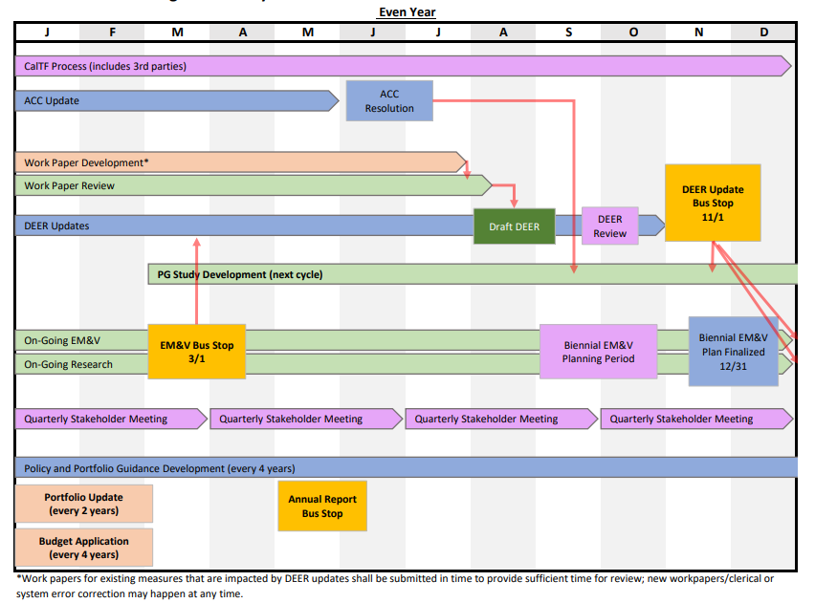
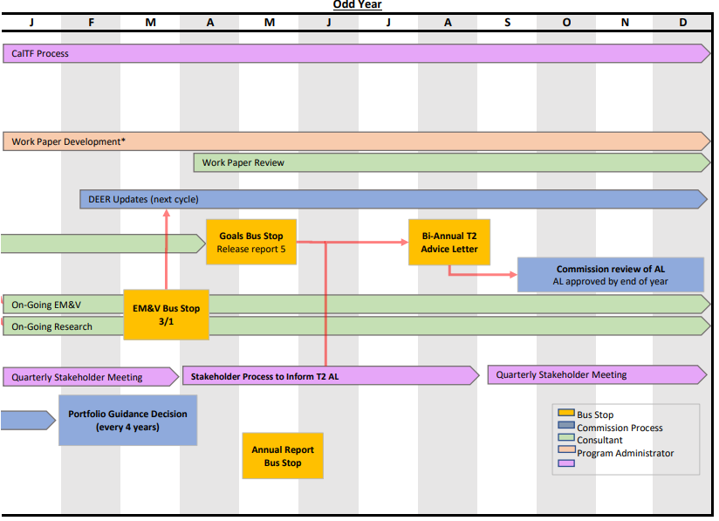
Rolling Portfolio Cycle Schedule

Slide 22
Transition to New Portfolio Process

Slide 23
Areas of Difference
Business plan filing
  The 8-year business plan, includes a proposed budget cap for each of those years
  High-level, strategic plan to guide EE portfolio and program focus
True-up/Mid cycle advice letter
  Tier 2 Advice Letters in September of odd years, not trigger-based
  Provides the opportunity to true-up modify the portfolio and budgets to account for new goals. The advice letter will ensure transparency that stakeholders can weigh in on the changes
CAEECC formal consultation
  2 formal meetings per 4-year cycle, less than the number proposed by CAEECC

Slide 24
Transition to New Portfolio Process
Annual Budget Advice Letters (ABALs)
  Eliminates the need for ABALs after the September 1, 2021 filings, which will authorize budget recovery in the transition years 2022 and 2023
    Review criteria remains largely intact for those ABALs, but the program administrators should also include TSB, but failing to meet the TSB threshold it is not a criteria for rejection of the ABALs
Business plan filing/Application
  Business Plan and new Applications due from program administrators on February 15, 2022, instead of September 2021 as was stated in the July 3, 2020 Scoping Memo

Slide 25
Transition to New Portfolio Process (Continued)
    This gives the program administrators the nine months requested in the motion from the adoption of the decision to the filing of their Business Plans
  With new portfolio process to begin in 2024, instead of the motion recommendation to start the new portfolio in 2026
    Filing date recommended in motion moved up because CPUC issued a July 3, 2020 Scoping Memo, which required all program administrators to refile their Business Plans
CAEECC role in transition
  PD emphasizes CAEECC role as an advisory body for seeking input on the Business Plans and mid-cycle advice letters

Slide 26
Questions?

Slide 27


Slide 28
Wrap Up & Next Steps

