Slide 1
PRESENTATION OF POSSIBLE IDEAS THAT
MAY SUPPORT INCREASED COLLABORATION IN THE SAVINGS ATTRIBUTION ARENA BETWEEN THE NEWLY FORMED MTA AND OTHER RELEVANT MARKET ACTORS
These ideas are meant to stimulate dialogue among the parties, with full expectation that they may not be the complete answer for the questions posed by the Commission

Slide 2
Section I Possible Additional Attribution Criteria for Savings Attribution

Slide 3
Why Consider Additional Criteria to be Included in Evaluation of MTI and C&S Savings Attribution?
Including additional criteria for assessing MTI and C&S savings attribution originates in the notion of an Initiative Life-cycle that has a process beginning with MTI involvement and flowing naturally to C&S adoption. The existing three criteria may not be adequate for evaluators to assess all factors involved in assessing the impacts over the course of the MTI life-cycle.

Slide 4
Attribution Factors Focused on Market Transformation
MTI Commences
Measure meets CEC criteria to commence adoption process
Ex Post Evaluation of C&S Adoption Commences
Primary MTI Scope
Primary Code Advocacy Scope
2023
2030
2036
Potential Additional Market Transformation Attribution Factors
(also applicable to MT work by a C&S Administrator):
4. Accelerating the Rate of Market Saturation
5. Reducing the Cost of a Measure to Meet the Cost-Effectiveness Threshold
6. Completion of Market Transformation Objectives in Accordance with the MTI Logic Model
Current Code Advocacy Attribution Factors
(also applicable to Advocacy work by an MTI):
Development of Compliance Determination Methods
Development of Code Language and Information in Support of the Standard
Document Feasibility or Market Acceptance

Slide 5
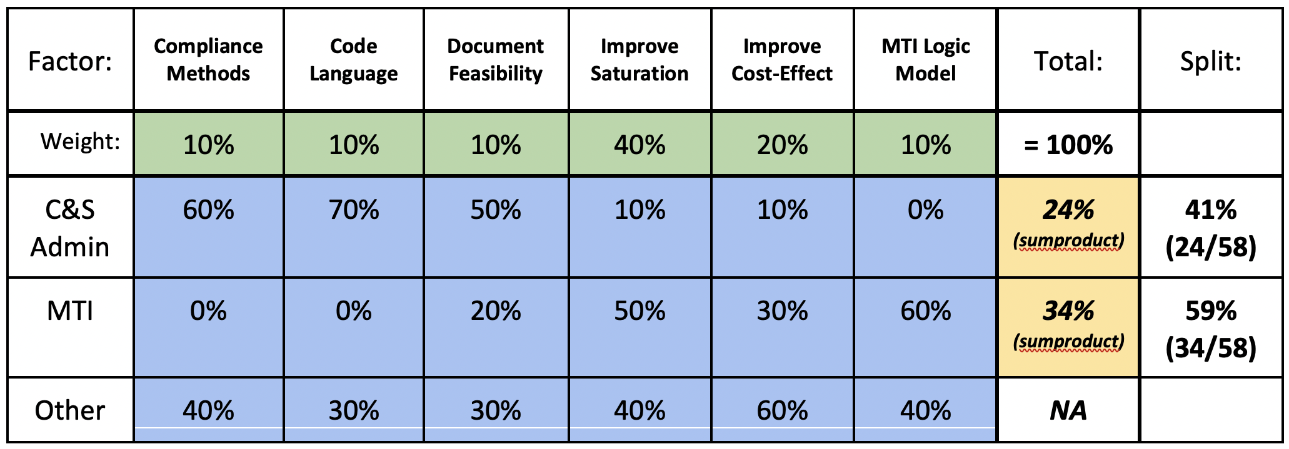
Strawperson Example of Possible Evaluation Assessment of Weighted Values
Weighting Values Established by Independent Evaluator
Attribution Factor Scores Established by Independent Evaluator
Measure meets CEC criteria to commence adoption process
Primary MTI Scope
Primary Code Advocacy Scope
2023
2030
2036

Slide 6
Questions

Slide 7
Section I I A Suggested Minimum Shared Savings Approach to Enhance Collaboration between the MTA and C&S Teams
(Option 4 on Margie Gardner’s Initial Matrix of Approaches)
“Likewise, we would like to avoid disputes over which initiative or program created the energy savings,
preferring to celebrate the victory without arguing over attribution. However, the existence of incentive mechanisms for existing program administrators may complicate this effort.” D.19-12-021 pg. 73

Slide 8
Problems to solve:
Ratepayer Imperative: Establish attribution rules that maximize ratepayer benefits and effectiveness of both the MTA and C&S Team efforts
Balance Reward Structures: Current market programs have built in rewards structures that may lead to less-than-optimal participation/collaboration in MTA market transformation initiatives
Avoid Anchor Bias: The California MTA presents a wholly new paradigm, requiring new thinking.
Reasonable Expectations Needed for MTA Planning: The MTA needs a reasonable understanding of long-term C&S savings, at least for the first several years (if measure adopted into code) in order to make go/no-go decisions

Slide 9
A Proposed Minimum Shared Savings Approach Aimed at (It is hoped) Facilitating Collaboration and Teamwork
If Delphi analysis shows 18% IOU influence and 82% MTI influence,
then the allocation for the IOU would be backstopped at 25%, with 75% for the MTI
IOU C&S Minimum Allocation
Delphi Allocated Portion
MTI Minimum Allocation
10%-30%
10%-30%
Total M&V Verified Savings from a Given Code Measure (Ex Post)

Slide 10
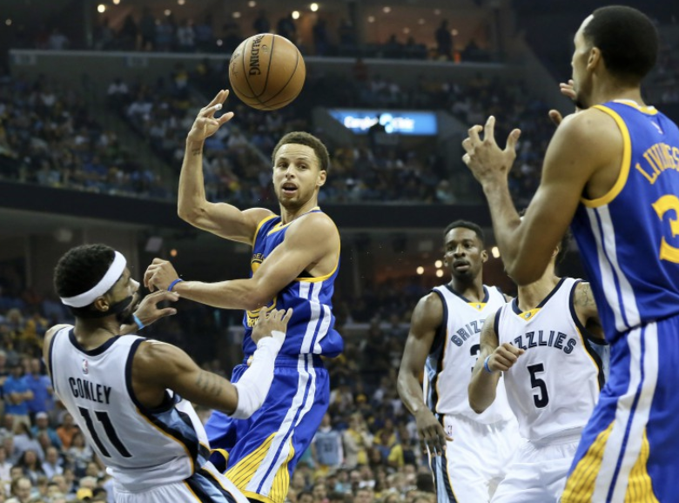
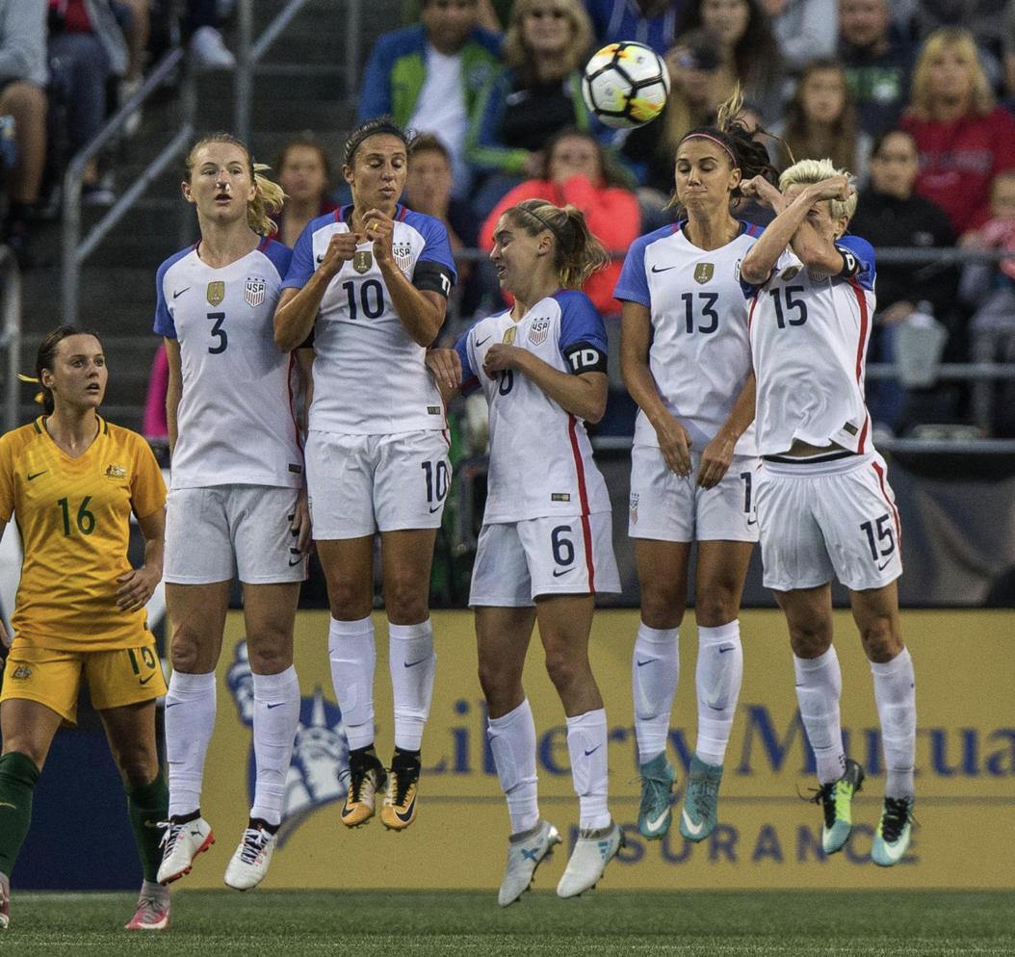
In sports, most compensation for a given season is fixed, regardless of individual impact.
Use what’s proven to work!
(Warriors World)
The bounty is shared.
Why?
(Cor Vos, Cycling Tips)
(Dean Rutz, The Seattle Times)

Slide 11
Questions

Slide 12
Appendix
(if needed)

Slide 13
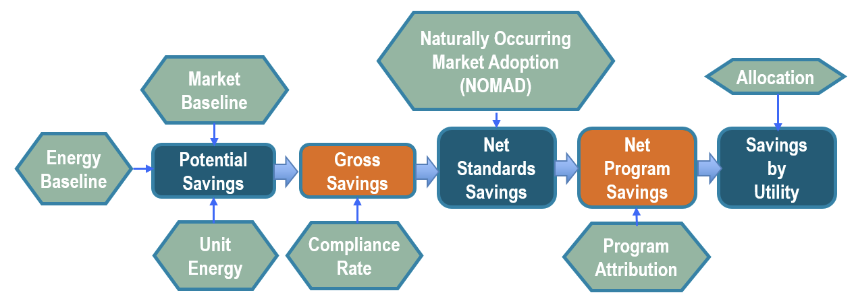
Appendix -- Current C&S M&V Flowchart

Slide 14
Alternate Approach
2) Bounds Based on Objective Variables [ IOU % / MTI % minimum bounds]
 | Overall MTI Investment before Code Adoption
Starting market saturation | $0-2 million | $2-6 million | $6-12 million | $12 million+
under 1% | 20% / 30% | 15% / 40% | 10% / 60% | 10% / 60%
1% - 4% | 25% / 25% | 20% / 35% | 15% / 55% | 10% / 50%
4% - 10% | 30% / 20% | 25% / 30% | 20% / 50% | 15% / 55%
10% - 20% | 40% / 15% | 30% / 25% | 25% / 40% | 20% / 45%
over 20% | 50% / 10% | 40% / 25% | 30% / 30% | 25% / 35%
Table to be developed by independent M&V analysis using Delphi panel
(perhaps no different than what would need to happen with ex post Delphi, only pre-assessing the values to decrease uncertainty)

