Slide 1
2019 ABAL Summary
3C-REN
Tri-County Regional Energy Network (3C-REN)
August 21, 2018

Slide 2
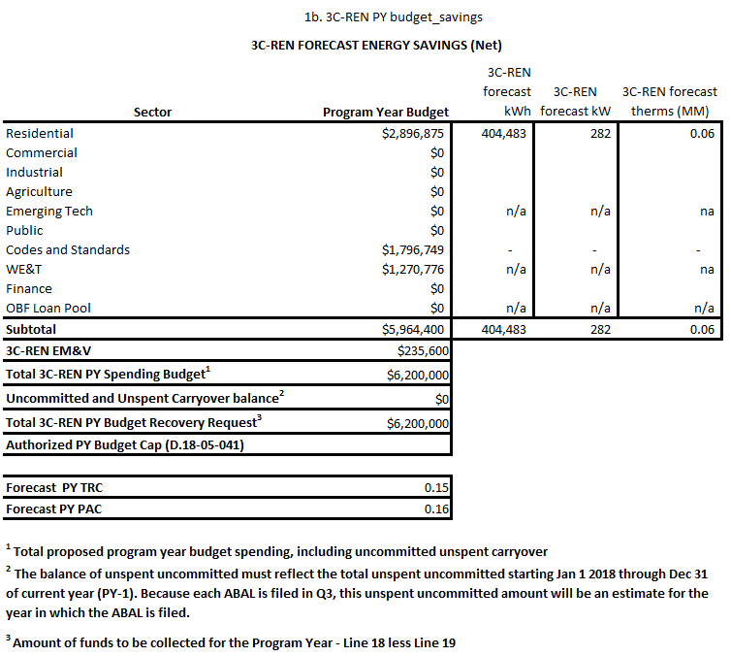
2019 Budget, Savings,& Projected C/E

Slide 3
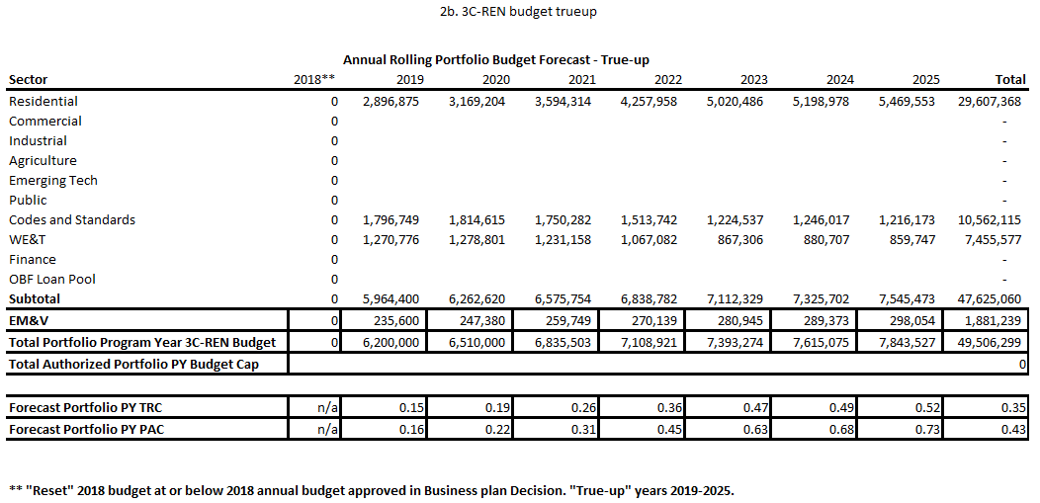
Budget True-up (2018-2025)

Slide 4
Changes in ABAL from 8/2 CAEECC Meeting
3C-REN
Decreased kWh, kW, and therms savings in Residential sector due to updated savings based on baseline usage and savings data obtained during metrics filing coordination with IOUs.
Minor increase in TRC and PAC ratios due to:
Reduced project costs for a small portion of Residential sector program to align with the project savings.
Universal update to the CET related to the avoided cost which increased the TRC for all PAs by a very small amount

Slide 5
Anticipated Changes From 8/21 to 9/4 Filing
3C-REN
EM&V budget to be reduced to align with CPUC/PA allocation split and ED guidance.

Slide 6
3C-REN Draft ABAL
3C-REN
Questions

Slide 7
Previous TRC Calculations
3C-REN
Current Forecasted TRC
Annual Rolling Portfolio Cost-Effectiveness Forecast
 |  | 2018** | 2019 | 2020 | 2021 | 2022 | 2023 | 2024 | 2025 | Total
Forecast Portfolio PY TRC |  | n/a | 0.148 | 0.193 | 0.258 | 0.357 | 0.469 | 0.487 | 0.521 | 0.347
Forecast Portfolio PY PAC |  | n/a | 0.161 | 0.216 | 0.306 | 0.448 | 0.631 | 0.678 | 0.735 | 0.431
** "Reset" 2018 budget at or below 2018 annual budget approved in Business plan Decision 18-05-041 "True-up" years 2019-2025.
Forecasted TRC in Business Plan before new HTR definition
3C-REN Business Plan TRC Forecast**
 |  | 2018 | 2019 | 2020 | 2021 | 2022 | 2023 | 2024 | 2025 | Total
Forecast Portfolio PY TRC |  | 0.27 | 0.310 | 0.350 | 0.390 | 0.410 | 0.430 | 0.430 | 0.450 | 0.400
Forecast Portfolio PY PAC |  | 0.39 | 0.460 | 0.550 | 0.650 | 0.700 | 0.760 | 0.760 | 0.790 | 0.660
Notes:
3C-REN adjusted non-resource and resource program costs, the overall change reflects the true-up calculations for the 2019 ABAL.
This slide shows an overall reduction in TRC and PAC calculation adjustments in accordance with CPUC Decision 18-05-041, 3C-REN adjusted program design, target and goals, metrics and savings to comply with changes to the Hard-to-Reach definition compared with the 01/23/2017 3C-REN Business Plan filing.

