Slide 1
WELCOME
NALMCO certification for lighting-related Workforce Standards
13 November 2024
Angela McDonald, Manager, Workforce Education & Training

Slide 2

Background
Energy Centers free training experience.
PG&E Workforce Education & Training supports California with no-cost classes, resources and tools:
Live online energy efficiency training led by industry experts.
On demand training for all skill levels available 24/7 online
Access to info about new technologies on a broad range of subjects from electric lighting, building envelope, electrification, and HVAC systems to air sealing and insulating.
Interactive instruction on practical skills you can use on the job.
Explore WE&T resources at pge.com/energycenters

Slide 3
Workforce Standards
Background
D.18-01-008 required that all individuals performing installation work for lighting control (LC) projects must meet the following standards:
    All projects that include the installation of lighting control systems in non-residential buildings that reserve a project incentive of $2,000 or more must utilize installation technicians who have earned a California Advanced Lighting Controls Training Program (CALCTP) certification.
These standards were required for any new third-party solicitation released after October 11, 2018 and by July 1, 2019, for other new or renewed projects that meet these thresholds defined by the standards.
Requirements apply to downstream projects in which incentives are paid to the contractor or the customer and not to upstream programs.
Program Administrators should be authorized to file a Tier 2 advice letter to propose additional lighting controls certification providers in the future in addition to CALCTP, as long as the certification program has characteristics equivalent to CALCTP. It is reasonable to request that the CAEECC convene a stakeholder discussion about any additional lighting controls certification to be proposed prior to an advice letter being filed. (COL 14 from D.18-10-008).

Slide 4
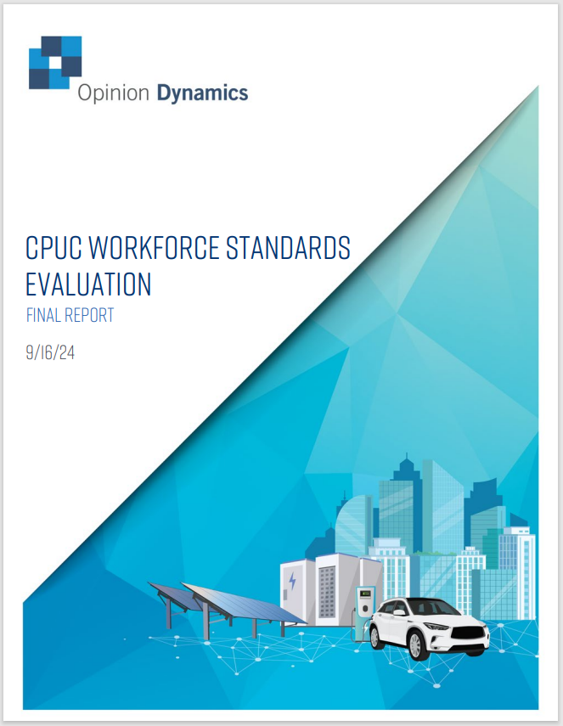
CPUC Workforce Standards Evaluation Report
Background
The recent Workforce Standards Evaluation Report summarizes the findings and recommendations from Opinion Dynamics's evaluation of Workforce Standards. ODC’s identifies several barriers to the effective implementation of CALCTP as the sole certification for lighting-related Workforce Standards.
  In Conclusion 2 and Recommendation 2, ODC recommends that the CPUC clarify its preference for the CALCTP installer technician training program as the ALC certification for Workforce Standards.
  In addition, ODC recommends that the IOUs should direct 3P implementers to collect the certification number of individuals, and other relevant information (e.g., technician name, contractor name) needed to verify certifications with CALCTP. The CPUC should then direct the IOUs to coordinate with CALCTP staff to verify the validity of the certifications based on key information (e.g., name, contractor, certification number, date of certification). To date, CALCTP’s implementer, ICF has indicated that this information cannot be provided to the IOUs or implementers for privacy reasons.

Slide 5
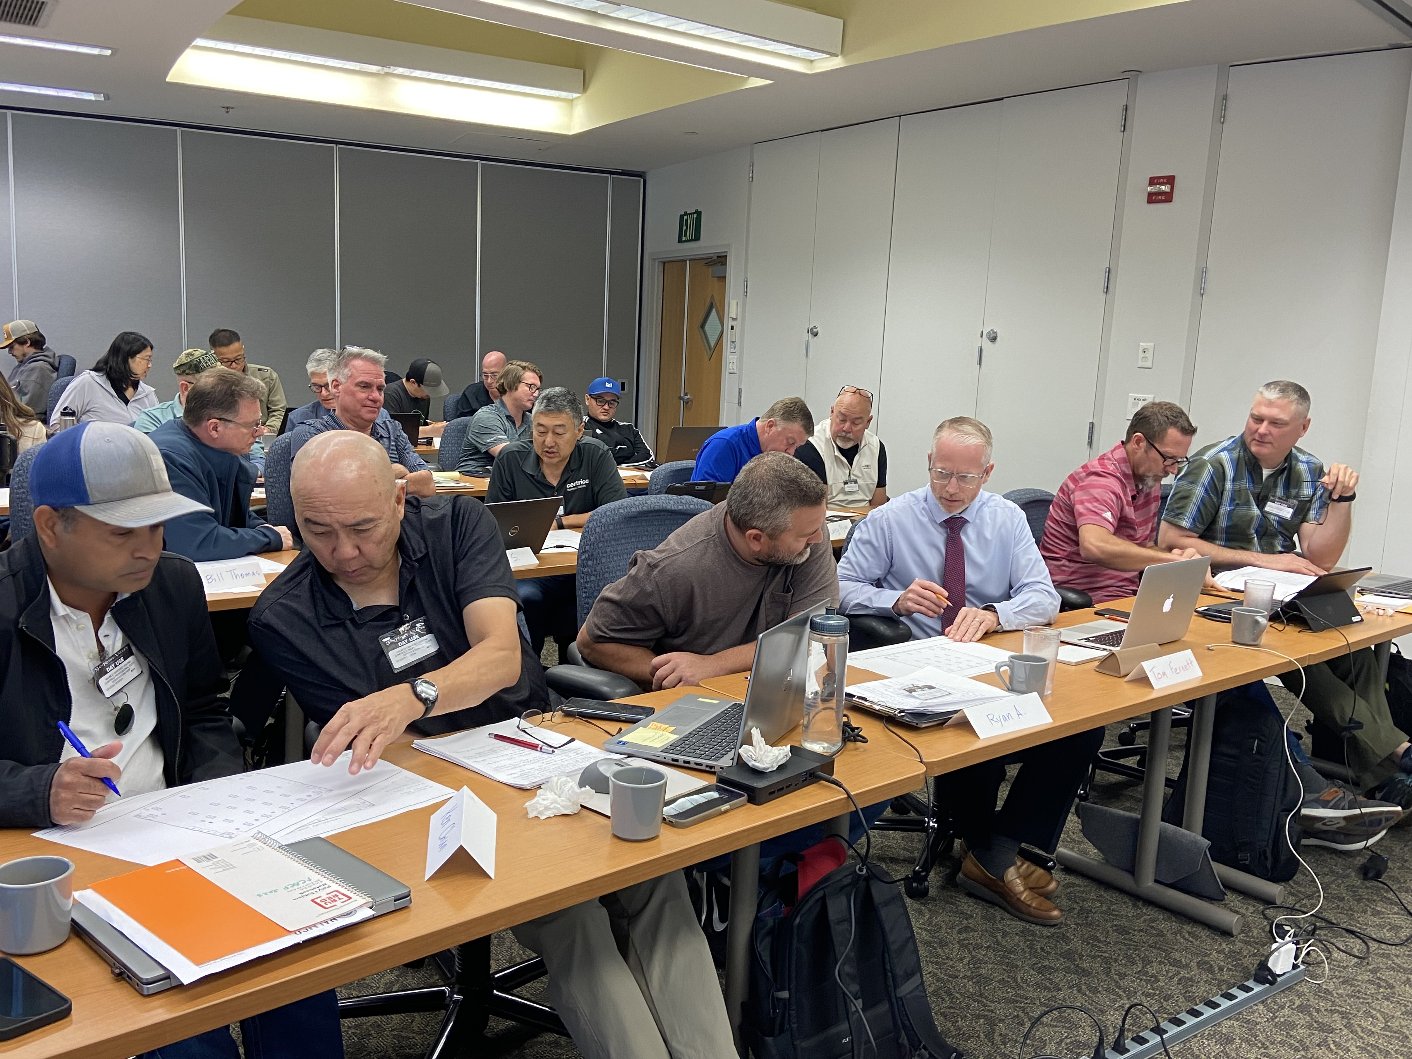
NALMCO Certified Lighting Controls Professional
Background
PG&E’s Workforce Education & Training program partnered with International Association of Lighting Management Companies (NALMCO) to pilot NALCMO Certified Lighting Controls Professional (CLCP) Training. This pilot training cohort was successfully completed by 21 students and all students who have completed the exam have successfully passed. This pilot program is equivalent to CALCTP training as follows:
Leverages Lighting Controls Association on-demand curriculum as a prerequisite
Provides 20 hours in-person lecture & hands-on instruction by industry experts
Includes a written online or in-person exam proctored by NALMCO

Slide 6
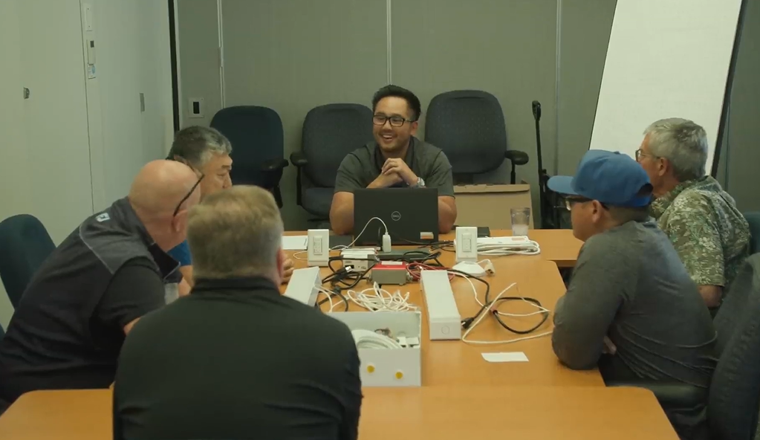
NALMCO Certified Lighting Controls Professional
Background
In conducting this pilot, PG&E found this training :
was effective for an IOU to administer
allows for comparable or lower cost than CALCTP training hosted by the IOUs.
In addition, privacy restrictions on sharing information about CALCTP students and certified individuals do not represent a barrier for NALMCO certification for LC Workforce Standards as all the pilot program’s trainees registered directly with PG&E and, NALMCO provides exam pass/fail results directly to PG&E.

Slide 7

NALMCO Certified Lighting Controls Professional
Discussion
PG&E proposes to submit a Tier 2 advice letter seeking approval of a revision to the Workforce Standards such that all projects that include the installation of lighting control systems in non-residential buildings that reserve a project incentive of $2,000 or more must utilize installation technicians who have earned a California Advanced Lighting Controls Training Program (CALCTP) or an International Association of Lighting Management Companies (NALMCO) Certified Lighting Controls Professional (CLCP) certification.

Slide 8

NALMCO Certified Lighting Controls Professional
Discussion
PG&E is seeking your feedback regarding the proposed request to revise the Workforce Standards such that all projects that include the installation of lighting control systems in non-residential buildings that reserve a project incentive of $2,000 or more must utilize installation technicians who have earned a California Advanced Lighting Controls Training Program (CALCTP) or an International Association of Lighting Management Companies (NALMCO) Certified Lighting Controls Professional (CLCP) certification.

Slide 9
THANK YOU

