Slide 1
Status of CAEECC MT Working Group: MT and EE Overlap (Savings Attribution)
Margie Gardner, Senior Advisor
September 22, 2020

Slide 2
Background
CPUC MT Decision (D.19-12-021) asked CAEECC to reconvene the MT Working Group (WG) to discuss issues of savings and goals overlap between the new MTA and existing EE Efforts
Sub-Working Groups (WG) formed:
    Accounting for MT and and other EE Efforts (Resource Acquisition (RA) or C&S Savings)
    Setting Goals
Discussing Some Initial Recommendations Today from the WG
    Seeking reactions from the full WG

Slide 3
Savings Sub-WG Meetings and Members
Savings Allocation
  Met 9/9 and 9/16
Members
Serj Berelson | CEDMC
Dan Suyeyasu | Code Cycle
Christie Torok | CPUC
Raghav Murali | CSE
Jay Luboff | Jay Luboff Consulting
Jeff Harris | NEEA
Mohit Chhabra | NRDC
Pat Eilert | PG&E
Margie Gardner | Resource Innovations
Randall Higa | SCE

Slide 4
FILL THE GAPS
Loop

Slide 5
1
Accounting for MT and Resource Acquisition (RA) Savings

Slide 6
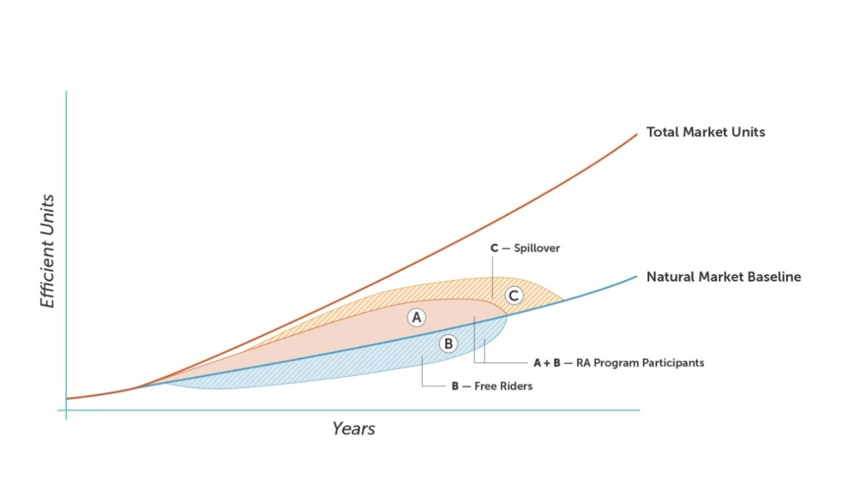
MT and RA Savings

Slide 7
Purpose: Avoid double counting
Sub-WG Proposal: Remove net RA Savings from the MT Savings
Total MT Savings = (MT Units x Savings per unit) – RA Net Savings; Where:
MT Units = Total Market Units – Natural Market Baseline Units
Savings/Unit = Developed in MTI Plan
RA Net Savings = Savings reported in CEDARS
for the same market (measures) targeted
by the MT initiative
    Likely a combination of A, B, C
MT units

Slide 8
Example
 | Caculation
Given: Total Market Units | 2,000
Given: Natural Market Baseline | 200
MT Units | 1800 (2,000-200 = 1,800)
Given: Unit Energy Savings (UES) | 150 kWh/yr
Given: Net RA Savings (kWh/year) | Reported by Utility in CEDARS Example assumes 100,000 kWh
TOTAL MT Savings (kWh/yr) | (150*1800) – 100,000 = 170,000

Slide 9
Questions on “net” RA savings
Is CEDARS the best source for net savings?
Will “free rider” RA calculations be biased by the MT activities? If so, what can be done?
  Keep FR rate static so less penalty to RA from a moving market?
    This is alluded to in Decision (p 159 in requirements for MTI Plan)
  Other ideas?

Slide 10
Most important: Collaboration
These are functional equations to avoid double counting
Actual MT success will depend on significant collaboration among MT and RA (and C&S)
  The whole can be greater than the sum of the parts
MT, RA, and C&S coordination in Decision: starts p 131
  Will be crucial to execute well
  RA coordination plan required in the MTI Plan – p 159

Slide 11
2
Codes and Standards

Slide 12
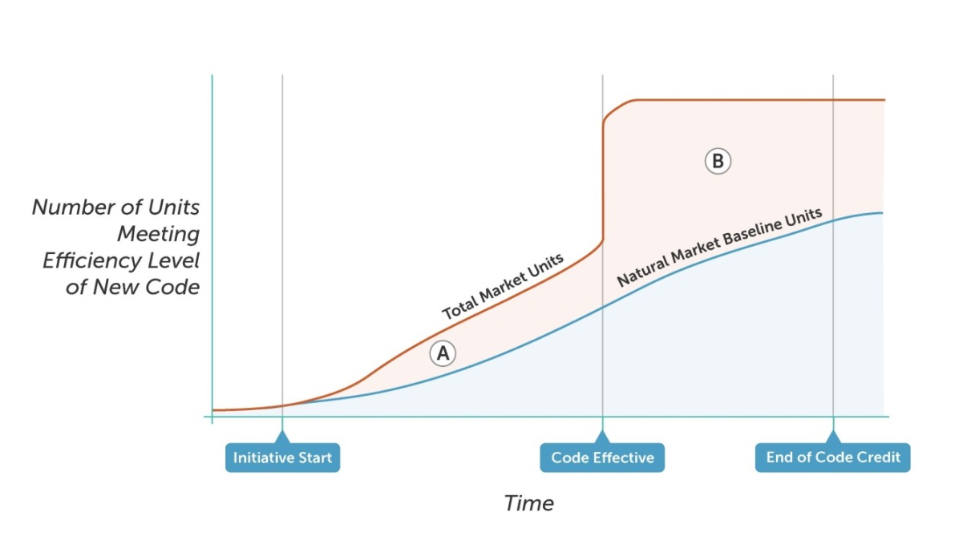
The Effect of Energy Code Adoption
B is the savings from C&S (pre-attribution)
Not to Scale

Slide 13
Many options in Review for MT/C&S
So far, C&S is most controversial
    MT and C&S have same/similar goal: LT permanent market change
Cooperation during MTI and C&S development is essential/required (Decision p 131)
    All agree

Slide 14
Options Reviewed
Evaluate C&S vs MT share in evaluation after C/S adoption
Wait and see if there’s significant overlap
Split* (and done) – pick a split now and move on
Split* and Evaluate: Select a split now and evaluate after C/S adoption
Note: If “Splitting” is part of the option e.g in #3 and #4, WG reviewed set of splitting options (next slide)
*Note that a “split” can be a number, percentage share, etc, or a process to get a split

Slide 15
Options if need a savings share (split) ….
Parties Agree at time of MTI development
Savings is the basis of the split Forecast savings for MTI and C&S based on the work of each
Budget is the basis of the split
Fixed percentage
Fixed multiplier 3x is in the decision already

Slide 16
Example of percent share
Not to Scale
%

Slide 17
Criteria Needed???
May want to discuss the options against key criteria
Not yet a discussion of the WG, but initial ideas include:
  Simple enough
  Helps guide good investments for the MTA and C&S teams
  Enhances cooperation between MTA and C&S teams
  Other criteria?

Slide 18
Questions?
Margie Gardner
Mgardner@Resource-Innovations.com

