Slide 1
Equity Metrics Workshop
August 31st, 2021
California Energy Efficiency Coordinating Committee

Slide 2
-Opening Remarks from Leuwam Tesfai -Agenda -Goals for Today -Overall Purpose of the Effort
Leuwam Tesfai is Chief of Staff and Legal Advisor to Commissioner Genevieve Shiroma at the California Public Utilities Commission

Slide 3
Agenda
Time | Topic
9:00 | Introductions, Remarks from Leuwam Tesfai (CPUC), Overall Purpose of the Effort
9:05 | Goals for Today
9:15 | Level Setting (Orientation on Key Terms)
9:20 | Logistics for Breakout Sessions
9:40 | Convene Breakout Sessions
10:40 | Break, transition back to Plenary
10:55 | Reconvene, Debrief or Report out from each Breakout Group
11:35 | Identify Common Themes
11:50 | Implications for Next Steps
12:00 | Adjourn

Slide 4
Workshop Goal
Give stakeholders an opportunity to influence the new Equity segment of CPUC-regulated energy efficiency programs

Slide 5
California Energy Efficiency Coordinating Committee (CAEECC) Overview
An informal collaborative that provides a forum to discuss key energy efficiency matters that come before the CPUC
23 member organizations
Founded in 2016
More information: https://www.caeecc.org/

Slide 6
Background and Purpose of CAEECC Equity Metrics Working Group
Background
In line with the CPUC’s Environmental and Social Justice Action Plan, the California Public Utilities Commission (CPUC) recently approved a substantial percentage of funding dedicated to improving access to energy saving programs for individuals, businesses, and communities that have often been underserved.
Purpose
In support of this decision, a working group of stakeholders has been drafting objectives and metrics to inform the equity efficiency programs that will be filed by the PAs in February 2022 for Commission approval

Slide 7
Level Setting
Orientation on Key Terms

Slide 8
Discuss key definitions: Hard-to-Reach (HTR), Disadvantaged Communities (DAC), and Underserved
Discussion Purpose: understand who the target population is (and who is eligible) for programs within the newly created Equity segment
HTR defined in D.18-05-041 section 2.5.2
DAC defined in SB 350 and discussed in the EE Proceeding in D.18-05-041 section 2.5.1
Underserved has not been defined by the CPUC in the CPUC's Energy Efficiency Proceeding

Slide 9
Hard-to-Reach (HTR) defined in D.18-05-041 section 2.5.2
Two criteria are considered sufficient if one of the criteria met is the geographic criteria defined below. There are common as well as separate criteria when defining hard-to-reach for residential versus small business customers. The barriers common to both include:
Those customers who do not have easy access to program information or generally do not participate in energy efficiency programs due to a combination of language, business size, geographic, and lease (split incentive) barriers. These barriers to consider include:
Language – Primary language spoken is other than English, and/or
Geographic – Businesses or homes in areas other than the United States Office of Management and Budget Combined Statistical Areas of the San Francisco Bay Area, the Greater Los Angeles Area and the Greater Sacramento Area or the Office of Management and Budget metropolitan statistical areas of San Diego County
For small business added criteria to the above to consider:
Business Size – Less than ten employees and/or classified as Very Small (Customers whose annual electric demand is less than 20kW, or whose annual gas consumption is less than 10,000 therm, or both), and/or
Leased or Rented Facilities – Investments in improvements to a facility rented or leased by a participating business customer
For residential added criteria to the above to consider:
Income – Those customers who qualify for the California Alternative Rates for Energy (CARE) or the Family Electric Rate Assistance Program (FERA), and/or
Housing Type – Multi-family and Mobile Home Tenants (rent and lease)”
Modification: include disadvantaged communities (as designated by CalEPA) in the geographic criteria for hard-to-reach customers

Slide 10
Disadvantaged Communities (DAC) defined in SB 350 and discussed in the EE Proceeding in D.18-05-041 section 2.5.1
• “Pursuant to Section 39711 of the Health and Safety Code, the California Environmental Protection Agency (CalEPA) developed a means for identifying disadvantaged communities, which may include, but are not limited to:
• (1) Areas disproportionately affected by environmental pollution and other hazards that can lead to negative public health effects, exposure, or environmental degradation.
• (2) Areas with concentrations of people that are of low income, high unemployment, low levels of homeownership, high rent burden, sensitive populations, or low levels of educational attainment.
• … CalEPA, pursuant to Health and Safety Code Section 39711, defines disadvantaged communities as those census tracts scoring in the top 25 percent of census tracts statewide on the set of 20 different indicators in CalEnviroScreen 3.0. As part of its definition of disadvantaged communities, CalEPA also finds that an additional 22 census tracts that score in the highest five percent of CalEnviroScreen’s Pollution Burden indicator, but that do not have an overall CalEnviroScreen score in the top 25 percent because of unreliable socioeconomic or health data, are also defined as disadvantaged communities”

Slide 11
Equity Working Group Discussions on Underserved
Should “Underserved” be defined using CPUC Environmental and Social Justice (ESJ) Action Plan?
Definition of ESJ Communities from ESJ Action Plan:
predominantly communities of color or low-income;
underrepresented in the policy setting or decision-making process;
subject to a disproportionate impact from one or more environmental hazards; and
likely to experience disparate implementation of environmental regulations and socio-economic investments in their communities.
DACs
All Tribal Lands
low-income households*; and
low-income census tracts*
ESJ Action Plan found at https://www.cpuc.ca.gov/news-and-updates/newsroom/environmental-and-social-justice-action-plan
*Low income households and low income census tracts defined in ESJ Action Plan as incomes below 80 percent of the area median income

Slide 12
Equity segment vs ESA
D.21-05-031 “EE Potential & Goals and Portfolio Approval & Oversight”: “We also clarify that the ‘equity’ category is distinct from our separate low-income energy efficiency Energy Savings Assistance (ESA) programs, which have separate goals and regulatory treatment. While there is some overlap in customers within the target segments, the ‘equity’ category is intended to be defined within the energy efficiency programs covered in this rulemaking that are not specifically targeting low-income populations with program offerings that low-income populations could receive at no cost from the ESA program.” Low-income customers are those that meet CARE income guidelines.

Slide 13
Breakout Questions & Logistics
9:20-10:40

Slide 14
Breakout Questions
What do you think the new Equity segment should achieve?
Should we focus on customers or also energy efficiency service providers?
Who is at risk of not being served?
How should we measure progress?

Slide 15
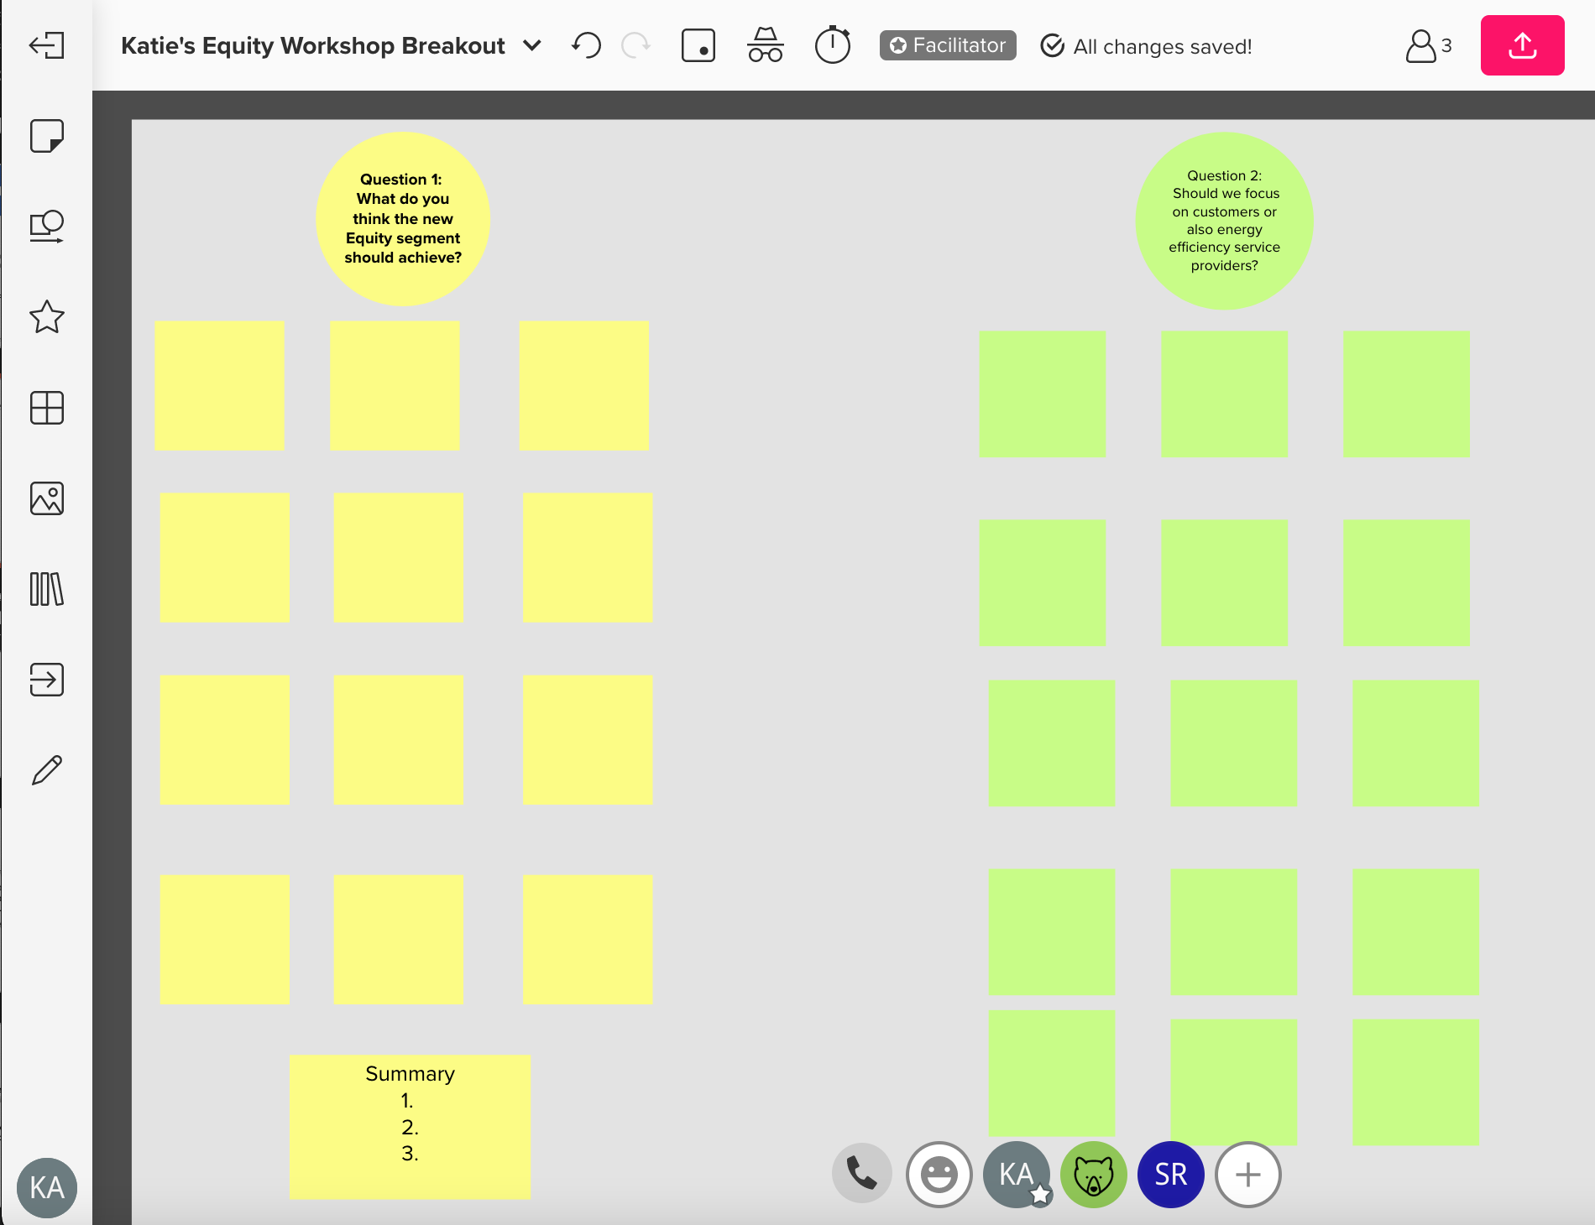
MURAL: Virtual Sticky Notes!

Slide 16
Mural Demo
Zoom in/out
Track vs mouse pad
How to type in a sticky note
How to turn off viewing other cursors

Slide 17
Breakout Logistics
60 minutes to answer 4 questions (9:40-10:40)
You’ll be randomly assigned to one of 6 breakout groups
Remember to leave ”breakout room” not “meeting” when your group is done
15-minute break (10:40-10:55)

Slide 18
Breakout Facilitators
Lara Ettenson, NRDC
Jenny Berg, BayREN
Melanie Peck, The Energy Coalition
Fabi Lao, Center for Sustainable Energy
Katie Abrams, CONCUR
Scott McCreary, CONCUR

Slide 19
Break 10:40-10:55

Slide 20
Reconvene
Report Out from Each Breakout Group
Summarize each group’s responses to the four breakout questions
Identify Common Themes

Slide 21
Next Steps

Slide 22
Appendix Slides

Slide 23
ESJ Action Plan Goals
Yellow highlight denotes Goals the CPUC called out when defining the new Equity segment
1.Consistently integrate equity and access considerations throughout CPUC proceedings and other efforts
2.Increase investment in clean energy resources to benefit ESJ communities, especially to improve local air quality and public health.
3.Strive to improve access to high-quality water, communications, and transportation services for ESJ communities.
4.Increase climate resiliency in ESJ communities.
5.Enhance outreach and public participation opportunities for ESJ communities to meaningfully participate in the CPUC's decision-making process and benefit from CPUC programs.
6.Enhance enforcement to ensure safety and consumer protection for ESJ communities.
7.Promote economic and workforce development opportunities in ESJ communities.
8.Improve training and staff development related to ESJ issues within the CPUC's jurisdiction.
9.Monitor the CPUC's ESJ efforts to evaluate how they are achieving their objectives.

Slide 24
Metric Setting Principles
Be used and useful by program administrators to manage their portfolio
Be timely
Rely on data used in program implementation
Be simple to understand and clear of any subjectivity
Be output-based
Have a readily interpretable meaning, with context added, if needed
Not be a replacement for evaluation, measurement, and verification (EM&V)
Have longevity
Source: 2017 ALJ Ruling Seeking Comments on Business Plan Metrics, page 3, posted to CAEECC meeting page

Slide 25
Sample Equity-related metrics that many PA’s populate across several portfolio sectors
Metric | Sector
Percent of total WE&T training program participants that meet the definition of disadvantaged worker. | Workforce Education and Training (WET)
Percent of incentive dollars spent on contracts* with a demonstrated commitment to provide career pathways to disadvantaged workers | Workforce Education and Training (WET)
Number Career & Workforce Readiness (CWR) participants who have been employed for 12 months after receiving the training | Workforce Education and Training (WET)
Percent of participation in disadvantaged communities | Residential (RSF)
Percent of participation by customers defined as “hard‐to‐reach” | Residential (RSF)
Percent of participation in disadvantaged communities | Residential Sector – Multi-family (RMF)
Percent of participation by customers defined as “hard‐to‐reach” | Residential Sector – Multi-family (RMF)
Percent of benchmarking by properties defined as “hard‐to‐reach” | Residential Sector – Multi-family (RMF)

Slide 26
Meeting Dates & Tasks
Meeting/ Workshop | Date | Tasks
First WG Mtg. | 15-Jul | -Discuss WG final deliverables, and any assumptions to make WG successful -Review pre-existing Objectives and Metric(s) -Identify gaps in Objectives and Metric(s) -Brainstorm alternatives -Discuss initial priorities
Second WG Mtg. | 18-Aug | -Flesh out Objectives and Metric(s) -Identify options in cases where consensus is not reached
Equity Workshop | 31-Aug | -Get stakeholder input
Third WG Mtg. | 14-Sep | -Refine Objectives & Metric(s) -Seek consensus on Objectives and Metrics -Discuss the basis PAs should use in setting Targets for Metrics in their filings
Final WG Mtg. | 29-Sep | -Finalize recommendations document -Strive for consensus & record supporters of options where consensus is not reached
Notes:
Note that mtgs will be virtual, and 9-approx. 1pm

