Slide 1
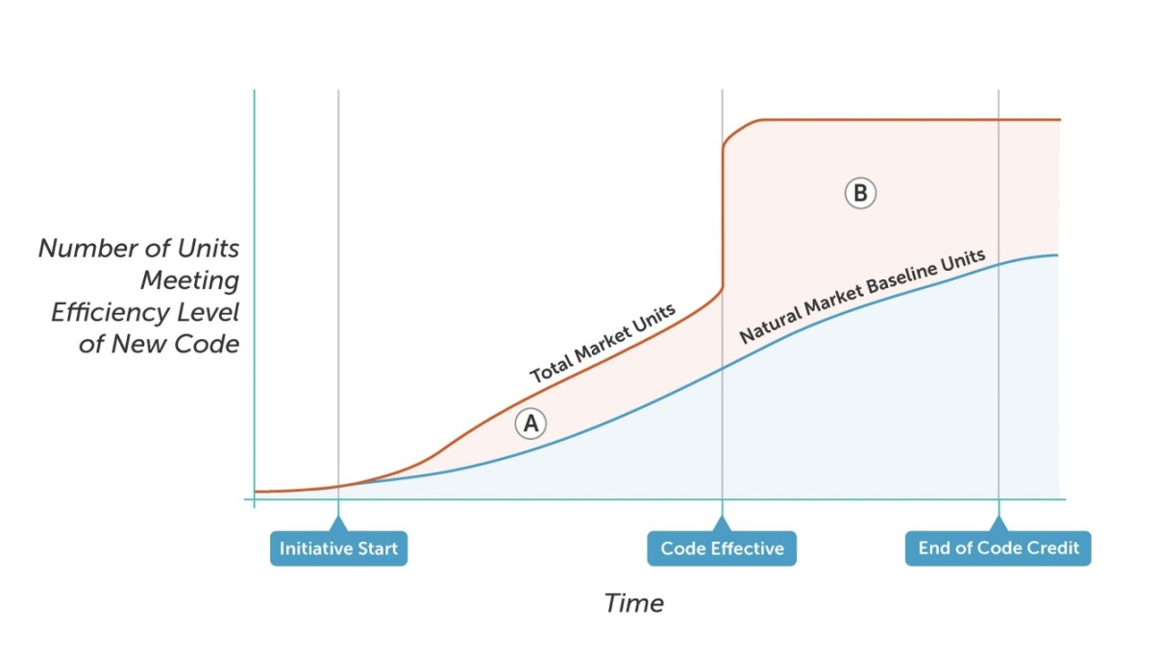
MTI Life-Cycle Energy Savings
Savings Post C&S Adoption
(Above NMB)

Slide 2
Pertinent Items from the Decision
Wholistic View: “think of market transformation as the umbrella under which all of the energy efficiency activities are taking place, with the MTIs designed to “wrap around,” in many cases, existing interventions in particular markets, in order to fill gaps and form a complete approach to transforming that particular market.” p72
Logic Model: “MTA should have the primary responsibility to develop the logic model for each MTI and to coordinate it with existing efforts. Thus, we expect the MTA will spend a great deal of effort and time on coordination efforts, stakeholder outreach, and coordination among program administrators.” p72
Goals and Overlap: “we think more detailed work may be needed to figure out how to set goals and how to attribute savings to various effort under the overall market transformation umbrella in each market, as well as how to ensure minimal duplication or negative overlap. In this …..overlap itself is not necessarily a problem, though conflict will be.” p 72
Collaboration: “we prefer a collaborative and coordinated approach to all of these issues” p 73
CPUC “should encourage close cooperation and collaboration between the MT portfolio and the existing rolling portfolio..” Finding of Fact 27
Section starting p 131 describing how to collaborate – identify overlaps; select MTI’s to enhance positive, minimize negative; collaborate to enhance outcomes, etc.

Slide 3
C-E Forecasts required: “Each market transformation initiative proposed by the market transformation administrator shall report its expected costs and benefits according to the total resource cost and program administrator cost tests, and shall include costs and benefits associated with related development and implementation of building codes and appliance standards, if applicable.” Order #10
MTI Plan:
Describe strategies and data for sizing the market and projecting a naturally occurring adoption curve or baseline for the market
Complete a Delphi process to finalize the initial baseline projection over the life of the initiative
Calculating/Updating savings
MTI Plan:
Articulate the data and methods that will be used to determine energy savings attributable to the program over its lifecycle
Present a forecast of energy savings over the lifecycle of the initiative, as well as a budget, and schedule of c-e. Specify a plan for updating the savings forecast at regular intervals….
If the MTI includes an existing RA program, present a RA coordination plan that demonstrates support from, and coordination with, all related RA programs. This plan could offer a fixed free‐ridership rate for the resource programs for an interim period. This plan may also present a schedule and process for updating free ridership assumptions and for phasing out the resource programs altogether over the longer‐term, in sync with the progress of the Market Transformation Initiative.

Slide 4
Monitoring and Improvement from MTI Plan:
“carefully determine interim market indicators and milestones that will track progress, and a data collection plan to support their measurement”
“Provide a plan for ongoing evaluation, measurement and evaluation to track progress, adjust strategies or metrics if needed and to substantiate savings claims”
“Specify when and how progress reports will be shared with the Commission and stakeholders that detail initiative activities, results and progress against milestones.”
C&S and MTI: “Many market transformation activities are logically related to the development and implementation of building codes and appliance standards.” Finding of fact 19
“The benefits and costs of activities related to codes and standards development and implementation should be included in the cost‑effectiveness calculations for MTIs where they are logically related.” Finding of Fact 28
If the MTI results in the adoption of a code or standard, the savings credit afforded the MTI for the years following code adoption shall be equal to three times the savings claim made in the final year of MTI operations prior to the code or standard adoption. P 128

Slide 5
Key goals / needs for MTI – C&S Savings Attribution
Collaboration: - MTIs with C&S outcomes should collaborate with C&S Administrator to enhance cost-efficiency of both efforts
MTI Savings Forecast: - Need some mechanism to forecast future savings stream in order to prioritize MTIs within the portfolio
Life-Cycle Savings Evaluation: Revised attribution methodology that considers the entire MTI life-cycle; attribution for early stage interventions all the way through to C&S advocacy
Cost-effectiveness: Resolve potential conflict between TRC and PAC:
TRC includes both MTIs and C&S program costs; integrated view of rate-payer effort, encourages collaboration
Program Administrator Cost (PAC) test looks at each component (MTI, C&S) separately – creates potential for silos and zero-sum game

Slide 6
Proposed Option 4: Post C&S Attribution w/backstop min/max savings.
Attribution Forecast at Scale-up Stage-gate
Independent Evaluation:
MTI Attribution Assessment
Max MTI threshold
Not to Scale
%
Min MTI threshold
Scale-up
MTI C&S Outcomes Documented in Logic Model filed with Tier 2 Advice Letter

Slide 7
Additional Considerations
Influence of Resource Acquisition (RA) programs that have elements targeting the same market opportunity as the MTI would also be considered in Post-C&S Life-cycle Attribution methodology
Basic principles of operation:
Assume C&S Administrator continues to do all C&S advocacy work (CASE reports, code language development, data analysis in support of standards, etc.)
No duplication of efforts Pre-C&S: MTI and C&S have to closely coordinate on activities pre-C&S advocacy;
Collaborative goal setting in markets targeted by MTI and C&S; i.e. same goals for timing and efficiency levels in both MTI logic models/goals and C&S team

