Slide 1
7th Semi-Annual
Energy Efficiency 3P Solicitation Meeting
July 11, 2022

Slide 2
Safety Message

Slide 3
Agenda
Time | Session | Objectives | Presenter
10:00 | Introductions | Safety Message Introductions and agenda | Darren Hanway, SCG Emma Ponco, SCG
10:05 | Opening Remarks | Meeting purpose and goals Solicitations process updates Results of stakeholder survey from Jan meeting | Justin Galle, CPUC Energy Division
10:20 | Topic 1: IOU Portfolio Update & Upcoming Solicitations | Solicitations schedule updates EE Business Plan Applications Process improvements | SCG – 10 min PG&E – 10 min SCE – 10 min SDG&E – 10 min Participants Q&A – 20 min
11:20 | Break
11:30 | Topic 2: Independent Evaluators’ Semi-Annual Report June 2022 | IE Observations on solicitations process from October 2021 through March 2022 Effective practices across IOUs IOU responses after each report | Kim Crossman, Independent Evaluator (IE), and PG&E Don Arambula, IE, and SDG&E Melanie Gillette, IE, and SCE Lauren Gage, IE, and SCG Participants Q&A - 10 min
12:20 | Lunch Break (40 min)
1:00 | Topic 3: Independent Evaluator Panel | Garnering robust bidder participation in third party solicitations Compensation in EE third party contracts Market Support and Equity solicitations | Jessie Levine, CPUC Energy Division (facilitator) Kim Crossman, IE Elizabeth Lowe, IE Grey Staple, IE Don Arambula, IE
1:45 | Topic 4: CEDMC Member Panel | Solicitation timing improvements Bidder feedback processes IOU contracting reforms DBE opportunities | Greg Wikler, CEDMC (facilitator) Joanne O’Neill, CLEAResult Ying Wang, Okapi Architecture Dan Stay, Guidehouse
2:30 | Open Discussion | Participant engagement Topics for next meetings | Matt Braunwarth PG&E (facilitator)
2:45 | Closing | Surveys Slide deck and meeting minutes to be posted to CAEECC | Emma Ponco, SCG
3:00 | Adjourn

Slide 4

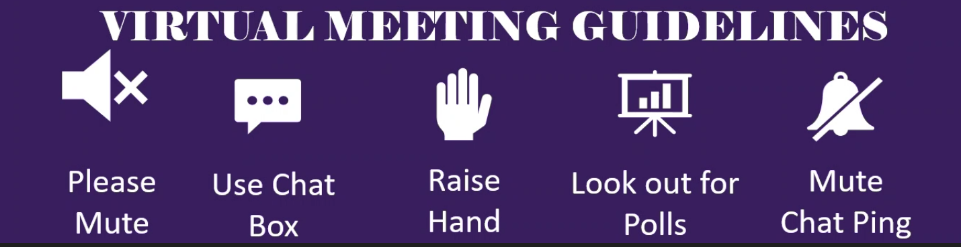
Logistics
All attendees have been muted.
To ask questions, please ‘raise your hand’ and a host will unmute you so you can ask your question.
If you would rather type, use the “Q&A” function (send to “all panelists”). Q&A questions will be read aloud by staff; attendees may be unmuted to respond to the answer verbally.
  *Reminder: Please press mute when done speaking
To submit questions to be read out anonymously, please email
Mia.Hart@cpuc.ca.gov

Slide 5
Energy Division Introduction
Seventh Semi-Annual Energy Efficiency Third Party Solicitations Stakeholder Engagement Forum
July 11, 2022

Slide 6
Meeting Purpose and Goals
Report out to stakeholders on solicitations progress from past 6 months and upcoming solicitations for 2022 and beyond
Transparency on process updates
  Status updates on progress made and effective practices
  Communicate efforts to address priority areas for continuous improvement
Gather feedback and identify emerging issues from the public
we want to hear from you

Slide 7
Past Stakeholder Engagement
6 semiannual workshops (July ‘19, Feb ‘20, July ‘20, Jan ‘21, July ‘21, Jan '22)
1 CPUC all party meeting (October ‘20)
Identified areas for improvement / new processes:
  Length and complexity of solicitations process
  Cultivating small and diverse businesses as 3P implementers
  Feedback to bidders / networking opportunities
  Distribution of risk in pay for performance programs

Slide 8
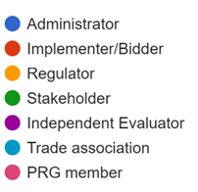
Survey Overview from Jan 2022 Stakeholder Meeting
Positive feedback:
  Appreciation of focus on issues identified at past stakeholder meetings
  Relevancy of topics
  Some satisfaction with new bidder feedback mechanisms
  Solicitations timeline improvements
Ongoing areas of concern:
  Contractual terms that are not aligned with standard industry practice, present unreasonable risk to implementers, and the trade-offs between P4P, NMEC, bidder cash flow requirements, etc.
  EE portfolio diversity
  Lack of solicitation/contract incentives for innovation
  Lack of customer/implementer perspective at stakeholder meeting
  Substantive responses given by IOUs at stakeholder meeting
What is your role in EE solicitations?
2
3
2
2
2
1
1

Slide 9
CPUC Policy Overview
D.15-10-028
D.16-08-019
D.18-01-004
D.18-05-041
D.18-10-008
D.21-05-031
D.21-12-011
EE Goals for 2016 and Beyond and Rolling Portfolio Mechanics
Guidance for EE Rolling Portfolio Business Plans Filings
Energy Efficiency Solicitation Process
Energy Efficiency Business Plans
Workforce Requirements and Third-Party Contract Terms & Conditions
EE Potential and Goals and Portfolio Segments
EE Actions to Enhance Summer Reliability
Oct. 2015
Aug. 2016
Jan. 2018
May 2018
Oct. 2018
May 2021
Dec. 2021
    Established “rolling portfolio” process reviewing and revising EE portfolios
    Continued existing third-party framework
  Guidance on third-party programs and admin
  Provided new third-party definition and % requirement
  Established process for third-party solicitations
  Revised third-party compliance %
  Established PRG and IE structure
    Discussed third-party programs as they relate to business plans
    Revised third-party compliance milestone for 2020
  Established workforce quality standards
  Defined “disadvantaged worker”
  Established standard and modifiable contract terms
  Adopted Total System Benefit metric
  Adopted EE segments of resource acquisition, market support, or and equity
  Authorized $30M statewide for third-party solicitations designed to produce peak and/or net peak demand savings

Slide 10
Segmentation of EE Portfolios began in program year 2022
Resource Acquisition
Primary purpose and short-term ability to deliver cost-effective avoided cost benefits to the electricity and natural gas systems
This segment should make up the bulk of savings to achieve Total System Benefit goals
Market Support
Primary objective of supporting the long-term success of the EE market by educating customers, training contractors, or moving beneficial technologies towards greater cost-effectiveness
May not produce cost-effective measurable savings in the short term
Equity
Primary purpose of providing EE to hard-to-reach or underserved customers and disadvantaged communities in advancement of the Commission’s Environmental and Social Justice (ESJ) Action Plan
May provide corollary benefits such as increased comfort and safety, improved indoor air
Notes:
- market support and equity programs are limited to 30% of overall budget of IOU PAs
- some programs categorized as market support or equity may be able to deliver quantifiable short-term energy savings in the first few years of operation or after a long period of operation, but perhaps not in enough quantity to support a calculation of cost-effectiveness for the program
- some resource acquisition programs may have equity or market support aspects (for example, a marketing budget that accompanies a direct install program), but the primary purpose of the program would still be delivery of energy savings in the near term, leading to a categorization as a resource acquisition program
- an individual program may only be assigned to one segment at a given time

Slide 11
Innovation definition used by Procurement Review Groups
A program proposal that demonstrates an ultimate increase in the uptake of cost-effective EE by advancing a technology, marketing strategy, or delivery approach in a manner different from past efforts.
Ideally scalable and replicable across sectors, segments, and technologies, and integrates other demand side technologies where feasible.
Examples could include:
  Technology: a measure that is no longer considered “emerging technology” but not yet fully in the market;
  Market strategy: new software strategies that support and promote comprehensive energy resource management;
  Delivery approach: a new strategy for customer engagement and enrollment.

Slide 12
Third-Party Solicitations: Contracts executed to date
    78 contracts have been executed with
    32 implementers
    $1.6 billion in total program budgets approved
    61% of total EE third-party portfolio budget dollars have been awarded to two firms
    $793 million has been awarded to Willdan Energy Solutions, via 8 contracts
    Mean contract value with/without Willdan:
    $25M / $14M
    First contracts effective and programs launched in July 2020

Slide 13
Transparency and predictability of schedules
Schedules posted monthly. Recently updated to include targeted savings, contract budgets, and contract timelines:
  Joint IOU Solicitation Timeline (July 1, 2022) – Scheduled stages of solicitations past and future
  Third-Party Implementers Table (July 1, 2022) – Executed contracts, with their date of execution and associated advice letters resulting from solicitation
  Energy Efficiency Third-Party Solicitations Dynamic Schedule – Gantt chart style schedule showing actual dates of past milestones, and forecast future dates

Slide 14
Efforts to identify and propose improvements
Opinion Dynamics Process Evaluation posted on Jan 28, 2022 to CPUC Public Document Area
Expansion of PRG membership: Nov 8, 2021 ED letter to IOUs
  Has not yielded any new PRG members
Independent evaluators’ semi-annual reports filed mid-June, 2022
  Hosted on CAEECC: Independent Evaluator Reports: Solicitat | caeecc

Slide 15
Efforts to identify and propose improvements
Third-Party solicitations improvements to be addressed in Energy Efficiency Rulemaking or Business Plan Application Proceeding
6/24/22 Scoping Memo and Ruling issued – identified third-party solicitation improvements as a topic for a ruling in Q2-Q4: 488538344.PDF (ca.gov)
Topics to be addressed:
  Revisions to Standard and Modifiable Terms and Conditions
  Reducing Solicitations Process Burdens
  Broadening Bidder Participation
  Supporting Innovation
  Improving Transparency to the Bidder Community
  Other Improvements

Slide 16
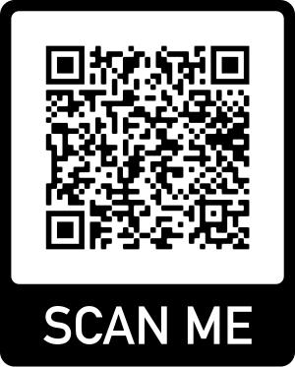
Please complete the survey!
Please make sure to complete the survey so that we can effectively respond to your feedback
The link is below along with a QR code that you can click on now and in the chat!
Link
July 11, 2022 Stakeholder Meeting

Slide 17

For more information:
Justin.Galle@cpuc.ca.gov

Slide 18
Topic 1:
IOU Portfolio Update &
Upcoming Solicitations
10:20am to 11:20Am

Slide 19
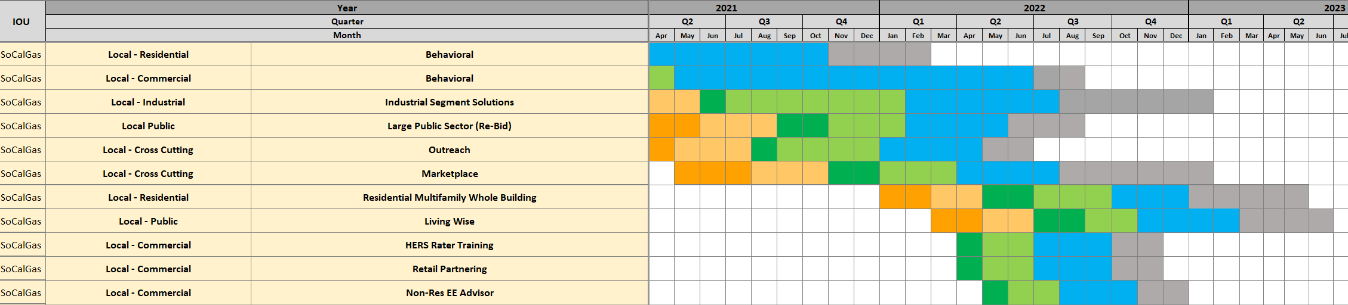
2022-2023 Solicitation Schedule
In the 1st half of 2022, SoCalGas implemented single or one stage solicitation for smaller program budgets.

Slide 20
Solicitation Forecast
SoCalGas is on track to meet the 60% the Third Party designed and implemented programs by 12/31/22.
Metric | 2022 | 2023
Third Party Programs | 60%¹ of portfolio budget | 67%^{1,2} of portfolio budget
Anticipated 2023 Program Solicitations
      Residential Single Family = $2.7M/Yr.
      Manufacturing Housing= $3.0M/Yr.
      Small and Medium Commercial=$5.0M/Yr.
      IDEEA 365=$3.5M/Yr.
      Com - Strategic Energy Management=$2.0M/Yr.
¹ 3PP budget includes the AB 841 budget.
² 2023 3PP budget reflects annual program budget.

Slide 21
SoCalGas Business Plan - Vision, Objectives, and Outcomes
SoCalGas’ energy efficiency portfolio will accelerate California toward its clean energy goals through innovative, comprehensive customer-centric decarbonization solutions.
Vision
Segments
Resource Acquisition
Market Support
Equity
Meet or Exceed Commission-Established TSB Goal with Minimum TRC of 1.0
Reducing market barriers to achieve the desired, long-lasting market effects
Focusing on providing corollary benefits such as increased comfort and safety, and improved indoor air quality
Key Objectives
Use of various and new methods for savings forecasting and quantification methods
Encourage Tech Innovation and Broad Market Participation
Provide access to disparities to EE programs and workforce opportunities
Strategy
Expand outreach to local contractors and market players on EE training and education
Conduct Third Party Solicitations to Fill Gaps
Promote energy affordability
Key Outcomes
Achieve TSB Goal in a Cost-Effective manner
Help build, enable, and maintain demand for EE products and services
Increased awareness and penetration of EE Programs to HTR and DAC

Slide 22
3PP Solicitation Goals & Objectives
Execute timely solicitations
Time savings through optimization improvements in the two- stage approach
Stimulate innovative program designs
Procuring innovative program designs and delivery approaches from the energy efficiency implementer community.
Increase diversity in bidders
Offer several supplier developments and technical assistance programs aimed to prepare and educate the small, diverse firms to be “contract ready” to for future solicitation opportunities
Cost-effective delivery of programs
Identify opportunities to optimize process steps and reduce lead time for program solicitation.

Slide 23
3PP Solicitation Outcomes
SoCalGas will focus efforts on recommendations from a CPUC-ordered study, PRG working groups, and IEs to improve the solicitation process for energy efficiency programs.
Length and duration of solicitation makes it difficult to standardize to fit the needs of contracting community
Competing priorities in scorecard tool; complex
A scorecard software tool to evaluate and score more effectively.
Low participation of new and small diverse business owners
Lack of new and innovative program ideas
Innovative Designs for Energy Efficiency Activities (IDEEA365) program, an ongoing offering to capture innovative new program proposals to enable customer engagement in energy efficiency.
Incorporate subcontracting goals into 3PP contracts; Readiness Programs such as Business Assessment, Elevate Entrepreneur Institute, SCORE (Smaller contractor realization effort).
Partnered with SoCalGas’ Performance Management and Organizational Strategy organization for Lean Six Sigma analysis.

Slide 24
Outcomes
SoCalGas will focus efforts on recommendations from a CPUC-ordered study, PRG working groups, IEs, and IOUs to improve the solicitation process for EE programs.
Providing bidder feedback continues to present challenges, lack of access to detailed comment by a bidder.
Provide individual bidder sessions outside of PowerAdvocate response. SoCalGas will also conduct third party program focus groups to understand barriers related to the solicitation process.
More flexible contracting is needed to overcome inherent contract risks and encourage small vendors to serve as prime contractors.
Increase education of small business partners about SoCalGas’ DBE Contractor Training Programs.
Balance “sticks” for underperformance with “carrots” for overperformance.
Develop risk and mitigation planning governance. The contracting strategy specifically aligns with third-party performance metrics. KPIs, variance explanations, validation of the flow of information in a timely manner, etc.

Slide 25
2022 Process Improvements
Through SoCalGas’ Lean Six Sigma (LSS) team, identified opportunities to optimize process steps and reduce lead time for SoCalGas’ EE Program Solicitation.
  Opportunity for Improvement (OFI): Technology, scorecard, communication, and scheduling.
Simplified the two-stage process by relaxing or modifying some of the categories in the RFA/RFP, scoring, negotiation phase to allow for entries of new, small, diverse business partners.
    For Stage 1, limit the criteria to program design and strategy and experience and skills only.
    For Stage 2, criteria include cost and energy savings, experience and skills, program design and strategy, social responsibility, and compliance.
Implemented one-stage solicitation process
Continue to work with our DBE partners in utilizing an internal reporting tool to identify subcontracting opportunities and challenges. The subcontracting approach includes meeting with top EE suppliers to increase their subcontracting performance and targeted showcases that introduce prime firms to diverse suppliers for future business opportunities.

Slide 26

EE Stakeholder Forum
Topic 1 – IOU Portfolio Update & Upcoming Solicitations
July 2022

Slide 27






1) Solicitation Schedule Updates
One solicitation discontinued in 2022
Six new solicitations planned for launch in 2023
Completed ten solicitations to date:
  Small Commercial
  Large Commercial
  Multifamily
  SW HVAC
  Federal
  K-12
  PLA
  Local Government
  Single Family
  Agriculture
Four additional solicitations expected to be completed in 2022
Four new solicitations planned for launch in 2022

Slide 28
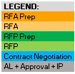
In Progress and Planned Solicitations
Source: Market Rate 3rd Party EE (R.13-11-005) | caeecc

Slide 29
Upcoming Solicitations - 2022
Four new solicitations starting in 2022
All are either Market Support or Equity
Small Business Outreach RFA released on July 7th
Register in PowerAdvocate to receive information about each solicitation

Slide 30
Upcoming Solicitations - 2023
Six new solicitations starting in 2023 (schedule subject to change)
Five related to a restructuring of the commercial sector
Smaller contracts may be an opportunity for small and/or diverse businesses

Slide 31
Outsourcing Forecast
SDG&E is forecasting to meet/exceed the requirement of 60% outsourced by 12/31/2022
Currently trending below the requirement of 25% of statewide outsourced by 12/31/2022
2022 contracted %’s lower than in January for Third-Party and Statewide
2023 projected % for Third-Party lower but remains the same for Statewide
Today
Key Metric | January 2022 Status
 | 2022 Contracted | 2023 Projected
Third-Party EE Programs | 62% of portfolio budget 40% minimum | 75% of portfolio budget 60% minimum
Statewide Only | 19% of portfolio budget 25% minimum | 23% of portfolio budget 25% minimum
Key Metric | July 2022 Status
 | 2022 Contracted | 2023 Projected
Third-Party EE Programs | 51% of portfolio budget 40% minimum | 67% of portfolio budget 60% minimum
Statewide Only | 16% of portfolio budget 25% minimum | 23% of portfolio budget 25% minimum

Slide 32
SDG&E Business Plan Vision & Strategy
SDG&E’s primary goals are to serve its customers and make significant progress towards achieving the State’s GHG reduction and grid decarbonization goals
Reinforce commitment to innovation in customer offerings and technology advancements
Mobilize end-to-end energy efficiency markets and participants
Encourage and facilitate greater outreach and education
Employ strategies to help reduce the high cost of certain long-life electric measures and associated customer investments required for fuel-substitution
Commitment to outsource as close to 100% of our EE programs as possible
Increase Fuel-sub measures in current programs
Propose New Market Support & Equity programs
Coordinate with Market Transformation Program(s)
Support funding for electrification enabling technologies

Slide 33
Portfolio Segmentation
Resource Acquisition | Market Support | Equity
Deliver TSB goals at 1.0 TRC | Support long-term success of EE market | Provide EE to hard-to-reach and underserved communities
Pay-For-Performance approach Solicit for programs designed at 1.25 TRC | Training and education of customers and the workforce Collaborate to expand awareness and access | Provide simple, comprehensive EE management solution for these communities
Achieve TSB goals cost-effectively | Increased awareness of EE products, services and trainings | Increased accessibility to EE products and services in hard-to-reach and underserved communities
Key Goals
Strategies
Outcomes

Slide 34
Portfolio Segmentation – Budget Allocation
Segment | 2024 | 2025 | 2026 | 2027 | Total 4 Years
Resource Acquisition | $48,115,551 | $50,824,269 | $49,944,603 | $52,620,587 | $201,505,010
Market Support | $18,661,344 | $20,002,059 | $19,473,278 | $19,795,454 | $77,932,135
Equity | $5,145,073 | $5,125,189 | $5,272,550 | $5,402,705 | $20,945,517
Codes & Standards | $4,556,131 | $4,607,379 | $4,642,647 | $4,684,500 | $18,490,656
EM&V | $3,186,587 | $3,356,621 | $3,305,545 | $3,437,635 | $13,286,388
Total | $79,664,685 | $83,915,516 | $82,638,623 | $85,940,881 | $332,159,706
Market Support & Equity % | 29.88% | 29.94% | 29.94% | 29.32% | 29.77%
Source: SAN DIEGO GAS & ELECTRIC COMPANY (U 902-M) 2024-2027 ENERGY EFFICIENCY ROLLING PORTFOLIO BUSINESS PLAN PREPARED TESTIMONY EXHIBIT 2, PAGE 17

Slide 35
Policy Proposal: Revise Two-Stage Solicitation Approach
A one-stage, two-step solicitation process will be more efficient and effective, and it will reduce resources for all parties involved in the process.
Stage 1: RFP
  Step 1: Bidder Interviews
  Step 2: Contracting
Benefits:
  Saves time by eliminating the RFA phase (appr. 3 months)
  Shorter process improves opportunities for small businesses to participate more
  More time for Implementers to make program corrections before we must re-solicit
  More timely re-solicitations to replace programs with “close” status
  Reduces resource commitments from all involved
Source: SAN DIEGO GAS & ELECTRIC COMPANY (U 902-M), 2024-2027 ENERGY EFFICIENCY ROLLING PORTFOLIO BUSINESS PLAN, PREPARED TESTIMONY, EXHIBIT 2, PAGES 223-225.

Slide 36
Process Improvements
Reduced solicitation time from 21 to 12 months
Adopted new EE PRG review options
Implemented new Interview process
Improved Bidder Outreach
Launched Bidder Partnering Tool
Developing RFP in parallel to RFA release
Leveraging new EE PRG review options
Email
Off-cycle meetings
Shortened from 90 to 60 minutes
Influences final bidder score
Added targeted paid advertising
Added more channels
Collaboration with SBAU
Opportunity for SBE/DBEs to add info to a partner list
Increases opportunity for partnering on solicitations

Slide 37
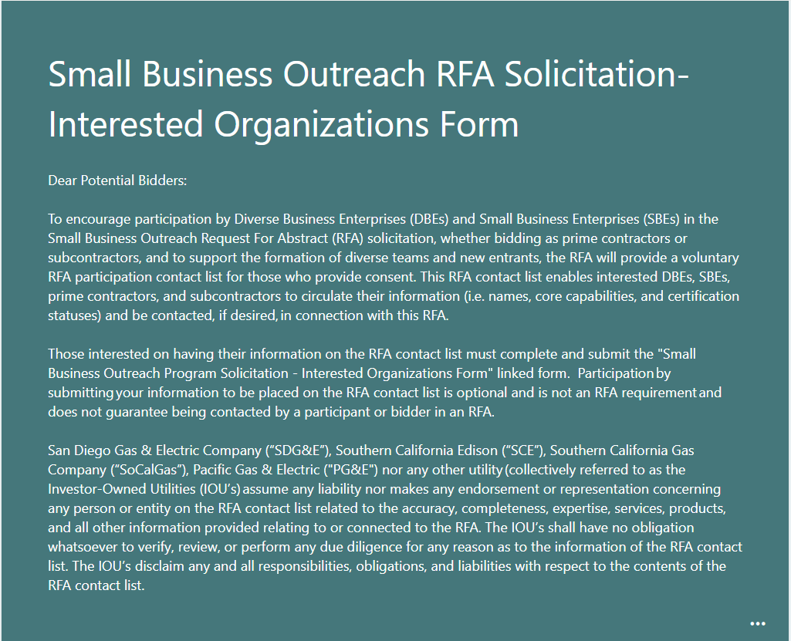
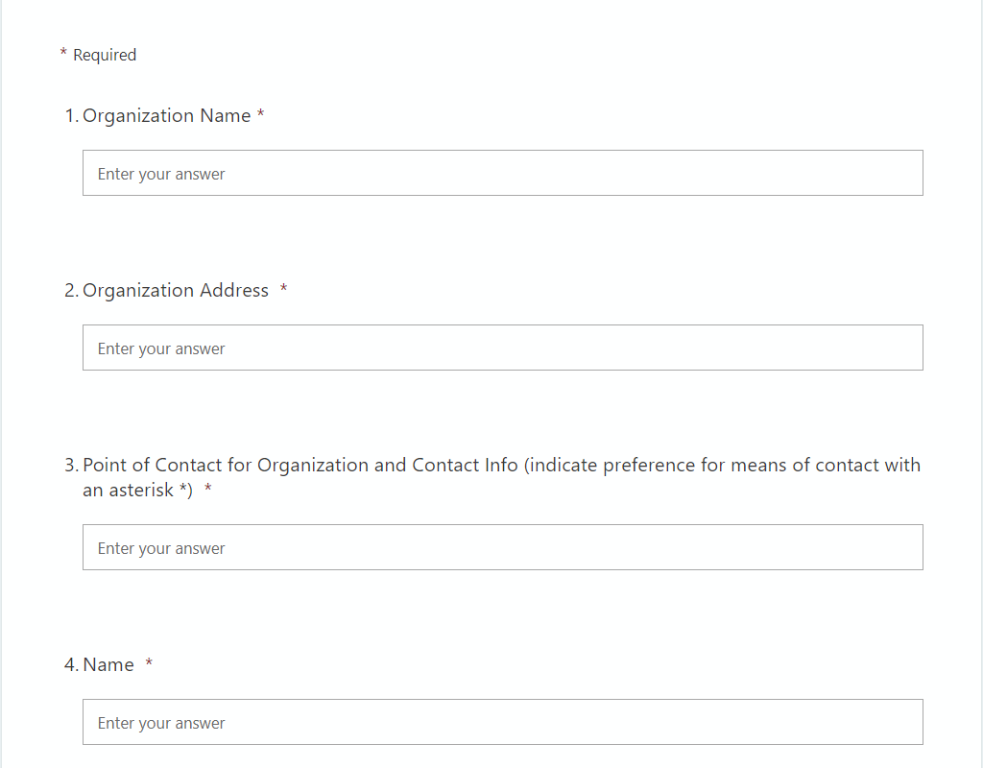
Bidder Partnering Tool
Example
A voluntary contact list for those who are open to partnering with other bidders on solicitations
Available for each solicitation at the RFA stage
Requirement is to register in PowerAdvocate for the solicitation (“Event”)
Look for the “Interested Organization Form”
  Option to list e.g., bidder name, core capabilities, and certification statuses
  References to the form can be found on SDG&E’s EE Landing Page, PEPMA, and PowerAdvocate*
  *Required to fill out the list for each individual solicitation event in PowerAdvocate

Slide 38
Southern California Edison
EE Stakeholder Forum
Topic 1 – IOU Portfolio and Solicitation Update

Slide 39
Solicitation Schedule: Planned & In Progress
SCE’s Energy Efficiency Solicitation Schedule Schedule as of 7/01/2022 (Schedule may be subject to change at IOU's discretion)
IOU | Year |  | 2022 |  |  |  |  |  |  |  |  |  |  |  | 2023 |  |  |  |  |  |  |  |  |  |  |  | 2024
 | Quarter |  | Q1 |  |  | Q2 |  |  | Q3 |  |  | Q4 |  |  | Q1 |  |  | Q2 |  |  | Q3 |  |  | Q4 |  |  | Q1 |  |  | Q2 |  |  | Q3 |  |  | Q4
 | Month |  | Jan | Feb | Mar | Apr | May | Jun | Jul | Aug | Sep | Oct | Nov | Dec | Jan | Feb | Mar | Apr | May | Jun | Jul | Aug | Sep | Oct | Nov | Dec | Jan | Feb | Mar | Apr | May | Jun | Jul | Aug | Sep | Oct | Nov | Dec
SCE | Local Customer Programs | Commercial
SCE | Local Customer Programs | Industrial
SCE | Local Customer Programs | Residential
SCE | Local Customer Programs | Agricultural
SCE | Local Customer Programs | Public
SCE | Statewide Programs | Lighting Program
SCE | Statewide Programs | Higher Education
SCE | Statewide Programs | Water/Wastewater Pumping
SCE | Cross-cutting | Electric Emerging Technologies
SCE | Local Reliability Programs | Res, Comm, Ind, Pub, Ag |  |  |  |  |  |  | No offers received - solicitation concluded
SCE | Local Equity Programs | Residential & SMB
SCE | Market Gaps Program | TBD
Summer Reliability solicitation did not receive any offers, the solicitation has concluded
Conducting portfolio analysis to determine Market Gap solicitation scope
  Expected to result in multiple solicitations
  Budgets are TBD, dependent on target market(s) and gap size(s)
Per the Business Plan, Market Support will be fulfilled by existing programs and new SCE-led local programs in the near term
  If gaps are identified, SCE may solicit for additional Market Support programs at a later date

Slide 40
Outsourcing Forecast
SCE exceeded the requirement to outsource 60% of budgets to Third Party designed and implemented programs ahead of the 12/31/22 deadline
SCE is currently below the 25% requirement of budget allocation toward Statewide programs
Metric | 2022 | 2023
Third Party Programs | 82%¹ of portfolio budget | 73%^{1,2} of portfolio budget
Statewide Programs | 7% of portfolio budget | 8% of portfolio budget
SCE has met the requested funding asks from all IOU Statewide programs
¹ The Third Party budget includes the AB 841 budget that is considered Third Party.
² 2023 AB 841 budget does not currently include unspent/uncommitted funding from 2022. 2022 does include them from 2021.
Data from 2021 Annual Report

Slide 41
SCE Business Plan - Vision, Objectives, and Outcomes
Lead development of a robust Energy Efficiency Portfolio to address key customer, technology, and policy needs to meet the State’s energy and environmental goals
Vision
Reduce GHG by 40% by 2030
Double EE by 2030 (SB 350)
Achieve California Decarbonization by 2045
Segments
Resource Acquisition
Market Support
Equity
Codes and Standards
Key Objectives
Meet or Exceed Commission-Established TSB Goal with Minimum TRC of 1.0
Support Long-Term Success of the EE Market’s Viability
Provide Equitable Coverage to Underserved Customers¹, HTR, and DAC
Advocate For More Stringent Building and Appliance Codes
Leverage Traditional Delivery Approaches by Sector
Encourage Tech Innovation and Broad Market Participation
Conduct Third Party Solicitations
Educate Market and Develop Compliance Tools
Attainment Methods
Conduct Third Party Solicitations to Fill Gaps
Leverage Existing Programs and New SCE-Led Local Programs
Align to Environment and Social Justice Action Plan
Key Outcomes
Achieve Cost-Effective TSB Goal
Broader Awareness and Participation in EE Market
Increased Penetration of EE Measures in HTR and DAC. EE participation by Underserved Customers¹
Code Compliance Improvements. Adoption of Reach Codes. Technology Readiness
¹ Definition is equivalent to “underserved communities” from the ESJ Action Plan p.77

Slide 42

Support of Innovation
Innovation: Advancing a new 1) technology, 2) marketing strategy, or 3) delivery approach
Innovation is in the forefront throughout and beyond the solicitation process.
  Evaluated during the RFA and RFP stages, and reported to the PRG
  Captured in the Program Plan Framework exhibit of each EE Contract
  Summarized in Tier-2 Advice Letter filings (if applicable)
Some challenges exist, delaying implementation of Innovative ideas:
  SEM strategies may encourage EE adoption in multiple customer sectors, but its enhanced savings benefits currently only apply to Industrial projects
  Marketplace website seeks to overcome longstanding market, psychological, and financial barriers to residential EE adoption, but the financing mechanism underwent a lengthy review
SCE continues to support and take the steps necessary to help Implementers deliver innovations to customers.
  Partner with Implementers and CPUC to overcome barriers to Innovation
  Plan outreach to Implementers for optional IDSM activities outside of the EE Contract:
    Facilitation of EE/DR program enrollments
    Marketing, outreach, and education activities

Slide 43
Solicitation Process Improvements
Improvements | Actions Taken | Benefits to Bidders
Streamline Solicitation Processes | Reduced the number of RFA and RFP questions by 30% - 40% Reduced RFA timeline by approximately 40% | Bidders spend less time developing an abstract Less overlap between RFA and RFP questions
Facilitate Introductions Between Potential Bidders | Provided opportunity for companies to reach out to each other and team up | Expected to broaden supplier diversity and expand opportunities for newer, niche, and/or SMB/DBE firms to partner
Improve Bidder Outreach Efforts | Informed Community Based Organization and EE proceeding service list to inform potential bidders regarding upcoming Solicitations | Expected to increase awareness of EE solicitation information to new and/or non-traditional potential bidders
Redesign Bidders’ Feedback Webinar | Established dialog and rapport with bidder community | Roundtable approach allows for direct, real-time conversation and follow-up questions
All Promote the Increase of Supplier Diversity & Encourage New Participants

Slide 44
EE Stakeholder Forum
July, 2022

Slide 45
PG&E Solicitation Timeline
Contracting = Negotiation meetings + contract review with PRG + contract execution
Advice Letter = PG&E advice letter drafting + CPUC approval
Implementation Plan = IP drafting + stakeholder conference + IP upload
Today
60% Deadline
Future Solicitations:
Zonal Electrification Program
Residential Equity
Residential Load Management
Residential Market Support Program
Customer Resiliency Support Program – Residential
Customer Resiliency Support Program – Public
Decarbonization Program
Clean Energy Optimization Pilot
Future solicitations will be added to the solicitation timeline throughout 2022 and 2023 once the scope for each solicitation is defined. Please monitor PG&E’s EE Solicitations webpage or the CAEECC webpage for updates.
www.pge.com/eesolicitations
https://www.caeecc.org/third-party-solicitation-process

Slide 46
Outsourcing Forecast
Metric | 2022 | 2023
Third-Party Programs | 64% of portfolio budget 40% Requirement | 62% of portfolio budget 60% Requirement
Statewide Programs | 13% of portfolio budget 25% Requirement | 17% of portfolio budget 25% Requirement
Currently on track to meet/exceed the 60% outsourcing requirement 12/31/2022
Assumes completion of Micro-Small Business contracting before 12/31/2022.

Slide 47
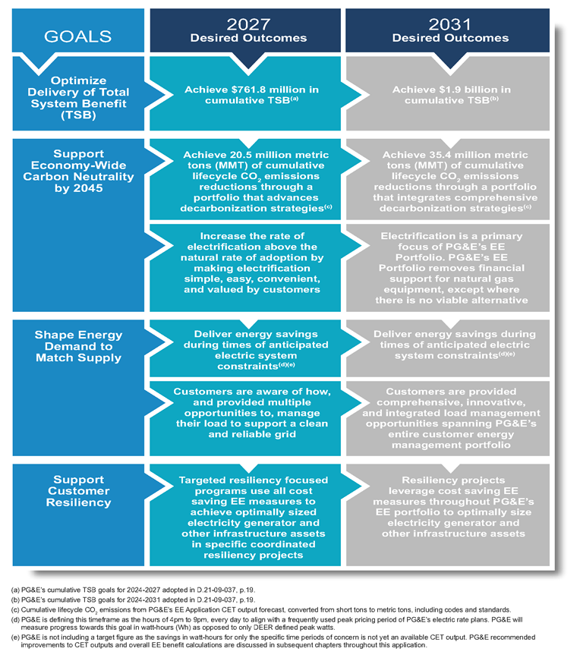
Business Plan Vision, Goals, and Outcomes
PG&E’s vision for EE is to help keep customer energy bills affordable, reduce energy demand on the grid, build resiliency to climate change, and advance building decarbonization in California

Slide 48



Portfolio Segments and Outcomes
 | Resource Acquisition | Equity | Market Support
Objective | Deliver TSB as cost-effectively as possible. Default categorization for PG&E programs | Address access disparities; promote energy and non-energy benefits; reduce emissions | Build, enable, and maintain: demand for EE products/services; supply of capable, motivated market actors; partnerships; innovation & accessibility; access to capital
Strategies & Mechanisms | Use multiple channels and locations Provide easy access and clear pathways ease participation Provide behavioral and operational interventions Broaden engagement with EE and other energy management solutions | Improve access for underserved customers through new small/micro business and residential equity (electrification-focused) programs “Zonal” Electrification: Target income qualified & disadvantaged communities where natural gas assets can be retired Statewide WE&T Programs: Serve disadvantaged workers | New programs focused on whole-building electrification education & training, load management, customer resiliency Enable all-electric/electric-ready buildings, accelerate adoption of advanced tech through new construction programs Local government partnerships support EE adoption OBF alternative pathway: access to capital Statewide WE&T: build future energy workforce
Metrics & Indicators | TSB and TRC ratio 3P programs have key performance indicators (KPIs) specific to contracts, including customer satisfaction, in addition to performance targets | Measure who/how target populations are “served” Assess energy and/or cost savings in targeted populations Examine “holistic” benefits As recommended by equity metrics WG | Metrics as recommended by MS metrics WG for different MS sub-objectives

Slide 49
Policy Proposal: Expand Options for Procurement
Broader range of procurement approaches would enable EE portfolios that can adapt to both gradually evolving and quickly shifting market needs.
Revisit use of single-stage solicitations → respond more quickly when market conditions are changing
Use more flexible “market access” approach → may appeal to smaller implementers, increase customer choice, lower delivery risk
Permit all-source RFPs for customer programs on a case-by-case basis → similar to multi-technology solicitations conducted in Energy Supply

Slide 50
Solicitation Process Improvements
Focus | Improvements | Benefit
Streamlined RFA/RFP | Removed overlap between RFA and RFP question content Removed time gap between RFA shortlist and launch of RFP Simplified questions Incorporated interview stage | Timeline of 2-stage process reduced to 10-12 months overall Reduced effort required by bidder to draft abstracts/proposals Reduced effort required by PG&E/IE to evaluate abstracts/proposals
Bidder’s Feedback Process | Increased granularity of feedback data beyond primary criteria to all sub-criteria Feedback includes indication of both absolute and performance relative to rest of field RFA and RFP debriefs offered following RFA and RFP shortlisting RFA Feedback offered to all solicitation participants, including advancing bidders | Feedback is more actionable Feedback is more timely Better bidder engagement in RFP
Small/Diverse Opportunities | Developing process to share contact information for partnering in each solicitation | Provides more partnering opportunities for small and diverse suppliers

Slide 51
Short Break
10 minutes

Slide 52
Topic 2: Independent Evaluators’ observations
July 11, 2022 Stakeholder Meeting
Apex ANALYTICS
Barakat consulting, Inc.
Don Arambula Consulting
EAJ Energy advisors
Great Work Energy
MCR Corporate Services
THE Mendota Group, LLC

Slide 53

Observations
Note: These Observations are based on what was observed and reported on during the October 2021 through March 2022 Reporting Timeframe
Notes:
Note that these observations and lessons learned are “public” information and, therefore, do not reflect the entirety of nor necessarily even the most important observations and lessons learned.

Slide 54
PG&E

Slide 55
PG&E Solicitations
Solicitation |  | Assigned IE | Solicitation Status
Initial | Revised
Local Agriculture | Local Multi-Sector | Barakat Consulting, Inc. | Complete
Local Commercial |  | EAJ Energy Advisors
Local Industrial |  | Great Work Energy
Local Public |  | Don Arambula Consulting
Local Residential |  | The Mendota Group
Statewide Residential New Construction | Statewide New Construction | The Mendota Group | Complete
Statewide Nonresidential New Construction |  | EAJ Energy Advisors
 |  | Barakat Consulting
Originally Not Proposed | Local Government Partnerships | Don Arambula Consulting | Complete
Statewide Codes & Standards: Coordinator, Title 20, & Federal | Statewide Codes & Standards | Barakat Consulting | Complete

Slide 56
PG&E Solicitations (Continued)
Solicitation |  | Assigned IE | Solicitation Status
Initial | Revised
Statewide Workforce Education &Training (WE&T): Career Connections K-12 |  | Great Work Energy | Complete
Statewide WE&T: Career and Workforce Readiness (CWR) |  | Great Work Energy | Complete
State of California and Department of Corrections | State of California | Don Arambula Consulting | Complete
Micro- and Small Business EE Equity |  | Great Work Energy | RFP

Slide 57
PG&E – IE Observations
Testing discrete criteria in either the RFA or RFP stage, but not both, could reduce effort and time. To ensure all criteria are considered in final selection, PG&E calculates final bid rankings based on scores from both RFA & RFP.
RFA & RFP Scoring Criteria
  The Equity RFP incorporated the framework recommended by the CAEECC equity metrics working group, which was well aligned with the objectives that had been laid out in the RFA.
Equity Metrics
Provide rapid feedback to all RFA bidders (both advancing and non-advancing) immediately following RFA shortlist notification, instead of waiting until after the solicitation is concluded (PG&E)
Bidder Feedback
  PG&E has devised a simple, effective approach to encouraging and scoring participation of Small Businesses in the Equity RFA in hopes of gaining maximum participation by small, local California businesses in the RFP.
Supply Chain Diversity

Slide 58
SDG&E

Slide 59
SDG&E Solicitations
Solicitation | Assigned IE | Solicitation Status
Local Small Commercial | The Mendota Group | Complete
Local Large Commercial | The Mendota Group | Complete
Local Multi-Family Residential | MCR Corporate Services | Complete
Statewide Plug Load and Appliance | Don Arambula Consulting | Contract Executed
Statewide Upstream/Midstream HVAC | The Mendota Group | Complete
Local Public K-12 | MCR Corporate Services | Complete
Local Public Sector Federal | MCR Corporate Services | Complete
Local Residential Single Family 1.0 | Don Arambula Consulting | Cancelled
Local Residential Single Family 2.0 | Don Arambula Consulting | RFP
Local Government | Don Arambula Consulting | Contracting

Slide 60
SDG&E Solicitations (Continued)
Solicitation | Assigned IE | Solicitation Status
Local Agriculture | Barakat Consulting, Inc. | Contracting
Statewide Residential HVAC Quality Installation and Quality Maintenance | Don Arambula Consulting | RFA
Local Behavioral | MCR Corporate Services | RFP
Local Industrial | The Mendota Group | Contracting
Local Industrial – Port Tenants | The Mendota Group | Contracting

Slide 61
SDG&E – IE Observations
SDG&E has improved its bidder feedback process by providing more details in written notifications and offering bidders debriefing sessions. The sessions include an opportunity for bidders to also give feedback to SDG&E.
Bidder Feedback
Process
SDG&E has collaborated with its PRG and collective IEs to improve the bidder interview process.
Improve Bidder
Interview Process
SDG&E has not accepted the IEs’ recommendation and prefers to score the bidder’s proposed redlines to the Company’s proposed terms and conditions.
  Score Bidder’s Redlines to Terms and Conditions
SDG&E continues to reduce timelines and refine its solicitation process in response to IE and stakeholder feedback
  Reduce Solicitation Timelines

Slide 62





Responses to IE Observations
Adjust interview process
Moved Calibration from after to before Interviews
Provide more detail in Bidder Feedback Notifications
Provided more details in written notifications
Offering Bidder Debrief Sessions to those not advancing
Scoring of Terms & Conditions
Reduce solicitation timelines
Survey evaluators after each solicitation stage
Enterprise policy
Reduced solicitation timelines from 18-21 months to 12 months, a 33% reduction
SDG&E has conducted several evaluations
Decided on a case-by-case basis

Slide 63
SCE

Slide 64
SCE Solicitations
Solicitation | Assigned IE | Solicitation Status
Local Residential, Commercial, Industrial (RCI) | MCR Corporate Services | Complete
Statewide Lighting | Barakat Consulting, Inc. | Complete
Statewide Emerging Technologies (Electric) | Barakat Consulting, Inc. | Complete
Local Public | Don Arambula Consulting | Contract Executed
Local Agricultural | Don Arambula Consulting | Contract Executed
Statewide Higher Education | MCR Corporate Services | Contract Executed
Statewide Water and Wastewater Pumping | MCR Corporate Services | Contract Executed
Local Equity - Residential | Barakat Consulting, Inc | RFA
Local Equity - SMB | Barakat Consulting, Inc | RFA

Slide 65
SCE – IE Observations
SCE is very conservative regarding the amount of information shared in bidder debriefing sessions, leading to some bidder frustration. IEs recommend more to be shared and allow bidders to provide feedback as well.
Bidder Feedback
IEs and PRG recommended that SCE include a list of utility support services and corresponding prices. Instead, SCE asks Bidders to identify and price the utility support services in the development of their proposal.
  Cost of IOU Support Services
SCE strongly encourages the bidders to redline the SCE's proposed EE Form Agreement in their RFP submissions. The IEs believe that this is unnecessary, prejudicial, and may be a significant legal cost burden on bidders.
  Redlines to the Agreement
SCE has reduced timelines for solicitations by reducing the number of questions in the RFA and RFP stages and developing RFP materials in parallel to the Abstract shortlisting process.
  Reducing Solicitation Timelines

Slide 66
Responses to IE Observations
Observation | Responses or Adjustments
Bidder Feedback Debriefing Sessions | SCE modified the content of our debriefing sessions – SCE now provides complete & conforming screen results overall RFA/RFP score quartiles. SCE may consider accepting feedback from the bidders during these sessions in addition to our existing surveys and annual bidders’ feedback webinars.
Cost Of IOU Support Services | Bidders are instructed to design RFP offers assuming they will handle all program services aside from de minimis. For the Equity solicitations, SCE is not requesting pricing for services at RFP. Under review: determining if services beyond Account Management activities will be provided as an option to bidders.
Redlines to the Agreement | Preliminary redlines are highly encouraged, but not required, at RFP. SCE requires bidders to sign an Attestation that they have read and understand the pro forma Agreement.
Reducing Solicitation Timelines | SCE is continuously improving the timing for solicitations by eliminating redundancies in the RFA/RFP questions and materials. SCE has also realized a reduction in timelines, given the targeted scope of the 7 most recent solicitations.

Slide 67
SoCalGas

Slide 68
SoCalGas Solicitations
Solicitations | Assigned IEs | Solicitation Status
Local Residential Single Family | The Mendota Group | Completed
Local Residential Multifamily | The Mendota Group | Completed
Local Small and Medium Commercial | Don Arambula Consulting | Completed
Local Small and Medium Public | Apex Analytics | Completed
Statewide Point-of-Sale Food Service | MCR Corporate Services | Completed
Statewide Midstream Water Heating | MCR Corporate Services | Completed
Statewide Gas Emerging Technologies | Don Arambula Consulting | Completed
Local Residential Manufactured Homes | Apex Analytics | Completed
Local Large Commercial | Don Arambula Consulting | Completed
Local Agricultural | MCR Corporate Services | Completed
Local Behavioral | Apex Analytics | Partially Executed
Local Industrial | Don Arambula Consulting | Contracting
Local Large Public | Apex Analytics | Contracting
Local Marketplace | Don Arambula Consulting | RFP
Local Outreach | Apex Analytics | Contracting
Local Multifamily Whole Building | Apex Analytics | RFA
HERS Rater Training | MCR Corporate Services | Pre-RFP (1 stage)
Energy Efficiency Advisor | MCR Corporate Services | Pre-RFP (1 stage)

Slide 69
SoCalGas – IE Observations
To improve the Implementation Plan (IP) review process, the IE recommended that the IOU creates a timely feedback loop with the IE before the IP upload.
Implementation Plan
  To facilitate a smoother process, SoCalGas has started to conduct a detailed review and modification of the contract template to accommodate non-traditional programs.
Contract Template
  SoCalGas should add additional detail on potentially overlapping programs and the Bidder’s responsibilities related to that interaction and SoCalGas’ role in the connection among third-party programs.
Overlapping Program Guidance

Slide 70
SoCalGas – IE Observations (continued)
Although SoCalGas has improved the scoring and scoring guidance process, additional improvements could be made to align scorers on the scoring methodology.
Alignment of Scoring Guidance
  The RFP contains questions with many subcomponents, which can be difficult for bidders to respond to and for scorers to track and score. SCG has reduced the complexity of the RFP questions.
Reduce Complexity of RFP Questions
  The contract template does not include a section on innovation. Future contracts should clearly identify the program’s innovative attributes. These attributes should be included in the Implementation Plan.
Include Innovation in Contract Template

Slide 71
Response to IE Observations
Implementation Plan
SoCalGas will work with the IEs to create the feedback loop prior to implementation plan upload.
Contracting Template/Include Innovation
SoCalGas’ supply management organization continues to review and provide standardized contracting support and experience to bidder community.
Overlapping Program Guidance
SoCalGas’ program managers will refine the strategies with innovative tactics to support SoCalGas’ energy efficiency goals.
Alignment of Scoring Guidance
Reduce complexity of RFP Outcomes
SoCalGas will analyze historical information across various vendor types and refining current and or introducing new scoring schemes and weights.
SoCalGas continues to adopt recommendations, removing and tailoring language for increased clarity and eliminating redundancies in the RFA/RFP questions and materials.

Slide 72

Effective solicitation practices
Notes:
Note that these observations and lessons learned are “public” information and, therefore, do not reflect the entirety of nor necessarily even the most important observations and lessons learned.

Slide 73
Effective Solicitations Practices
During the Semi-Annual Report development process, the IEs have identified effective practices focused on the 3P process
The effective practices presented here do not reflect a consensus among Independent Evaluators
We are only highlighting newly adopted Effective Practices by one or multiple IOUs during the recent Semi-Annual Reporting Period

Slide 74
Effective Solicitation Practices
  Streamlining the two-stage process by eliminating redundancy in RFA and RFP scoring criteria (PG&E)
Streamlining the Two-Stage Process
IOUs are improving the timing for solicitations by reducing 1) questions in the RFA/RFP materials, 2) time between RFA and RFP stages, and 3) time between RFP selection & contracting/negotiations. (All)
Timing of the Two-Stage Process
Provide rapid feedback to all RFA bidders (both advancing and non-advancing) immediately following RFA shortlist notification (PG&E)
Post-RFA Bidder Feedback

Slide 75
Effective Solicitation Practices – continued
  Requesting feedback from the evaluation team after each stage of the solicitation will allow the team to identify opportunities for improvement and apply them in future stages and solicitations (PG&E, SDG&E, SCE)
Continuous Improvement
Having a two way dialog during bidder debriefs/feedback requesting feedback from bidders on the solicitation process is an appropriate and effective way to make improvements in the process (PG&E, SDG&E)
Two Way Bidder Feedback
Collaborative contract negotiations produces an improved program offering and cost-effectiveness showing at a lower cost to ratepayers. This creates a sense of partnership b/t IOU and implementer. (SCG, SDG&E)
Collaborative Negotiations

Slide 76

discussion

Slide 77
Lunch Break
12:20 pm – 1:00 pm
Please complete the survey so that we can effectively respond to your feedback.
Link

Slide 78
Topic 3: Independent Evaluator Panel Discussion
Moderator: Jessie Levine, Energy Division
1:00 -1:45pm
July 11, 2022

Slide 79
Agenda, Moderator, and Panelists
Moderator | Jessie Levine, Energy Division
Panelists | Don Arambula Don Arambula Consulting Elizabeth Lowe Barakat Consulting Kim Crossman Great Work Energy Grey Staples The Mendota Group
Agenda
Introduction
Garnering Robust Bidder Participation in Third Party Solicitations
Compensation in EE Third Party Contracts
Market Support and Equity Solicitations
Questions and Answers
Closing Remarks
Questions? Email Mia.Hart@cpuc.ca.gov

Slide 80
Discussion Question 1: Garnering Robust Bidder Participation in Third Party Solicitations
Question: A competitive process depends on active bidder participation in third party solicitations. Please discuss your views on barriers to participation, trends you have observed, and opportunities for improvement.

Slide 81
Discussion Question 2: Compensation in Energy Efficiency Third Party Contracts
Question: If the IEs were designing implementer compensation provisions from the ground up, what are the principles and effective models to look to?

Slide 82
Discussion Question 3:
Market Support and Equity Solicitations
Question: What early challenges or new opportunities are you seeing for third party programs in the newly established Market Support or Equity segments? Should there be distinct solicitations processes or guidance for these segments, in contrast to Resource Acquisition, if any?

Slide 83
Independent Evaluator Panel Discussion
Questions?
Mia.Hart@cpuc.ca.gov

Slide 84
For more information:
Jessie.Levine@cpuc.ca.gov

Slide 85
Topic 4: CEDMC Panel Discussion
Moderator:
Greg Wikler, CEDMC
1:45pm -2:30pm

Slide 86
CEDMC Discussion
Solicitation timing improvements
Bidder feedback processes
IOU contracting reforms
DBE opportunities

Slide 87
Open discussion
Moderator:
Matt Braunwarth PG&E

Slide 88
Open Discussion
Participant engagement
Topics for next meetings

Slide 89
Closing Remarks and Don’t forget the Survey!
Slide deck and meeting minutes will be posted to CAEECC.
Please make sure to complete the survey so that we can effectively respond to your feedback.
The link is below along with a QR code that you can click on now and in the chat!
Link

