Slide 1

Participation Gap Analysis Among Residential Energy Efficiency Programs in California
July 30, 2020
By Dairou Wang, Eunice Zordilla, Elizabeth Pereda, Monina Letargo & Tianfang Guo
Created for the NRDC as part of the MPA Capstone, USC Sol Price School of Public Policy

Slide 2
OVERVIEW
Executive Summary
Methodology
Scope
Non-Low Income Participation
Statewide
Regional
5. Statistical Analysis

Slide 3
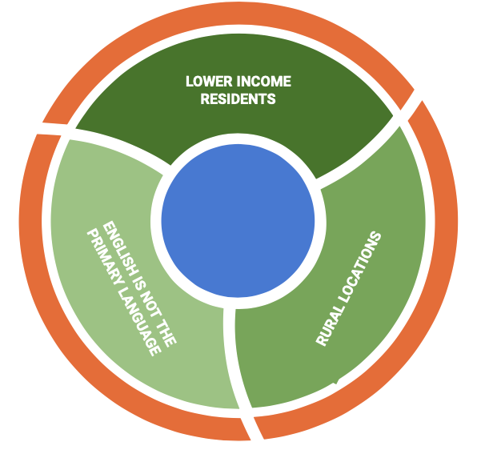
EXECUTIVE SUMMARY
Energy efficiency is a key resource to reduce harmful Greenhouse Gases and lessen Global Climate Change
California is currently short of SB 350 energy savings goals in all sectors
Our goal is to determine whether Energy Efficiency program benefits are distributed equitably

Slide 4
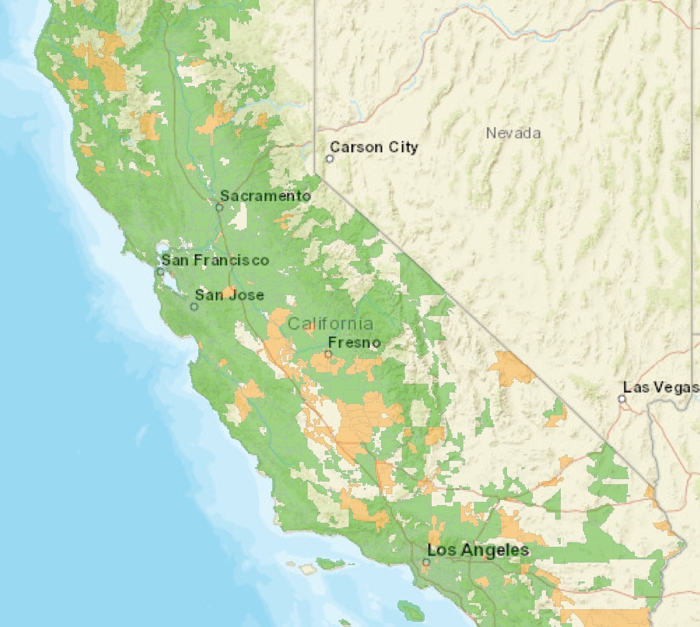
Study Includes the Majority of IOU Service Territory
Investor Owned Utilities:
Pacific Gas and Electric
San Diego Gas & Electric
Southern California Gas
Southern California Edison
Service Territory = 1637 Zip Codes
NON-LOW-INCOME
Zip Codes with Median household income above the upper limit of CARE/FERA program for family of 2.
LOW-INCOME
Zip Codes excluded from the study area

Slide 5
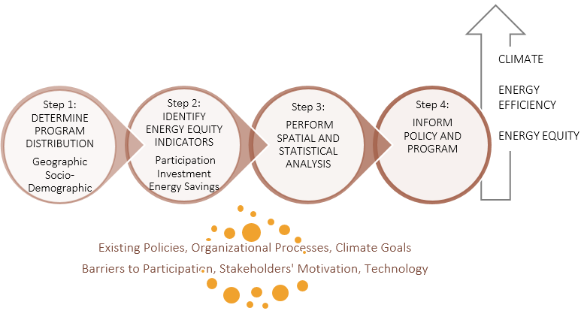
Process Model for Equity Analysis in Residential Energy Efficiency Programs

Slide 6
METHODOLOGY
Research Question 1 | Program | Indicator | Measurement | Data Sources | Data Analysis
Are there gaps in program participation by geographic area? | All Residential Programs of the Major IOUs | Participation | # Units by Zip Code | PAs (CEDARS) Tiger/ Line Shapefiles | GIS Spatial Analysis, Hotspot analysis by GeoDa, and Statistical Correlation Analysis
 |  | Investment | Dollar Gross Incentive | PAs (CEDARS)
 |  | Energy Savings | kWh/Therms Saved per Household | PAs (CEDARS)

Slide 7
METHODOLOGY
Research Question 2 | Program | Indicator | Measurement | Data Sources | Data Analysis
Are there gaps in program participation by socio- demographic groups? | All Residential Programs of the Major IOUs | Participation | # of Household by Income Type, Ethnicity, Primary Language, Education, Age | PAs (CEDARS) U.S. Census Bureau ACS 5-year estimates | GIS Spatial Analysis, Hotspot analysis by GeoDa, and Statistical Correlation Analysis
 |  | Investment | Dollar Gross Incentive | PAs (CEDARS)
 |  | Energy Savings | kWh/Therms Saved per Household | PAs (CEDARS)

Slide 8
Participation Among Non-Low Income
Statewide -

Slide 9
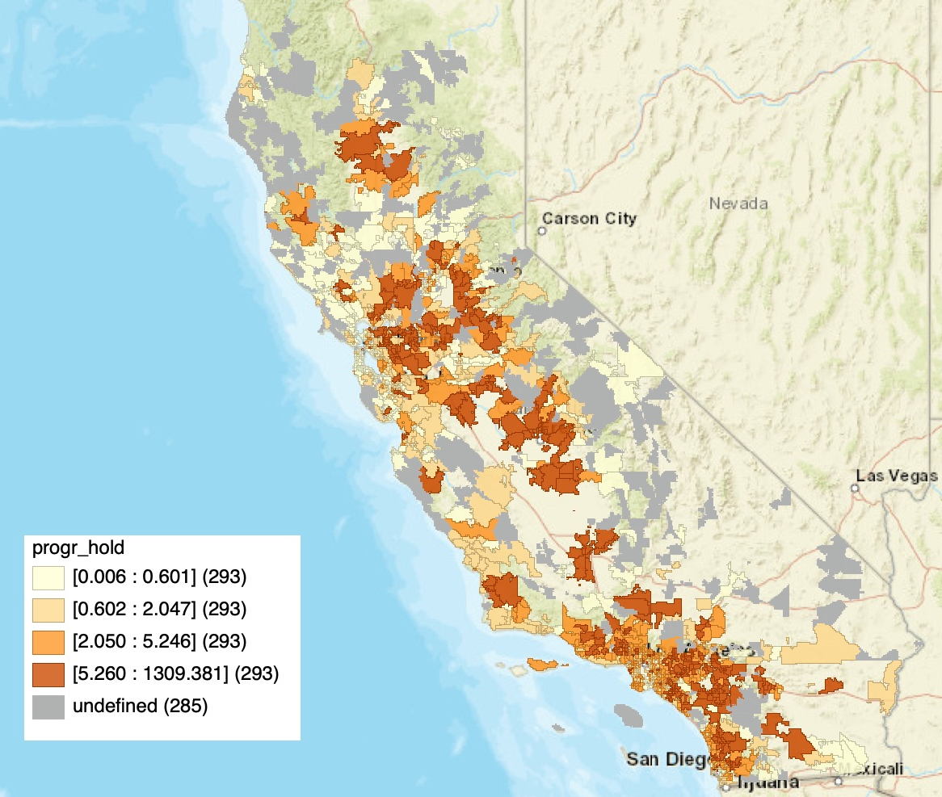
Residential Energy Efficiency Program Activity Among Non-Low Income Zip Codes
Approximately 89% of Zip Codes included in study are categorized as non-low income.
The darker shading represents higher level of program activity
Grey areas represent Zip Codes without data
CA - Program Activity

Slide 10
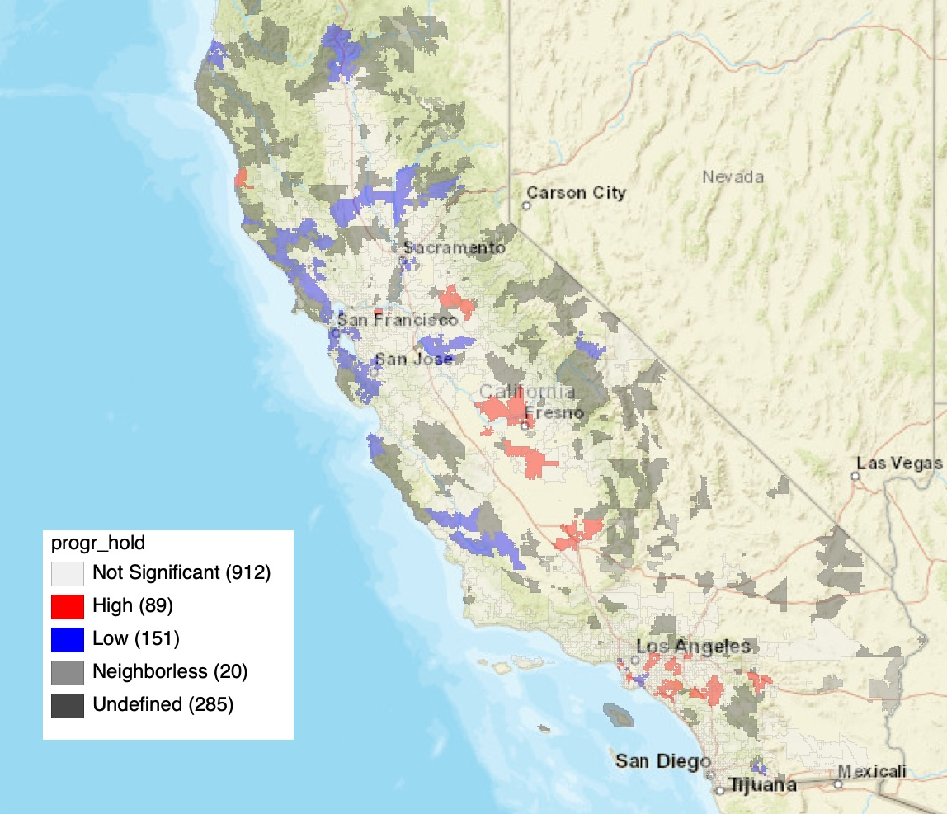
Hot Spot Analysis of Residential Energy Efficiency Program Activity : Among Non-Low Income Zip Codes
Visualization of Zip Codes with the highest and lowest levels of program activity
Highest concentrations of program activity are located in the Bay area, San Joaquin Valley and Los Angeles/Orange County.
Based on a total of 1457 Zip Codes due to geographic gaps in original dataset
CA - Program Activity

Slide 11
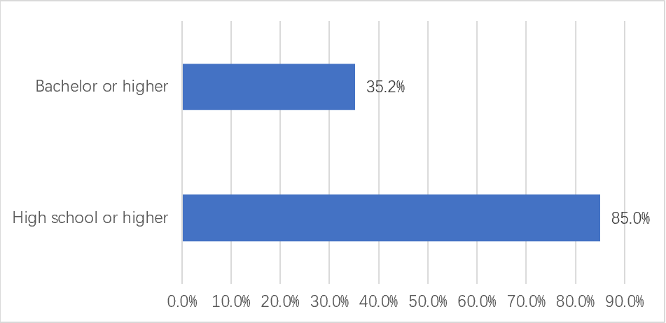
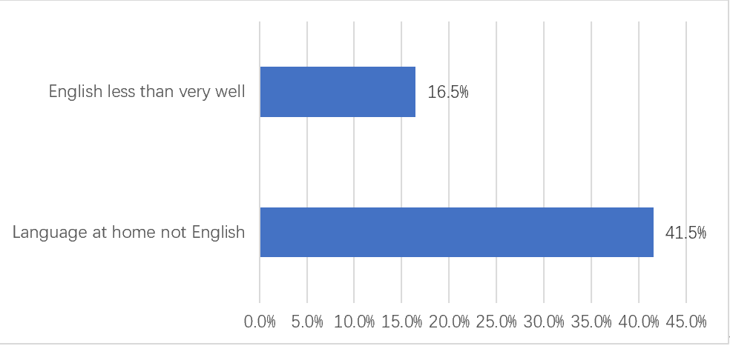
Attained Education and Language Level Among Total Population
Bachelor or
Higher
English Less than Very Well
High School or Higher
Language at Home Not English
Educational Level of Participants
Language Level of Participants

Slide 12
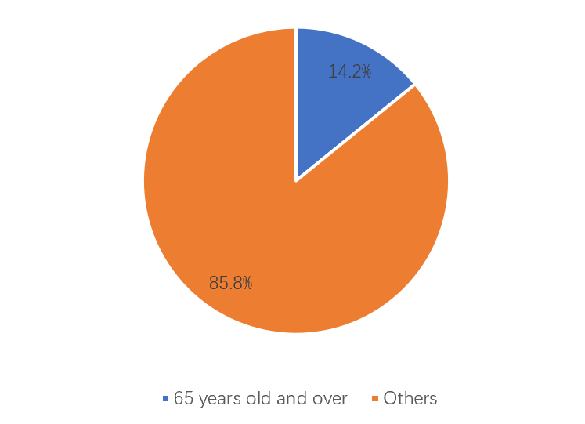
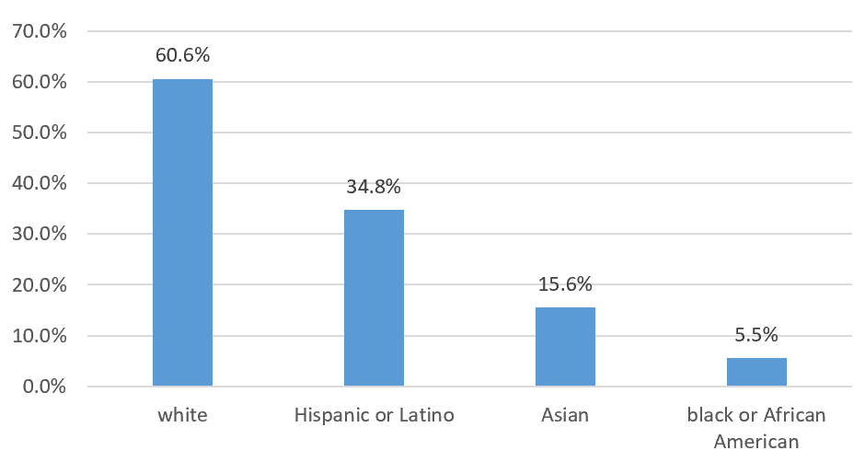
Ethnicity and Age Among Total Population
Distribution of Ethnicity
Percentage of Age of Participants
14.2%
White
Hispanic/ Latino
Asian
Black/ African-American
> 65 years old
Others

Slide 13
Participation Among Non-Low Income
Regional -

Slide 14
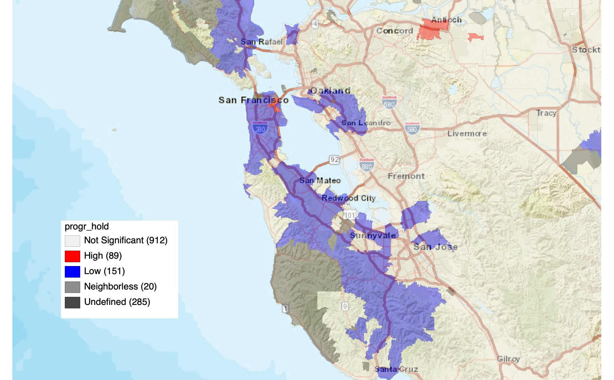
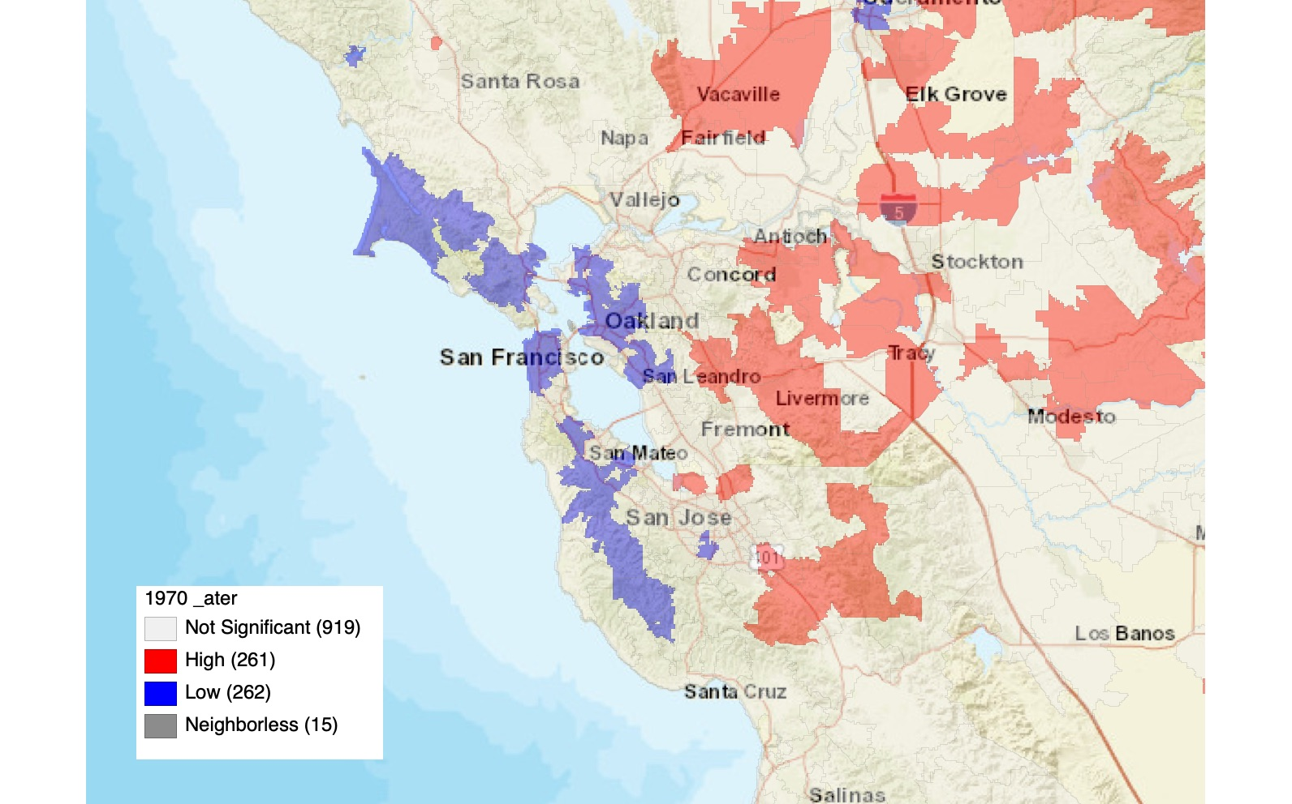
Zip Codes with Homes Built After 1970 Coincide with Lowest Program Activity
PROGRAM ACTIVITY
AGE OF RESIDENCE
BAY AREA COMPARISON

Slide 15
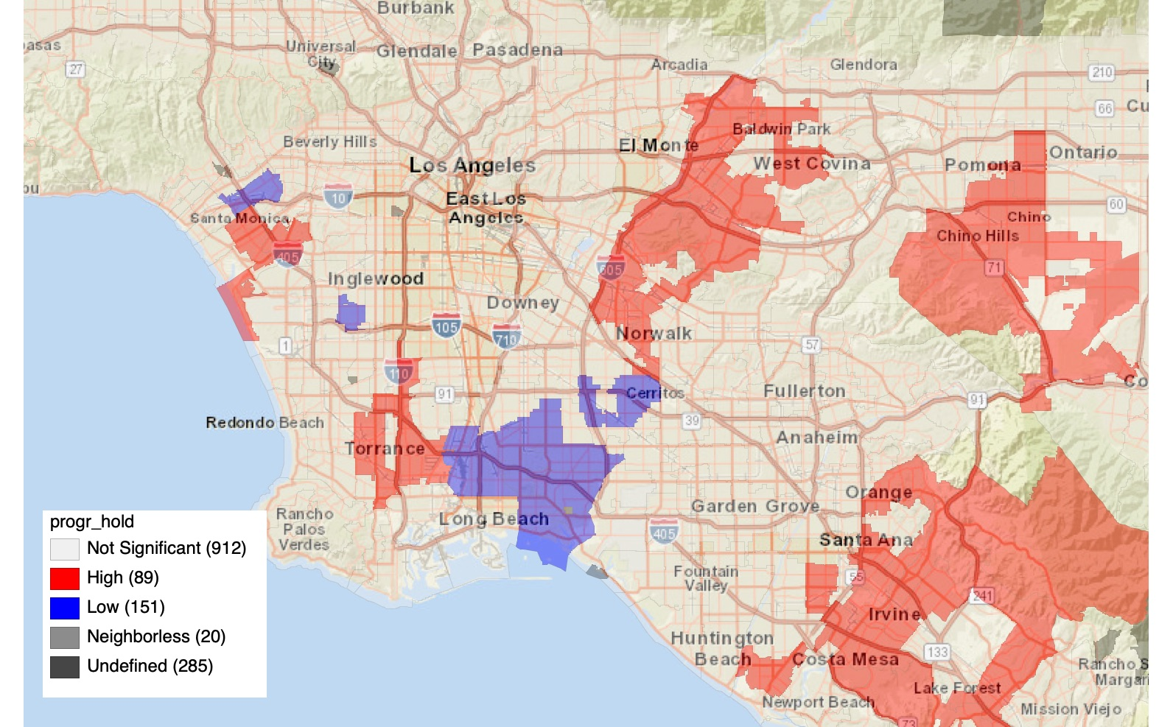
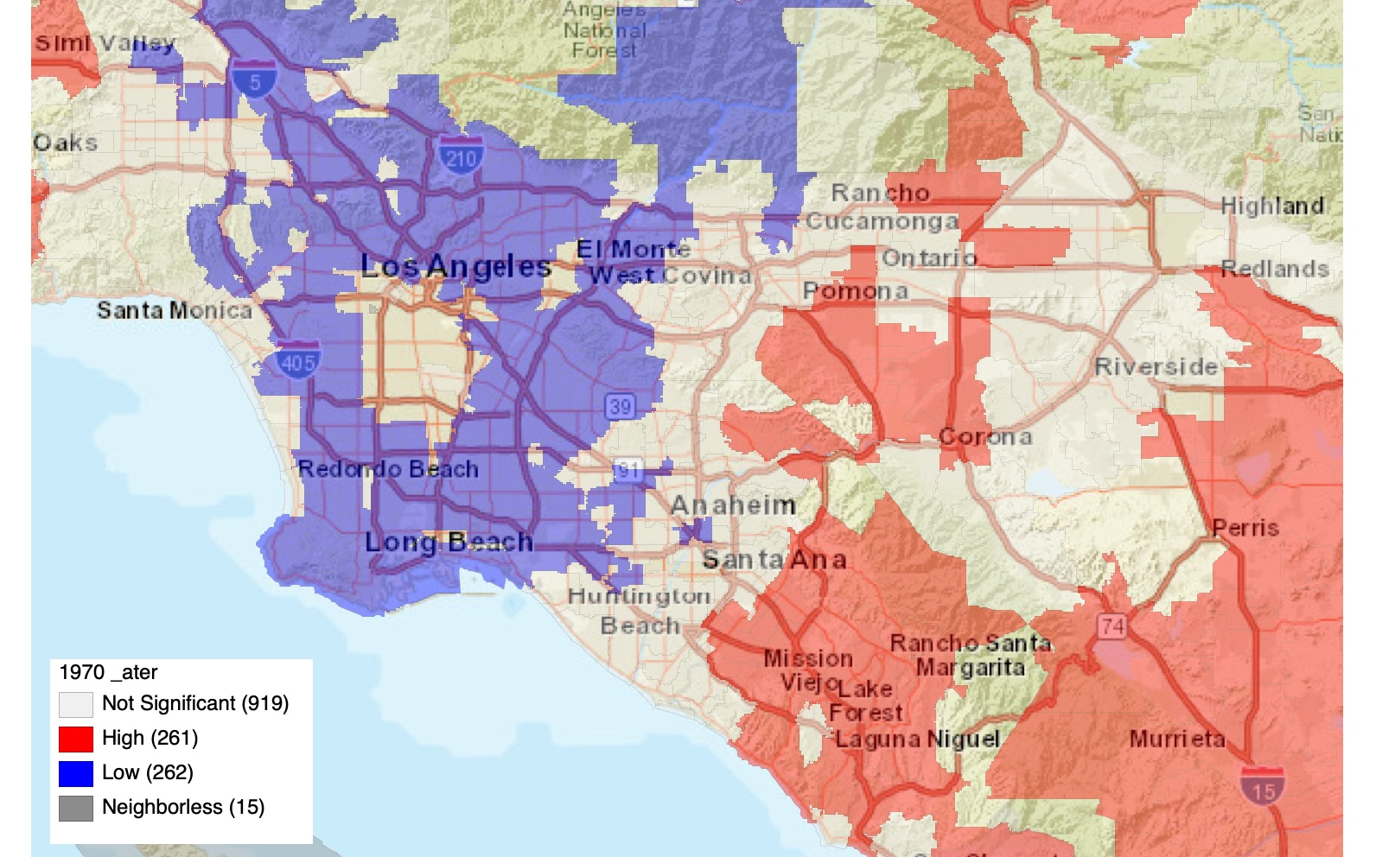
Zip Codes with Homes Built After 1970 Coincide with
Higher Program Activity
PROGRAM ACTIVITY
AGE OF RESIDENCE
L. A. METRO & ORANGE COUNTY AREAS COMPARISON

Slide 16
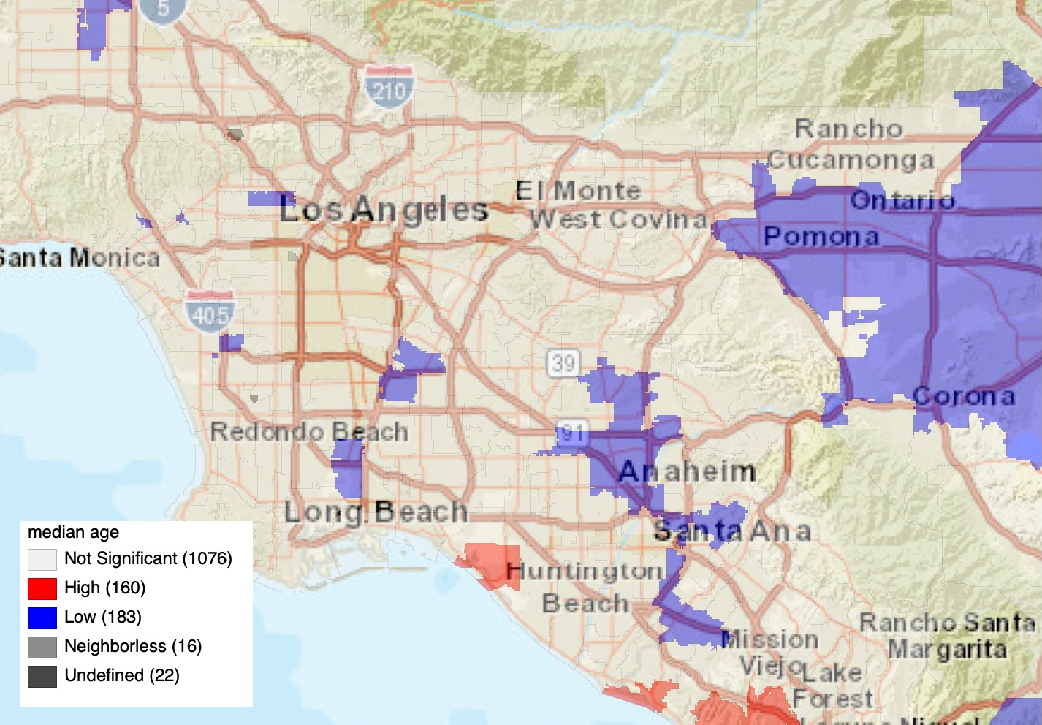
Higher Median Age Coincides with Zip Codes Showing
Lower Program Activity
PROGRAM ACTIVITY
MEDIAN AGE
L. A. METRO & ORANGE COUNTY AREAS COMPARISON

Slide 17
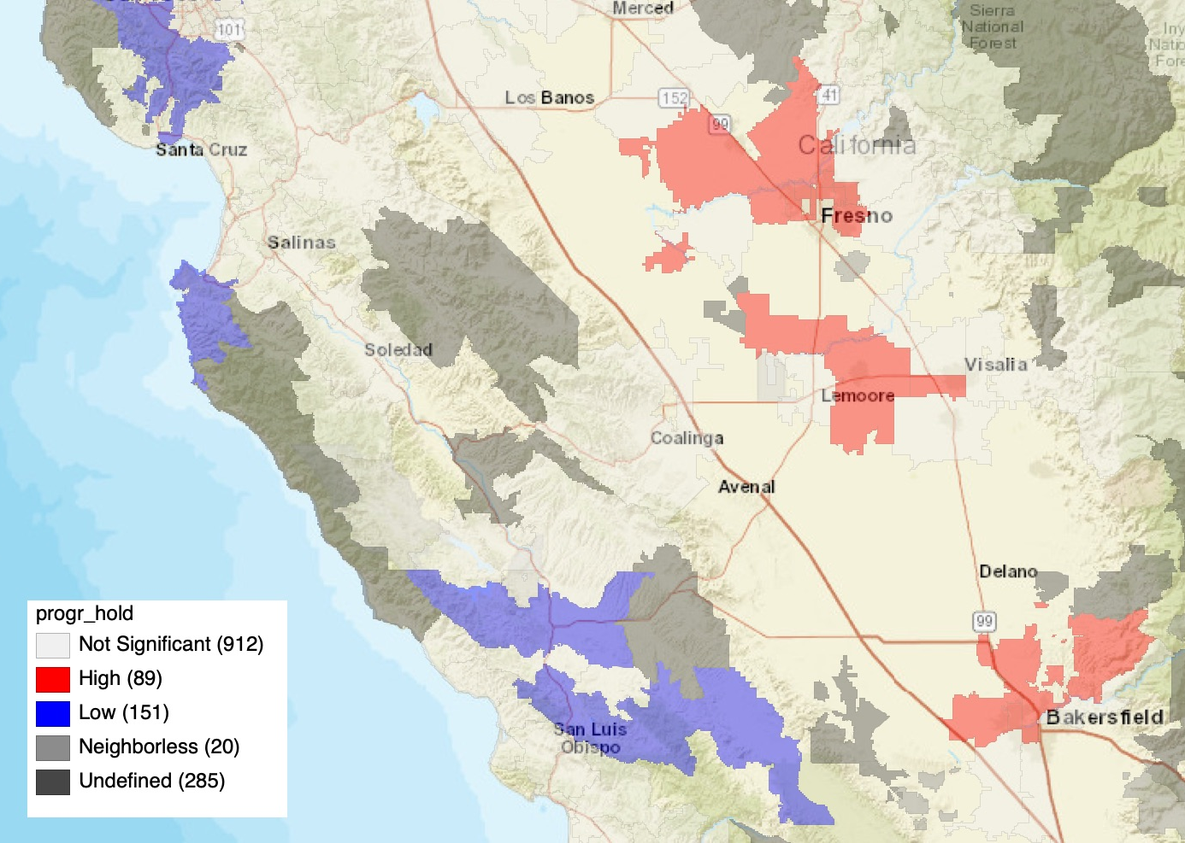
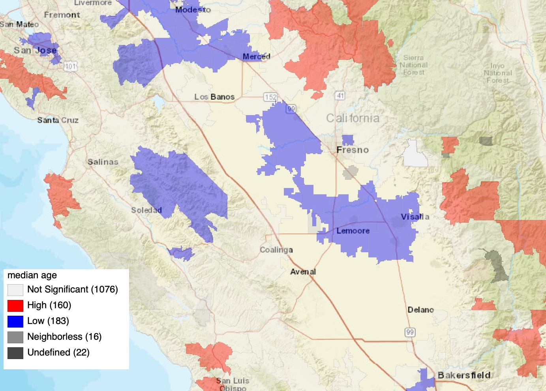
Lower Median Age Coincides with Zip Codes Showing
Higher Program Activity
PROGRAM ACTIVITY
MEDIAN AGE
SAN JOAQUIN VALLEY COMPARISON

Slide 18
Statistical Analysis

Slide 19
Use T-test to compare the difference on Participation Activity per household .
There is no significant difference between lower and higher group of Zip Codes in income and education characteristics.
T-Test and Regression Analysis

Slide 20
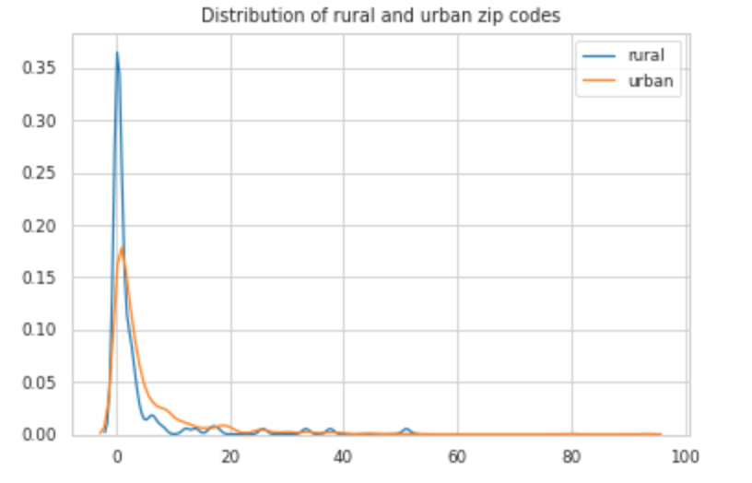
T-TEST ANALYSIS - RURAL vs. URBAN
Distribution of Rural & Urban Zip Codes
Rural zip codes are more prone to zero program activity when compared to urbanized zip Codes.
 | Population | Average Program Activity
Rural | <2500 | 2.97
Urban | ≥ 2500 | 5.00
*P value is 0.002 < 0.05, which is statistically significant.

Slide 21
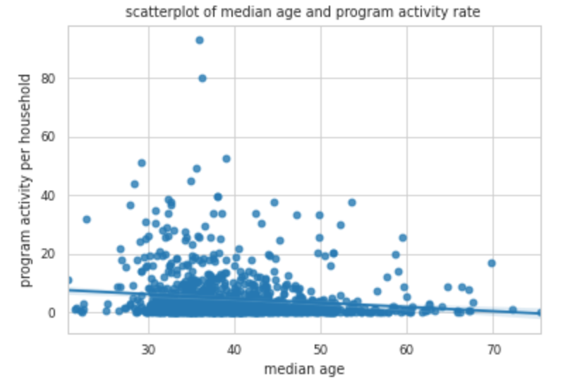
T-TEST ANALYSIS - Age
Scatterplot of Median Age & Program Activity Rate
Percent of Population | Range of Median Age Among Zip Codes | Average Program Activity
≤ 25% | 20.7-34.7 | 6.35
≥ 75% | 43.9-75.4 | 3.39
*P value is 0.003 < 0.05, which is statistically significant
Lower median age coincides with higher participation rates
Younger zip codes tend to have higher program activity rate than older ones

Slide 22
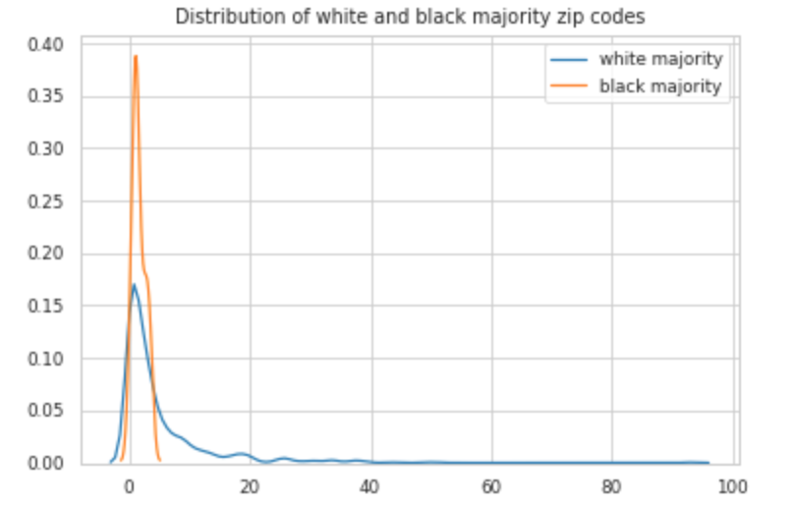
T-TEST ANALYSIS - Ethnic Majorities
Distribution of White & Black Majority Zip Codes
Population > 50% | Average Program Activity
White | 4.93
Black/African American | 1.67
*P value is 0.000< 0.05, which is statistically significant.

Slide 23
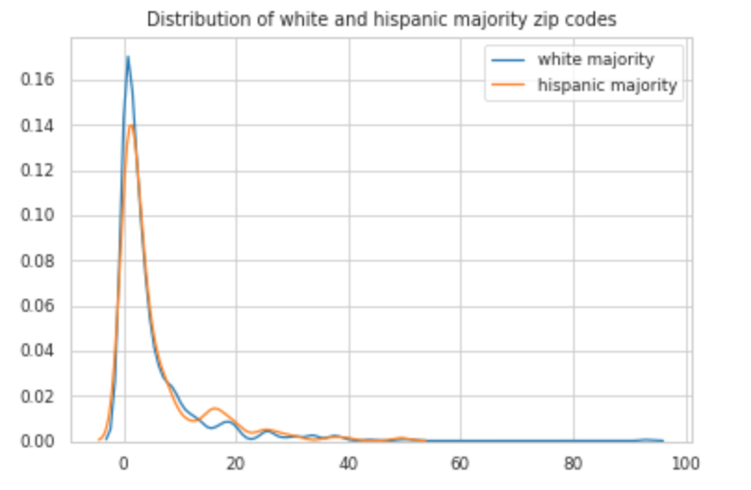
T-TEST ANALYSIS - Ethnic Majorities
Distribution of White & Hispanic Majority Zip Codes
Population > 50% | Average Program Activity
White | 4.93
Hispanic/Latino | 5.57
*P value is 0.14 > 0.05, which is not statistically significant. There is no significant difference between white majority and Hispanic majority zip codes

Slide 24
T-TEST ANALYSIS - Ethnicity White
Zip Codes with higher percentage of White population are more prone to lower program activity when compared to zip codes with lower percentage of white.
% of White Population | Range of % Among Zip Codes | Average Program Activity
≤ 25% | 9.9 - 53.4 | 4.44
≥ 75% | 82.5 - 100 | 3.19
*P value is 0.02 < 0.05, which is statistically significant.

Slide 25
T-TEST ANALYSIS - Black/African American
Zip codes with higher percentage of Black/African American are more prone to higher program activity when compared to zip codes with lower percentage of Black/African American.
Black/African American % of Population | Range of Percentages Among Zip Codes | Average Program Activity
≤ 25% | 0.0 - 1.0 | 3.54
≥ 75% | 5.3 - 80.30 | 6.08
*P value is 0.00 < 0.01, which is statistically significant.

Slide 26
T-TEST ANALYSIS - Asian
Zip codes with higher percentage of Asian population are more prone to higher program activity when compared to zip codes with lower percentage of Asian.
Asian % of Population | Range of Percentages Among Zip Codes | Average Program Activity
≤ 25% | 0.0 - 2.9 | 3.34
≥ 75% | 16.7 - 74.6 | 4.92
*P value is 0.012 < 0.05, which is statistically significant.

Slide 27
T-TEST ANALYSIS - Hispanic/Latino
Zip codes with higher percentage of Hispanic/Latino are more prone to higher program activity when compared to zip codes with lower percentage of HIspanic/Latino.
Percent of Hispanic or Latino Population | Range of Percentages Among Zip Codes | Average Program Activity
≤ 25% | 0.0 - 13.3 | 4.00
≥ 75% | 42.1 - 95.8 | 5.53
*P value is 0.01 < 0.05, which is statistically significant.

Slide 28
T-TEST ANALYSIS - Language
Zip codes with higher percentage of participants whose home language is not English tend to have higher average program activity.
 | Range | Average Program Activity
Speak English at Home | ≥ 71.3% | 4.25
Speak Other Languages at Home | ≥ 28.7% | 5.17
*P value is 0.023 < 0.05, which is statistically significant.

Slide 29









USC+NRDC ENERGY TEAM
Dairou Wang
Monina Letargo
Elizabeth Pereda
Eunice Zordilla
Tianfang Guo
Lara Ettenson
Nicholas Cain
Mohit Chhabra

Slide 30
Thank you!

