Slide 1
2019 ABAL Overview
[Southern California Edison]

Slide 2
2019 Budget & Cost-Effectiveness
2

Slide 3
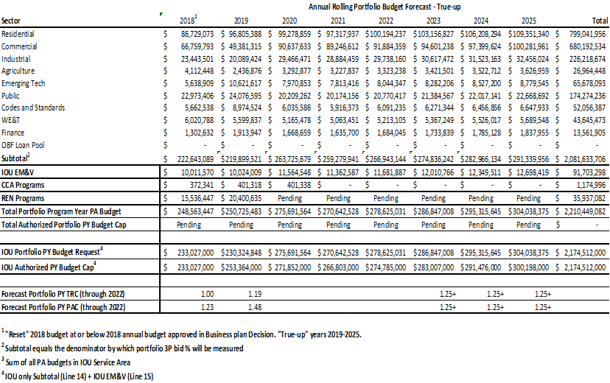
Budget True-Up (2018-2025)
3

Slide 4
Changes in ABAL from 8/2 CAEECC Meeting
Maintained cost-effectiveness between 1.0 and 1.25
CEDARS cost-effectiveness calculator updated, increasing SCE TRC
Draft budget remains below 2019 authorized budget – approx. $23M
$18M budget increase since 8/2 meeting
Retained Commercial Direct Install and Schools Energy Efficiency Programs
Increased budgeted startup funds for new 3rd party programs
Remaining funds ($23m) below authorized allocated to remaining years
Savings forecast is above CPUC goals for both kWh and kW
Additional optimization throughout, including: Res Energy Advisor; Non Res HVAC; Res Direct Install; Plug Load & Appliances; Multifamily EE
Commercial Direct Install and Schools EE programs will provide immediate 2019 savings and may be targeted to hard-to-reach areas
Updated Codes & Standards savings data and created “National and International Standards” sub-program as part of C&S
4

Slide 5
Anticipated Changes from 8/21 to 9/4 Filing
Modifications to reflect DEER changes, non-DEER changes, and/or other energy savings / cost-effectiveness dispositions, including Savings by Design
Minor adjustments to measures and programs within the portfolio from further optimization
May revise program closure list
All budget and savings inputs may be changed during the final quality control and review process before final filing
Edits to draft Advice Letter language to reflect aforementioned changes and other reviews
EM&V budgets may change based on final inputs
5

Slide 6
Questions?

