Slide 1
An Analysis of Residential Underserved Customers in California Invester-owned Utility Programs
Prepared for: the CAEECC sub-Working Group on Underserved Customers
Prepared by (in alphabetical order) Kristen Bush, Jessica Dunn, Sadia Gul, Mark T. Lozano, Leslie Nelson, and Tobiah Steckel.
Supervised by: Prof Alissa Kendall, and with the assistance of Dr. Hal Nelson
2/24/2020

Slide 2







Meet the team
This project was conducted for the class EGG298A – Data Science for Equity in Energy Systems. Fall, 2020
Sadia Gul
Jessica Dunn
Kristen Bush
Mark Lozano
Leslie Nelson
Tobiah Steckel
Alissa Kendall

Slide 3
Background (Literature Review Digest)
Energy Justice & Equity
  Energy consumption is primarily driven by human behavior (Elnakat et al., 2016; Reames et al., 2018)
    Informed by spatial and socio-economic conditions
    Influenced by the lived experience/household practices
Residential Energy Efficiency Programs
  Challenges include:
    Traditional & specialized financing products (Leventis et al., 2016)
    "energy efficiency gap" (Reames, 2016a)
    "energy efficiency financing coverage gap" (Forrester et al., 2020)
    Proprietary energy use data (Reames, 2016b)

Slide 4
Research Questions
Are there differences in the access to the residential energy efficiency programs benefits across geographic areas and sociodemographic groups in California?
Do certain program characteristics improve service?
Do certain program characteristics provide more equitable service?

Slide 5
Approach
Data from CEDARS and census data aggregated at the zip code level
Additional CEDARS Program Data Integrated:
  Barriers to entry (H/M/L)
  Housing type (SF/MF/Both)
  Upstream/Midstream/Downstream/Direct Install
Census data differs slightly from USC
  No filter for zip codes excluded from analysis
  Demographic variables omitted to limit collinearity

Slide 6
Methods
Broadly, three components to analysis
  The summation of response variables (that approximate service) at the zip code level
  The summation of response variables at the program level
  The summation of response variables at the zip code level when filtered program characteristics
To respectively provide
  A relationship between service and demographic makeup
  A relationship between service and program characteristics
  A relationship between service and demographic/program characteristics

Slide 7
Response Variables
To Approximate Service we chose 7 variables:
Participation rate
Lifecycle gross kWh savings per household
Lifecycle gross therm savings per household
Lifecycle net kWh savings per household
Lifecycle net therm savings per household
Gross incentive per household
End user rebate per household
Notes:
NumUnits/total_households
TotalLifecycleGrosskWh/total_households
TotalLifecycleGrossTherm/total_households
TotalLifecycleNetkWh/total_households
TotalLifecycleNetTherm/total_households
TotalGrossIncentive/total_householdsUnitEndUserRebate/total_households

Slide 8
Methods
Spatial Mapping
Multivariate Regression
  To inform a relationship between response variable and given explanatory variable (positive/negative)
Multivariate Regression w/ Variable Selection
  Unsupervised selection of variables resulting in lowest error to affirm relationships derived from initial regression (through minimizing collinearity/ or bad predictors)
Welch's t-test between lowest 20% (underserved) and highest 20%
  If distribution of service is equal across demographics there should be no difference in these populations

Slide 9
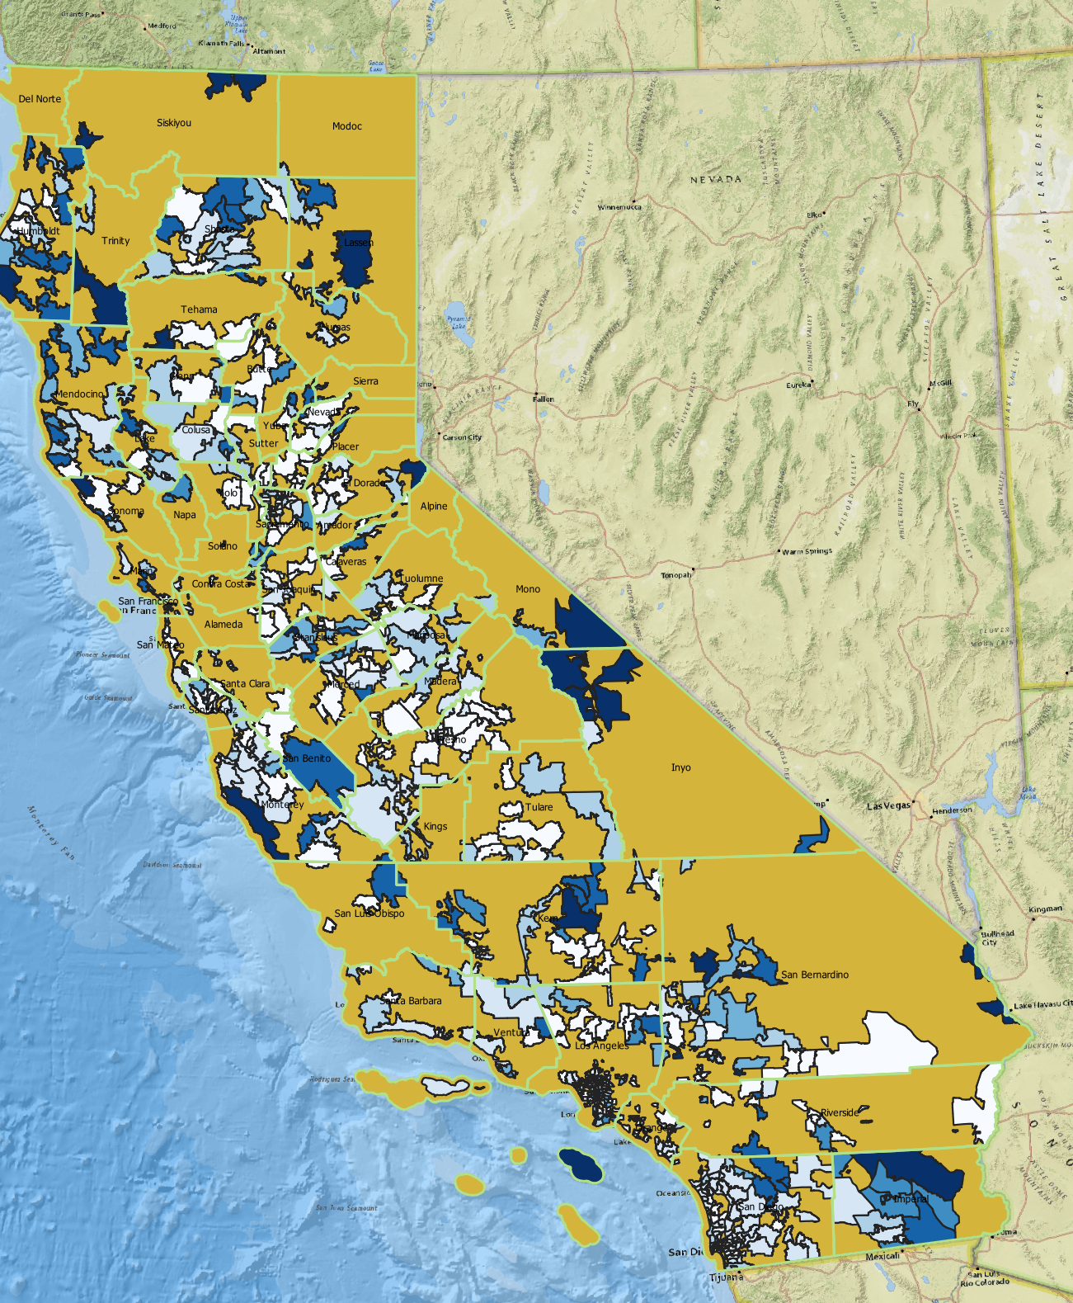
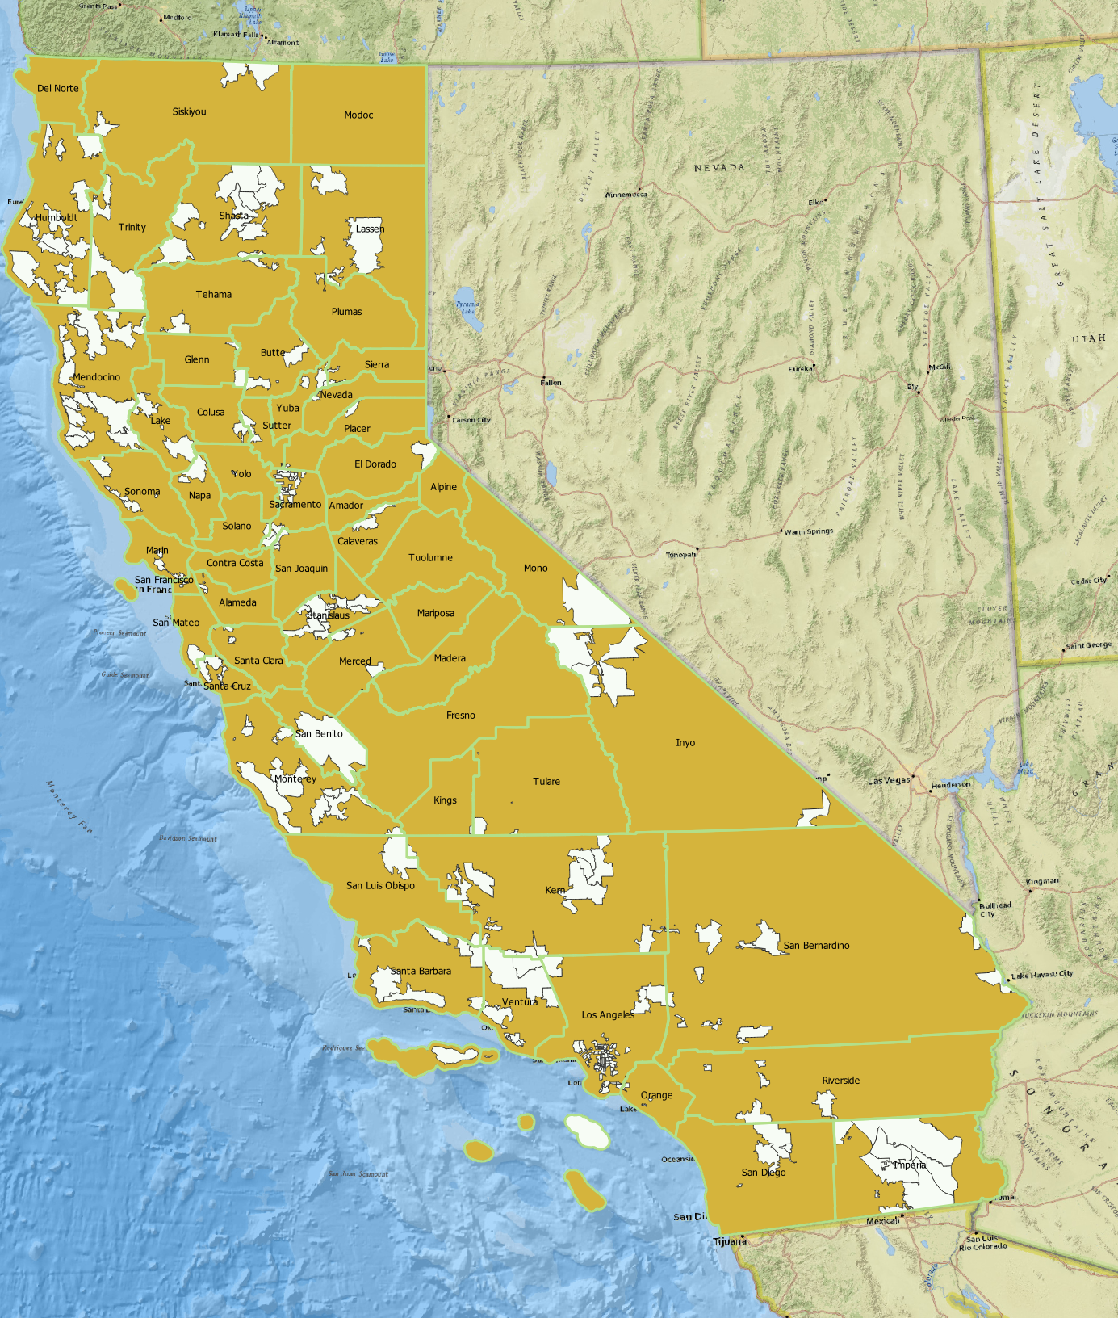
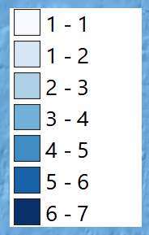
Spatial Mapping
Frequency of a zip code falling into
Bottom 20% (darkest blue = highest frequency)
Gross kWh bottom 20% (shown in white

Slide 10
Average population-weighted CalEnviroScreen (CES) percentile burden score for the lower and upper quintiles of selected response variables.
Quintile | Average CES Percentile
Unit Rebate
Lower quintile |  | 52.535
Upper quintile |  | 47.141
Number of units
Lower quintile |  | 52.199
Upper quintile |  | 43.734
Net kWh saved
Lower quintile |  | 62.13
Upper quintile |  | 48.776
Net therm saved
Lower quintile |  | 52.624
Upper quintile |  | 50.016
Gross incentive
Lower quintile |  | 51.454
Upper quintile |  | 49.874
CalEnviroScreen is the state of California’s environmental health screening tool that reports the burden faced by communities across census tracts (OEHHA, 2018). The communities in the upper quartile of burden (i.e., the 75th percentile) are considered disadvantaged communities and are the center of many equity-based policies.

Slide 11
Spatial Analysis and CalEnviroScreen
Overlay analysis revealed that, on average, communities who saw the least benefits from energy efficiency programs had (sometimes negligibly) higher burden scores than those who saw the most benefits from these programs
The distribution of benefits is nearly equal across all communities (as defined by CalEnviroScreen designations).
As equitable distribution would provide more benefits to those who face higher burdens, this lack of difference in burden between the upper and lower quintiles shows that current energy efficiency programs may be underperforming
We are curious to hear possible explanations for this distribution in benefits.

Slide 12
T-test by zip code: Net kWh savings per household
 | Mean of bottom 20% | Mean of top 20% | Population mean
Median household income | $56,715 | $75,092 | $73,934
Population under the poverty level | 20% | 15% | 15%
Renters | 49% | 43% | 42%
High school diploma as highest degree | 80% | 83% | 84%
Population with disability | 14% | 11% | 12%
Population without healthcare | 10% | 8% | 8%
Old housing | 15% | 5% | 10%
Mobile homes | 10% | 5% | 6%
Native American population | 2% | 1% | 1%
Notes:
The t test compares the mean of the two groups. So in this case we broke up groups based on the kWh savings. We are comparing the zip codes within the top 20% of kWh savings per household and the zip codes within the bottom 20% of kWh savings per household. Then we have pulled out the variables that show statistical significance.
Arrows just represent where there was a greater than five percent difference, although all of these categories matter. So the population under the poverty level is significantly higher in the bottom 20% than in the top 20% this aligns with the much lower median income in the bottom 20% -
We see the bottom 20% also has a higher popoulation with renters, old housing and mobile homes.
*In the report: "For underserved zip codes, there appears to be a higher percentage of poverty, old housing, population with a disability, population with no healthcare, population living in a mobile home, the population of Native Americans, and population renting. Additionally, for the underserved zip codes there seemed to be a lower population percentage of high school graduates, a lower population percentage with access to broadband internet, and a lower median household income. "

Slide 13
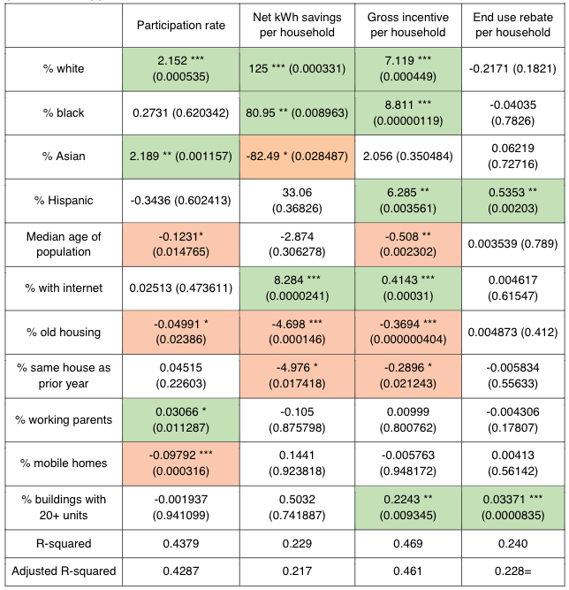
Multivariate Regression
Underserved zip codes (i.e., those in the lowest quintile) have
  A higher percentage of old housing
  An older population
  A higher percentage of mobile homes
  A higher percentage of residents living in the same house as the year prior.
Notes:
The multivariate regression was also completed using the zip code level data. The table lists variables that have statistical significance for at least one of the response or explanatory results and the table entries shaded in green or orange indicate coefficients with statistical significance. The green represents a positive correlation, and the orange represents a negative correlation.
So depending on the response variable, the underserved zip codes have
A higher percentage of old housing
An older population
A higher percentage of mobile homes
A higher percentage of residents living in the same house as the year prior.
but, identifying the correct metric to determine a population as being served or underserved is difficult and this is really made evident by the differing results for each response variable – the response variables are the columns.
For example the net kWh savings per household is much different than the participation rate, and there are even contrasting results positive and negative for the percent asian population response variable.
Despite the differences between the response variables, it is evident energy efficiency programs are not serving old housing to the same extent as newer housing, due to its statistical significance in three of the response variables analyzed.
And to just reiterate the other populations that also show a negative correlation are the older population, higher percentage of mobile homes, and higher percentage of residents living in the same house as the year prior.
We can gleam some information from this but a lot of the correlations that likely could have been made are lost due to the data being at the zip code level and increasing this granularity to the census track level would likely lead to more conclusive results

Slide 14
Program information
For each program, reviewed the Program Implementation Plan linked in CEDARS (if available)
  Gathered overview information, housing type, program targets, and barriers to entry
Program targets were not as standardized, easy to define, or relevant to our project so they were not included
Monetary barriers to entry were classified at high or low
  If no information was available, they were classified as low
Program type (midstream or downstream) was considered
Year (2017,2018,2019) was considered

Slide 15
Program Filtered Analyses: Assessing the combination of program characteristics and demographics
Original analysis (all programs)
Modified – filtered by high monetary barrier programs
 | Mean of bottom 20% | Mean of top 20%
Black or African American Population | 5.6% | 4.9%
High GRAPI | 46% | 46%
 | Mean of bottom 20% | Mean of top 20%
Black or African American Population | 7.0% | 5.0%
High GRAPI | 47% | 44%
Criteria for high monetary barrier programs: Must have some characteristics that require an amount of investment (i.e. must have smart thermostat, must be tech savvy, must contribute over 50% of project costs, must complete building performance modeling). Or must be a high energy user.
GRAPI = Gross rent as a percentage of income

Slide 16
Program Filtered Analyses: Assessing the combination of program characteristics and demographics
Original analysis (all programs)
Modified – filtered by midstream programs
 | Mean of bottom 20% | Mean of top 20%
Black or African American Population | 5.6% | 4.9%
High GRAPI | 46% | 46%
Hispanic | 34% | 38%
 | Mean of bottom 20% | Mean of top 20%
Black or African American Population | 6.4% | 3.7%
High GRAPI | 47% | 44%
Hispanic | 41% | 32%
Criteria for midstream: targeting retailers and contractors.

Slide 17
Data limitations
Because we only had zip-code level information, we were limited to merely a spatial understanding of where programs have been delivered – and even there it is highly aggregated
Within CEDARS zip-code data, one particular issue is the lack of clarity between the weight of a reported "unit"
Without knowledge of natural gas use/electricity use its hard to isolate service in some cases

Slide 18
What we can understand from the analyses conducted
The spatial distribution and hotspots of "service" indicators
The statistical analyses by zip code demonstrate that populations underserved by energy efficiency programs are within zip codes that have older housing, lower income residents, a higher renting population, and a higher population of Native Americans.
Household level data is necessary to answer the questions originally sought

Slide 19
What could be done with household-level data
Quantile Regression
  Variability within demographic groups
Explore Interactions
  Median household income
  Population Density
  Climate factors

Slide 20
Points for discussion
What is meant by adequately served? Are we defining it?
Are we missing any metrics/ sociodemographic groups?
Does this work help identify and explain sociodemographic groups that aren't being adequately served?
Do these results provide evidence that certain program characteristics can be used as a means of providing more equitable access?
Can program flags be tools to increasing equity ?
Should program targets be coupled with "measurable" outcomes?

Slide 21
Thank you!

Slide 22
Presentation order
1-2 Alissa
3-8 Kristen
9-11 Mark
12-13 Jess
14-20 Tobiah

