Slide 1
EE Application Outline Development (IOU presentation)
June 24, 2021

Slide 2
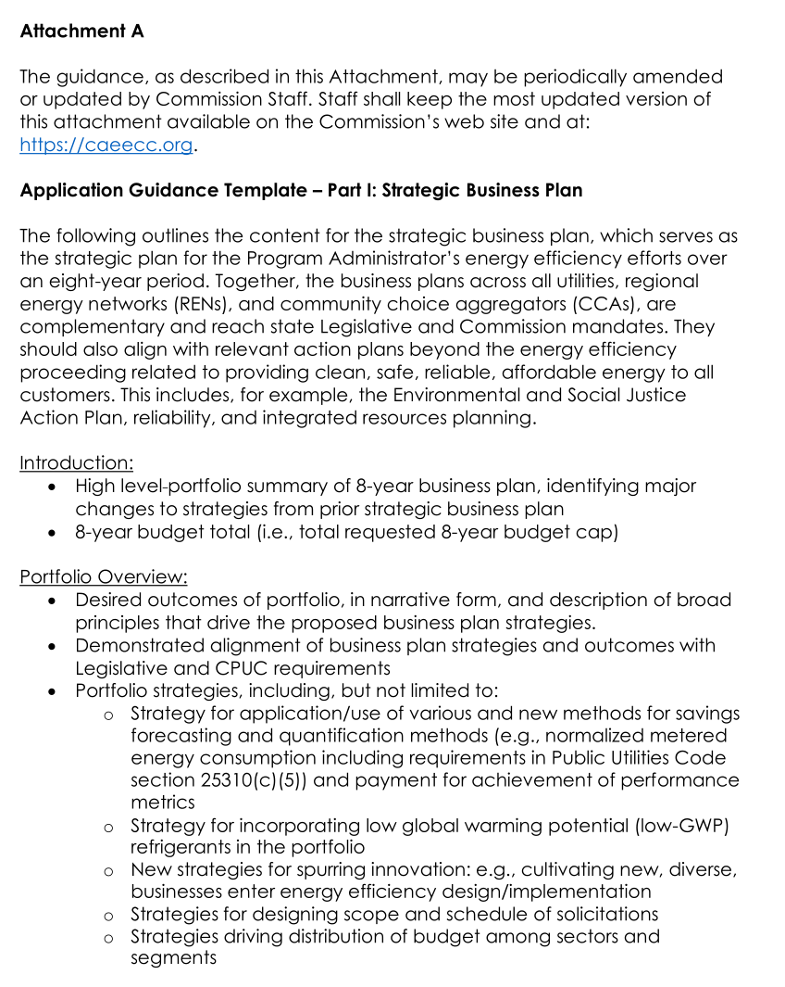
Background
D.21-05-031 OP 6 requires PAs to use a standard template when preparing EE applications.
A draft template was included with the decision.
The final version will be posted no later than September 30.

Slide 3
Outline & Spreadsheets
On May 27th during the reporting PCG ED staff asked PAs to convene and develop a plan to deliver a draft of application spreadsheets and application prose templates by June 24th (today).
By July 22nd PAs will complete templates for review and receive ED & Cal Advocates feedback.
ED Staff has the final word on the outline and spreadsheet templates, and will incorporate into official templates by September 30th
SCE shared the outline documents developed for their own Application with the team as a starting point.

Slide 4
Plan for Outline and Spreadsheet Template Development
By June 18th – PAs provide feedback on Outline and Spreadsheets (based on SCE’s starter materials or new materials)
Send feedback directly to SCE (Brandon.Sanders@sce.com)
By June 23 SCE to provide Feedback summary including revised outline / spreadsheets to PAs
June 24 – Plan presented at CAEECC
June 25 – PAs meet to discuss outline feedback, document consensus items, determine how to handle outstanding items (large meetings or small item-specific discussions)
By June 30 – Spreadsheet sub-team meets to discuss spreadsheet templates, determine how to handle outstanding items
By July 9 – All PA feedback incorporated into draft outline and spreadsheets which are sent to ED, Cal Advocates, and others for feedback / comment.

Slide 5
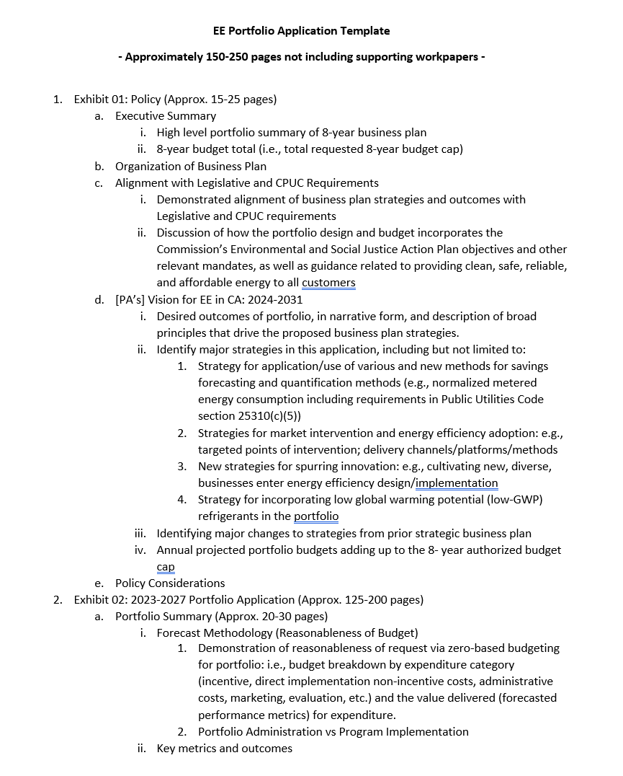
SCE’s Outline & Spreadsheet Starters

