Slide 1
Market Support Metrics WG Third Mtg
September 9, 2021
California Energy Efficiency Coordinating Committee

Slide 2
Agenda
Time | Topic
9:00 | Approach for Today’s Meeting
9:10 | Segment “Objectives/sub-Objectives” Updated sub-Objective #5 Proposal from Cal Advocates AND SoCalREN, BayREN, SCE, PG&E, CHEEF AND TEC Sub-Objectives #’s 1-4 Primary Objective Next steps on Segment “Objectives/sub-Objectives”
10:00 | Associated Priority Metrics (for each Segment Objective/sub-Objective) Proposed Metrics-related Principles from sub-WG Proposed Metrics from sub-WG Identify any gaps in Metrics, and brainstorm alternatives Target-setting principles, time permitting Next steps on Metrics
12:10 | Final Report Discuss annotated draft Report outline Discuss CSE proposed MS/MT language Discuss next steps on Final Report
12:40 | Wrap-Up and Next Steps Debrief where ended up and how meeting went Discuss all Next Steps, including work between meetings, and approach/strategy for final meeting on 9/21
1:00 | Adjourn

Slide 3
Primary Meeting Goals
Refine Objectives & Metric(s)
Seek consensus on Objectives and Metrics
Discuss the basis PAs should use in setting Targets for Metrics in their filings, time permitting

Slide 4
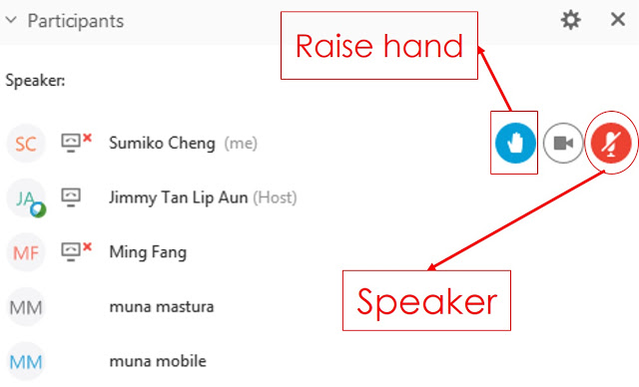
WebEx Technical Reminders
Raise hand to enter queue – then unmute when called upon
Mute when not speaking
Zoom in & out of documents
Members of the Public can provide feedback when invited via Q&A; they will be muted
Image courtesy: Blended Learning

Slide 5
Segment “Objectives/ sub-Objectives”*
Updated sub-Objective #5 Proposal from Cal Advocates AND SoCalREN, BayREN, SCE, PG&E, CHEEF AND TEC
Is this language acceptable to the WG?
Sub-Objectives #’s 1-4
Any fine tuning of language needed, are these acceptable to the WG?
Primary Objective
Any need to change Primary Objective language based on Commission definition, or define “EE Market,” or include additional contextual text in Report?
Next steps on Segment “Objectives/sub-Objectives”
*The Facilitation Team is using the terminology “Objectives/sub-Objectives” here; some proposals use other terminology for sub-Objectives such as “Goals” or “Outcomes”

Slide 6
Sub-Objective #5
Proposal from SoCalREN et al AND Cal Advocates (negotiated post 2nd WG mtg.) | Build, enable, and maintain greater, broader, and/or more equitable access to capital and program coordination to increase affordability of and investment in energy efficient projects, products, or services. [Activity e.g., access to capital]

Slide 7
Sub-Objective #1
Agreement at 2nd WG Mtg. | Build, enable, and maintain demand for energy efficient projects, products, and services in all sectors and industries to ensure interest in, knowledge of benefits of, or awareness of how to obtain energy efficiency products and/or services. [Activity e.g., educating customers, building demand] Note: Proposed word edit from sub-MSMWG on Metrics

Slide 8
Sub-Objective #2
Agreement at 2nd WG Mtg. | Build, enable, and maintain supply chains to increase the capability and desire of market actors to supply energy efficient projects, products, and/or services and to increase the ability, capability, and desire of market actors to perform/ensure quality installation that optimizes energy efficiency savings. [Activity e.g., training contractors] Note: Proposed word edit from sub-MSMWG on Metrics

Slide 9
Sub-Objective #3
Agreement at 2nd WG Mtg. | Build, enable, and maintain partnerships between with consumers, governments, advocates, contractors, suppliers, manufacturers, community-based organizations and/or others to obtain delivery and/or funding efficiencies for energy efficiency projects, products, and/or services and added value for partners. [Activity e.g., building partnerships] Note: Proposed word edits from sub-MSMWG on Metrics

Slide 10
Sub-Objective #4
Agreement at 2nd WG Mtg. | Build, enable, and maintain innovation and accessibility in technology, approaches, and services development to increase cost-effectiveness value of, decrease costs of, increase energy efficiency of, and/or increase scale of and/or access to emerging or existing energy efficient projects, products, and/or services. [Activity e.g., moving beneficial technologies towards greater cost-effectiveness] Note: Proposed word edit from sub-MSMWG on Metrics

Slide 11
Primary Objective: “Supporting the long-term success of the energy efficiency market”
Any need to change Primary Objective language based on Commission definition, or define “EE Market,” or include additional contextual text in Report?

Slide 12
Next Steps on Segment “Objectives/sub-Objectives”
To come based on meeting discussion

Slide 13
Associated Priority Metrics (for each Segment Objective/sub-Objective)
Proposed Metrics-related Principles from sub-WG
Proposed Metrics from sub-WG
Identify any gaps in Metrics, and brainstorm alternatives
Next steps on Metrics

Slide 14
Proposed Metrics-related Principles from sub-WG
Segment vs. Program
Market Support (MS) metrics proposed by the working group (WG) should focus on measuring performance of the overall segment, not of individual programs.
When developing metrics, the WG should take a top-down approach meant to assess whether the MS segment is performing against the five sub-objectives.
Guidelines to setting metrics
The recommendations of the WG should not prevent program and portfolio design flexibilities as this is important in the MS segment.
Sub-objectives, metrics, and indicators can be revisited in the future to adjust as needed, in a TBD stakeholder process.
When to use them?
MS programs should serve at least one MS sub-objective.

Slide 15
Proposed Metrics-related Principles from sub-WG
Program Portfolios
PAs (especially the IOU-PAs) are encouraged, but not required, to offer a portfolio of MS programs that support all 5 of the MS segment sub-objectives.
PAs and Program Implementers can develop their own MS metrics to track the performance of their programs.
Although MS segment programs can contribute to Resource Acquisition program participation in the short and long term, MS segment programs are not required to do so.
Non-Resource Codes and Standards (C&S) activities should be segmented within C&S and not MS.
The Market Support Segment should build and enable the foundation for future long-term energy savings that align with Commission and California climate policy.
Reporting
PAs should begin tracking and reporting on MS metrics during program years 2022-2023.

Slide 16
1) Build, enable, and maintain demand for energy efficient projects, products, and services in all sectors and industries to ensure interest in, knowledge of benefits of, or awareness of how to obtain energy efficiency products and/or services. [Activity e.g., educating customers, building demand]
Total Market – AKAB Survey to IOU Customers
% of customer sample aware of EE product/service (awareness)
% of customer sample that is knowledgeable of EE product/service's benefits (knowledge)
% of customer sample that is interested in obtaining the product/service (attitude)
% of customer sample that has taken action towards obtaining product/service (behavior)

Slide 17
2A) Build, enable, and maintain supply chains to increase the capability and desire of market actors to supply energy efficient projects, products, and/or services and to increase the ability, capability, and desire of market actors to perform/ensure quality installation that optimizes energy efficiency savings. [Activity e.g., training contractors]
Total Market – AKAB Survey to California Market Actors
Capability and desire to supply
% of market actors aware of energy efficient products and/or services that can be supplied to customers (awareness)
% of market actors knowledgeable of energy efficient products and/or services that can be supplied to customers (knowledge)
% of market actors that are interested in supplying energy efficient products and/or services to customers (attitude)
% of market actors that have supplied energy efficient products and/or services to customers (behavior)

Slide 18
2B) Build, enable, and maintain supply chains to increase the capability and desire of market actors to supply energy efficient projects, products, and/or services and to increase the ability, capability, and desire of market actors to perform/ensure quality installation that optimizes energy efficiency savings. [Activity e.g., training contractors]
Total Market – AKAB Survey to California Market Actors
Increase ability, capability and desire to realize quality installations
% of market actors aware of what is required to perform/ensure quality installation of energy efficient products and/or services that optimizes energy efficiency savings (awareness)
% of market actors knowledgeable of how to perform to perform/ensure quality installation of energy efficient products and/or services that optimizes energy efficiency savings (knowledge)
% of market actors that are interested in performing/ensuring quality installation of energy efficient products and/or services that optimizes energy efficiency savings (attitude)
% of market actors that have performed/ensured quality installation of energy efficient products and/or services that optimizes energy efficiency savings (behavior)

Slide 19
3) Build, enable, and maintain partnerships between with consumers, governments, advocates, contractors, suppliers, manufacturers, community-based organizations and/or others to obtain delivery and/or funding efficiencies for energy efficiency projects, products, and/or services and added value for partners. [Activity e.g., building partnerships]
Survey to Program Partners identified by PAs
Number of partners
Assessed value of the partnership by partners
% of partners that have taken action supporting energy efficiency
We may need to define partnerships
Can we address data exchange gap? (in a metric or indicator)

Slide 20
4) Build, enable, and maintain innovation and accessibility in technology, approaches, and services development to increase cost-effectiveness value of, decrease costs of, increase energy efficiency of, and/or increase scale of and/or access to emerging or existing energy efficient projects, products, and/or services. [Activity e.g., moving beneficial technologies towards greater cost-effectiveness]
Aggregated confidence level in performance verification by product, project, and service
Types, precision and accuracy required by payors for verification of benefits
No., types, and purposes of payors for performance verification
Percent increase in market penetration of new EE products or services
Percent increase in awareness of new EE products or services
number of new, validated technologies recommended to CalTF
number of projects that validate the technical performance, market and market barrier knowledge, and/or effective program interventions of a new technology
cost effectiveness of a technology prior to market support program relative to cost effectiveness of a technology after intervention by the market support program (% change in cost effectiveness) Key Definitions: "new" refers to technology that has not previously been assigned a measure code by any CA ratepayer funded PA. "Validated" refers to assessment of technology/market/program characteristics by a PA or entity that is financially independent of the manufacturer. Methodology: a) Count number of submissions to CalTF; b) Count number of projects completed per program tracking database; c) estimated cost effectiveness utilizing CPUC approved process (TBD).
These prioritized metrics were not discussed in the sub-group.

Slide 21
5) Build, enable, and maintain greater, broader, and/or more equitable access to capital and program coordination to increase affordability of and investment in energy efficient projects, products, or services. [Activity e.g., access to capital]
Total Market – AKAB Survey
% of market actors aware of capital access opportunities for investments in energy efficient projects, products, and/or services (awareness)
% of market actors knowledgeable about capital access opportunities for investments in energy efficient projects, products, and/or services (knowledge)
% of market actors interested in leveraging capital access opportunities for investments in energy efficient projects, products, and/or services (attitude)
% of market actors that were unable to take action due to access to capital or affordability of energy efficient projects, products, or services (behavior)
Sub-WG did not complete this discussion. There remained questions as to applicability and feasibility of this approach.

Slide 22
Target-setting principles (time permitting)
From Prospectus: “Although the WGs will not be tasked with setting the specific numeric Targets for the Metric(s) used in each PA’s filing, the WGs will discuss the basis (i.e., principles and guidelines) PAs should use in setting such targets in their filings”
Recommendations from sub-MSMWG on Metrics
PAs should not set targets until data has been collected during the first 2 program years (or a baseline has been set).
PAs could present targets for WG proposed metrics during the 2023 true-ups for the 2024-2027 cycle.
The WG may want to recommend certain metrics be changed to indicators without targets, rather than metrics with targets.

Slide 23
Metrics Discussion (cont.) and Next Steps
Identify any gaps in Metrics, and brainstorm alternatives
Next steps on Metrics

Slide 24
Final Report
Discuss annotated draft Report outline
Discuss next steps on Final Report

Slide 25
Report Outline (slide 1 of 3)
Section 1: Intro & Overview
1.1 WG Charge and Overview
Purpose, # mtgs and timeframe, key questions/scope
1.2 Background on Newly Created MS Segment
Context from D. 21-05-031
1.3 WG Members
Table of organizations (not names)
1.4 Recommendations
Approach to seeking consensus – How WG handled non-consensus items, and # (if appropriate)
How PAs and ED Should Address/Resolve Non-Consensus Recommendations
1.5 Report Outline
Overview of remaining sections
Section 2: Objectives
2.1 Background
Context within overall structure of principles, Objectives, Metrics; approach to developing Objectives
2.2 Consensus Recommendations
To come (hopefully 4-5 consensus Objectives and any supporting text)
2.3 Non-Consensus Recommendations
To come (hopefully no more than 1-2 non-consensus Objectives, plus who proposed and supported each)

Slide 26
Report Outline (slide 2 of 3)
Section 3: Metrics
3.1 Background
Context within overall structure of principles, Objectives, Metrics; approach to developing Metrics
3.2 Consensus Recommendations
To come (hopefully 4-5 consensus Metrics and any supporting text)
3.3 Non-Consensus Recommendations
To come (hopefully no more than 1-2 non-consensus Metrics, plus who proposed and supported each)
Section 4: Target-Setting Principles
4.1 Background
Background on how fits into scope; discussion of how principles were developed
4.2 Consensus Recommendations
To come
3.3 Non-Consensus Recommendations
To come

Slide 27
Report Outline (slide 3 of 3)
Section 5: Discussion of Key Scope Questions
5.1 Key Scope Question 1: Primary Application of Objectives & Metrics
5.2 Key Scope Question 2: PA Filing Requirements & Ability to Propose New Objectives & Metrics
5.3 WG Proposal on Distinction between Market Transformation vs Market Support Objectives
Appendix A: WG Member Organizations & Representatives
Table of member and ex-officio names and organizations (leads and alternatives)

Slide 28
CSE Proposed Market Support/Market Transformation Language for Inclusion in Report
(new from 8/9/2021 proposal)
The California energy efficiency (EE) market will benefit most from a collaborative approach between the Market Transformation Administrator (MTA) and EE Rolling Portfolio Program Administrators. The CAEECC Working Group understands MT and the Market Support (MS) segment to be distinct efforts and offers the following guidance:
MT and MS efforts will require ongoing and significant collaboration among administrators and stakeholders to be successful.
MTIs and MS programs will not operate in silos and activities within each effort are anticipated to influence the other; including providing additional support or changing the needs of the EE market.
Administrators should not be inhibited by rigid distinctions but should consider conceptual differences when designing MS programs and identifying MTIs.

Slide 29
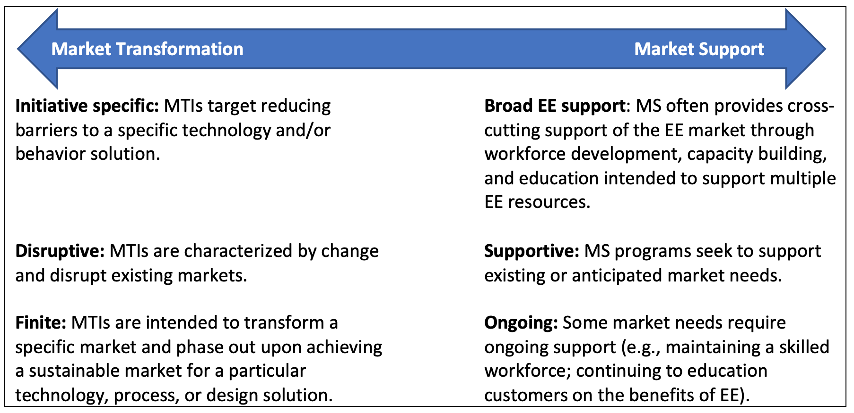
Conceptual distinctions between MT and MS

Slide 30
Wrap-Up and Next Steps
Debrief where ended up and how meeting went
Discuss all Next Steps, including work between meetings, and approach/strategy for final meeting on 9/21

Slide 31
Meeting Dates & Tasks
Meeting/ Workshop | Date | Tasks
First WG Mtg. | 13-Jul | -Discuss WG final deliverables, and any assumptions to make WG successful -Review pre-existing Objectives and Metric(s) -Identify gaps in Objectives and Metric(s) -Brainstorm alternatives -Discuss initial priorities
Second WG Mtg. | 12-Aug | -Flesh out Objectives and Metric(s) -Identify options in cases where consensus is not reached
Third WG Mtg. | 9-Sep | -Refine Objectives & Metric(s) -Seek consensus on Objectives and Metrics -Discuss the basis PAs should use in setting Targets for Metrics in their filings
Final WG Mtg. | 21-Sep | -Finalize recommendations document -Strive for consensus & record supporters of options where consensus is not reached
Notes:
Note that mtgs will be virtual, and 9-approx. 1pm

