Slide 1
CAEECC Quarterly Meeting
Full CAEECC Meeting #34
Facilitation Team: Jonathan Raab and Katie Abrams
June 22, 2022

Slide 2
Agenda

Slide 3
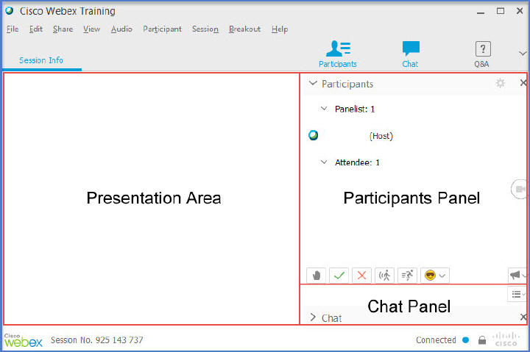
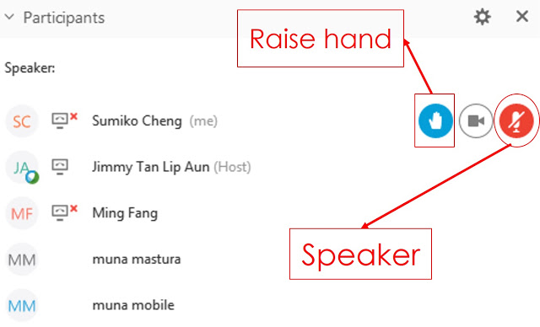
WebEx Technical Reminders
Raise hand to enter queue – then unmute when called upon
Mute when not speaking
Zoom in & out of documents
Chat the Host (Susan Rivo) with technical difficulties
Chat “Everyone” with substantive questions or comments (Members should provide verbal remarks)
Image courtesy: Blended Learning and FCSO
Notes:
By using chat to message “All attendees”, everyone can see the question or comment posted. This is to ensure that all attendees, not just panelists (speakers & members) can see the chat.

Slide 4

Two Options for Public Participation
Written:
  Use the Chat at any time during the meeting to ask questions or provide feedback.
    Chat to “Everyone” (not just panelists) so everyone can see remarks.
    Co-Chair Jenny Berg and other CAEECC Members will respond to the Public, as applicable
  Use the Chat for technical difficulties
    Chat to the Host, Susan Rivo
2. Verbal:
  Email <Susan@raabassociates.org> if you’d like to make a verbal comment
  Susan will add you to the mic queue
  Public mics will be open as noted in the agenda

Slide 5
Session 1: Evolving Scope of CAEECC

Slide 6
Topics
Presentation from Facilitation Team on background and options; & initial Member discussion
Public input
Presentation from Energy Division

Slide 7
Presentation from Facilitation Team & Initial Member Discussion

Slide 8
Brief Historical Context
CAEECC originated from a multi-party proposal, was authorized by D.15-10-028, and launched in 2016 to provide a collaborative venue for stakeholders to discuss energy efficiency matters under CPUC purview
D.15-10-028 establishes a statewide coordinating committee for the purpose of stakeholder involvement in “business plan, Tier 2 advice letter budget filing, and implementation plan preparation.”
Over time, CAEECC has been used to:
  Support the development and expansion of energy efficiency programs that reduce greenhouse gas emissions in line with state climate and energy goals while responding to customer needs and market dynamics
  Provide input to the Program Administrators (PAs) in the development and implementation of their energy efficiency business plans
  Improve collaboration and communication among parties and with CPUC on energy efficiency matters
  Resolve disagreements among stakeholders whenever possible to reduce the number of matters that need to be litigated before the CPUC

Slide 9
What CAEECC Has Specifically Accomplished
Forum to vet multi-year draft Business Plans and ABALs through Full CAEECC meetings
Convener of Working Groups to develop recommendations and new approaches on select topics
Contract Terms (2018),
NMEC (2018),
Market Transformation (2018-2021),
EE Portfolio Filing (2019-2021),
Underserved (2020-2021),
Market Support and Equity Metrics (2021),
Composition-DEI (2022)
Venue for public workshops
Topics: Standard & Negotiable Contract Terms/Workforce Standards, DEER Peak Savings Values, Disadvantaged Worker, NMEC/M&V, and Local Government Partnership Terms & Conditions

Slide 10
What Has Changed
Commission requirement for increasing 3P program design and implementation of IOU programs (IOUs have less influence over program design and implementation)
Spinoff of Market Transformation to independent statewide entity - based on CAEECC recommendations/Commission decisions
Change in the Business Plan/Application processes and frequency - based on CAEECC recommendations/Commission decisions
Increasing importance of JEDI (Justice, Equity, Diversity, and Inclusion) issues – based on Commission commitment and CAEECC recommendations
Discussion: Other major changes?

Slide 11
What Should CAEECC’s Scope be Going Forward?
Body to vet Business Plans/Four Year Applications and/or just select related issues
Vehicle to reach communities to gather input on equity segment and other matters
Forum for addressing important ad-hoc issues as they arise through working groups and workshops
Forum for important updates
Other?
Discussion Questions
  What’s missing from above in terms of potential future Scope of CAEECC?
  Of all the potential scope items, what’s most important, least important, and why?

Slide 12
Proposed Next Steps on Evolving Scope of CAEECC
Continue to discuss CAEECC Scope at September meeting and pass along thoughts to new JEDI-based Working Group; but do not finalize Scope until input received from WG
At September or later meeting discuss current structure of CAEECC, and potential refinements/alternatives
Other next steps?

Slide 13
Presentation from Energy Division followed by Member Discussion and
Public Input on Evolving Scope of CAEECC

Slide 14

Break

Slide 15
Session 2: Composition, Diversity, Equity, and Inclusion (CDEI) Working Group -- Followup

Slide 16
Topics
Compensation Task Force Update (including RFI results)
JEDI-related Working Group: scope, charge, and Prospectus finalization process
CDEI WG recommendations-implementing 1-2 before new WG launches
Public input

Slide 17
Compensation Task Force Update

Slide 18
Where compensation task force fits in
Composition, Diversity, Equity & Inclusion Working Group
Compensation Task Force
Future JEDI-focused Working Group

Slide 19
COMPENSATION TASK FORCE Overview
Charge
Develop a compensation mechanism for eligible members to pilot for a future Working Group focused on CAEECC’s JEDI efforts. While the Compensation TF’s scope will focus primarily on funding for the JEDI-focused WG, if relevant, its recommendations could inform funding for other CAEECC activities.
Meetings
3-6 virtual meetings (plus optional onboarding mtg) June through August (or November) 2022
Updates & Approval by CAEECC
Updates will be provided at each remaining 2022 Full CAEECC quarterly meeting (today, September 15, and November 15 (if needed)). Recommendations will be presented for approval at the September or November 2022 Full CAEECC meeting.
Additional Information
Member Roster, Scope of Work, and meeting materials available at https://www.caeecc.org/compensation-task-force

Slide 20
KEY Questions for Task force
What funding mechanisms, if any, are recommended considering the timing and purpose of the future JEDI-focused Working Group?
What are the eligibility requirements for applicants?
What activities and expenses are appropriate for funding (e.g., travel, staff time for attending meetings, preparation time, etc.)?
Should there be a cap on the funding (for individual members of a working group, and/or for an entire working group)?
What additional guidelines are needed, if any, regarding compensation for an eligible working group member or working group?
What is the timeline for getting compensation in place, and what is the TF’s recommendation for how that impacts the recruitment & launch of the JEDI-focused Working Group?

Slide 21
Compensation Task Force Members
 | # | Company | Lead
CAEECC Members | 1 | 3C-REN* | Alejandra Tellez
 | 2 | Bay Area Regional Energy Network (BayREN) | Jennifer Berg
 | 3 | CodeCycle.org | Dan Suyeyasu
 | 4 | Pacific Gas & Electric (PG&E) | Lucy Morris
 | 5 | San Joaquin Valley Clean Energy Organization* | Kelsey Jones
 | 6 | Southern California Edison (SCE)* | Christopher Malotte and Kellvin Anaya
 | 7 | Small Business Utility Advocates | Ted Howard
 | 8 | Southern California Regional Energy Network (SoCalREN)* | Lujuana Medina
Non-CAEECC Members | 9 | American Eco Services | Nicole Milner
 | 10 | Arup | Sahar Abbaszadeh
 | 11 | Future Energy Enterprises, LLC* | Annette Beitel
 | 12 | Silent Running LLC* | James Dodenhoff
 | 13 | The Utility Reform Network (TURN) | Constance Slider Pierre
Ex-Officio | 14 | California Public Utilities Commission (CPUC)* | Stephanie Green, Jesus Torres, and Nils Strindberg
Notes
1) *Represents organizations that participated in the CAEECC Composition, Diversity, Equity & Inclusion Working Group
2) Application process for interested non-CAEECC stakeholders closed 5/11/2022; all applicants were admitted

Slide 22
Initial findings on compensation needs (for jedi-focused wg) based on recent caeecc request for information
In April, CAEECC circulated a Request for Information regarding interest in participating in the Compensation TF and/or future JEDI-focused Working Group, and whether participants would want/need compensation for participating in the WG
44% of 16 respondents said they would or might seek compensation in the JEDI-related Working Group
The types of compensation respondents said they would seek included staff time for attendance, preparation, travel, and accommodations

Slide 23
Compensation TF meeting update
Kickoff meeting 6/8/2022
-received presentation from CAEECC Composition, Diversity, Equity & Inclusion WG members
-brainstormed funding guidelines, eligibility criteria, and potential funding sources
Will meet twice more prior to the next Full CAEECC meeting on 9/15
-meetings will be led by Michelle and Suhaila from Common Spark Consulting

Slide 24
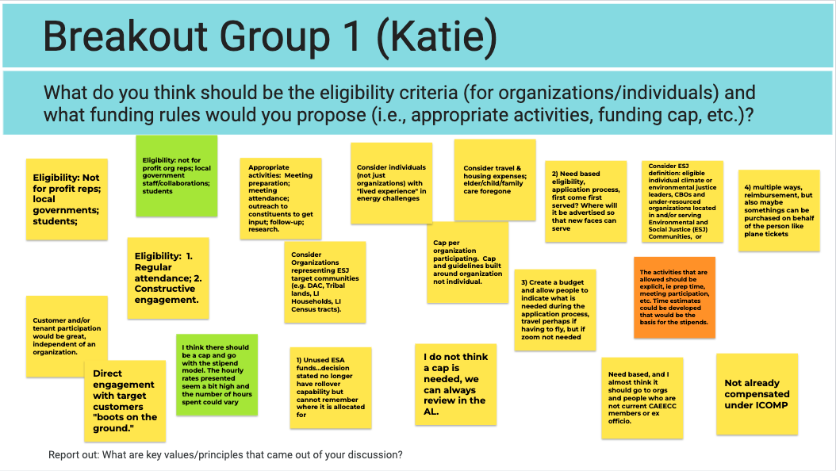

Slide 25
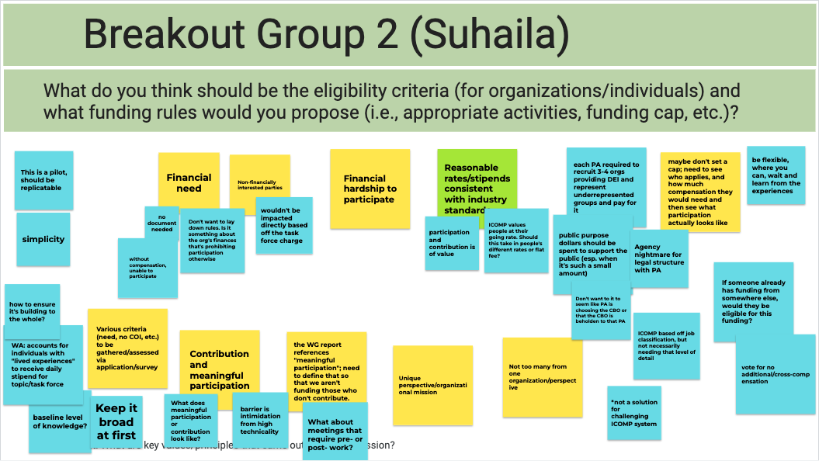

Slide 26
Overview of funding sources presented to compensation tf
Note: this table was presented to the Compensation TF based on worked developed by the CDEI WG; the Compensation TF has only had one meeting to discuss funding sources and other compensation matters
Funding Source (in no particular order) | Pros | Cons | Note
Energy Efficiency funding | Funding availability | Questions of budget eligibility from certain stakeholders | Approved budgets for 2022 is about $820M and for 2023 are roughly $935M; this is projected to increase to slightly exceed about $1B annually from 2024-27 CDEI WG recommended that all ratepayer funding sources be considered inclusive of Energy Efficiency (EE) EM&V funding (EM&V rationale could be significant process improvements from integrating strong JEDI initiatives into EE programs).
Legislation | Stable/long-term | Could take many years to secure
Philanthropic funding | Potential for long-term funding & partnership | Possible real or perceived conflict of interest | Suggest focusing on direct underwriting through an existing program rather than through a lengthy and highly uncertain grant application process. Avoiding real or perceived Conflict of Interest is of paramount importance.
Grant funding | May be readily available | Uncertainty; Application process can be lengthy
Intervenor Compensation (ICOMP) | Existing funding source | Lengthy reimbursement that is not guaranteed and is burdensome | See slide 47 for details.

Slide 27
Compensation TF: possible leading contender for funding source
Initial broad support for using Energy Efficiency (ratepayer) funding via CAEECC
This would be for eligible participants of the JEDI-focused WG, and possibly other CAEECC activities
Contracting could potentially be through the existing CAEECC Facilitation contract or a separate supplemental contract held by a Program Administrator (IOU or non-IOU)
Notes
The TF began discussing contract mechanisms at a high-level, but these bullets are based on the facilitation team’s preliminary discussion with Energy Division and CAEECC co-chairs
The TF has not developed formal recommendations yet – this is being shared as an update and to solicit initial CAEECC member and public input
Questions & Input?

Slide 28
JEDI-related Working Group
Discussion of scope & charge – and Prospectus finalization process

Slide 29
Future jedi*-focused wG: proposed Objectives**
SCOPE OF CAEECC: Align the governance policies with CPUC and state goals around justice, equity, diversity, and inclusion as well as recognize climate goals and the shift of energy efficiency to support carbon goals and address health inequities.
COMPOSITION OF CAEECC: Create a framework with a diversity of voices representative of the community within the scope of CAEECC’s work.
APPROACH TO INCLUSIVITY: Enable inclusive meetings and various opportunities for underrepresented voices to have access to, and supportive capacity for meaningfully participation.
1
2
3
*JEDI = Justice, Equity, Diversity, and Inclusion
**These are the Objectives presented at the April 2022 CAEECC meeting, revised based on feedback to focus primarily on JEDI not “Restructuring”

Slide 30
Jedi-focused WG: Proposed Scope
Composition & Eligibility
Compensation for Eligible Stakeholders
Recruitment & Retention
Facilitation
Competency Building
Notes:
This is a summary of the scope ideas presented at the April 2022 CAEECC meeting.
The WG will be charged with proposing reporting/accountability metrics associated with its recommendations.

Slide 31
Proposed TF & WG Implementation Schedule
Launch RFI in late April/early May
Launch TF late May/early June
JEDI-focused WG members
Recruit & select WG Members in October
JEDI-focused WG (6-9 months)
Launch JEDI-focused WG in Nov (pending Comp.)
Orange star indicates 2022 CAEECC meeting dates (6/23, 9/15, and 11/30)
Green star indicates Compensation TF meeting dates (6/8, and 2-3 times TBD in summer/fall 2022)

Slide 32
Proposed prospectus finalization process
Present Draft Prospectus for member review and approval at September Full CAEECC meeting
After launching, the JEDI-focused WG will have the opportunity to revise the Draft Prospectus (as other CAEECC Working Groups have done)
CAEECC facilitation staff prepares Draft Prospectus (in consultation with CPUC and Co-Chairs) based on CDEI WG

Slide 33

Public Comment

Slide 34
CDEI WG Recommendations
Implementing select few before new WG launches
Process:
Present each of the 3 topics
Member clarifying questions & initial reactions on each of the 3 topics
Public input on all 3 topics
Further Member discussion and approval seeking

Slide 35
Summary of CDEI WG recommendation ideas that could be advanced before JEDI-focused WG launches
Goal: Identify any recommendations the Full CAEECC would potentially like to start implementing before recruitment & launch of the JEDI-focused WG – focused on reducing application burden for applicants
Candidate Recommendations
  *Competency Building Recommendation #2: Include a demonstration of and commitment to JEDI in the Membership Application
  Competency Building Recommendation #3: Provide EE, JEDI, and CAEECC primers
  Recruitment & Retention Recommendation #1: Identify, outreach, and engage organizations outside of traditional CPUC parties
  Recruitment & Retention Recommendation #4: Engage with Service Providers who work with Underrepresented Customers
  *Conflict of interest process/disclosure requirements
  Facilitation Recommendation Ideas
  Others?
*Represents the recommendations Energy Division proposed the Facilitation Team advance for review at today’s Full CAEECC meeting

Slide 36
1st CDEI WG recommendation for review:
Include a demonstration of and commitment to JEDI in the JEDI-focused Working Group Application
Summary:
Specific proposal is to add this question to the WG’s application:
CDEI WG’s competency building recommendation #2 proposed changing the JEDI-focused WG application to include a demonstration of and commitment to JEDI in the Membership Application
“As a representative of X organization, I will actively 1) demonstrate and 2) commit to an ongoing education and personal commitment to Justice, Equity, Diversity, and Inclusion in my participation as a CAEECC Working Group member.”

Slide 37
Related CDEI WG recommendation for discussion: EE and DEI experience questions in the JEDI-focused Working Group Application
Proposed Questions related to EE and DEI in JEDI-focused WG application
  Do your representative and alternate have experience with and expertise related to issues of Diversity, Equity, and Inclusion (DEI)?
    Yes/no
  Do your representative and alternate have experience with and expertise related to energy efficiency (EE)?
    Yes/no
  If you answered yes to either question above, please briefly elaborate on your experience with and expertise in issues of Diversity, Equity, and Inclusion (DEI) and/or energy efficiency (EE).
    Required if answered yes to either question above
Discussion for CAEECC
  Should all of these questions be included in the JEDI-focused WG application?
  Should experience/expertise in EE and/or DEI be required selection criteria for JEDI-focused WG, or just useful information to know about applicants?

Slide 38
2nd CDEI WG recommendation for review:
Conflict of Interest Process & Disclosure Requirements for the JEDI-focused Working Group
Summary of proposed changes:
Remove requirement for non-CAEECC Members to provide an exhaustive client list (Groundrule III.E.II.a, page 4)
      Disclosures: Non-CAEECC Member organizations participating in a Working Group are required to disclose to the Working Group and the Facilitation Team both a) the entities with whom they are currently doing energy-related business with or for, both currently and within the past year and b) whether they are proposing to will represent their own organization or another entity, and if so whom. If new contractual relationships develop during the course of the Working Group, or their representation changes, they will update their disclosures.
Add attestation statement that non-CAEECC Members do not have a conflict of interest?
  Need to either define conflict of interest or refer to a CAEECC COI Policy that would need to be updated and revised

Slide 39
Public Comment followed by Member discussion and approval seeking

Slide 40
Break

Slide 41
Session 3: New Business Plan Dashboard

Slide 42
Orientation to Energy Division’s Business Plan Tableau Dashboard
Energy Division Staff developed a Tableau Dashboard using the information from Program Administrators’ (PAs) Applications that was submitted to CEDARS
The Dashboard contains information related to Energy Savings, TSB, Cost Effectiveness and Budget by sector and segment
A link to the dashboard and related information can be found at https://www.caeecc.org/6-22-22-full-caeecc-mtg
Note, CAEECC facilitation staff developed this slide as a placeholder for the forthcoming presentation/demo from Energy Division

Slide 43
CAEECC Planning/Next Steps

Slide 44
Topics
Co-Chair Transition
Facilitation Team Transition
Updated Workplan
Topics for September Full CAEECC Meeting
Summarize accomplishments for day and delineate next steps
Meeting evaluations

Slide 45
CAEECC Co-Chair Transition
Proposal from CAEECC leadership (current Co-Chairs, Facilitation team, and CPUC Energy Division)
Program Administrator Seat:
Lucy Morris, PG&E to take over from Jenny Berg, BayREN, effective immediately
Non-Program Administrator Seat:
Lara Ettenson, NRDC wishes to continue, but by her request for continuity sake Jenny Berg to serve as interim proxy until Lara is back late summer/fall 2022
Questions on proposal?
Other proposed alternatives?
Approval

Slide 46
Facilitation Team Transition
PG&E assuming CAEECC Facilitation contract from SCE, and rebid the contract
New team selected by PG&E and Selection Committee
Note that this full switch was supposed to occur July 1, but is delayed by PG&E on-boarding—in the interim Common Spark and Gemini being added to Raab/SCE contract

Slide 47
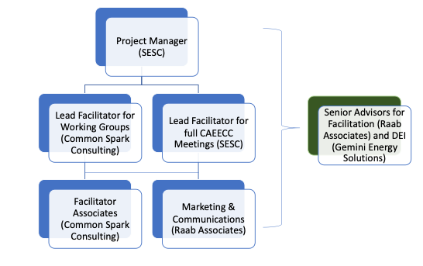
New facilitation team Organizational structure
Highlights
Designed for flexibility, efficiency and to leverage expertise
Redundancy for concurrent meetings
Retains institutional knowledge while bringing in new perspectives
Team
Strategic Energy & Sustainability Consulting (Katie Abrams)
Common Spark Consulting (Michelle Vigen Ralston, Suhaila Sikand, and others)
Raab Associates (Jonathan Raab and Susan Rivo)
Gemini Energy Consulting (Anthony Kinslow II)

Slide 48
Updated CAEECC Workplan
2022 (July-December)
2 quarterly CAEECC meetings
3-5 Compensation Task Force meetings
1-2 JEDI-focused Working Groups
Other meetings or workshop?
2023
4 quarterly CAEECC meetings
6-9 JEDI-focused Working Group meetings
Other meetings or workshops?
Note: We’ll revisit the 2023 Workplan at the December Full CAEECC meeting in preparation to file annual Advice Letter

Slide 49
Proposed Topics for September 15 Full CAEECC Meeting
Continued discussion on evolving scope of CAEECC, as well as CAEECC structure
Compensation TF update
JEDI WG
Review & approve Draft Prospectus
Possible further discussion of acceleration of certain recommendation(s)
Any 4-Year Applications/Business Plans topics?
Other topics?

Slide 50
4/12 Full CAEECC Meeting Evaluation Survey Results
Question | Avg. Score
Objectives of the meeting were clearly articulated on the agenda | 4.9
Objectives of the meeting were accomplished | 4.5
Presentations and background documents were clear and helpful | 5.1
CAEECC Members (including PAs) were flexible in seeking outcomes that were potentially mutually agreeable, where applicable | 4.9
The facilitators were effective in running the meeting (e.g., fostering a constructive and efficient forum, being impartial, and making sure no one dominated discussions) | 5.3
Overall, the online meeting format (WebEx) was smooth and effective | 4.9
Overall, this Full CAEECC meeting was successful | 4.6
Notes
1) Scores are 1-6 scale, where 1 is "strongly disagree" and 6 is "strongly agree” ; and 3.5 is mid-point of 1-6 scale
2) Scores based on responses from 24 members
3) Facilitation Team and Co-Chairs reviewed and debriefed comments from respondents

Slide 51
6/22 Meeting Evaluation
See email from Susan Rivo
Please complete today! (no later than June 29th in any case)

Slide 52
Appendix

Slide 53
Process for prioritizing and refining recommendations
84 ideas generated
Brainstormed into 5 categories
15 total recommendations
1 overarching & 14 supporting recommendations
Full WG prioritized then mini teams refined recommendations

Slide 54
5 categories of recommendations
Compensation
Competency Building
Restructuring CAEECC
Recruitment & Retention
Facilitation
Plus approx. 70 adtl’ recommendation ideas; proposed living definition of Diversity; Justice, Equity, Diversity & Inclusion (JEDI) glossary; and meeting norms (to be discussed through Restructuring WG and June CAEECC mtg, respectively)

Slide 55
What are the steps of the proposal?
Request for Information
Launch soon after 4/12 meeting
Do they need funding?
Compensation Task Force
Use the CDEI WG report to develop its charge
No need to seek formal CAEECC approval
Future JEDI-focused Working Group
Participate in Compensation TF?
Who is interested in JEDI-focused WG?
Launch within month, duration 3-6 months
Develop a final prospectus from CDEI WG report
Ensure accountability/metrics of success
Target launch Nov ’22; formal application process
Duration at least 6-9 months

Slide 56
Why Now?
CAEECC is not structured to address justice, equity, diversity, and inclusion (JEDI) as it pertains to energy efficiency under the purview of the CPUC.
The 2015 authorizing language does not include JEDI objectives and is centered around people with extensive CPUC-related energy efficiency experience.
CAEECC’s structure and engagement approach needs updating to advance the Commission’s equity and energy efficiency goals.
Perpetuating the status quo will continue to leave people out who are impacted by CAEECC and CPUC efficiency decisions.

Slide 57
WHY Compensation
Some key stakeholders have indicated they have limited financial resources and staff capacity to actively participate in CAEECC.
Need to identify optimal and feasible funding sources and ways of delivering these financial resources to Community-Based Organizations (CBOs) and other under-resourced organizations to encourage their participation and engagement in CAEECC for the long-term.
The need for compensation is a theme across CPUC proceedings and processes (not just for CAEECC).
CPUC acknowledges the need for funding through a CBO Participation Pilot Program, as outlined in its Environmental and Social Justice (ESJ) Action Plan, which calls for News and Outreach Office staff to “Identify a funding source outside of ICOMP and create a pilot program that aims to facilitate deeper involvement of CBOs in CPUC programs and processes.”

Slide 58
Compensation Barriers
The CPUC’s Intervenor Compensation Program (ICOMP) does not align with the needs of CBOs and environmental justice organizations, e.g., the process is too complicated; it’s not financially sustainable for under-resourced groups to have to wait lengthy periods of time to be “reimbursed”.
Current statutory and regulatory requirements make it difficult for ratepayer funds to be used to compensate CBOs.
There are some CBOs and other under-resourced organizations that have expressed they would participate and engage in CAEECC and/or the Working Groups if they were compensated. However, more tailored information is needed. For example, what type of compensation model do these organizations think would best meet their needs? What types of activities would these organizations like to be compensated for? Additionally, there might be organizations that would like to be compensated but have not shared this preference with CAEECC leadership.

