Slide 1
third party programs solicitations update
CAEECC
May 14, 2020

Slide 2
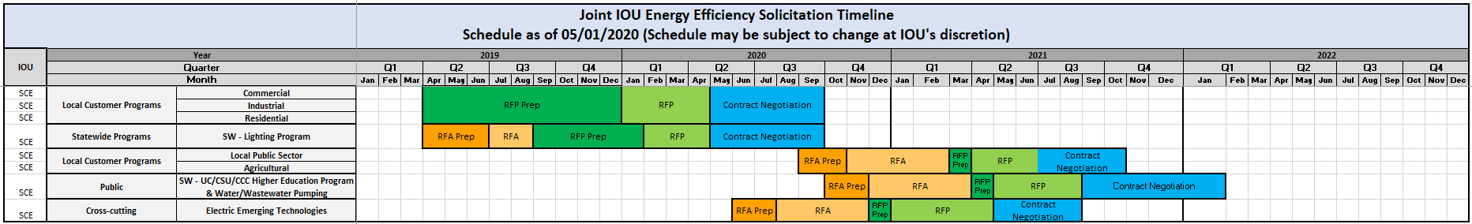
SCE Solicitation Timeline
25%
40%
60%

Slide 3
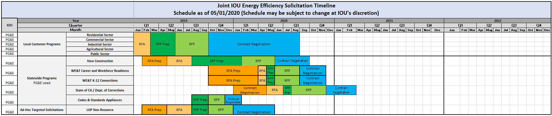
PG&E Solicitation Timeline
25%
40%
60%

Slide 4
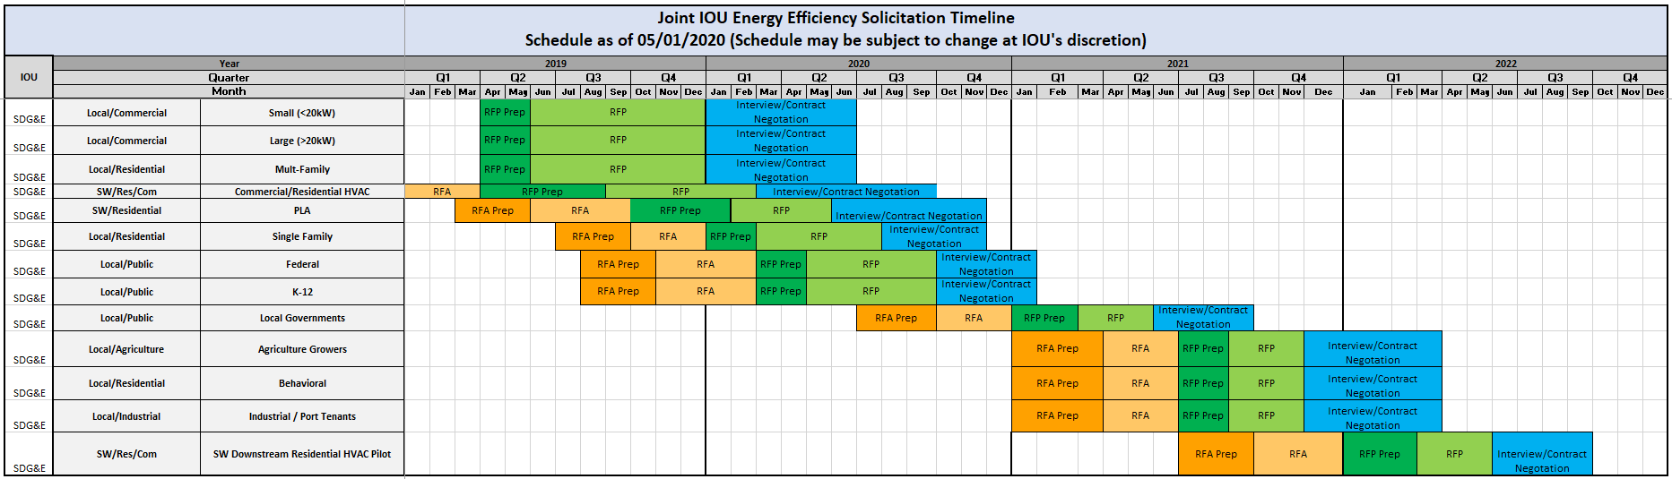
SDG&E Solicitation Timeline
25%
40%
60%

Slide 5
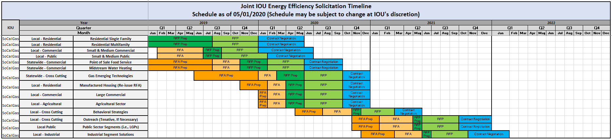

SoCalGas Solicitation Timeline
25%
40%
60%

