Slide 1
Status of CAEECC MT Working Group: MT and EE Overlap (Savings Attribution)
October 21, 2020

Slide 2
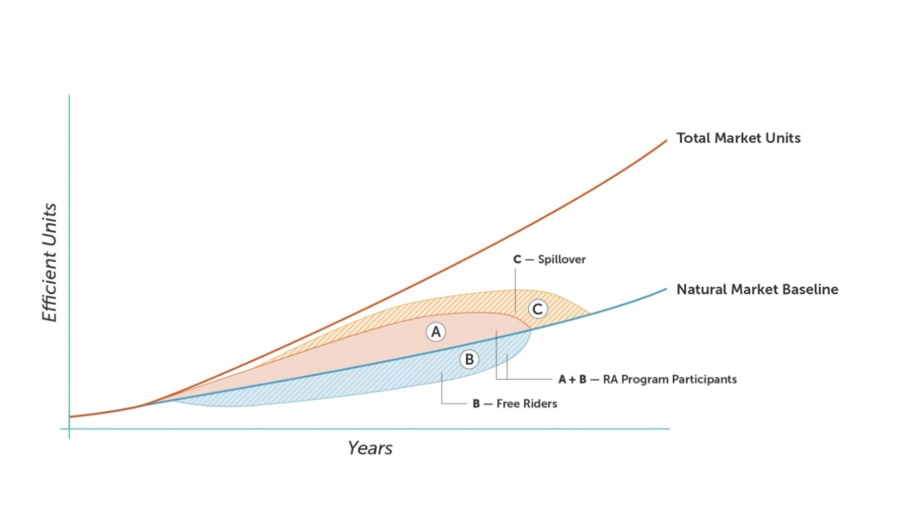
MT and RA Savings
Sub-WG Proposal: Remove net RA Savings from the MT Savings
Purpose: Avoid double counting
Total MT Savings = (MT Units x Savings per unit) – RA Net Savings; Where:
MT Units = Total Market Units – Natural Market Baseline Units
Savings/Unit = Developed in MTI Plan
RA Net Savings = Savings reported in CEDARS
for the same market (measures) targeted
by the MT initiative
    Likely a combination of A, B, C
MT units

Slide 3
Questions on “net” RA savings
When there are metered savings with multiple measures embedded in one savings number for an RA program, but only one or a few of the measures is an MTI target, how do the savings for the RA program get removed?
Is CEDARS the best source for net savings?
Will “free rider” RA calculations be biased by the MTI activities? If so, what can be done? [e.g., keep FR rate static so less penalty to RA from a moving market (This is alluded to in Decision (p 159 in requirements for MTI Plan]

