Slide 1
CAEECC Quarterly Meeting
Full CAEECC Meeting #28
Facilitation Team: Dr. Jonathan Raab, Dr. Scott McCreary, and Katie Abrams
March 17, 2021

Slide 2
Agenda
Time | Session | Objectives | Presenter
9:00 | Introductions | Introductions, review of agenda and meeting objectives | Facilitator
9:10 | Session 1: Important Updates & CAEECC Discussion | Market Transformation Administrator RFP Market Transformation WG (report & evaluation) Underserved WG; and 3rd Party Solicitation Process | Christie Torok (CPUC) Facilitator; Co-Chairs; Amri Christianto (SCE)
9:50 | Session 2: CAEECC 2021 Planning Session | Workplan & Proposed Quarterly CC Dates; Potential New CAEECC Members (if any?); CAEECC Roles & Responsibilities and Groundrule Survey Results; and Proposed Groundrule changes; and CAEECC Conflict of Interest Policies/Enforcement | Facilitator; Co-Chairs; Facilitator & Co-Chairs; Co-Chairs
10:50 | Break
11:00 | Session 3: EE Portfolio Reform | Presentation, Q&A, and Discussion w/ Energy Division | Jen Kalafut, Jessica Allison, and Alison LaBonte (CPUC)
11:55 | Wrap-Up/Next Steps | Summarize accomplishments for day and delineate next steps | Facilitator
Noon | Adjourn (please complete meeting evaluation asap)

Slide 3
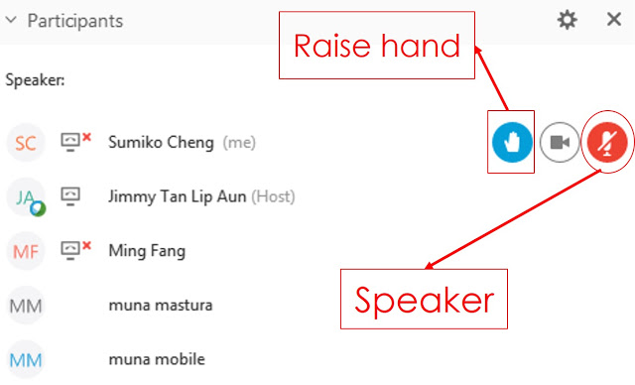
WebEx Technical Reminders
Image courtesy: Blended Learning
Raise hand to enter queue – then unmute when called upon
Mute when not speaking
Zoom in & out of documents
Note: members of the MTWG and EE Filing working groups, who are not formal CAEECC members, will be able to provide input and ask questions in Sessions 1 and 3, respectively, by emailing Susan Rivo at susan@raabassociates.org – Susan will elevate you to panelist so you can raise your hand and speak

Slide 4
Session 1: Important Updates & CAEECC Discussion

Slide 5
Topics
Market Transformation Working Group (MTWG) - Report & Evaluation
Underserved WG
3rd Party Solicitation Process
Market Transformation Administrator RFP

Slide 6
Market Transformation WG: Phase II Report
Reached consensus on most principles and many recommendations, with four non-consensus issues
The method to prevent double counting between Market Transformation Initiatives (MTIs) and Resource Acquisition programs
Whether to add factors to savings attribution methods (between MTIs and Codes and Standards (C&S)) now, or once market actors are defined
Whether to adjust the weighting of factors (for attributing MTIs and C&S savings) now or later
Whether or not a percentage of savings between MTIs and C&S should be pre-allocated, or all allocated by ex-post evaluation
Report posted to meeting page on 2/1/2021: https://www.caeecc.org/1-22-21-mtwg-mtg

Slide 7
Method for Double Counting Options
(MTIs and RAs)
Method for Double Counting Option | First Choice Option | Acceptable Option
Option A: Remove all RA Savings (7 first choice, 13 acceptable) | -CSE -CEDMC -CodeCycle -Jay Luboff Consulting -NRDC -Resource Innovations -The Energy Coalition | -CEE -CSE -CEDMC -CodeCycle -Don Arambula Consulting -Energy Solutions -Jay Luboff Consulting -NRDC -Outthink -Resource Innovations -SBUA -SMART Local 104 -The Energy Coalition
Option B: Deciding to Simply Subtract RA Savings is Premature (11 first choice, 15 acceptable) | -CEE -Don Arambula Consulting -Energy Solutions -Enervee -Outthink -PG&E -Public Advocates Office -SBUA -SCE -SMART Local 104 -SoCalREN | -CEE -Don Arambula Consulting -Energy Solutions -Enervee -Jay Luboff Consulting -NRDC -Outthink -PG&E -Public Advocates Office -SBUA -SCE -SMART Local 104 -SoCalREN -PG&E -The Energy Coalition

Slide 8
Attribution of Factors Options
(MTIs and C&S)
Attribution Factor Option | First Choice Option | Acceptable Option
Option A: Addition of MTI Related Factors Now (4 first choice, 9 acceptable) | -CEDMC -CodeCycle -Jay Luboff Consulting -The Energy Coalition | -CEDMC -CSE -CodeCycle -Don Arambula Consulting -Jay Luboff Consulting -NRDC -Outthink -SBUA -The Energy Coalition
Option B: Detailing Additional Factors is Premature Until Roles of Market Actors Are Defined (15 first choice, 17 acceptable) | -CEDMC -CEE -CSE -Don Arambula Consulting -Energy Solutions -Enervee -NRDC -Outthink -PG&E -Public Advocates Office -Resource Innovations -SBUA -SCE -SMART Local 104 -SoCalREN | -CEDMC -CEE -CSE -Don Arambula Consulting -Energy Solutions -Enervee -Jay Luboff Consulting -NRDC -Outthink -PG&E -Public Advocates Office -Resource Innovations -SBUA -SCE -SMART Local 104 -SoCalREN -The Energy Coalition
^{[1]} Approximately half of CEDMC members support Option A as their first choice and half Option B.

Slide 9
Weighting of Factors Options
(MTIs and C&S)
Weighting of Factors Option | First Choice Option | Acceptable Option
Option A: Make Adjustments to Weighting of Factors Now (3 first choice, 7 acceptable) | -CodeCycle -Jay Luboff Consulting -The Energy Coalition | -CodeCycle -CSE -Don Arambula Consulting -Jay Luboff Consulting -NRDC -Outthink -The Energy Coalition
Option B: Adjustments to Weighting of Factors Now is Premature (15 first choice, 17 acceptable) | -CSE -CEDMC -CEE -Don Arambula Consulting -Energy Solutions -Enervee -NRDC -Outthink -PG&E -Public Advocates Office -Resource Innovations -SBUA -SCE -SMART Local 104 -SoCalREN | -CSE -CEDMC -CEE -Don Arambula Consulting -Energy Solutions -Enervee -Jay Luboff Consulting -NRDC -Outthink -PG&E -Public Advocates Office -Resource Innovations -SBUA -SCE -SMART Local 104 -SoCalREN -The Energy Coalition

Slide 10
Pre-Allocation of Savings Options
(MTIs and C&S)
Pre-Allocation Option | First Choice Option | Acceptable Option
Option A: Pre-allocate a portion of savings and the rest allocated ex post (6 first choice, 13 acceptable) | -CEDMC -CEE -CodeCycle -Jay Luboff Consulting -SoCalREN -The Energy Coalition | -CEDMC -CEE -CodeCycle -CSE -Don Arambula Consulting -Jay Luboff Consulting -NRDC -Outthink -Resource Innovations -SBUA -SMART Local 104 -SoCalREN -The Energy Coalition
Option B: No pre-allocation of savings—entirely ex post (13 first choice, 18 acceptable) | -CEDMC -CSE -Don Arambula Consulting -Energy Solutions -Enervee -NRDC -Outthink -PG&E -Public Advocates Office -Resource Innovation -SBUA -SMART Local 104 -SCE | -CEDMC -CEE -CSE -Don Arambula Consulting -Energy Solutions -Enervee -Jay Luboff Consulting -NRDC -Outthink -PG&E -Public Advocates Office -Resource Innovations -SBUA -SMART Local 104 -SoCalREN -SCE -SoCalREN -The Energy Coalition
^{[1]} CEDMC’s member organizations were split exactly 50/50 on Options A and B as their first choice, but either option is acceptable to nearly all CEDMC member organizations.

Slide 11
MTWG Evaluation – Phase II Scores
Evaluation Question | Average | Median | Low | High
Overall Goals & Objectives Clearly Articulated | 5.1 | 5.0 | 4.0 | 6.0
Overall Goals & Objectives Accomplished | 4.7 | 5.0 | 2.0 | 6.0
Effective Proposal Development Process | 4.9 | 5.0 | 2.0 | 6.0
Successful Approach to Consensus and Non-Consensus Issues | 4.8 | 5.0 | 2.0 | 6.0
Documents Clear & Helpful | 4.9 | 5.0 | 3.0 | 6.0
Members Flexible Seeking Agreements | 4.1 | 4.0 | 1.0 | 6.0
Facilitators Were Effective | 5.0 | 5.0 | 2.0 | 6.0
MTWG Process Created More Value Than if at CPUC | 5.2 | 5.0 | 2.0 | 6.0
All Things Considered, MTWG Was A Successful Process | 4.5 | 5.0 | 3.0 | 6.0
Notes
1) Scores are 1-6 scale, where 1 is "strongly disagree" and 6 is "strongly agree”; and 3.5 is mid-point of 1-6 scale
2) Phase II scores based on responses from 13 of 18 voting MTWG members
3) MTWG Member associated evaluation comments available on 3/17 CAEECC mtg page (“Phase II MTWG Process Survey Results - Anonymous responses”): https://www.caeecc.org/3-17-21-full-caeecc-mtg

Slide 12
MTWG Evaluation – Phase I vs. II Scores
Evaluation Question | Phase II Averages | Phase I Averages | Delta
Overall Goals & Objectives Clearly Articulated | 5.1 | 5.5 | (0.4)
Overall Goals & Objectives Accomplished | 4.7 | 5.1 | (0.4)
Effective Proposal Development Process | 4.9 | 5.2 | (0.3)
Successful Approach to Consensus and Non-Consensus Issues | 4.8 | 5.2 | (0.4)
Documents Clear & Helpful | 4.9 | 5.3 | (0.4)
Members Flexible Seeking Agreements | 4.1 | 4.7 | (0.6)
Facilitators Were Effective | 5.0 | 5.1 | (0.1)
MTWG Process Created More Value Than if at CPUC | 5.2 | 5.5 | (0.3)
All Things Considered, MTWG Was A Successful Process | 4.5 | 5.3 | (0.8)
Notes:
1) Scores are 1-6 scale, where 1 is "strongly disagree" and 6 is "strongly agree” ; and 3.5 is mid-point of 1-6 scale
2) Phase I scores based on responses from 18 respondents; Phase II scores based on responses from 13 of 18 voting MTWG members

Slide 13
MTWG Phase II Evaluation Key Points
The overall evaluation results were mixed with overall success at only 4.5, but the process having created more value than if it had remained at CPUC (5.2)
Solid but not outstanding: Meeting goals and objectives (4.7), effective proposal development (4.9), approach to consensus/non-consensus issues (4.8), and facilitation (5.0).
Particularly concerning was members flexibility in seeking agreements (4.1)--this could in large part be due to certain members wanting to defer decision-making on key issues to later and a different group
Notably all the scores were lower than Phase I MTWG (from 0.1 to 0.8), with the overall success dropping from 5.3 to 4.5. Several reasons for this elaborated in comments and facilitation observations:
  CPUC decision mid-way to not have results filed formally
  More non-consensus issues
  Process concerns early-on by some, Webex vs. in-person meetings, narrower and more allocative issues, etc.

Slide 14
Underserved WG
Goal & Approach: conducting analyses to identify underserved customers in the three sectors (Res, SMB, and Public sectors); identify root causes; and develop recommendations for forum/process to address each type of Underserved customer Over the past several months, three Research Teams (based at UC Davis, UCSB, and UC Riverside) continued their analysis while providing periodic updates
Status of 3 sub-WGs as of 2/24/2021 UWG meeting:
  Residential (UC Davis): analysis/report completed Dec 2020
  SMB (UC Irvine and Green Love Economics): analysis in-progress; report spring 2021
  Public sector (UCSB): workplan completed; analysis summer 2021
Illustrative findings are emerging, but are not yet sufficiently developed or definitive to form the basis for compelling policy recommendations
Research teams will continue their respective focus on gathering sufficiently complete datasets with appropriate granularity, conducting regression analysis and spatial analysis, and reporting on whether results clearly points to robust identification of and reasons for underserved sectors
Anticipate final analysis completed summer 2021
WG report to Energy Division upon completion of analyses

Slide 15
third party programs solicitations update
CAEECC
March 17, 2021

Slide 16
SCE Solicitation Timeline
Today

Slide 17
PG&E Solicitation Timeline
Today

Slide 18
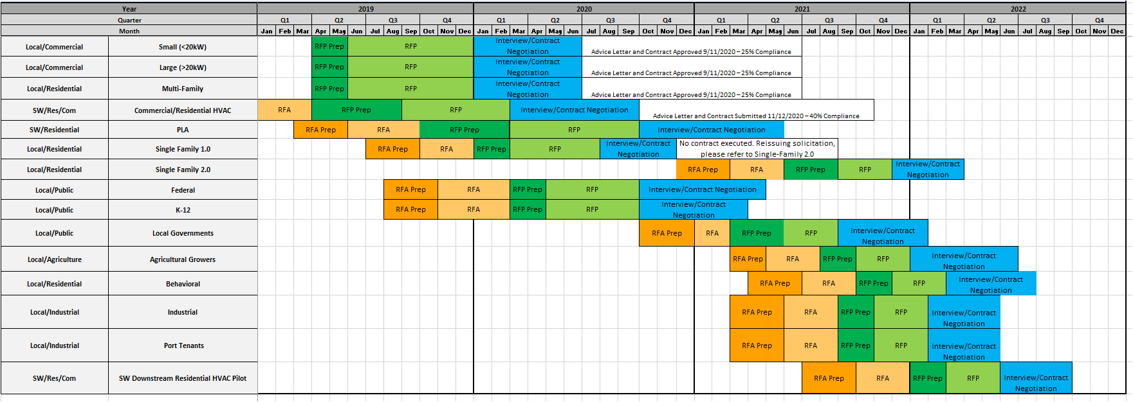
SDG&E Solicitation Timeline
Today

Slide 19
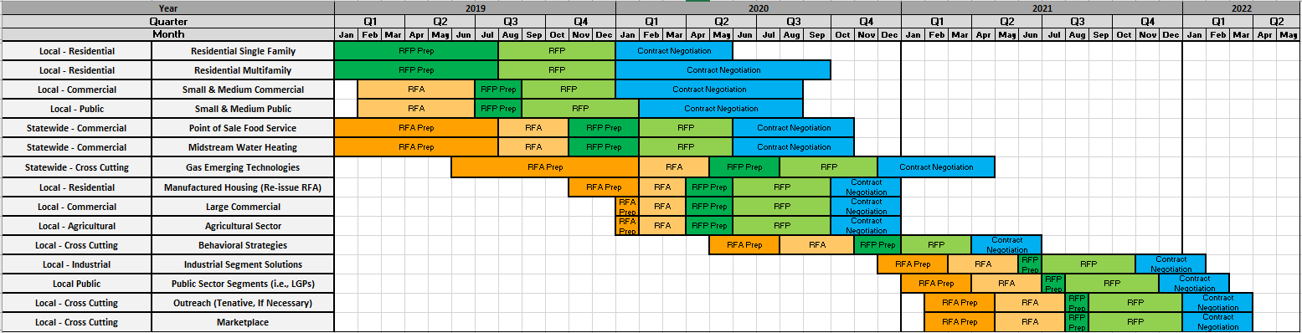
SoCalGas Solicitation Timeline
Today

Slide 20
Session 2: CAEECC 2021 Planning Session

Slide 21
Topics
Workplan & Proposed Quarterly CC Dates
Potential New CAEECC Members
CAEECC Annual Evaluation Survey Results; and Proposed Groundrules Changes
CAEECC Conflict of Interest Policies/Enforcement

Slide 22
Workplan
Full CAEECC Quarterly Meetings
Four quarterly meetings
Underserved Working
1 meeting in February
Could be a Phase 2 based on Phase 1 findings & recommendations
Market Transformation Working Group
Completed final meeting, report, and evaluation January/February 2021
New Portfolio Filing (aka Business Plan) Working Group (or full CAEECC)
2.5 days WG meetings (assuming 2 major issues), and half day for reviewing PAs draft Filings (regarding 2 major issues)
Depends on timing/final CPUC decisions on EE Filing WG Process recommendations
Unspecified Workshops/Working Group Meetings
2 Workshops TBD
2 Working Group Meetings TBD
March 17
June 24
August 5 (if CAEECC needs to review ABALs); September 2 (if not)
December 2
Possibly 1 more WG meetings for Phase 1 (plus sub-WG meetings)

Slide 23
Potential New CAEECC Members
Received one inquiry, but they didn’t complete the application process
CAEECC to evaluate member composition and identify if any important related stakeholder groups are missing by end of 2021

Slide 24
CAEECC Annual Evaluation Survey Results
 | Average | Median | Low | High
Members complying with roles & responsibilities | 5.2 | 5.0 | 4.0 | 6.0
Facilitation team complying with roles & responsibilities | 5.3 | 5.0 | 2.0 | 6.0
Co-chairs complying with roles & responsibilities | 5.1 | 6.0 | 3.0 | 6.0
Adhering to groundrules for substantive issues | 4.8 | 4.0 | 4.0 | 6.0
Adhering to groundrules for process issues | 4.7 | 4.0 | 3.0 | 6.0
Clarity on who is responsible for groundrule enforcement | 4.5 | 5.0 | 1.0 | 6.0
CAEECC fosters open & honest dialogue | 5.2 | 5.0 | 1.0 | 6.0
Notes
1) Scores are 1-6 scale, where 1 is "strongly disagree" and 6 is "strongly agree” ; and 3.5 is mid-point of 1-6 scale
2) Scores based on responses from 17 of 21 members

Slide 25
CAEECC Groundrule Compliance Survey Key Results
Members generally feel that Member (5.2); Facilitation Team (5.3); and Co-chair (5.1) compliance with their respective roles and responsibilities was fairly high
Members also generally feel that groundrules related to Substance (4.8) and process (4.7) were being adhered to
Almost all Members feel that CAEECC fosters open & honest dialogue (5.2), although one Member gave this a 1
The lowest score was whether there’s clarity for who’s responsible for groundrule enforcement (4.5), with two Members giving this a 1
We received associated comments from only 3 Members, with only one proposing areas for potential groundrule modifications but no specific groundrule language; however, the Co-Chairs/Facilitation Team are proposing a set of groundrules related to clarifying groundrule enforcement

Slide 26
Proposed Groundrule Changes
New groundrules on Enforcement of Roles & Responsibilities and Groundrules – see “Proposed New Enforcement Groundrules” on the 3/17 Full Quarterly CAEECC meeting page: https://www.caeecc.org/3-17-21-full-caeecc-mtg
Other groundrule changes?

Slide 27
CAEECC Conflict of Interest(COI) Policies/Enforcement/Updating
History, intent, and content of CAEECC’s COI policies and enforcement
CAEECC Discussion
  Is a CAEECC COI policy/set of groundrules still necessary?
  If so how, if at all, should it be updated, and by whom?
  How should it be enforced, and by whom?

Slide 28

Break

Slide 29
Session 3: EE Portfolio Reform

Slide 30
Presentation, Q&A, and Discussion with Energy Division
See CPUC presentation ‘EE Portfolio Reform CPUC (3-15-21)’ posted to 3/17 meeting page

Slide 31
Wrap Up & Next Steps

