Slide 1
Cost Effectiveness in EE
Adam Scheer
CAEECC
8/2/2018

Slide 2
Outline
- Brief Policy Overview
- Deeper Dive into TRC
- Example: PG&E’s 2017 Portfolio – TRC and PAC
- Avoided Costs – Trends and Challenges
- Challenges Between TRC and Policy Goals
Low Mid-Day Avoided Costs
Serving DAC, HTR, and Low Income Customers
Driving Deep Savings
Achieving Savings Goals
- Summary
- Q&A and Discussion

Slide 3
Cost Effectiveness: Background
Cost Effectiveness – Brief Regulatory Background
California Standard Practice Manual¹ defines cost effectiveness tests
Each Test measures cost effectiveness through a different perspective
California applies “Dual Test” for EE: TRC and PAC
¹http://www.cpuc.ca.gov/uploadedFiles/CPUC_Public_Website/Content/Utilities_and_Industries/Energy_-_Electricity_and_Natural_Gas/CPUC_STANDARD_PRACTICE_MANUAL.pdf

Slide 4
The TRC: What Does it Measure?
The TRC gauges value for the utility and its customers
Avoided Costs from Electricity and Gas Savings
TRC* ≈
+
+
+
Incentives to free riders
+
Measure costs incurred by non-free riders
Admin
Marketing
Implementation
+
+
+
EM&V
Non-Resource
ESPI
*Both the numerator and denominator of the TRC are NPV calculations
TRC: Important Drivers
Benefits (i.e. Avoided Costs)
Lifecycle Net Savings
→ Gross Savings, NTG, EUL
Energy and Associated Prices
Savings Load Shapes
GHG Cap-and-Trade Cost and Adder
Discount Rate
Costs
Admin, Marketing, Implementation, EM&V, SW ME&O
Measure Cost (IMC or FMC)
Incentives
Participant benefits (bill savings) not included

Slide 5
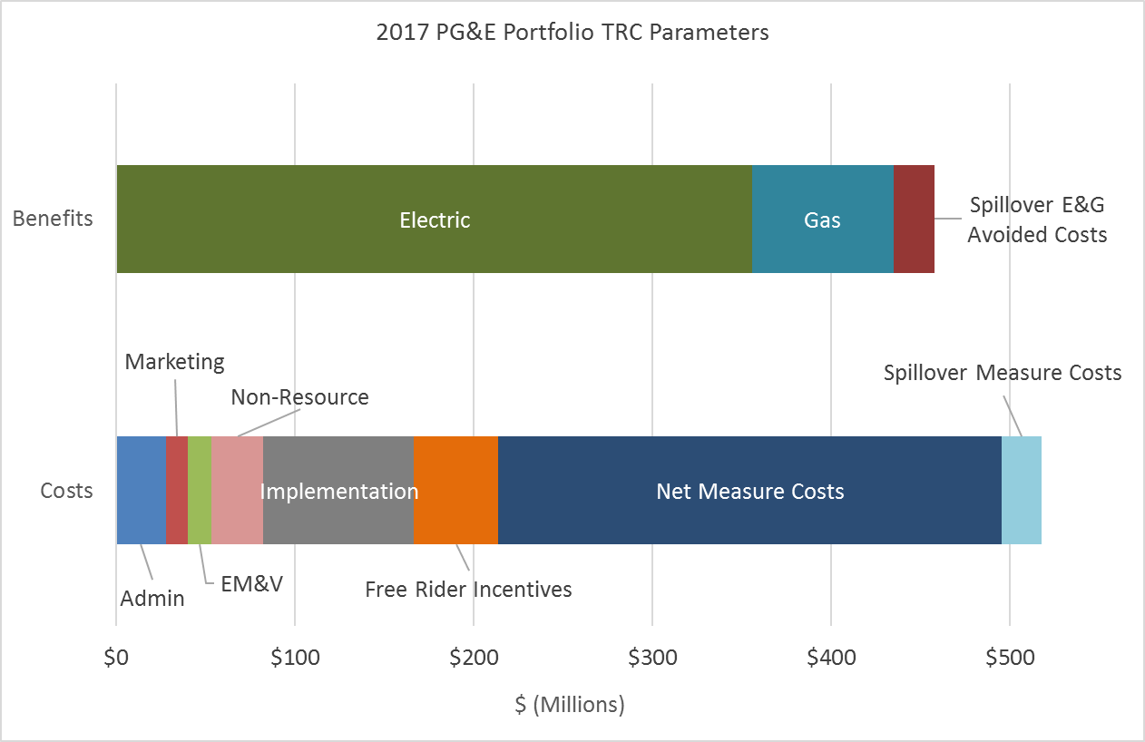
PG&E 2017 Portfolio: TRC Input Breakdown
2017 PG&E portfolio TRC = 0.88 (Excluding Codes and Standards)
Notes on Figure:
Non-Resource = WE&T, SW ME&O, IDSM, Strategic Energy Resources, and Financing
Admin, Marketing, and Implementation include resource program costs only to avoid duplicative counting with these fields in the non-resource program budgets.
PG&E’s 2017 ESPI was $0 due to 2006 – 2008 program cycle reimbursement
Measure Costs accounted for 60% of PG&E’s 2017 portfolio TRC cost.

Slide 6
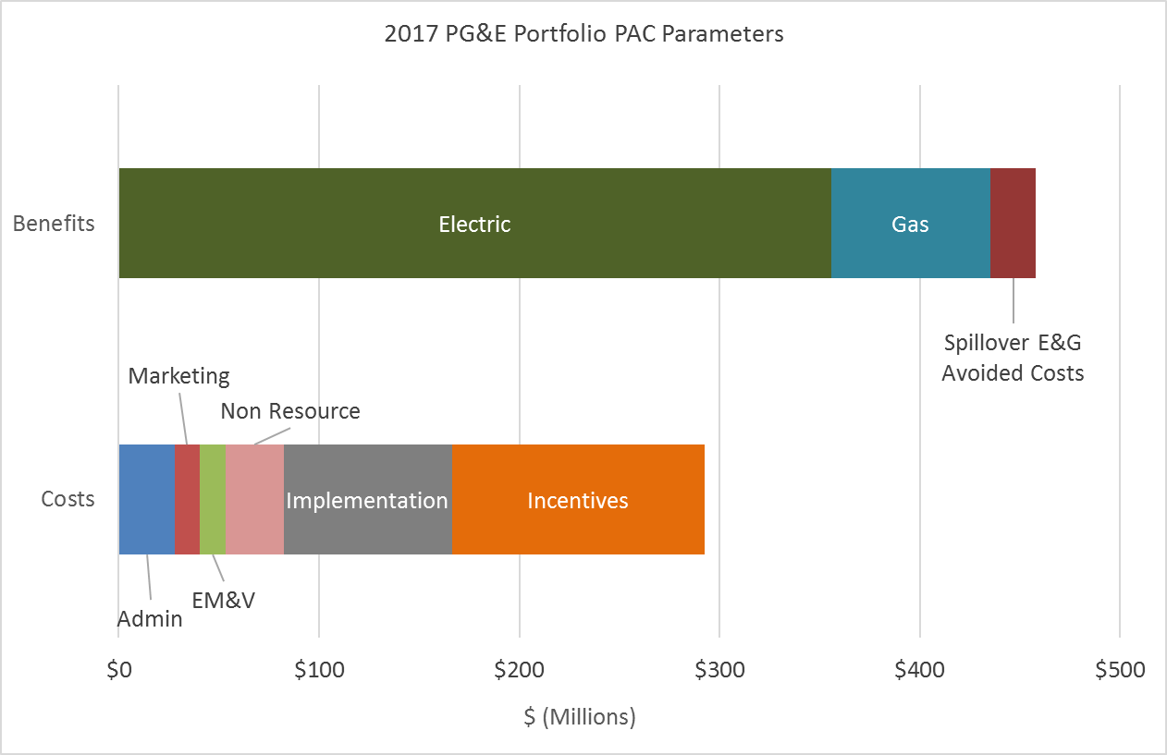
PG&E 2017 Portfolio: PAC Input Breakdown
2017 PG&E portfolio PAC = 1.57 (Excluding Codes and Standards)
Notes on Figure:
Non-Resource = WE&T, SW ME&O, IDSM, Strategic Energy Resources, and Financing
Admin, Marketing, and Implementation include resource program costs only to avoid duplicative counting with these fields in the non-resource program budgets.
PG&E’s 2017 ESPI was $0 due to 2006 – 2008 program cycle reimbursement
Absence of Measure Costs and use of full Incentive spend are the major differences between the PAC and TRC.

Slide 7
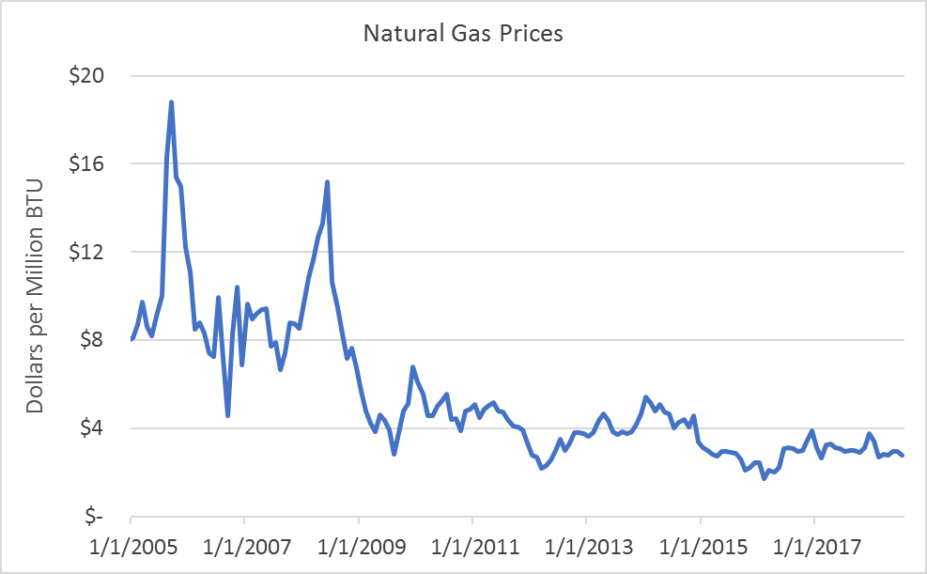
Avoided Cost Trends: Natural Gas Prices
Low natural gas prices limit TRC and PAC avoided costs.
Natural gas prices have fallen consistently since 2005.
Gas costs are forecasted to increase over the next two decades.¹
https://www.macrotrends.net/2478/natural-gas-prices-historical-chart
Other factors such as losses and transmission costs, and avoided GHG are included in the natural gas avoided costs.
¹Avoided Costs 2017 Interim Update, Energy and Environmental Economics, Inc. 2017.

Slide 8
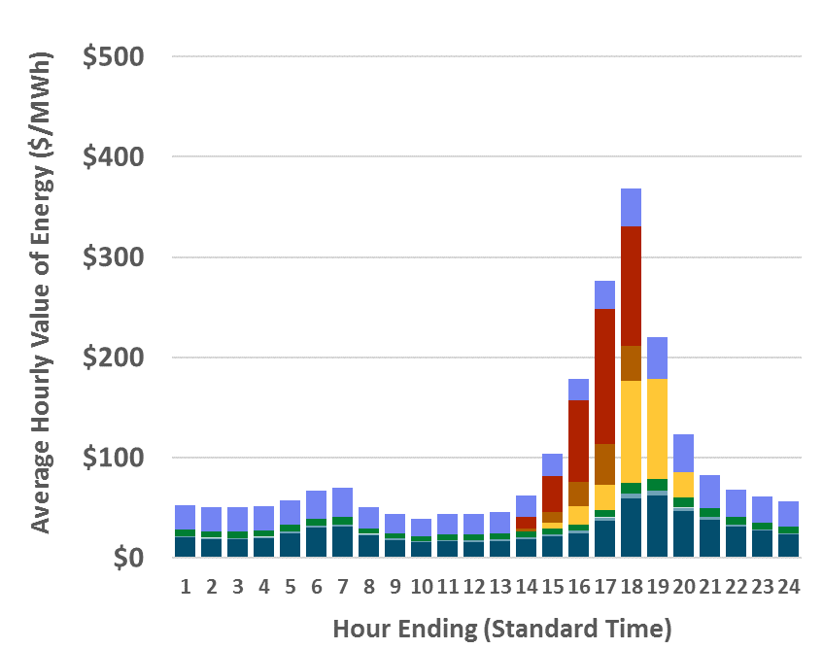
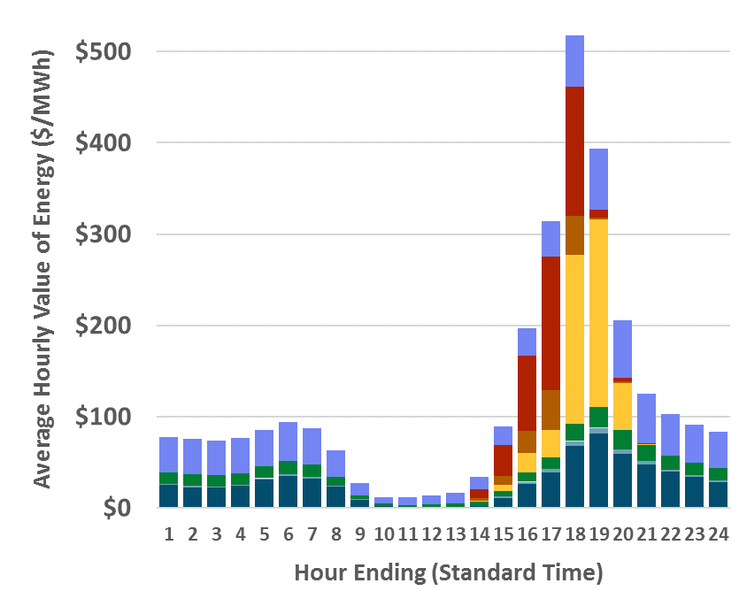
Components of Electric Avoided Costs
2019
2024
High capacity and T&D costs during summer peak hours drive high evening avoided costs.
Mid-day savings decreasing in value
CZ4 shown; ftp://ftp.cpuc.ca.gov/gopher-data/energy_division/EnergyEfficiency/CostEffectiveness/ACC_2018_v1f.xlsb

Slide 9
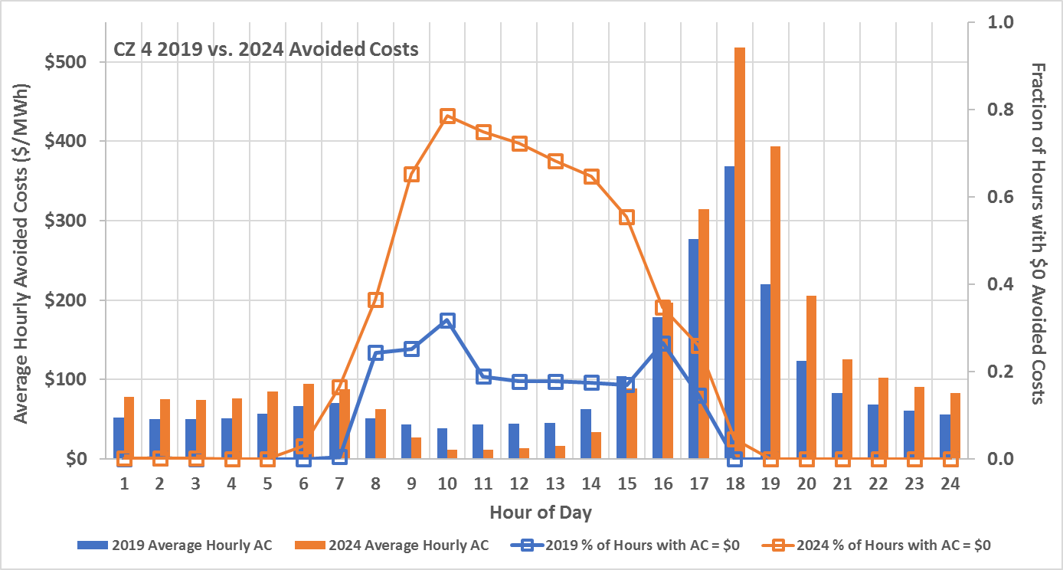
Electric Avoided Costs: Important Trends
Hourly $0 avoided costs are driving down mid-day benefits.
In 2019, 9% of hours have $0 Avoided Costs
In 2024, 25% of hours have $0 Avoided Costs, 61% from 7 am - 4 pm. (Current DEER Peak Hours are 2 – 5 pm)
CZ4 shown; data from ftp://ftp.cpuc.ca.gov/gopher-data/energy_division/EnergyEfficiency/CostEffectiveness/ACC_2018_v1f.xlsb

Slide 10
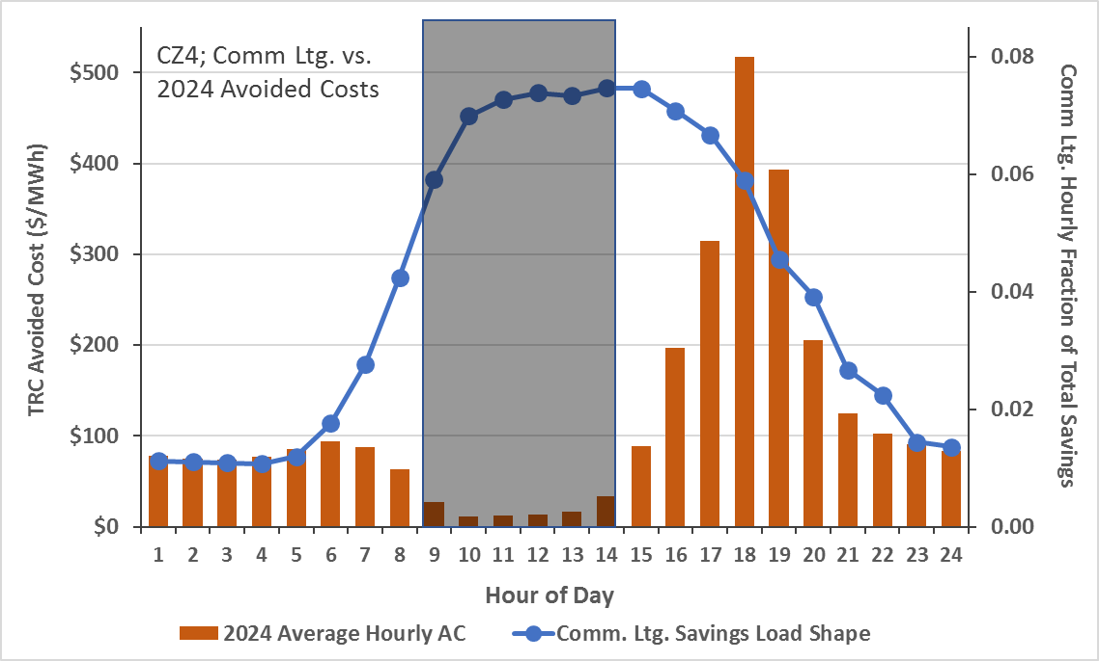
TRC and Policy Goals. Round 1 – Serving the SMB Sector
Very low mid-day avoided costs, yields low TRC benefits for serving SMB and many other non-res customers.
Comm Lighting vs. 2024 Avoided Costs
42% of savings during hours of dramatically reduced avoided costs.
Load shapes obtained from: the Database for Energy Efficiency Resources; DEER 2011 Non-Res Indoor_Non-CFL_Ltg

Slide 11
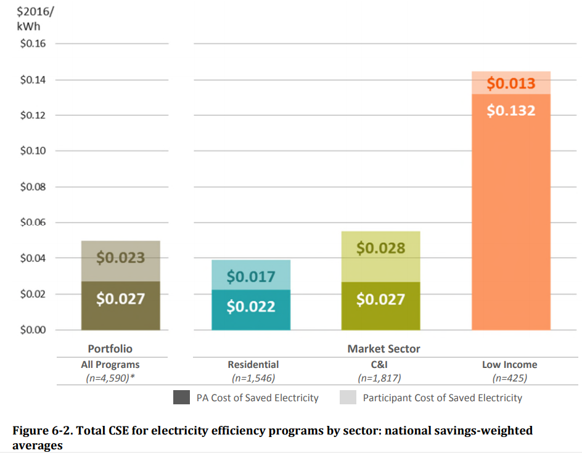
TRC and Policy Goals. Round 2 – Serving DAC and HTR
It is often more expensive to serve DAC, HTR and Low-Income customers.
Supporting DAC, HTR and Low-Income customers is a major policy priority.
3x cost for delivering EE to the low income sector.¹
High costs are anticipated for DAC/HTR (the need for Direct Install, expensive customer recruitment etc.)
¹The Cost of Saving Electricity Through Energy Efficiency Programs Funded by Utility Customers: 2009–2015. I. Hoffman et al. (LBNL, 2018).

Slide 12
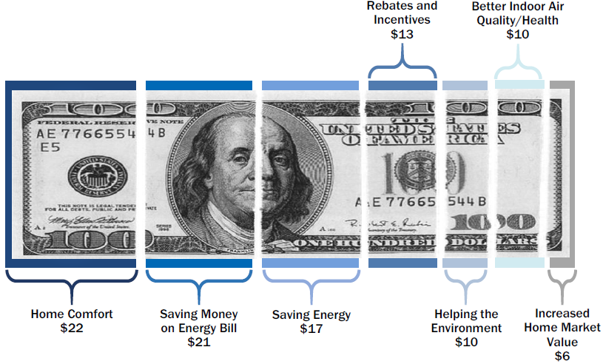
TRC and Policy Goals. Round 3 – Deep Savings
Higher Efficiency Equipment and Practices = Higher Measure Cost
PG&E Energy Upgrade California Home Upgrade participants: The value of a retrofit
High Product Quality = High Measure Cost
Deep retrofit programs drive substantial costs into portfolio
PG&E Whole House Program: Marketing and Targeting Analysis. Opinion Dynamics Corporation, 2014. CALMAC ID: PGE0302.05
Customers report that half of EUC benefits are non-energy factors,¹ yet all costs are traditionally included in the TRC.
¹This evaluation finding is supported in Energy Upgrade California – Home Upgrade Program Process Evaluation 2014-2015, EMI Consulting, 2015. CALMAC ID: PGE0389.01

Slide 13
TRC and Policy Goals. Round 4 – Achieving Savings Goals
Energy efficiency is changing. Meeting portfolio savings targets and SB 350 goals now requires:
More holistic programs and less reliance on “widgets”
Growth of financing and pay-for-performance programs
Leveraging private investment with incentive dollars
Deploying new technologies, including energy management systems
Moving markets
Integration with other distributed energy resources
Investment in the workforce
Meeting TRC targets requires a narrowed portfolio focused on:
Low cost savings
Established technologies
Easy-to-Reach customers

Slide 14
Q&A and Discussion

Slide 15
Appendix

Slide 16
Important Acronyms
DAC = Disadvantaged Community
DI = Direct Install
EM&V = Evaluation, Measurement, and Verification
EUL = Effective Useful Life
ESPI = Energy Savings Performance Incentive (PA Shareholder Incentive)
HTR = Hard to Reach customer
IDSM = Integrated Demand Side Management
MC = Measure Cost. MC = Incremental Measure Cost (IMC) for replace-on-burnout or Full Measure Cost (FMC) for Early Retirement (ER) or programs based on Normalized Metered Energy Consumption (NMEC).
NPV = Net Present Value
NTG = Net-to-Gross Ratio
PAC = Program Administrator Cost Test
SW ME&O = Statewide Marketing, Education, and Outreach
TRC = Total Resource Cost Test
WE&T = Workforce Education and Training

Slide 17
The TRC and PAC
Algebraic formulations:
$$TRC=$$
$$\frac{NPV of \left(NTG+ME\right)×Lifecycle Benefits of Avoided Electricity and Gas}{NPV of Admin+Marketing+Non−Resource+ESPI+Implementation+\left(1−NTG\right)×Incentives+Measure Cost×(NTG+ME)}$$
Admin
costs
Marketing
costs
Non-Resource Programs
ESPI
(shareholder incentive)
Implementation cost
Incentives paid to free riders
Measure costs incurred by non-free riders, including Market Effects, or ‘Spillover’
PAC $=\frac{NPV of \left(NTG+ME\right)×Lifecycle Benefits of Avoided Electricity and Gas}{NPV of Admin+Marketing+Non−Resource+ESPI+Implementation+Incentives}$
Admin
costs
Marketing
costs
Non-Resource Programs
ESPI
(shareholder incentive)
Implementation cost
Incentives
See the Standard Practice Manual for more information:
¹http://www.cpuc.ca.gov/uploadedFiles/CPUC_Public_Website/Content/Utilities_and_Industries/Energy_-_Electricity_and_Natural_Gas/CPUC_STANDARD_PRACTICE_MANUAL.pdf

Slide 18
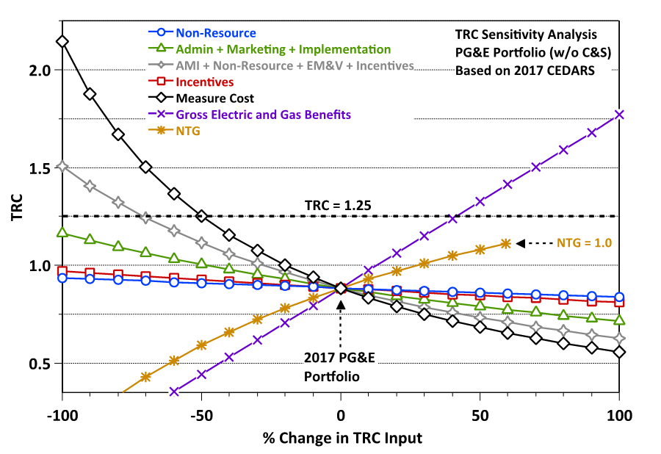
PG&E’s 2017 Portfolio: TRC Sensitivity Analysis
The graph below shows how a given % change in specific input(s) would impact portfolio TRC.
The portfolio TRC is most sensitive to Measure Costs and Benefits.
Figure note: -100% eliminates an input. +100% doubles an input.

Slide 19
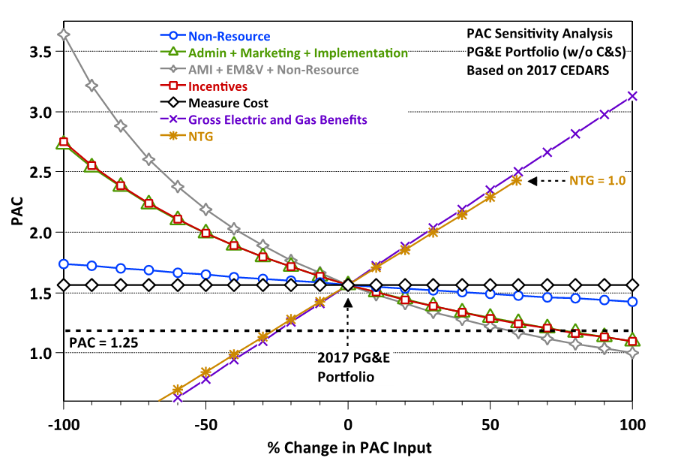
PG&E’s 2017 Portfolio: PAC Sensitivity Analysis
The graph below shows how a given % change in specific input(s) would impact portfolio PAC.
The portfolio PAC is most sensitive to Incentives, AMI (Admin, Marketing and Implementation), Benefits, and NTG.
Figure note: -100% eliminates an input. +100% doubles an input.

Slide 20
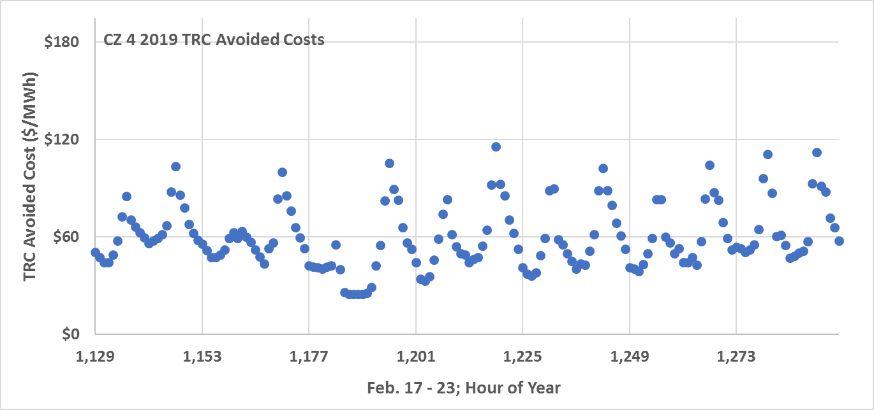
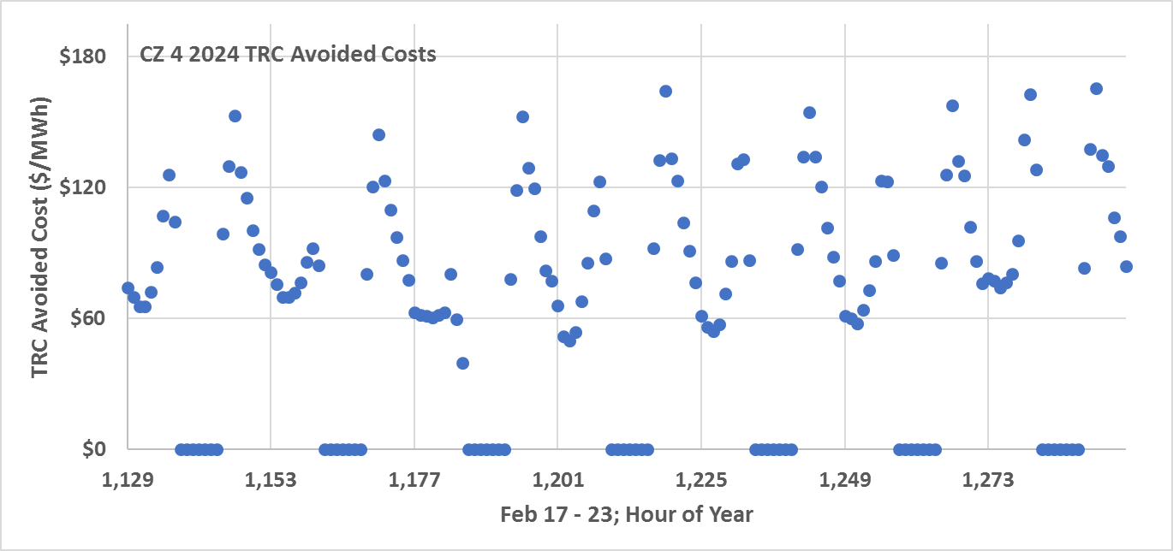
$0 Avoided Costs
CZ 4; 2019 vs 2024:
Projected periods of renewable curtailment lead to cratering mid-day avoided costs
CZ4 shown; data from ftp://ftp.cpuc.ca.gov/gopher-data/energy_division/EnergyEfficiency/CostEffectiveness/ACC_2018_v1f.xlsb

