Slide 1
Third Party Solicitations Update Full Quarterly CA Energy Efficiency Coordinating Committee Meeting February 28, 2019

Slide 2
AGENDA
Update of EE 3P solicitation timeline
Past and future trainings & solicitation activities
Workpaper FAQ updates
Cost-Effectiveness Tool (CET) Training
Forum for CET Questions
Summary of Dec. 10 Consolidated PRG Meeting
May 2019 Consolidated PRG Meeting
Follow-Up from Dec. 10 Consolidated PRG Meeting
SW IOU Scoring Plan
Definition for Innovation
Sharing of Best Practices

Slide 3
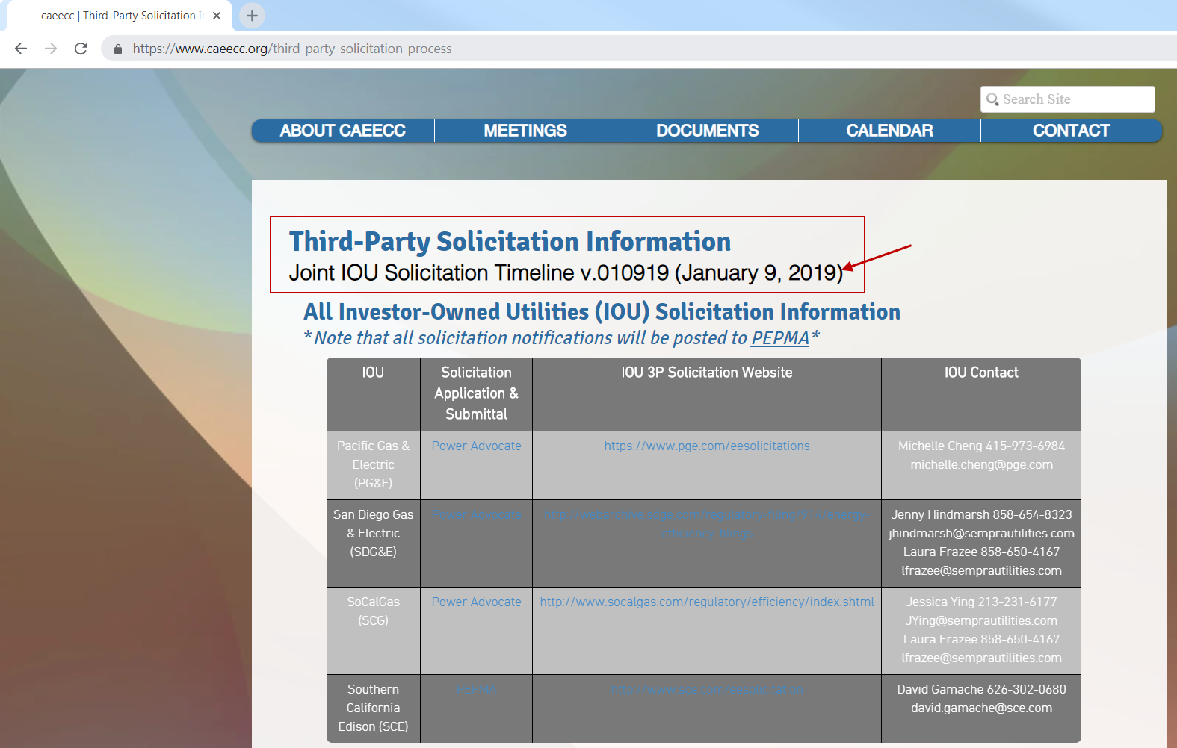
Update of EE 3P Solicitation Timeline
The EE solicitation timeline has been updated on the CAEECC website at https://www.caeecc.org/third-party-solicitation-process

Slide 4
Update of EE 3P Solicitation Timeline

Slide 5
Past Trainings & Solicitation Activities
Workpaper Development Training
The IOUs (PG&E, SCE, SoCalGas, and SDG&E) and the CPUC hosted a training on the process and requirements for developing workpapers for new deemed measures and deemed measure updates. Two training sessions were held on the dates below where the same content was presented at each training.
Tuesday, November 27, 2018 at PG&E’s Pacific Energy Center, San Francisco
Thursday, November 29, 2018 at SDG&E’s Energy Innovation Center, San Diego
Cost-Effectiveness Tool (CET) Training
The California investor-owned utilities hosted along with the California Public Utility Commission a training on the process and requirements for determining the cost effectiveness of programs based on the CPUC’s requirements and available tool. Two Energy Efficiency Cost Effectiveness Training Sessions were offered primarily with third party implementers in mind. The objectives of the trainings were to:
Provide an overview of cost effectiveness and the cost effectiveness tests used in energy efficiency programs and portfolios; and
Demonstrate the use of the CPUC’s cost effectiveness tool (CET)
Two training session opportunities were offered, and the same content was presented in each training. Trainings were held on the following dates:
Thursday, January 10, 2019 at Southern California Gas Company’s Energy Resource Center <9240 Firestone Blvd., Downey, CA 90241
Monday, January 14, 2019 at Marin Clean Energy’s Concord Office <2300 Clayton Road, #11th Floor Suite 1150, Concord, CA 94529

Slide 6
Dec. 10 Consolidated PRG Meeting
Meeting attendees included all PRG members, Independent Evaluators (IEs), and Investor Owned Utilities (IOU) members
Outcome from Meeting
Next Consolidated PRG Meeting Tentatively Scheduled for Late-May 2019

Slide 7
May 2019 Consolidated PRG Meeting
Meeting attendees will include all PRG members, Independent Evaluators (IEs), and Investor Owned Utilities (IOU) members
Tentative agenda:
Follow-up from Dec. 10 Consolidated PRG Meeting
PRG to share “best practices”

