Slide 1
CAEECC MT Working Group
Savings and C&S:
Examples from Other Regions
Margie Gardner, Senior Advisor
August 11, 2020

Slide 2
Overview
Accounting for MT and Resource Acquisition (RA) Savings
  Illinois TRM Framework
  NEEA Approach – which was presented as an option during development of the IL TRM
Counting C&S
  Illinois TRM Framework

Slide 3
1
Accounting for MT and Resource Acquisition (RA) Savings

Slide 4
Accounting for MT and RA Savings

Slide 5
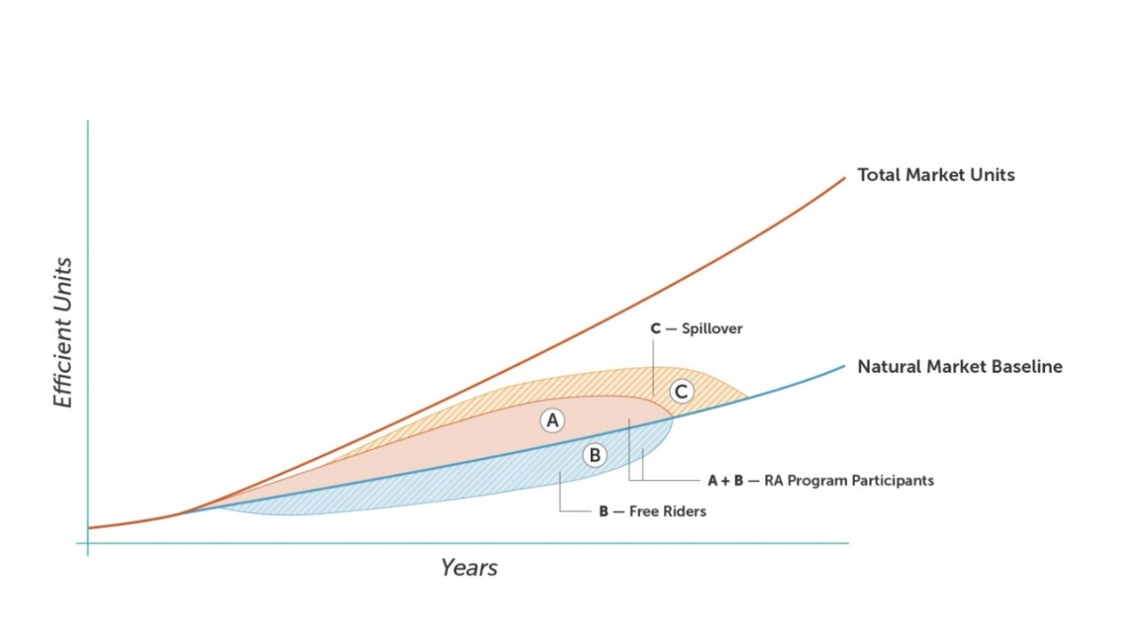
MT and RA Theory Overlay

Slide 6
Option 1: Remove all RA Savings from the MT Savings (Adopted in IL TRM)
Total MT Savings =
[(Total Market Units - Natural Market Baseline Units) *
Savings per unit] –
Verified RA Savings
”Verified RA Savings” are those reported to
the Illinois Commerce Commission – typically
a combination of A, -B, and/or C

Slide 7
Option 2: Meld the RA and MT Frameworks (NEEA practice)
MT Energy Savings Adjusted for RA =
MT Units_{adjustedRA} * UES_{MT}
Where
UES_{MT} = Unit Energy Savings for MT initiative
MT Units_{adjustedRA} = MT Units – RA_{adjustment} Units
Where
MT units = Total Market Units – Natural Market Baseline Units
RA_{adjustment} Units = RA Units * [1 - (Natural Baseline Units/Total Market Units)]

Slide 8
Example
 | IL TRM | NEEA
Given: Total Market Units | 2,000 | 2,000
Given: Natural Market Baseline | 200 | 200
Given: RA Units (Gross) | NA | 700
RA_{Adjusted} Units | NA | 630 (700*(1-(200/2000) = 630
MT Units | 1800 (2,000-200 = 1,800) | 1,370 (2,000-200-630 = 1,170)
Given: Unit Energy Savings (UES) | 150 kWh/yr | 150 kWh/yr
Given: Total RA Savings (kWh/year) | Reported by Utility (using 700 *150 for this example = 105,000) | Not Cal’d by NEEA
TOTAL MT Savings (kWh/yr) | (150*1800) - prior row (example implies 270,000-105,000=165,000) | 175,500 (1370 * 150 = 175,500)

Slide 9
Most important: Collaboration
These are possible functional equations to avoid double counting
Actual MT success will depend on significant collaboration among MT and RA
  The whole can be greater than the sum of the parts!

Slide 10
2
Codes and Standards in the IL TRM

Slide 11
C&S savings for Cost Effectiveness Purposes
Conclusions of Law #28 (p 86):
  “The benefits and costs of activities related to C&S development and implementation should be included in the cost-effectiveness calculations for MTIs where they are logically related.”

Slide 12
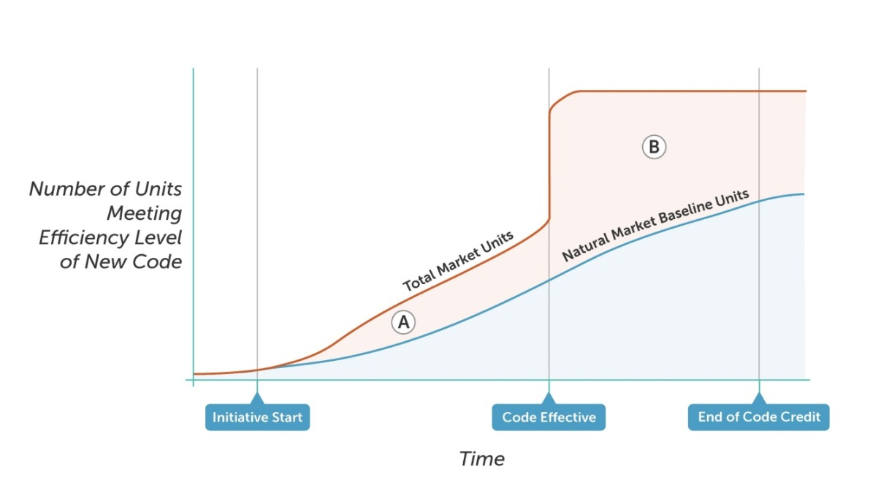
The Effect of Energy Code Adoption

Slide 13
Savings from Enhancing Code Compliance

Slide 14
IL TRM: Savings from C&S and enhanced compliance
C&S can be an integral part of savings goals and accomplishments for an MT initiative in IL
  Enhanced code compliance as well
IL calculation of savings based on standard approaches
Notes:
Thoughts on CA…

Slide 15
Thoughts for CA C&S/RA Savings
Strong C&S adoption (and compliance) infrastructure
  Already exists in CA and works well
MT and C&S should work synergistically
  Coordinate heavily as MT initiatives are crafted
Options for savings/goals,
  Follow ”conclusions of law #28”
  C&S work isn’t in all market segments – so goals/savings go to MT where there isn’t overlap
  Some markets C&S already active
    If MT expands the C&S savings or achieves them earlier, then share the savings

Slide 16
Questions?
Margie Gardner
Mgardner@Resource-Innovations.com

