Slide 1
Status of BayREN Programs During COVID-19 Shelter In Place
Jenny Berg, ABAG/MTC
May 7, 2020

Slide 2
Guiding Principles
BayREN is a regional engine for local economic recovery
Expanding online access will expand our impact
Focus on supporting our contractor workforce and local government capacity

Slide 3
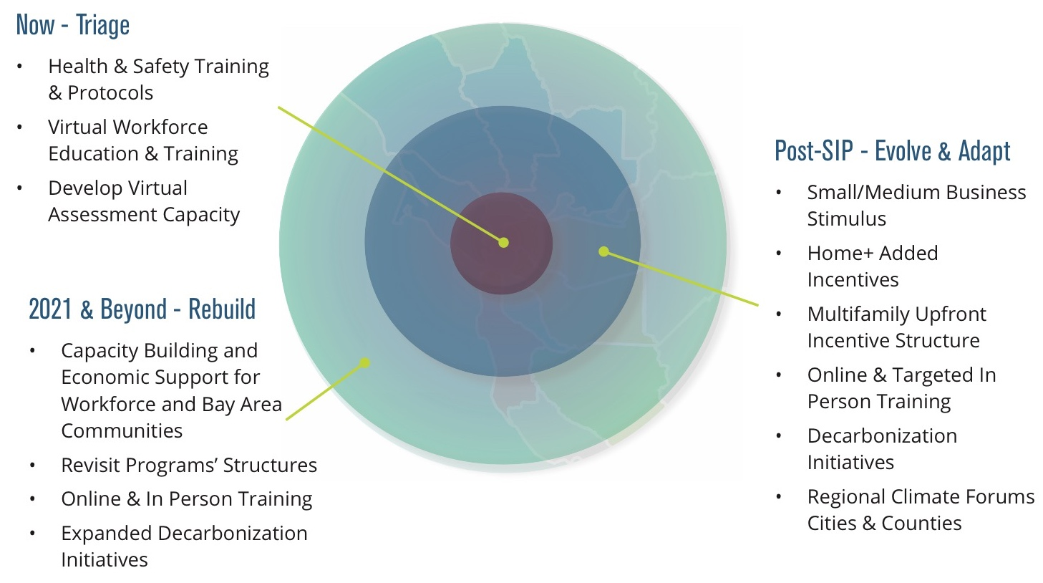
Triage – Evolve & Adapt – Future Focus/Rebuild Stronger

Slide 4
Who We Serve
Small and medium businesses & commercial property owners
Multifamily property owners
Homeowners & Renters
Contractors
City and County Building Department Staff
Building Industry & Real Estate Professionals

Slide 5
Support for our Contactor Workforce
Virtual Training and Education
New Online Learning Portal
New Health and Safety Training

Slide 6
New Program Offerings
For Small and Medium Businesses and Commercial Property Owners
Contactless energy audits
New Health and Safety Equipment Protocols
Online hub for small business resource and links to county economic development offices and centers
Interest-free microloans with 50% cash-match grant (in development)

Slide 7
New Residential Program Offerings Single Family
For Homeowners & Renters
Virtual energy assessments
Increased incentives for contractors
Energy Efficiency Toolkit

Slide 8
New Residential Program Offerings Multifamily
For Multifamily Property Owners
Phased incentive pathway to make 25% of project cost available prior to construction
Health and hygiene best practices for multifamily common areas

Slide 9
Virtual Trainings and Forums – Available Now!
For Contractors
City and County Building Department Staff
Building Industry and Real Estate Professionals

Slide 10
Looking Ahead: BayREN Decarbonization Forum Series to Support Local Government Staff
Goals
Understand how to shift local climate plans and priorities to continue energy efficiency and decarbonization initiatives during COVID-19
Create a space where Bay Area cities and counties can collaborate to support each other and move quickly
Outcomes
Identify the most impactful local decarbonization initiatives that also provide health and economic benefits
Work across jurisdictions to leverage scarce resources and collectively commit to advancing these initiatives

Slide 11
Questions? Jenny Berg jberg@bayareametro.gov 510-384-9087

