Slide 1

Multifamily Finance Program
SoCalREN Stakeholder Webinar

Slide 2
Purpose
This webinar is being held in compliance with D.18-05-041 to seek stakeholder input on SoCalREN’s Implementation Plan for the SoCalREN Multifamily Finance Program scheduled to launch in Q4 2019.

Slide 3
SoCalREN Multifamily Finance Program
Program name: | SoCalREN Multifamily Finance Program
Program type: | Non-Resource
Implementer type: | Third-party
Target sector(s), segment(s): | Multifamily, Residential Sector
Primary intervention strategy: | Downstream
Performance Metrics: | Number of funded financial projects, finance proposals delivered, educational webinars held, and contractor sales webinars held, percent funded DAC financial projects, and attributed energy savings
Projected TRC: | n/a
Program Description:
The Multifamily Finance Program (MFF Program) broadens access to finance for more multifamily property owners/contractors for energy efficiency upgrades by allowing a financial institution partner to modify its underwriting criteria and accept more risk than it would otherwise on qualified projects. The program design incorporates a credit enhancement that will reduce the borrowing rate for the borrower and the design incorporates features that make the program process easy for the borrowers, financial institutions, contractors, and the administrator, therefore, encouraging investments in energy efficiency.

Slide 4
SoCalREN Multifamily Finance Program
Program Delivery and Customers Service Elements
Third Party Implementer will: Perform Marketing, Education and Outreach (ME&O) to support and increase uptake on financing energy efficiency retrofits through the SoCalREN Multifamily Program, including: Education and training on program features, benefits, financial products, finance proposals, eligibility criteria, process from application to financing disbursement and repayment process; Education and training for participating contractors on how to use financing to sell more comprehensive retrofit projects that achieve deeper energy savings; and Leveraging Residential Community Coordinator to attract greater participation from DAC/HTR customers Attract private capital through program enrollment meetings with financial institutions and executing lender agreements triggering enrollment Provide Finance Proposals for all approved projects in the Multifamily Program to property owners and contractors Provide finance product assistance to multifamily property owners to address their energy reduction goals, budget constraints and project timeline Manage credit enhancement account through tracking disbursements and repayments

Slide 5
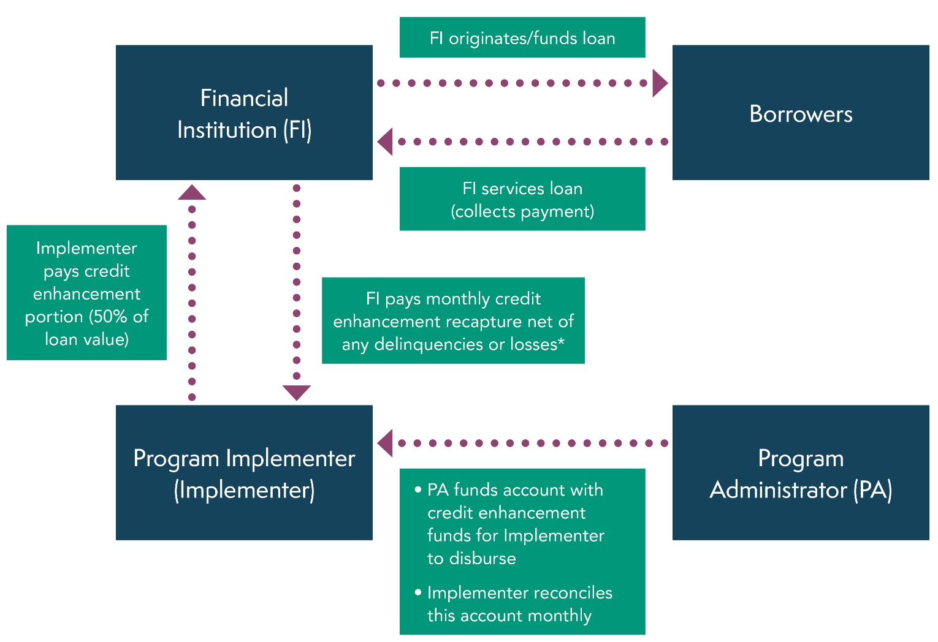
Credit Enhancement Structure
*Delinquent payments subsequently collected by FI will also be transferred to Implementer.
5

Slide 6
SoCalREN Multifamily Finance Program
 | 2020
Total Budget | $950,000
Gross Savings – kWh | n/a
Gross Savings: – kW | n/a
Gross Savings: – Therms | n/a
Notes:
From Implementation Plan

Slide 7
Stakeholder Comments on Draft Multifamily Finance Program Implementation Plan
SoCalREN draft Multifamily Finance program implementation plan has been posted on the California Energy Efficiency Coordinating Committee (CAEECC) website for stakeholder review and can be located at the following link: https://www.caeecc.org/draft-implementation-plans-for-revi
SoCalREN will be accepting comments on these documents until December 5, 2019.
Please send comments regarding any of the draft documents provided to Lujuana Medina at LMedina@isd.lacounty.gov.
7

Slide 8
Questions?
Lujuana Medina
Manager
323.881.3971
LMedina@isd.lacounty.gov
Fernanda Craig
Program Manager
323.265.8106
fcraig@isd.lacounty.gov

