Slide 1
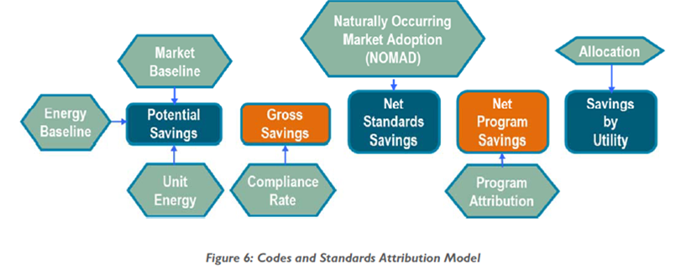
California Codes and Standards Attribution
Codes & Standards Program Advocacy & Attribution Study Final Report (TRC) Accessed:
https://pda.energydataweb.com/api/view/2279/Final%20Report%20CS%20Attribution%20Study%20July%205%202019.pdf

