Slide 1
CAEECC Quarterly Meeting
Full CAEECC Meeting #30
Facilitation Team: Dr. Jonathan Raab and Katie Abrams
September 2, 2021

Slide 2
Agenda
Time | Session | Objectives | Presenter
9:00 | Introductions | Introductions, review of agenda and meeting objectives | Facilitator
9:10 | Session 1A: Important Updates; and CAEECC Planning & Procedures | 3rd Party Solicitation Update Groundrules update Filing Template for Biz Plans/4 Year Applications Topics for next full CAEECC meeting (12/2) including discussion on preparations for February Biz Plans/4 Year Applications | Brandon Sanders (SCE) Facilitator Ely Jacobsohn (CPUC) Facilitator
10:00 | CPUC Commissioner Genevieve Shiroma | Meet & Greet CAEECC Members – opening remarks from the Commissioner, followed by introductions of CAEECC Members | Commissioner Shiroma
10:20 | Session 1B: Important Updates; and CAEECC Planning & Procedures | Equity and Market Support Metrics Working Groups Upcoming two-year evaluation of CAEECC composition and possible invitations for new Members | Facilitator Co-Chairs and Facilitator
10:55 | Break
11:05 | Session 2: Biennial Budget Advice Letters (BBALs): Segmentation | Presentation/discussion of PAs’ approach to Segmentation (including new Equity and Market Support segments); and other key anticipated BBAL issues | Jenny Berg (BayREN), Chris Malotte (SCE), and Rob Bohn (PG&E)
12:10 | Wrap-Up/Next Steps | Summarize accomplishments for day and delineate next steps | Facilitator
12:15 | Adjourn (please complete meeting evaluation asap)

Slide 3
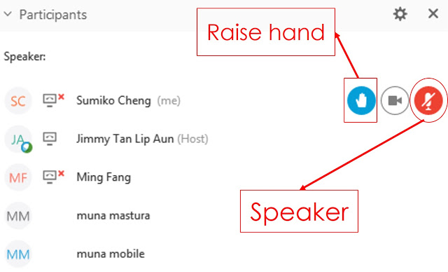
WebEx Technical Reminders
Raise hand to enter queue – then unmute when called upon
Mute when not speaking
Zoom in & out of documents
Members of the Public can provide feedback when invited via Q&A; they will be muted
Image courtesy: Blended Learning

Slide 4
Session 1A: Important Updates; and CAEECC Planning & Procedures

Slide 5
Topics
3rd Party Solicitation Update
Groundrules update
Filing Template for Biz Plans/4 Year Applications
Topics for next full CAEECC meeting (12/2) including discussion on preparations for February Biz Plans/4 Year Applications

Slide 6
third party programs solicitations update
CAEECC Quarterly Meeting
September 2, 2021

Slide 7
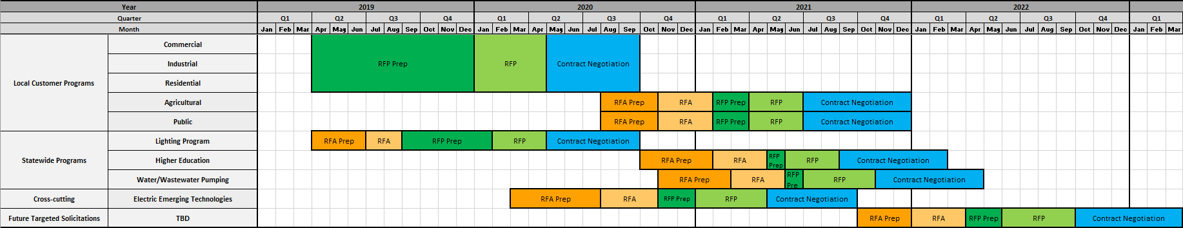
SCE Solicitation Timeline
Today

Slide 8
PG&E Solicitation Timeline
Today

Slide 9
SDG&E Solicitation Timeline
Today

Slide 10
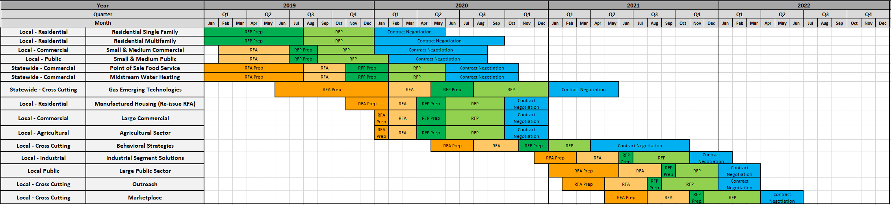
SoCalGas Solicitation Timeline
Today

Slide 11
Groundrules – Summary of Changes since 3/17 full CAEECC Meeting
Prospectus Process Change
  Sections IV.A and VI.A.iv were updated to “specify, on a case-by-case basis, whether the full CAEECC will retain final recommendation-making authority or delegate it to a Working Group, Workshop, or Subcommittee.”
New Enforcement Groundrule on Dispute Communications
  Section IV.E.i was updated as follows: “Members, Co-Chairs, the Facilitation Team and Commission staff are encouraged to document oral conversations about a dispute (once it is raised) in writing to allow for a record of the communications. Information relevant to the dispute shall be shared between the involved parties. [section E.i amended 7/12/2021 per guidance from ED].”
Disclosures
  See next slide
Notes:
Prospectus process change
Sections IV.A and VI.A.iv were updated AFTER the meeting based on discussion and verbal approval of the language you copied/pasted from mtg summary in your email below
A redline showing these changes was posted to the 3/17 mtg page on 5/17
New Enforcement Groundrule on DISPUTE COMMUNICATIONS

Slide 12
New Section E in III. CAEECC Roles and Responsibilities (regarding Disclosures)
  E: CAEECC Working Groups Members
    All Working Group Members
      Both CAEECC and non-CAEECC Working Group Members will adhere to the CAEECC Roles & Responsibilities and Groundrules, as outlined in this document, or as modified specifically for that Working Group
    Non-CAEECC Members Participating in a Working Group
      Disclosures: Non-CAEECC Member organizations participating in a Working Group are required to disclose to the Working Group and the Facilitation Team both a) the entities with whom they are currently doing energy-related business with or for, both currently and within the past year and b) whether they are proposing to represent their own organization or another entity, and if so whom. If new contractual relationships develop during the course of the Working Group, or their representation changes, they will update their disclosures.
  This proposed Groundrule was piloted with the new Metrics Working Groups; it is now being moved for full CAEECC approval

Slide 13
2024-2031 Business Plan Templates
Ely Jacobsohn
CPUC – Energy Division

Slide 14
On Track to Consistent Business Plan Templates
D.21-05-031 Attachment A
PUC Provided guidance on content for 8 Year Business Plans and 4 Year Portfolio Applications
Delegated to CAEECC and ED to collaborate on Templates
Final Attachment A Guidance
CAEECC Stakeholders provided feedback to ED suggesting additional and/or clarification of various elements
Draft Template Status
Data - PAs have offered spreadsheets for 2024-31 Business Plans based on most recent ABAL requirements
PAs used final guidance released by ED on July 15 to iterate on templates among each other and with ED
Narrative - PAs have offered outlines that comprise the information in Attachment A in more streamlined flow
Key Elements
Data – Total System Benefit now required as primary goals metric
Structure - 8 Year Business Plan anticipated to be like Executive Summary with out-year projections, while 4 Year Application will include detailed descriptions, strategies, and expectations with regional and historical context
Expecting Finalized Templates by mid Sept. Sept 31, 2021 is Due Date

Slide 15
Next CAEECC Meeting Potential Topics: 12/2/2021
Final BBAL Filings Debrief?
  Possible discussion on final high-level budgets, cost-effectiveness, and segmentation
Preparations for February Biz Plan/4-year Applications
  Discussion on what CAEECC would like to discuss, in addition to PA segmentation strategies?
Equity and Market Support Metrics Working Group
  Final recommendations/products
  Evaluations
CAEECC Membership Composition Evaluation & Next Steps
Presentation by CalTF and possible other overlapping groups?
2022 CAEECC Workplan, Quarterly Meeting Dates, and Facilitator Contract
CAEECC Meeting Evaluations
Others?

Slide 16
CPUC Commissioner Genevieve Shiroma Meet & Greet

Slide 17
CAEECC Member Organizations
Bay Area Regional Energy Network (BayREN) | IBEW-NECA Labor Management Cooperation Committee | San Diego Gas & Electric (SDGE)
Cal Advocates (CA Public Advocates Office) | Local Government Sustainable Energy Coalition | SF Department of the Environment
California Advanced Lighting Controls Training Program (CALCTP) | Marin Clean Energy (MCE) | Sheet Metal Workers Local 104
California Energy Commission (CEC) | Natural Resources Defense Council (NRDC) | San Joaquin Valley Clean Energy Organization (SJVCEO)
California Efficiency + Demand Management Council (CEDMC) | Pacific Gas & Electric (PGE) | Southern California Gas (SCG)
CodeCycle | Redwood Coast Energy Authority (RCEA) | Southern California Regional Energy Network (SoCalREN)
Center for Sustainable Energy (CSE) | Small Business Utility Advocates (SBUA) | The Energy Coalition
 | Southern California Edison (SCE) | Tri-County Regional Energy Network (3C-REN)

Slide 18
Session 1B: Important Updates; and CAEECC Planning & Procedures

Slide 19
Topics
Equity and Market Support Metrics Working Groups
Upcoming two-year evaluation of CAEECC composition and possible invitations for new Members

Slide 20
Equity & Market Support Metrics WGs: Overview
Charge: Recommend objectives and metrics, plus approach for target-setting, to inform PA filings for the new Equity and Market Support segments
Two separate but parallel Working Groups—one on Equity segment; the other on Market Support segment
4 half-day WG meetings each (plus 1 Equity Workshop): July-September 2021
Report delivered to PAs and CPUC September 2021
Prospectus available at https://www.caeecc.org/6-24-21-full-caeecc-mtg

Slide 21
Equity & Market Support Metrics WGs: Meeting Dates & Tasks
Meeting Dates & Tasks
Meeting/ Workshop | Market Support WG | Equity WG | Tasks
First WG Mtg. | 13-Jul | 15-Jul | -Discuss WG final deliverables, and any assumptions to make WG successful -Review pre-existing Objectives and Metric(s) -Identify gaps in Objectives and Metric(s) -Brainstorm alternatives -Discuss initial priorities
Second WG Mtg. | 12-Aug | 18-Aug | -Flesh out Objectives and Metric(s) -Identify options in cases where consensus is not reached
Equity Workshop | NA | 31-Aug | -Solicit ideas from stakeholders to inform equity segment objectives and metrics”
Third WG Mtg. | 9-Sep | 14-Sep | -Refine Objectives & Metric(s) -Seek consensus on Objectives and Metrics -Discuss the basis PAs should use in setting Targets for Metrics in their filings
Final WG Mtg. | 21-Sep | 29-Sep | -Finalize recommendations document -Strive for consensus & record supporters of options where consensus is not reached
Notes:
Note that mtgs will be virtual, and 9-approx. 1pm

Slide 22
Market Support Metrics WG – Progress Update
Objectives are largely agreed-upon (will continue to refine Objectives if need be); working now on key Associated Metrics
Sub-WG on key associated Metrics meeting multiple times between 2nd and 3rd meetings to:
  Discuss guidelines for using metrics
  Review proposals from sub-WG members on key associated Metrics
  Make recommendations to full WG by 9/9 meeting
Next full MSMWG meeting on 9/9

Slide 23
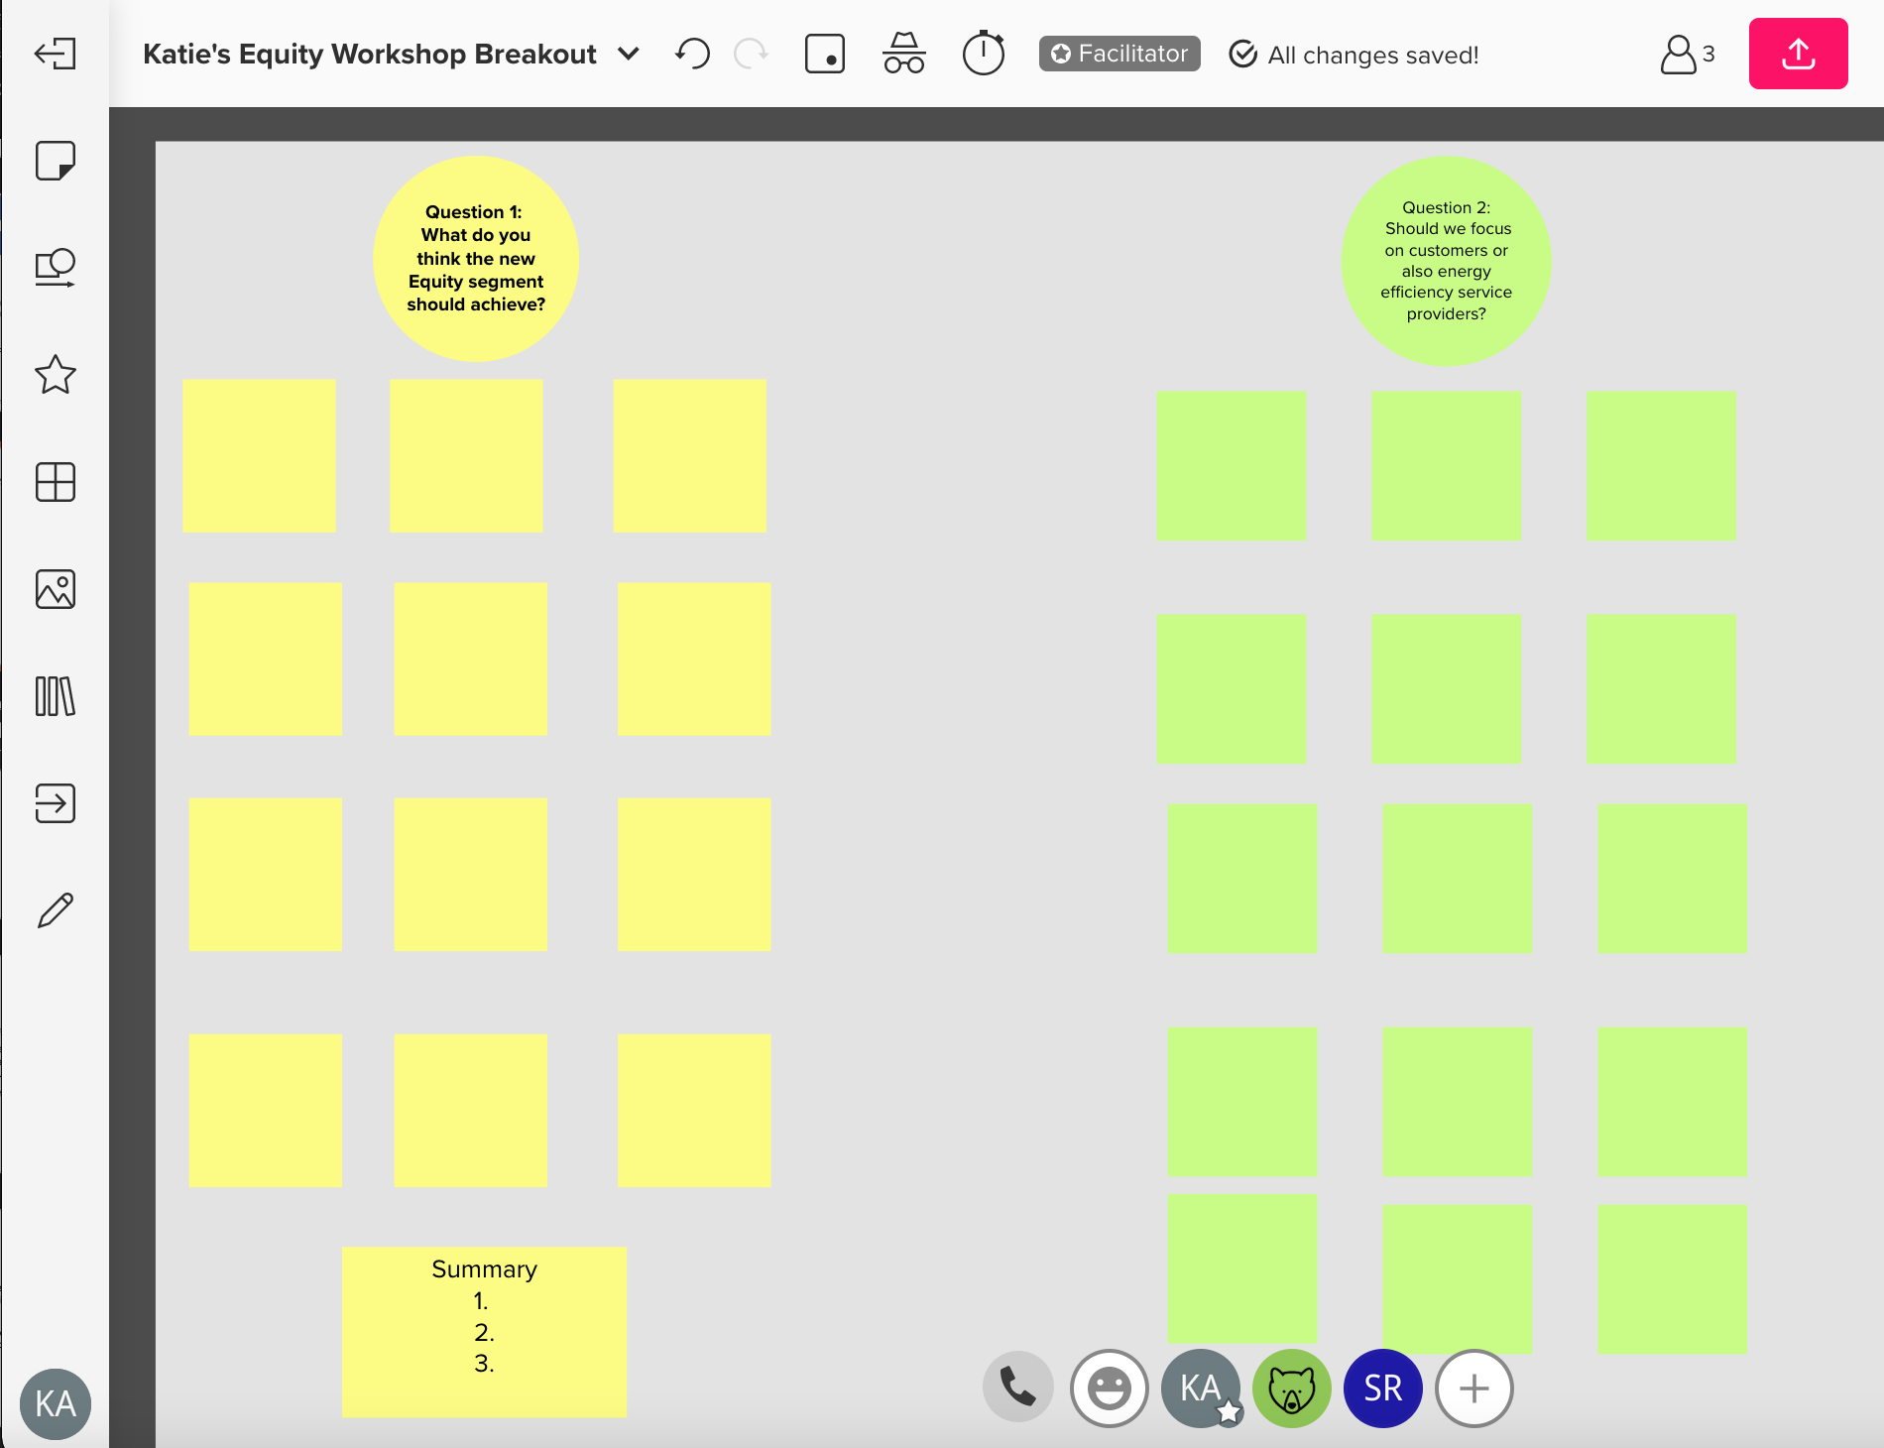
Equity Metrics WG – Progress Update
Workshop 8/31 aimed at gathering stakeholder input
  Used Mural (virtual ”sticky notes”)
  Approx. 130 registrants
Sub-WG to flesh out Objective(s) and key associated Metrics for full WG’s consideration
Next full EMWG meeting on 9/14

Slide 24
Upcoming two-year evaluation of CAEECC composition and possible invitations for new Members
Per CAEECC Membership: Criteria and Process: Process for Adding a New Member Organization: Groundrule 7: “Periodically (i.e., every other year) the CAEECC should consider whether important broad stakeholder clusters are missing from current CAEECC make-up—e.g., an organization specializing in social justice issues”
Scope & Approach:
  What types of organizations are currently missing or underrepresented?
  How could we attract additional participants not represented?
  Does it make sense for the Facilitation Team to lead this effort alone? If not, who?
  Other process suggestions?

Slide 25

Break

Slide 26
Session 2: Biennial Budget Advice Letters (BBALs): Segmentation
Presentation/discussion of PAs approach to Segmentation; and other key anticipated BBAL issues

Slide 27
Energy Efficiency BBAL Market Support and Equity
Segmentation Considerations
August 2021

Slide 28
Program Segmentation Sorting
Took existing programs and sorted into buckets of:
Resource Acquisition
Statewide
Local 3P
Local SCE run
Market Support
Equity
Codes and Standards
Other
AB841
Market Transformation

Slide 29
Equity and Market Support Offerings
Considerations
2022 & 2023 Budget Commitments
  AB841
  Statewide Programs from IOUs
  Local 3rd Party Programs
Evaluate and determine Portfolio Gaps
  Market Support
  Equity
    Residential – Middle Income (Area Median Income (AMI))
    Commercial – Small/Medium
Pursue portfolio gaps that contribute to EE objectives or market support & Equity while balancing opportunities, impact and effort
Additional Program Delivery Considerations
  Go-to-market approach
  Ramp-up plan

Slide 30
Presentation to CAEECC
Segmentation of Residential Programs
September 2, 2021

Slide 31
How will BayREN Segment programs? TBD
Resource
SM/Med Business
Other?
Market Support
Codes & Standards
Equity
BAMBE
Other?
Green Labeling
Other
Home+
WU$ave?
Business Finance (MAF?)
“REN’s, by their nature and primary purpose, are more likely to have a greater share of their portfolio devoted to market support and/or equity programs.”

Slide 32
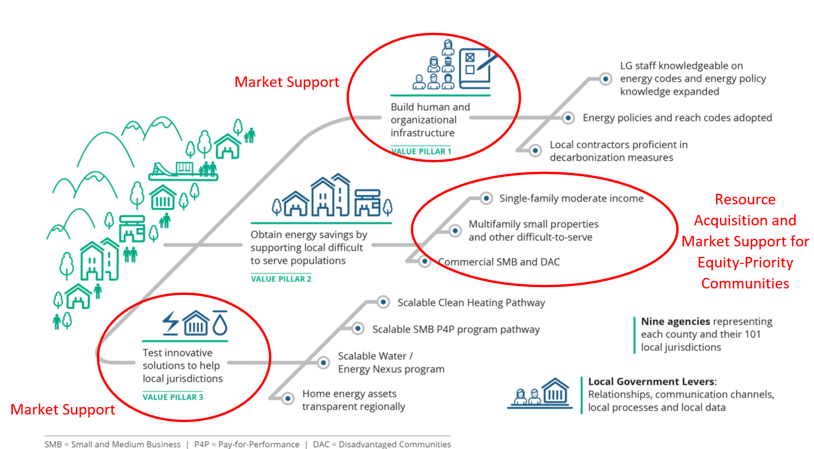
BayREN Programs Cut Across CPUC Segments
Even before D.21-05-031, BayREN focused on resource acquisition, market support and equity

Slide 33
BayREN’s Vision and Definition of Equity
BayREN Vision 2025.
By 2025, BayREN’s organization, resources and programs will evolve to more intentionally integrate equity, while filling gaps and addressing barriers to energy efficiency and electrification, as an essential part of meeting State climate and energy goals.
BayREN Equity Definition.
For BayREN, equity means addressing systemic barriers to energy efficiency and electrification, especially for, and in collaboration with, equity priority communities and those who disproportionately face energy burdens, climate impacts, and are underrepresented in policy and decision-making.
Even for non-equity programs, asking programs to reflect on BayREN equity principles.

Slide 34
Residential (Multifamily)
Targets underserved audience. Targets local difficult to serve audiences within MF including buildings
Resource acquisition goals.
Energy goals within common areas and tenant units.
Equity oriented activities. Specific activities to serve equity priority communities
Focused on underserved groups and equity offering, but clear resource acquisition goals
Are small ( <100 units)
Have a resident ownership structure, such as a Homeowners Association or co-operative
Are a deed-restricted or naturally-occurring affordable property
Are located within a DAC (The proxy for DAC are AB 1550 communities and based on address/zip code)
Wholistic approaches to sustainability in multifamily buildings (by working with Green Business, Counties that also work on recycling, water conservation, etc.)
The opportunity to improve the landlord-tenant dynamic
Structural improvements (non-ee) necessary to advance energy efficiency
Community health for vulnerable communities

Slide 35

Residential (Single Family) – Home+
Program with elements of resource acquisition, market support and equity
Targets underserved audience. Targets low and moderate-income with resource acquisition and market support offerings
Market support activities outside of resource acquisition goals. Provides Energy Advisor services, the impacts of which are mostly outside of the Home+ program
Equity oriented activities.
Resource acquisition goals. Energy goals and targeted measures
Green House calls
Moderate income tiered rebate
Landlord assistance for renters; focus on replacement
Outreach in language and long-term partnerships with CBOs that work with ESL populations

Slide 36
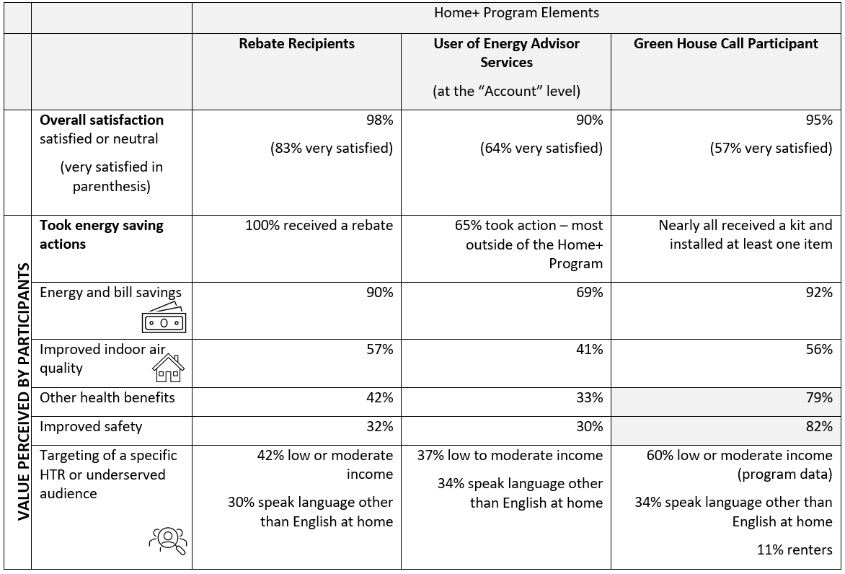
Residential Home+ evaluation data showing value
Clear value of both equity and market support elements

Slide 37
Residential – Green Labeling
Market support program - focused on new program design with the potential to scale without long-term investments from CPUC funds
Integrates equity at an implementation level
Accessibility
Translation of materials
Assessors who speak other languages
Problem: Energy efficiency information is lacking around major residential decision points, such as home buying or renovations
Solution 1: Promote energy efficiency labeling
Assess program through Equity Discussion Guide
Affordability
Tier rebates based on income
Accountability
Develop and track equity metrics
Solution 2: Train realtors on EE so they can educate and provide resources to clients
Health
Train realtors on healthy housing benefits of energy efficiency upgrades
Community Vibrance
Incorporate equity into all real estate trainings
Just Transition
Focus new assessor enrollment on minority and women-owned businesses
Market Support Program

Slide 38
Questions?
Jenny Berg jberg@bayareametro.gov

Slide 39
PG&E Preliminary Portfolio Segmentation Strategy
September 2, 2021

Slide 40


PG&E’s Approach to Segmentation
PG&E recognizes the importance of the new EE paradigm created by portfolio segmentation and embraces the opportunity to align EE program objectives with policy objectives.
Portfolio segments can help us go beyond the short-term delivery of cost-effective energy savings and better serve our triple bottom line of people, planet, and California’s prosperity.

Slide 41



Preliminary PG&E Segmentation Strategy
Resource Acquisition
Default categorization for PG&E’s programs, including most of the newly solicited resource programs. For a program to be categorized outside of RA, it must have a strong case for meeting the equity or market support definition.
Equity
Programs that support underserved populations, including residential customers and small & micro businesses.
Programs under consideration: Targeted Small & Microbusiness, Building decarb support for Low-to-Moderate Income Residential customers
Market Support
Programs in which the primary objectives are to contribute to the long-term success of the broader energy efficiency market, including education and training, building partnerships, and accelerating adoption of emerging technologies or code. These programs have a broader impact on market than just at the sites of intervention.
Programs under consideration: Emerging Technologies, WE&T, New Construction, Local Government Partnerships
Codes and Standards
All activities that directly support building codes and appliance standards, including both advocacy programs and non-advocacy programs such as reach codes, code readiness, and code compliance.

Slide 42


A brief case for NC in market support
How the SW New Construction programs meet the Market Support definition
The primary objective of the new construction programs is to support the long-term success of the EE new construction market by:
  providing EE design assistance to promote the early adoption of future code elements to make long-term changes to standard practices in the new construction market
  building partnerships and educating new construction market actors
  accelerating adoption of advanced EE technologies
  driving decarbonization through IDSM
The programs were solicited in the pre-market support segment paradigm and the implementers designed the programs to maximize cost effectiveness, HOWEVER, the primary objective of the programs has always been market support.
Why it’s strategically important to have New Construction in Market Support
Allows implementers to prioritize market support activities over delivering cost-effective energy savings.
Better support aggressive building codes in future code cycles.

Slide 43
Segmentation Discussion Questions
Do you agree with, and have any specific feedback on the segmentation approaches proposed by SCE, BayREN, and PG&E, respectively?
PG&E Suggested Discussion Questions:
  Which segment does EM&V belong in? If multiple, how should these costs be allocated in PA budget advice letters?
  What do stakeholders expect to see in the 2022-2023 budget advice letters in terms of program segmentation justification?
  What do stakeholders expect to see in the 2024-2031 EE portfolio applications in terms of program segmentation justification?

Slide 44
Wrap Up & Next Steps

Slide 45
6/24 Full CAEECC Meeting Evaluation Survey Results
Question | Avg. Score
Objectives of the meeting were clearly articulated on the agenda | 5.0
Objectives of the meeting were accomplished | 5.0
Presentations and background documents were clear and helpful | 5.2
Program administrators (PAs) were responsive to stakeholder input, where applicable | 4.8
CAEECC Members (including PAs) were flexible in seeking outcomes that were potentially mutually agreeable, where applicable | 4.9
The facilitators were effective in running the meeting (e.g., fostering a constructive and efficient forum, being impartial, and making sure no one dominated discussions) | 5.2
Overall, the online meeting format (WebEx) was smooth and effective | 5.3
Overall, this Full CAEECC meeting was successful | 5.1
Notes
1) Scores are 1-6 scale, where 1 is "strongly disagree" and 6 is "strongly agree” ; and 3.5 is mid-point of 1-6 scale
2) Scores based on responses from 11 members
3) Facilitation Team and Co-Chairs reviewed and debriefed comments from respondents

Slide 46
9/2 Meeting Evaluation
See email from Susan Rivo
Please complete today! (no later than September 9th, 2021)

