Slide 1
High-level Summary of CAEECC Stakeholder Process Evaluation
Facilitator: Dr. Jonathan Raab, Raab Associates
CAEECC Meeting #21
June 10, 2019
The Energy Coalition, PacMutual Building, 523 W 6th Street,
1st Floor Historic Conference Room, Los Angeles

Slide 2
Impetus & Methodology
D. 18-05-041- Facilitation Team tasked w/assessing level of collaboration w/in CAEECC, and make process/structural recommendations
Findings and Recommendations are based on:
  Post meeting surveys: quantitative & qualitative; instituted halfway thru (8/18) evaluation period
  Recent verbal interviews with each CAEECC Member
  Facilitation Team’s observations and experience

Slide 3
Six Full CAEECC Meetings Held in 2018-2019

Slide 4
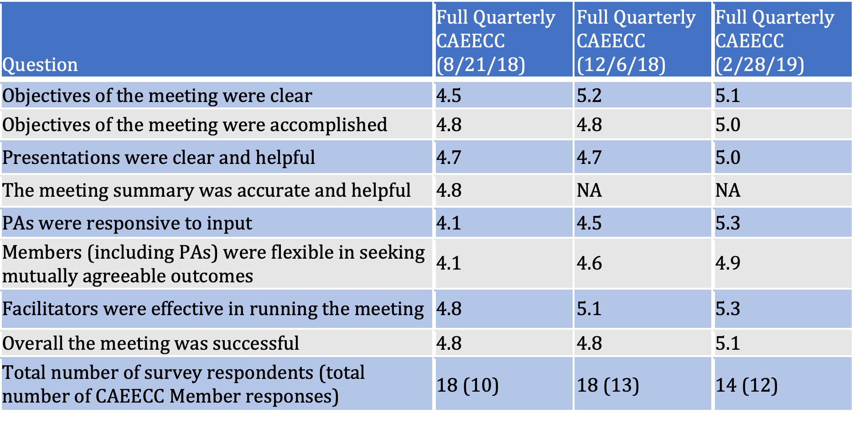
Full CAEECC Meetings-Post-Meeting Evaluation Surveys
Notes:
The “overall success” of these meetings ranged from 4.8 to 5.1. The lowest scores recorded (scores of 4.1) were for the August 21, 2018, meeting on the Annual Budget Advice Letters (ABALs) and applied to questions on: 1) PAs responsiveness to input, and 2) Members’ flexibility in seeking mutually agreeable outcomes.

Slide 5
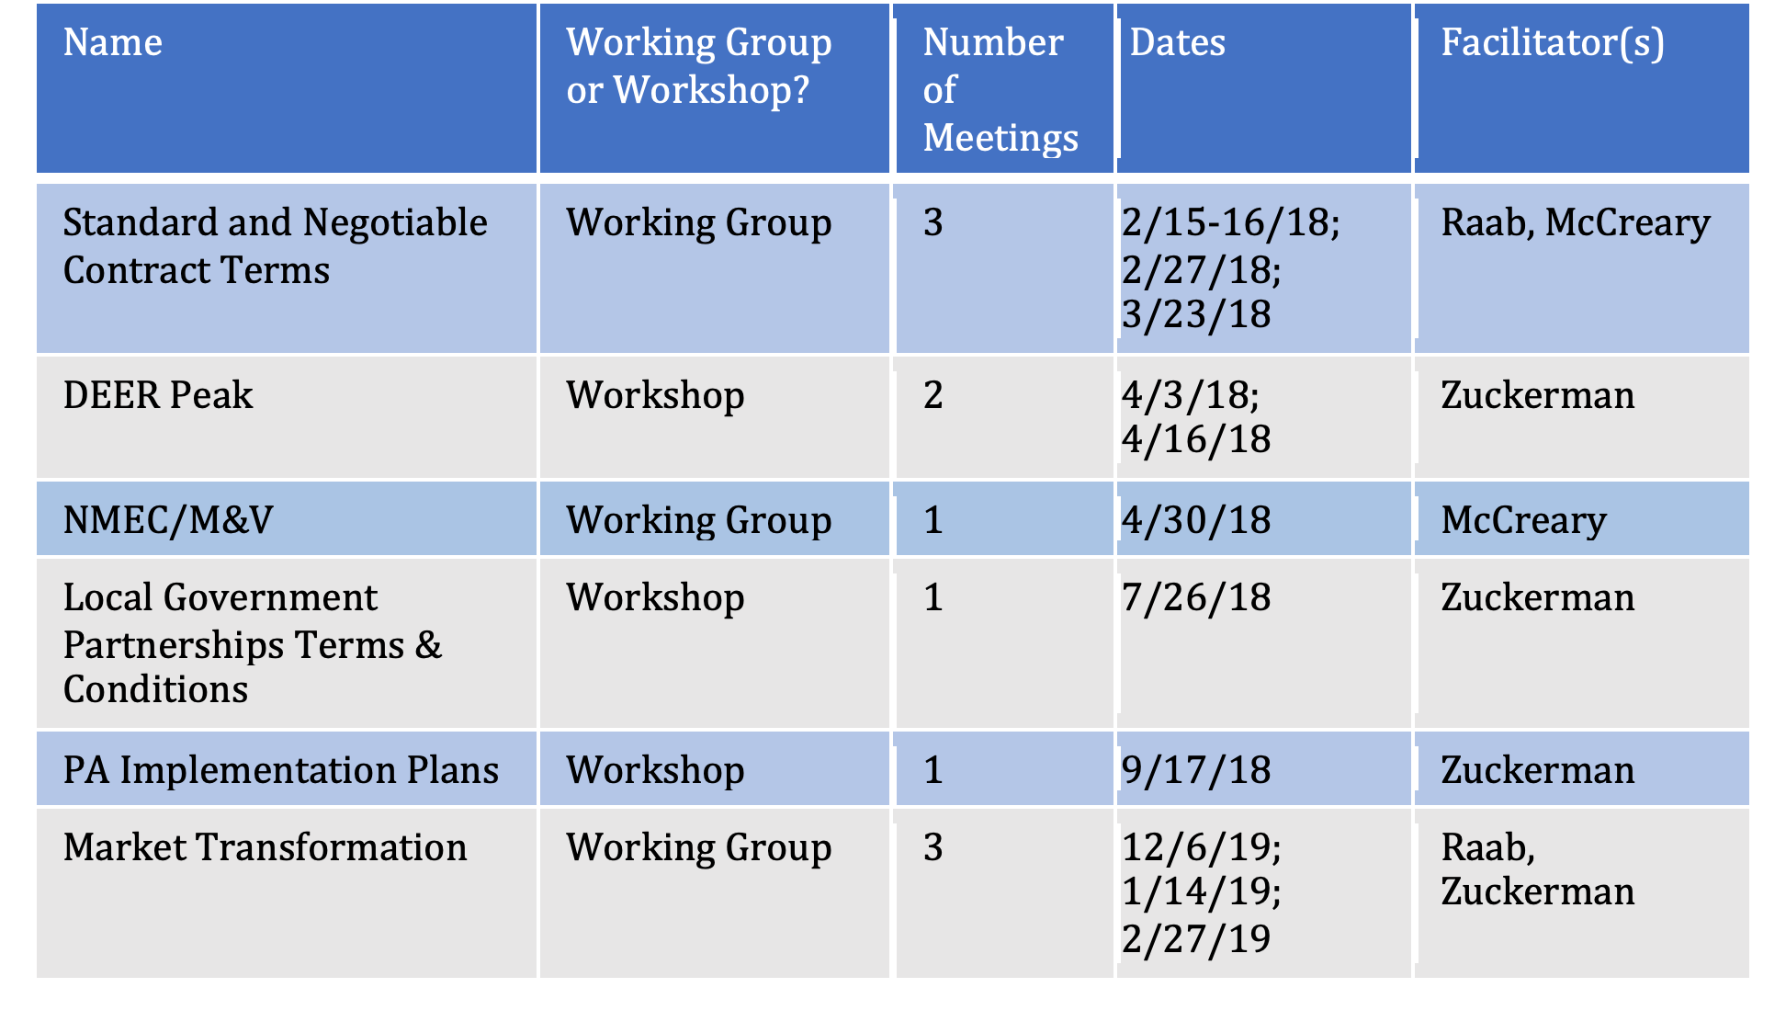
Six CAEECC-Hosted Working Groups and Workshops (11 Mtgs.)

Slide 6
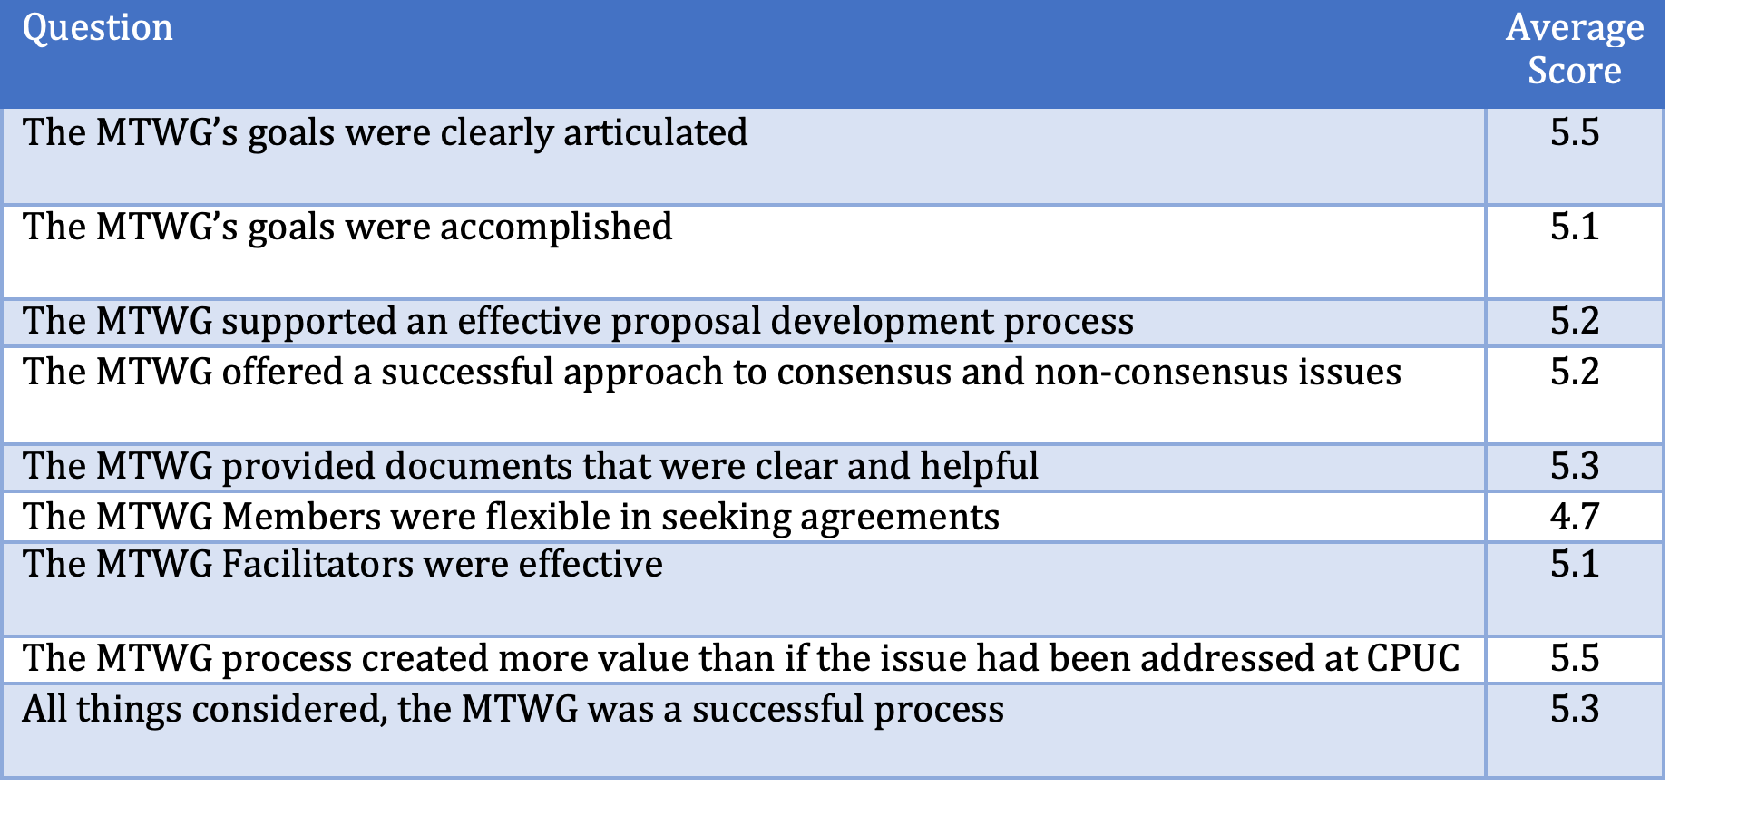
Average Score of MTWG Questions

Slide 7
Facilitation Team:
Findings

Slide 8
Findings: Overall Success, Challenges, and Value Added
CAEECC meetings/processes generally successful (4.8-5.5 on scale of 1-6)
Meetings/processes structured as joint problem solving (MTWG, DEER Peak) most successful. Those structured in a sounding board fashion (Full CAEECC ABALs, Contract T&Cs) had more mixed success
Highest CAEECC value add – developing recommendations on cross-cutting policy and implementation issues
Deliberations provided more value on certain issues than had they remained at CPUC—better equipped to explore/develop mutually agreeable solutions

Slide 9
Findings: CAEECC Collaboration
PAs Responsiveness
  Generally high, for “active listening” although it can vary by individual PA (style) or issue (contentiousness of the issue).
  More mixed for “making changes” with willingness to correct factual errors or make changes that they agreed to, but often facing time or policy constraints or significant differences of opinion.

Slide 10
Findings: CAEECC Collaboration
Members Flexibility
  Greater on CAEECC undertakings intentionally structured to seek mutually agreeable outcomes
  More partisan and less flexible for the CAEECC undertakings which were structured more as sounding boards

Slide 11
Findings: Agenda Setting
Members want more flexibility and agency in topic selection
Members also want:
  (1) confirmation on CAEECC venue and strategy;
  (2) clearer goals for each topic (i.e., education, structured feedback, or consensus-seeking/recommendations); and
  (3) more time for public comment

Slide 12
Findings: Member engagement and facilitation
Member participation has been robust overall
Timely posting and Facilitation Team review is beneficial
Member feedback could be more timely
Facilitation Team effectiveness and fairness rated highly in evaluations and interviews by nearly all

Slide 13
Facilitation Team: Recommendations

Slide 14
Recommendations: ED/CPUC; CAEECC Members; & Facilitators
Identify appropriate cross-cutting policy and implementation issues for CAEECC
Be more deliberate about end-goals (consensus recommendations, structured feedback, education), appropriate CAEECC meeting type (Full CAEEC, Working Group, or Workshop), and process structure
Seek earlier non-PA input and allow for more joint problem solving before PA filings

Slide 15
Recommendations: Energy Division/CPUC
Consider allowing CAEECC to tackle topics without need for CPUC white paper or proposed solution
Consider under what circumstances certain issues of broad CAEECC interest could be pursued without Energy Division pre-approval

Slide 16
Recommendations:
Facilitation Team
Confirm new Working Groups/Workshops with Members and seek feedback on timing and strategy
Continue to solicit potential topics/feedback on draft agendas from CAEECC
Allocate enough time in agendas for discussion and for public comment

Slide 17
Recommendations: CAAEECC Members
Improve responsiveness on Facilitation Team/Co-Chair requests for feedback and input on draft agendas, post-meeting online surveys, etc.

Slide 18
Other Potential Improvements: Mentioned by Members
Reviewing CAEECC membership criteria for new and existing Members;
Refining document review time and time needed for each meeting; and
Other structural issues related to when it might be appropriate for CAEECC to have access to technical expertise, or for the CPUC to take on issues directly, with professional facilitation support

Slide 19
Proposed Next Steps
Today--Respond to CAEECC questions, and get initial feedback on findings/recommendations
Facilitation Team available to discuss findings/recommendations with CPUC
Work with Co-Chairs and ED to develop any recommended changes with CAEECC input
Seek approval by ED and/or CAEECC as appropriate

