Slide 1
Overview of SCE’s Annual Budget Advice Letter for Program Year 2021
August 6, 2020
Presented By:
Tory Weber, SCE EE Portfolio Principal Manager
DRAFT-SUBJECT TO CHANGE

Slide 2
Discussion Topics
Objectives and Schedule
Portfolio Cost Effectiveness and Key Drivers
Third-Party Expected Results
Third-Party Update and Transition
Portfolio Changes
COVID-19 Impacts

Slide 3
2021 ABAL Objectives
Meet ABAL approval requirements (D.18-05-041)
Meet energy savings and demand reduction goals​
Total Resource Cost (TRC) must be >1.0 thru 2022, then >1.25​
Stay within authorized budget​
Include statewide programs​
Meet third-party contract requirements (D.18-01-004)
25% by 9/30/20
40% by 12/31/20
60% by 12/31/22
Reflect budget and schedule for new programs from local and statewide solicitations
1. Current SCE Programs
- Resource programs
- Non-resource programs
2. Future SCE Programs
- Local 3rd Party Solicitations
- SCE-led Statewide
3. Statewide Programs (Non-SCE Lead)
- Fixed % of Costs
- SCE admin costs
4. Other Costs
- EM&V - SWME&O

Slide 4
Schedule
Because of the timing gap between ABAL filing and third-party contract execution, budget and savings details will be provided in a supplemental filing.
SCE is currently negotiating contracts with Residential, Commercial, and Industrial (RCI) and SW Lighting third-parties
25% of the portfolio will be contracted by 9/30/20 per mandate
Third-party budget and savings values were spread equally across RCI in order to maintain confidentiality prior to contract execution
Actual contracted values will be reported in Supplemental filed in Q4 2020*
Key Dates
Residential, Commercial, Industrial (RCI) and
SW Lighting Contracted
ABAL Supplemental
CAECC Mtg
ABAL Due
8/6
9/1
9/30
Q4
2020
3rd Party Contracting
Contract Advice Letter Filings
*SCE does not expect this to reopen the protest period

Slide 5
Summary of Key Metrics
SCE’s 2021 ABAL meets requirements for cost effectiveness, budget, and savings goals achievement.
 | 2021 ABAL | Meets ABAL Requirement?
Cost-effectiveness* (TRC) | 1.22 | ✓
Budget Authorized Budget Cap | $222.3 million¹ $266.8 million | ✓
Forecast Savings (kWh) Savings as % of CPUC Goal² Forecast Savings (kW) Savings as % of CPUC Goal² | 336 million kWh 141% 69,000 kW 159% | ✓
¹ Excludes EM&V funding allocated to SoCalREN and 3CREN
² Excludes Codes & Standards

Slide 6
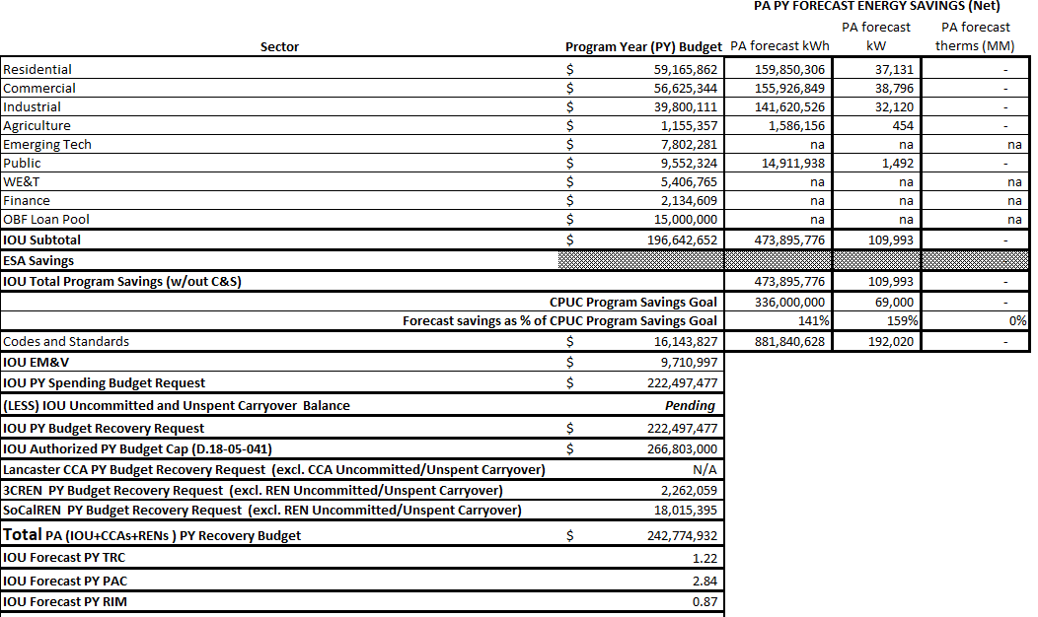
2021 Budget & Cost-Effectiveness
CPUC Savings goals from Decision Adopting Energy Efficiency Goals for 2020-2030
Excludes ESA savings
Projected savings and cost effectiveness from CEDARS; excludes Market Effects
Cost effectiveness excludes codes and standards
IOU EM&V includes RENs’ EM&V

Slide 7
3rd Parties are a Key Driver of Cost-Effectiveness
83% of portfolio benefits are from expected RCI* and Statewide proposals
Information is draft and subject to change
SCE will stay in the market until after Third-Parties ramp up
Portfolio Benefits - Without Codes & Standards
*
*denotes Residential, Commercial, Industrial sectors

Slide 8
2021 Cost Effectiveness Details
TRC Benefits and Costs Comparison
Notes
RCI* benefits and costs are grouped to ensure confidentiality of negotiations with third-parties
RCI and SW programs are the drivers of cost effectiveness
Third-party benefit and cost details for RCI and SW programs will be provided in the supplemental filing
Not shown:
Statewide ME&O
Codes & Standards
Pension & Benefits
CCA/REN
Energy Savings Assistance ESA)
*
*Denotes Residential, Commercial, Industrial sectors

Slide 9
Proposed Program Closures
SCE proposes to close the programs listed below.
Close Immediately
Multifamily EE Rebate Program
Not cost effective
Third-party programs expected to fill gap from closure
Agriculture Energy Advisor
(includes Pump Test Sub-Program)
Energy Leadership Partnership Strategic Support
Closed to New Enrollments, but Continue to Process Customer Commitments
Primary and Fabricated Metals
Not cost effective
No new enrollments accepted after 2020
Third-party programs expected to fill gap from closure
Nonmetallic Minerals and Products
Comprehensive Petroleum Refining

Slide 10
Proposed to Close after Transition to Third-Parties
These programs will remain open until suitable 3rd party replacements are in market
Ramp up/wind down timing uncertainties may affect budget and schedules during the transition period.
To account for ramp up, SCE budgeted for existing programs to the end of Q1 2021.
2020
2021
2022+
Transition to 3rd Party Proposed Designed and Delivered Programs
Plug Load Appliance Program
SW Plug Load Appliance
Residential New Construction
SW New Construction
Savings By Design
Non-Residential HVAC
SW Residential/Commercial HVAC
Commercial Deemed Incentives
SCE Local 3rd Party
Industrial Calculated EE
Industrial Deemed EE
Midstream Point of Purchase
SCE-Led SW Lighting

Slide 11
SCE-led Statewide Programs
SCE is the statewide lead for the programs listed below
SW Lighting is anticipated to launch in May 2021
The remaining SW programs will launch in 2022
Statewide Program | 2021 Program Budget (Total for all contributing IOUs) $ millions | Expected or Actual Launch Date | Percent Electric | Combined (Electric & Gas) Proportional Contribution per Load-Share (Target share. Actual funding may be within +/- 20%)
 |  |  |  | SCE | PG&E | SDG&E | SCG
Water/Wastewater Pumping | $15.9 | Sep 2022 | 80% | 32.1% | 45.6% | 14.0% | 8.4%
Lighting (Upstream) | $36.0 | May 2021 | 100% | 40.1% | 44.4% | 15.5% | 0.0%
ETP, all electric | $53.7 | Apr 2022 | 100% | 40.1% | 44.4% | 15.5% | 0.0%
Institutional Partnerships UC/CSU/CCC | $12.0 | Sep 2022 | 80% | 32.8% | 45.6% | 14.0% | 8.4%

Slide 12
COVID-19 Impacts
Commission acknowledged forecasting uncertainties in 7/3/20 Scoping Memo (R.13-11-005)
Difficult to estimate the COVID-19 impacts on the final 2020 results and to separate participation impacts of COVID from other recent trends in energy efficiency
SCE’s 2021 forecasts of budget and savings estimates reflect the best available information from both market participants and SCE
2021
2020
Engaged with Energy Division since March to ensure safety and continuity of services
SCE lifted suspension of activities on 5/29
Implemented virtual inspections and virtual workshops
Continue mitigation strategies as advised by state and federal authorities
Closely monitor impacts
Third-parties may account for impacts in proposals
Pay-for-performance third-party contracts mitigate potential downside risk to cost effectiveness
Fund-shift as needed to mitigate portfolio risks

Slide 13
Anticipated Changes from 8/6 to 9/1 Filing
Incorporate feedback from today’s presentation
Continue to make adjustments based on best available information from contract negotiations, including non-SCE statewide programs
Minor adjustments to measures and programs within the portfolio from further optimization
May revise program closure list
All budget and savings inputs may be changed during the final quality control and review process before final filing
Edits to draft Advice letter language to reflect aforementioned changes and other reviews
EM&V budgets may change based on final inputs

Slide 14
QUESTIONS? FEEDBACK?

Slide 15
APPENDIX

Slide 16
Third Party Solicitation Update
SCE will inform the Energy Division when SCE has contracted at least 25% third-party by 9/30 and 40% third-party by 12/31/2020.
Solicitation | Update
Residential, Commercial, Industrial | Currently in negotiations; contracts signed by 9/30/20
SW Lighting | Currently in negotiations; contracts signed by 9/30/20
Public/Agriculture | Contracts anticipated end of 2021. Existing programs to remain for 2021
SW Higher Education SW Water/Wastewater Pumping SW Emerging Technologies | Contracts anticipated end of 2021 into early 2022
Refer to the CAEECC website for solicitation schedule details:
https://www.caeecc.org/third-party-solicitation-process
Note: solicitation schedules are subject to change

Slide 17
2021 ABAL Budget vs. 2021 Claims
Savings and Expenditures from pre-2021 expected to be claimed in 2021.
Notes
Program Year
2021 ABAL
Filed Sept. 2020
Program Year
2021 EE
Annual Report
Filed May 2022
The ABAL focuses on expenditures for a given year, the EE Annual Report is focused on savings for a given year
2021 ABAL budget request of $222.5 million reflects expenditures in 2021 with savings that will be claimed in 2021 and beyond
EE Annual Report provides a retrospective on performance
Future Commitments & Expenditures
Expenditures in 2021 with savings expected to be claimed in 2022 and beyond
2021 Commitments & Expenditures
Expenditures in 2021 with savings expected to be claimed in 2021
Past Commitments Realized
Savings from previous years’ expenditures claimed in 2021

Slide 18
What is Total Resource Cost (TRC)?
TRC determines portfolio cost effectiveness.
TRC Calculation
Total Resource Benefits
Avoided Costs
Environmental Benefits (GHG)
TRC
=
Administration
Capital Cost (to customer and utility)
Increased Supply Cost
Total Resource Costs
All costs and benefits are evaluated on a “net” basis, which means the effects of free ridership are removed
Free ridership is considered actions taken independent of the utility’s intervention; in other words, benefits that would have occurred naturally had the utility NOT intervened
TRC >= to 1.0 indicates cost effectiveness

