Slide 1
Integrating Market Transformation and
Codes and Standards - NW Approach
September 15, 2020

Slide 2
NW C&S Overview
NEEA responsible for supporting majority of C&S work in NW; additional support from states, BPA and NW Power Council
NEEA C&S is both a stand-alone business unit and core MT activity within MTIs
C&S functions very similar to Cal C&S including:
  Code development, support, training, and compliance measurement at state and national level
  Standards support at state and National levels
  Emphasis on technical and data analysis
  Includes support for development of testing protocols and other intermediate related functions
C&S has logic models for New Construction (Comm & Res) that dovetails with a Logic Model for NC MT activities
Notes:
NW and California C&S have long-standing collaboration on C&S activities
NW Utilities primarily involved in legislative / administrative advocacy

Slide 3
NEEA’s Codes Work
Development
National model codes (IECC, 90.1)
Above-code new construction voluntary programs
State code adoption
Training, education and technical support
Codes impact assessment
Codes compliance evaluation
3 ©NEEA 2019
Notes:
The goals are two parts:
1. Support regional efforts to enhance energy codes and lock-in market transformational measures in residential and commercial buildings
2. Develop new test rating method to truly measure energy savings in the field
2021 IECC: We are working on several codes change proposals that we plan to submit by January 2019 deadline.
State code adoption: WA residential code, Idaho and Montana’s reviews on 2018 IECC.
Training, education and technical support: continue to provide in-person, online and target trainings. Will unveil the new WA commercial code online portal to replace the static compliance spreadsheet.
New test rating methods will focus on the lab and field tests. Partnership with California, Pacific Coast Collaborative and Canada Standards Association.

Slide 4
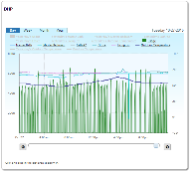
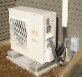
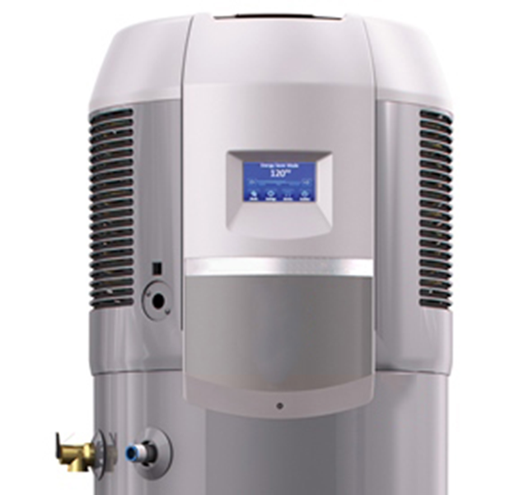
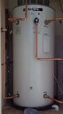
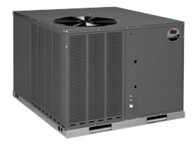
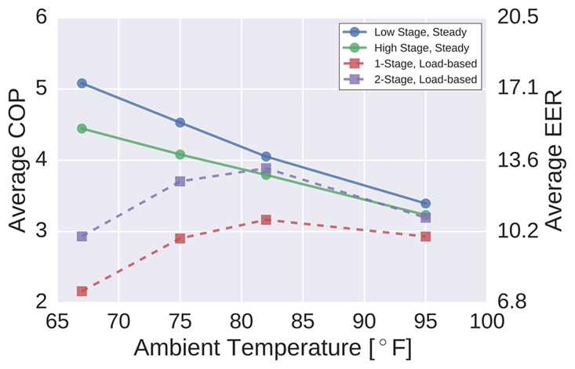
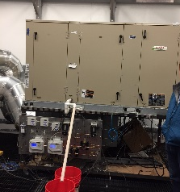
NEEA’s Standards Work (Examples)
Air-to-Air Heat Pumps
New test & rating procedure with CSA
Load-based testing under system controls
New rating procedure – SCOP_{C} & SCOP_{H}
Ratings in 8 climate zones
Applications annex
Gas Furnaces and Boilers
New test & rating procedure with CSA
P.2 Residential
P.8 Commercial package gas furnaces
Packaged Commercial RTUs
New testing and rating system at Purdue U.
Collaborative funding
Load-based testing
Multiple modes
Performance mapping
Notes:
How we do it
We work on current DOE test procedures to incrementally improve test procedures in the context of the current DOE framework.
We work with members of Pacific Coast Coalition to develop innovative test procedures.
We work with CEC (State Standards) to develop test procedures not completed by DOE.
We work with innovative utilities and manufacturers to develop programs around certain products.
residential gas fired furnaces/boiler and industrial and commercial gas-fired package furnaces (P.2. & P.8). The test procedure has been completed and the committee is completing one more final review on the entire test procedure before submitting for public review. The final review is planned to extend into the 2nd quarter. This standard will support the condensing gas RTU initiative that NEEA is undertaking.

Slide 5
NW Approach to MT / C&S Integration
C&S considerations included in selection for new MTIs at concept development; C&S endpoints and likelihood of success increase priority if present
C&S outcomes included in MTI Logic Models and reported in market progress evaluations
C&S work included in MTIs during early lifecycle stages is funded by MTI*
C&S adoption support (language development, technical analysis, code training, etc.) generally funded by C&S but may included additional funding from MTI if needed

Slide 6
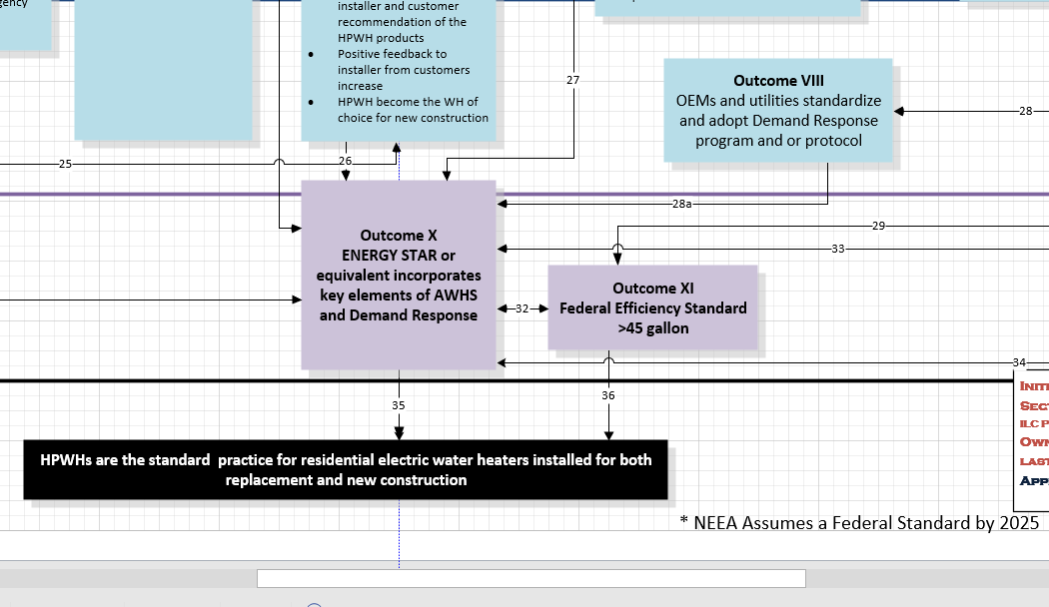
HPWH Logic Model Example

Slide 7
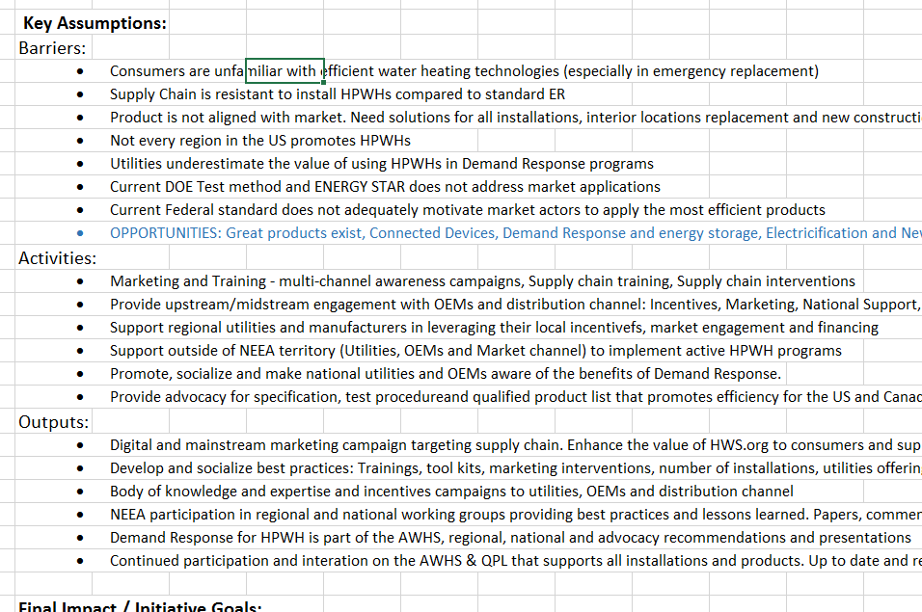
HPWH MPI Example

Slide 8
NEEA MT - C&S Energy Savings & Attribution
Savings for Codes and Standards calculated using similar methods as California
Two primary buckets:
  MTI: savings where C&S integral outcome of MTI (as documented in the logic model)
  C&S Portfolio: Savings not associated with an MTI
Attribution different for Codes vs Standards:
  Codes: Attribution credit for adopted measures for 10 years (three code cycles)
  Standards: Attribution determined by delphi panel approach similar to CA approach.

Slide 9
Savings comes through programs as well as support during the rule-making process
Voluntary Programs
Clothes Washers | 2007 | 2011
Dishwashers | 2012 | 2013
Motors | 2007 | 2010
Heat Pump Water Heaters (Large Tanks) | 2010 | 2015
Direct Standards Work
Electric Motors | 2014 | 2016
Battery Chargers | 2013 | 2014
Rooftop Units (CAC and HP) | 2016 | 2018/2023
Walk-in Coolers | 2014/2017 | 2017/2020
Commercial Refrigeration Equipment | 2014 | 2017
Furnace Fans | 2014 | 2019
Ceiling Fans/Kits | 2016/2017 | 2019/2020
Fluorescent Lamp Ballasts | 2011 | 2014
Small Electric Motors | 2010 | 2015
External Power Supplies | 2014 | 2016
Refrigerated Beverage Machines | 2016 | 2019
Pre-rinse Spray Valves | 2016 | 2019
Pumps, Commercial and Industrial | 2016 | 2020
Notes:
Here is a list of the specific standards that we include in our savings portfolio.
We group them into standards a part of a voluntary program and other Standards.
-Voluntary
Spelled out as a goal in the program logic model
Direct Stds
Where we work within the rule-making process
Comments
Attend meetings
Provide data
Could leverage prg./emerging tech work

