Slide 1
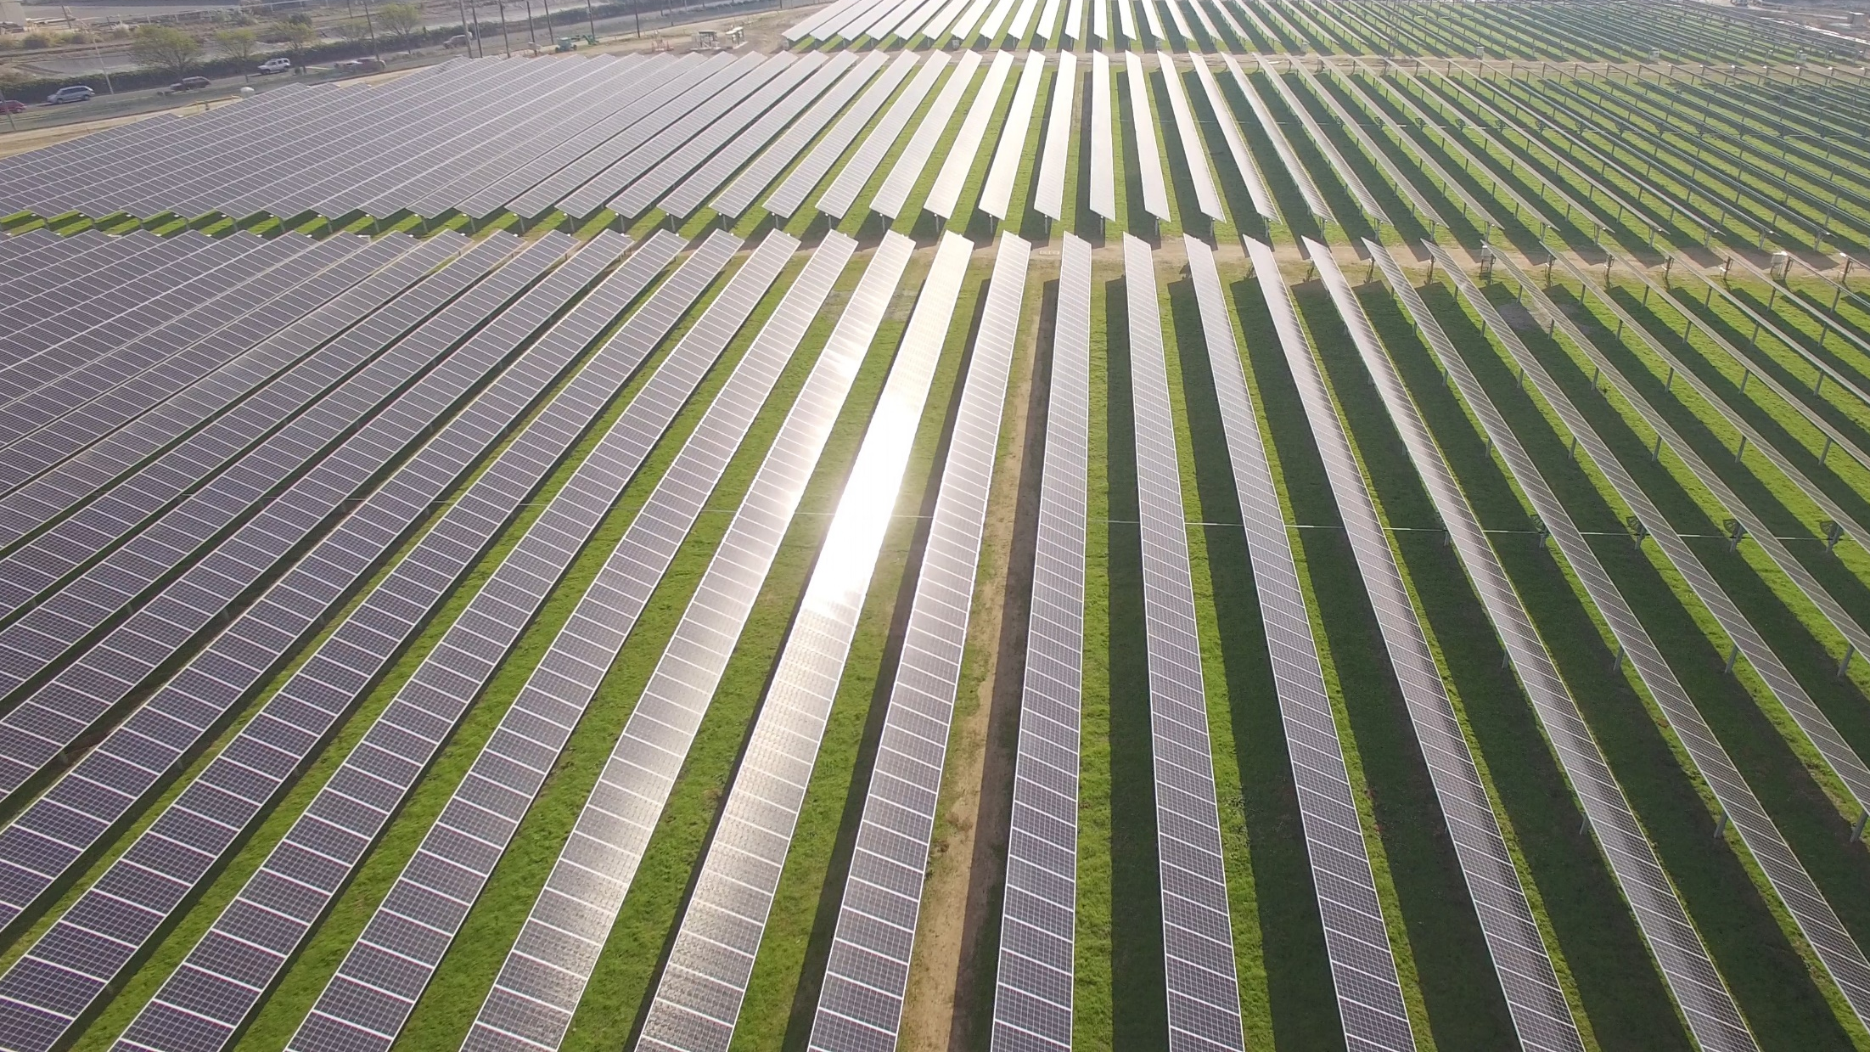
Draft Implementation Plan Workshop
MCE Commercial Efficiency Marketplace

Slide 2
Agenda
Welcome & Introductions
Commercial Program and Sub-program overview
Implementation Plan Content
Questions

Slide 3
Welcome &
Introductions

Slide 4
Jenn Kreutzer-MCE
Joey Lande –MCE
Qua Vallery -MCE
Alice Havenar-Daughton-MCE
McGee Young-Recurve
Carmen Best-Recurve
Adam Scheer-Recurve
Program Team

Slide 5
Address climate change by reducing energy-related greenhouse gas emissions
OUR MISSION
Renewable energy and energy efficiency
Cost-competitive rates
Economic and workforce benefits
More equitable communities

Slide 6
MCE Service Territory
36 Member Communities
Marin County + 11 cities and towns
Solano County + 2 cities
Napa County + 5 cities and towns
Contra Costa County + 14 cities
Notes:
MCE’s Current Service Territory

Slide 7
Open & Public Process
This workshop is intended to elicit feedback on MCE’s DRAFT Implementation Plan for a sub-program to the Commercial Program
Feedback received may directly inform the program design. Input may be provided today through Tuesday, December 8th, 2020, via email to
jlande@mceCleanEnergy.org

Slide 8
Commercial Program Background
MCE currently administers a commercial energy efficiency program, focused on a wide group of non-residential customers.
The program is currently served by two program implementers, and is funded at $1.4 million for 2020.
The addition of a new sub-program allows the commercial program to fully leverage MCE’s Business Plan funding level of ~$3.3 million.

Slide 9
MCE Commercial Sub-Program:
The Commercial Efficiency Marketplace

Slide 10
Sub-Program Overview
Program ID
MCE02-A
Sector
Commercial
Implementer Type
Third Party
Program Type
Resource, Population Level NMEC
Market Channel
Downstream

Slide 11
Program Budget
Commercial Efficiency Marketplace
$63,149
$300,000
$931,750
$7,826
$1,302,725
Full Commercial Program
$241,623
$1,229,326
$1,509,592
$30,000
$3,010,541
2021
Admin
Direct Implementation - Non-Incentive (DINI)
Incentives
EM&V
Total

Slide 12
Projected Net Impacts
Commercial Efficiency Marketplace
0
2,650,750
43,250
Full Commercial Program
273
5,224,085
88,905
2021
kW
kWh
Therms

Slide 13
Forecasted Cost Effectiveness
Commercial Efficiency Marketplace
1.08
1.36
Full Commercial Program
1.33
1.45
2021
TRC
PAC

Slide 14
Implementation Plan

Slide 15
Program Rationale
Rethink program design
Population-level NMEC as an enabler
Don’t tell customers how they have to save energy
Build on aggregator strengths/business models
Foster cost-effective program delivery
Structure a contract based on the objective
Primary objective is cost-effective energy efficiency procurement, not specific services

Slide 16
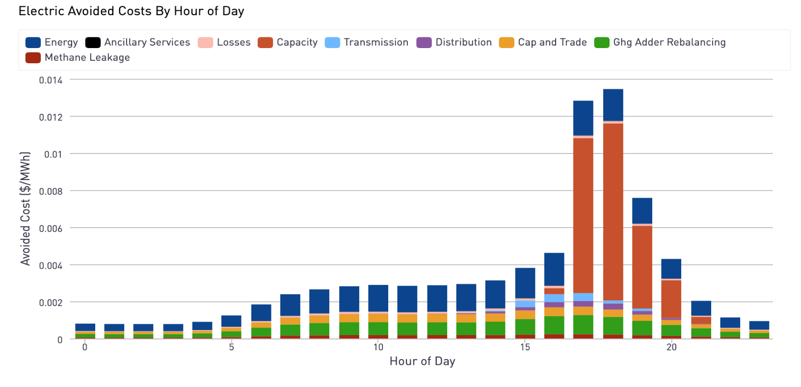
Program Rationale
Not all savings are equal

Slide 17
Program Description
Multiple aggregators will drive participation
They are paid on the value of benefits delivered, once the benefits exceed costs (implementation + customer costs)
The marketplace offers simplicity, flexibility and transparency
A true pay-for-performance program
Paying a variable price for energy savings to meet minimum cost-effectiveness thresholds, and only paying for the CE savings delivered

Slide 18
Program Description
Projects are developed around a core set of primary measures
Lighting, HVAC and heat pumps
Aggregators leverage Recurve’s portal and project value calculator to understand the connection between project costs, savings, avoided cost value and cost effectiveness
Incentives push aggregators to balance costs, deliver optimized load shapes and maximize benefits

Slide 19
Program Description
Each aggregator enters into a “Flexibility Purchase Agreement (FPA)” The FPA outlines key terms of participation.
Recurve will assist with customer optimization, and provide access to the aggregator portal
Aggregators can screen for customer eligibility, enroll projects and view portfolio results, with Recurve tracking savings in near-real-time M&V

Slide 20
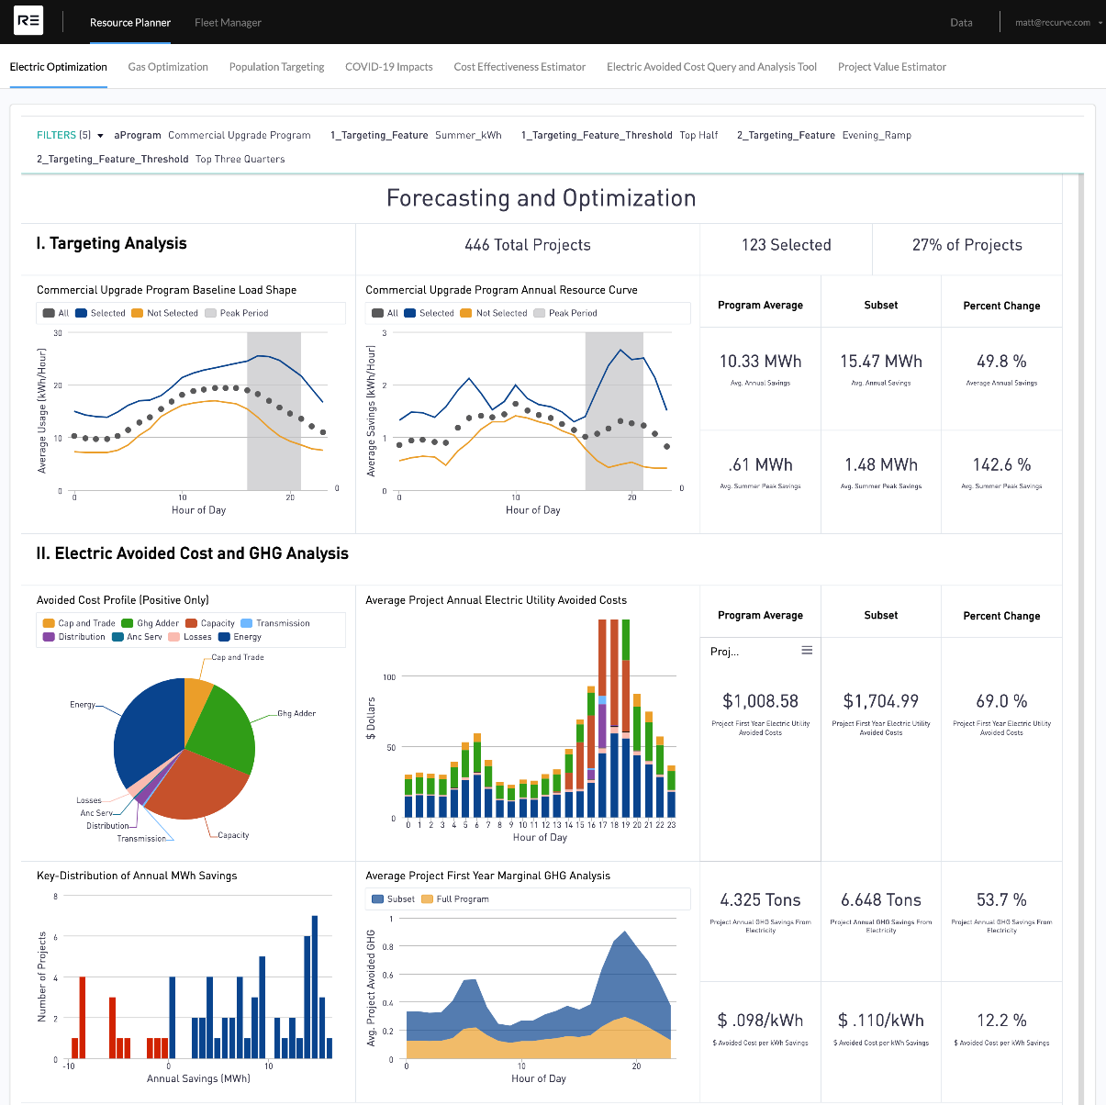
Program Portal
Customer targeting
Load shape optimization
GHG impacts
Avoided cost valuation

Slide 21
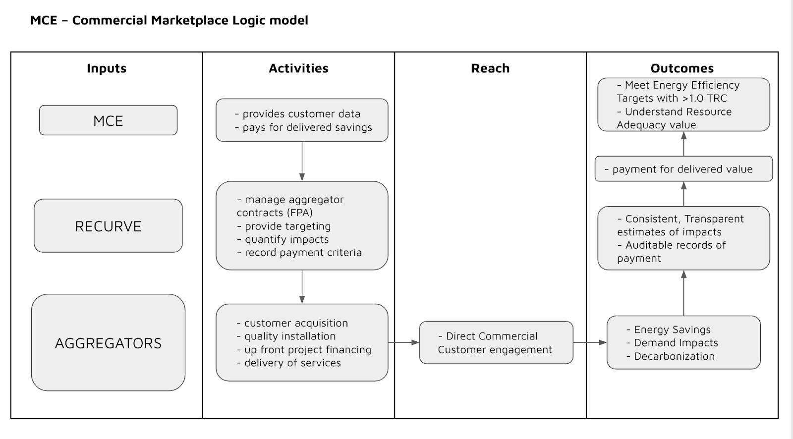
Program Delivery

Slide 22
Participant Selection Process
MCE sets standards for customer eligibility and coordination among implementers
Recurve will screen the population based on eligibility criteria, aggregators’ ideal customer type and target primary measure
Aggregators may pull customers from this list or they may identify customers from other means of outreach

Slide 23
Innovation
Maximizing reach, diversifying capability, reducing admin costs and mitigating risk with a single third party contract
Flexibility for All
Customers, MCE, & Aggregators
Aligning customer needs, project value, and cost effectiveness through aggregator payments
Payments will be based on the benefits (avoided costs) of the projects delivered net of the customer & admin costs to maintain cost-effectiveness

Slide 24
Aggregator Payments
The avoided cost calculator provides the foundational value available to aggregators net of overhead costs.
The Forecasted Fixed Price per unit of energy saved is based on the deemed load shape:
An Efficiency Payment for the portfolio is calculated using the fixed rate and the measured annual savings:
A Bonus (flexibility) Payment for the portfolio is based on the incremental value of the actual load shape over the deemed load shape and measured annual savings:

Slide 25
Aggregator Payments
Program Benefits
(forecasted annual kWh * EUL * avoided cost)
Performance Payment (actual savings * avoided costs - admin and customer costs)
.
Benefits must exceed costs to receive performance payments
Admin Costs (15% of forecasted program Benefits)
Admin Costs
Customer Costs (variable based on individual projects)
Customer Costs
Customer Costs

Slide 26
Payable and Claimable Savings
Payable Savings will be calculated based on CalTRACK 2.0 methods with two adjustments to arrive at net impacts:
Fixed NTG Ratio of 0.95 approved for Commercial NMEC
A comparison group analysis for COVID adjustments
Claimable Savings to the CPUC will be net, using the methods cited above, and considering normal year weather.

Slide 27
Program Coordination
The Program will coordinate with other PAs to ensure double dipping risks are mitigated, to minimize potential customer confusion
Monthly coordination meetings
Data sharing
Program implementation
Program attribution
MCE – PG&E – Recurve – BayREN – EBCE

Slide 28
QA Plan
Aggregator Roles | MCE Role
Responsible for performance, including subcontractors | Evaluate the quality of facility analyses and design documents and customer facing material
Accountable for resolution of customer complaints | Evaluate installed energy efficiency measures for consistency with stated/forecasted measures
Responsible for warranties and production guarantees | Complete on-site inspections for projects with low savings realization rates, high CVRMSE or CVRMSE change, or high variance from stated scope
Responsible for installation and quality of the project | 10% inspection rate on photographic support
Responsible for all paperwork required in the Flexibility Purchase Agreement | ~2-4% onsite inspection rate
Responsible for photographs taken of every measure installed on site, pre and post | Generation of QA Inspection Reports

Slide 29
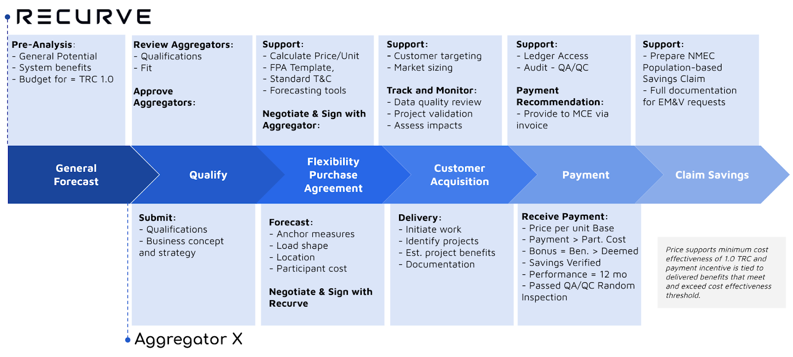
Marketplace Diagram

Slide 30
Timeline and Milestones
Milestone
Implementation Webinar
Comments/Feedback Period
Review of Comments and Feedback
Implementation Plan Filing
Timeline
11/24/2020
11/24/2020 - 12/8/2020
12/8/2020 – 12/29/2020
12/29/2020

Slide 31
Questions

Slide 32
MCE Manager of Customer Programs
jlande@mceCleanEnergy.org

